Slide 1
Authentication & Authorization Project Professor Name: Nital Shah

Slide 2
Introduction
This project demonstrates the use of Authentication and Authorization Concept as shown in the screenshot in upcoming slides.

Slide 3
Team Members
Suraj Tamang
Dinesh Saud
Amit Magar
Biplove Jaisi

Slide 4
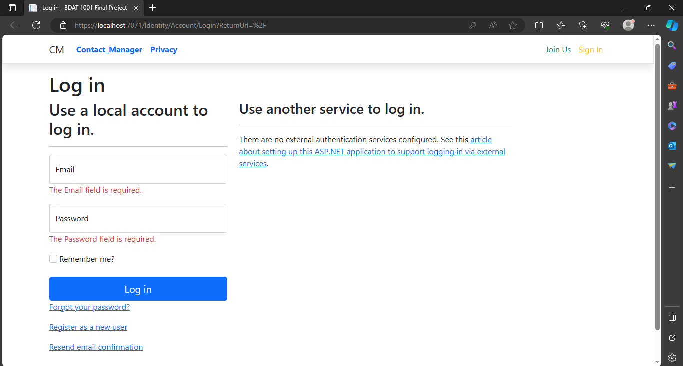

Slide 5
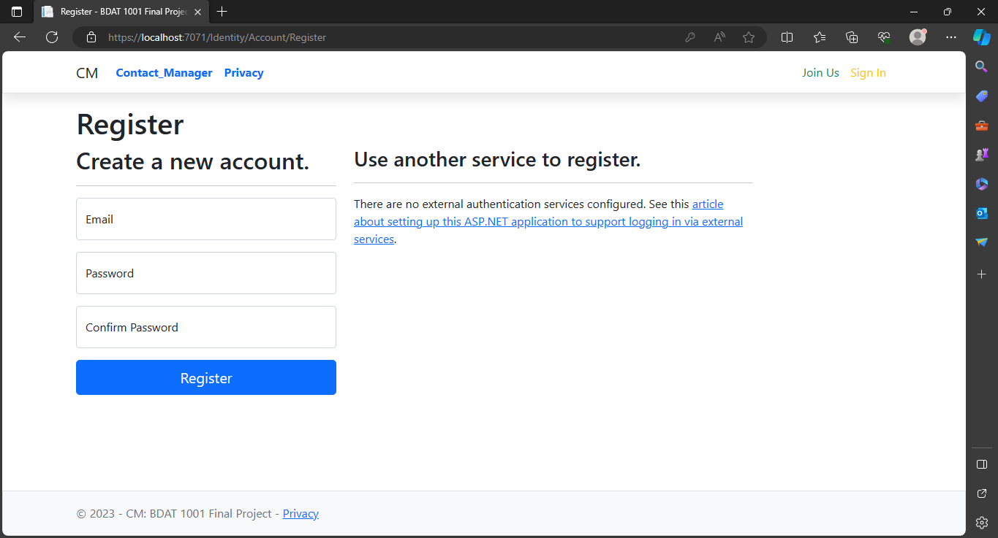

Slide 6
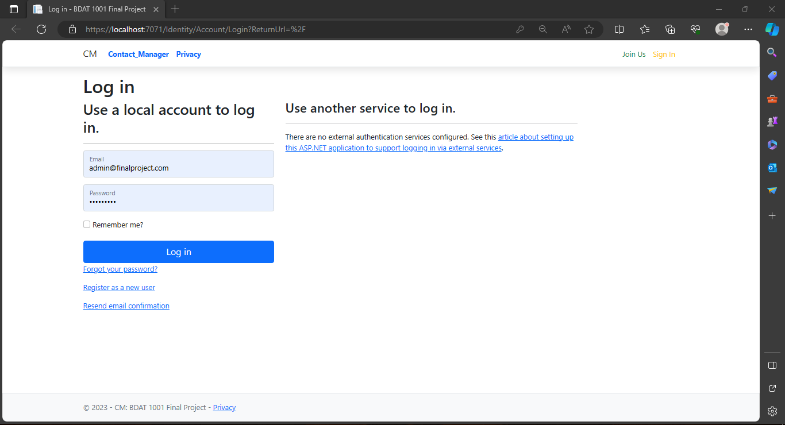

Slide 7
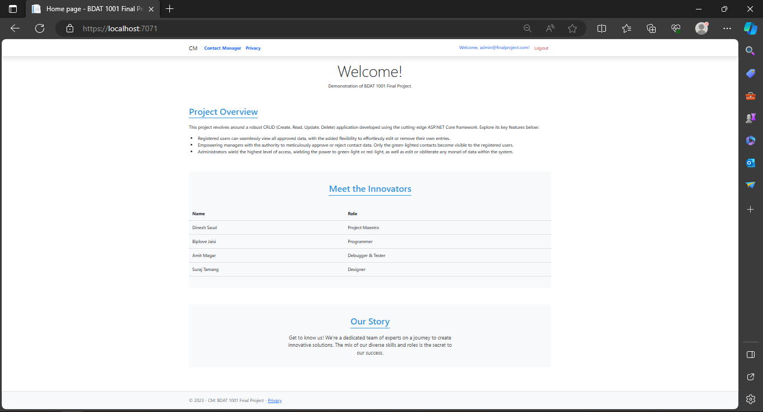

Slide 8
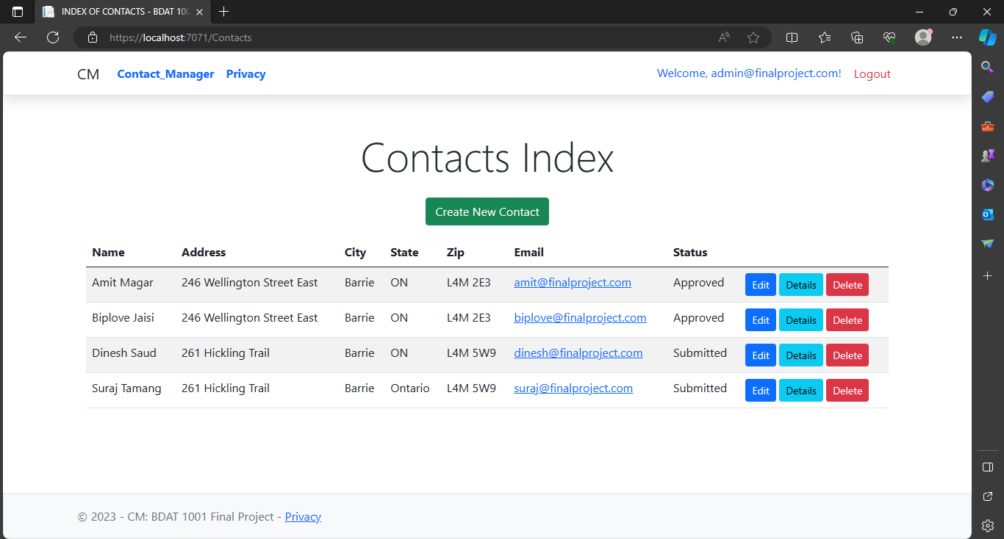

Slide 9
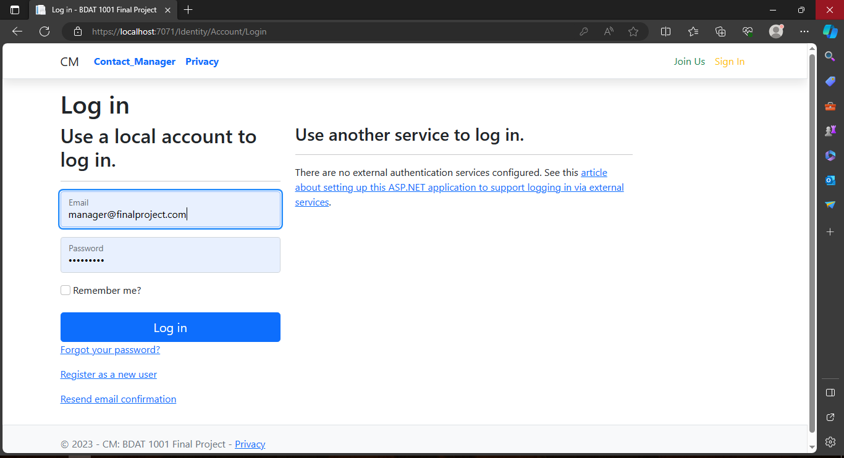

Slide 10
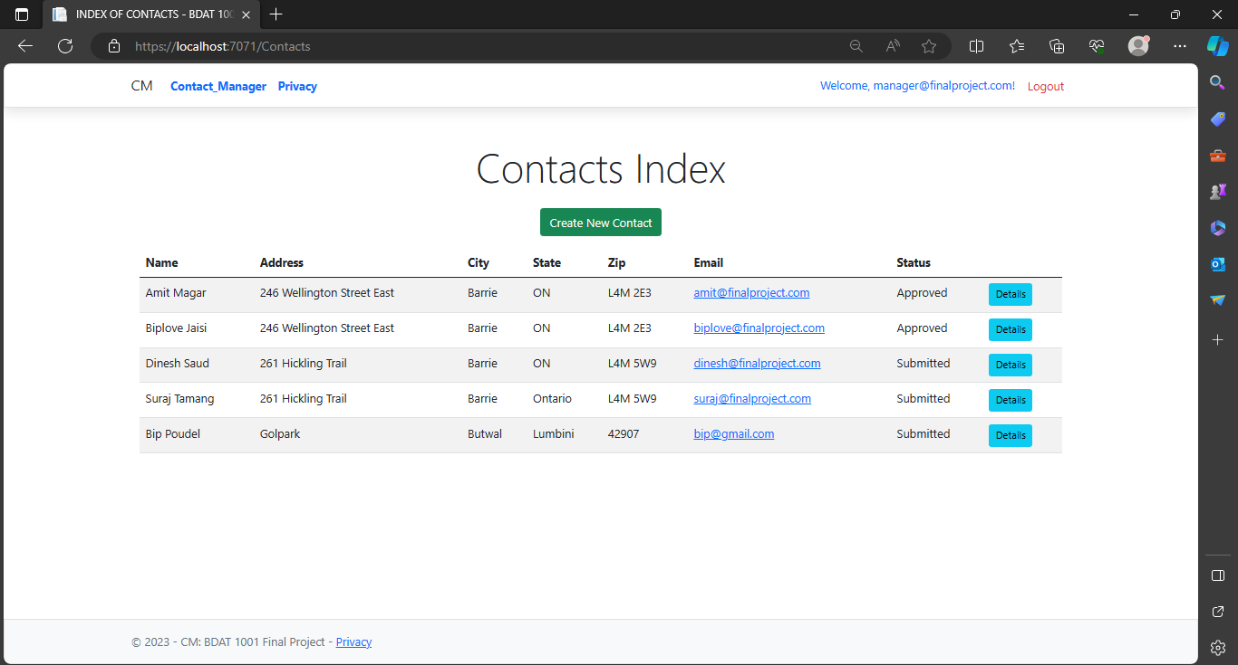

Slide 11
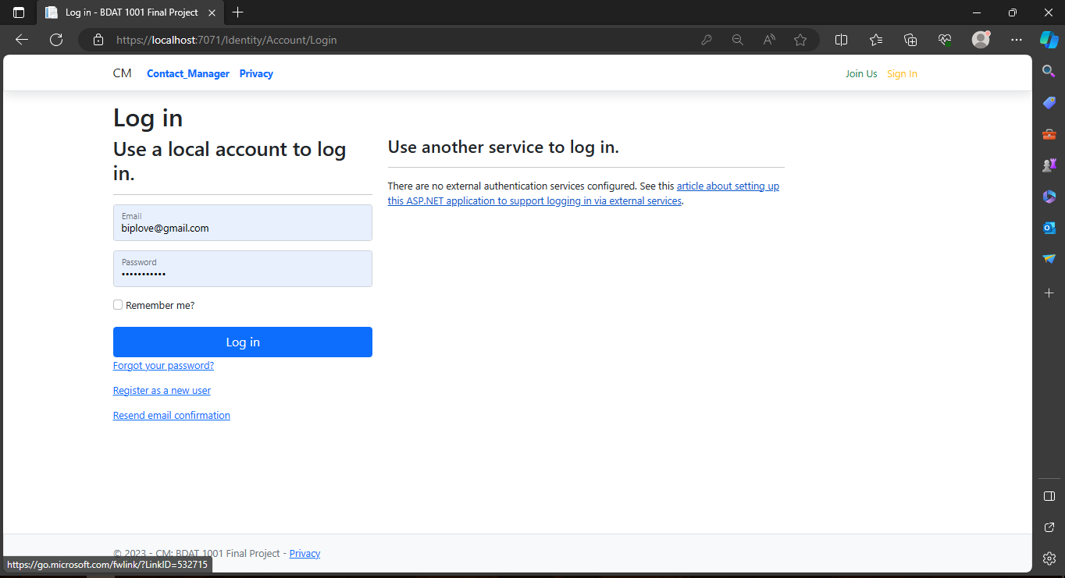

Slide 12
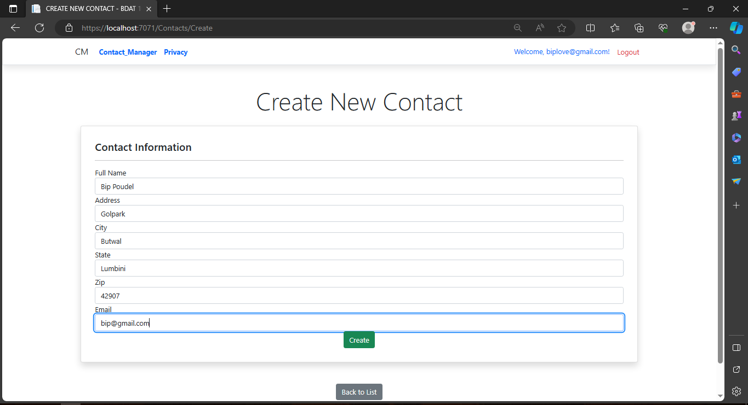

Slide 13
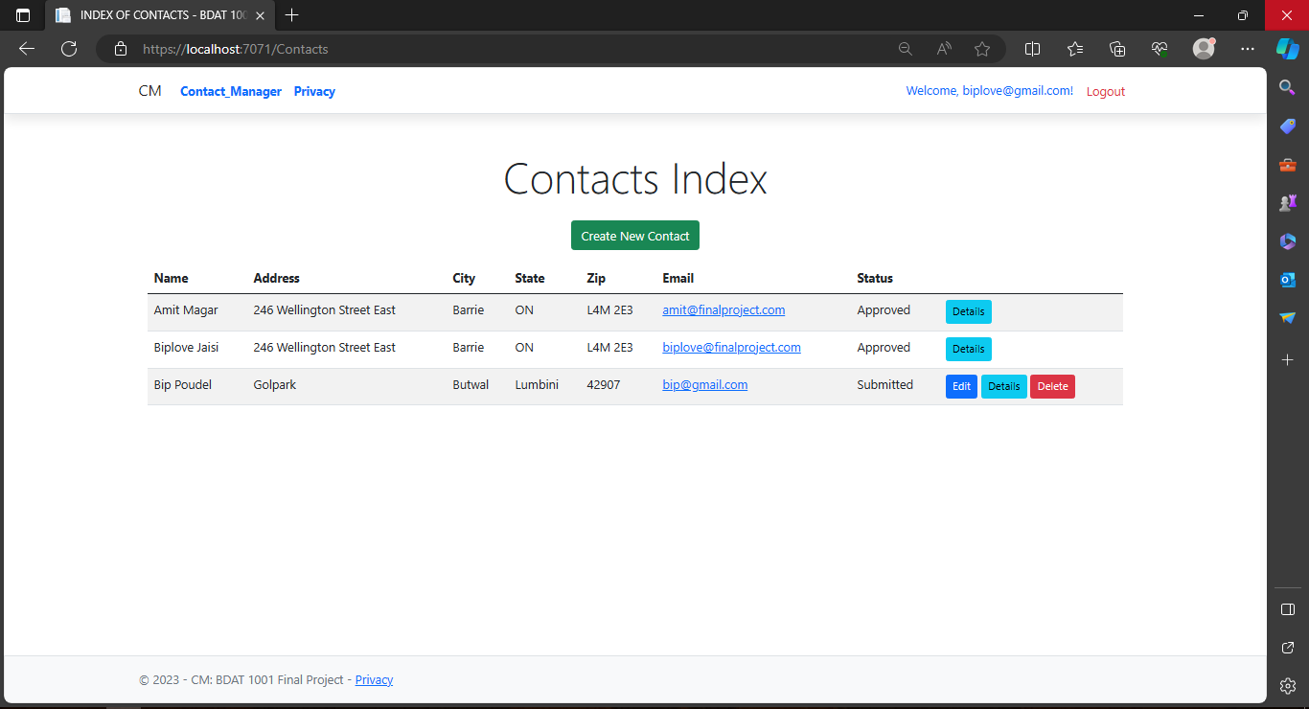

Slide 14
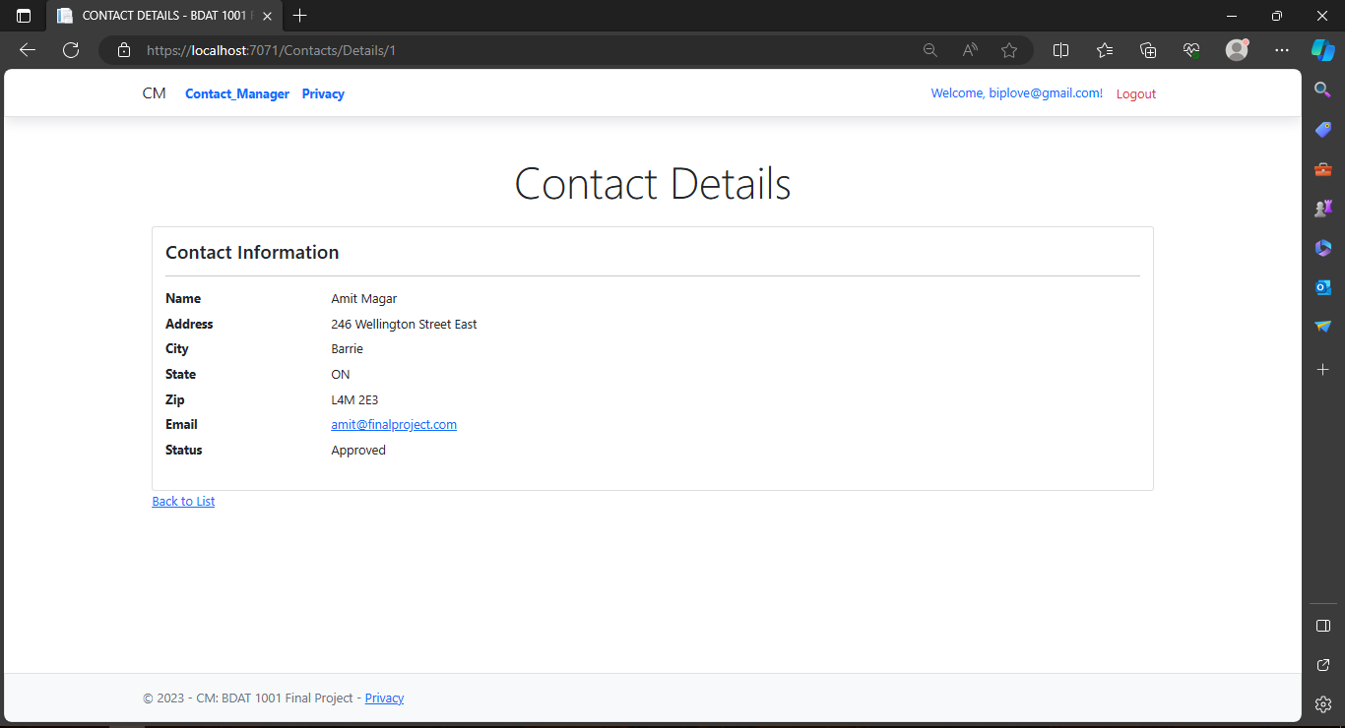

Slide 15
Any Queries???
…

Slide 16
Thank You
.

