Slide 1
Automated Deployment of Recipe Sharing Application using CI/CD
-A DevOps-Based Approach using Jenkins and AWS
Presented by: Amit Ningappa Pujari Zeal College of Engineering and Research
AWS Batch 1

Slide 2
INTRODUCTION
Recipe Sharing Web Application designed to help users create and explore recipes easily
Developed using MERN Stack for full-stack web development
Allows users to add, view, and manage recipes in an organized way
Focus on automating deployment using CI/CD pipelineJenkins is used to manage build and deployment process
Application is deployed on AWS EC2 using multiple servers

Slide 3
OBJECTIVE
To develop a recipe sharing web application using MERN stack
To automate the deployment process using CI/CD pipeline
To implement Jenkins for continuous integration and deployment
To deploy application on AWS EC2 using multiple instances
To reduce manual effort and improve deployment efficiency
To ensure reliable and scalable application delivery

Slide 4
Problem Statement
In traditional systems, deployment of web applications is done manually, which is time-consuming and repetitive. It often leads to human errors and makes the process less reliable. Managing frontend and backend on different servers becomes difficult without proper automation. Due to the lack of a continuous integration and deployment pipeline, updates are slow and inefficient. Therefore, there is a need for an automated solution that can simplify deployment and improve overall efficiency.

Slide 5
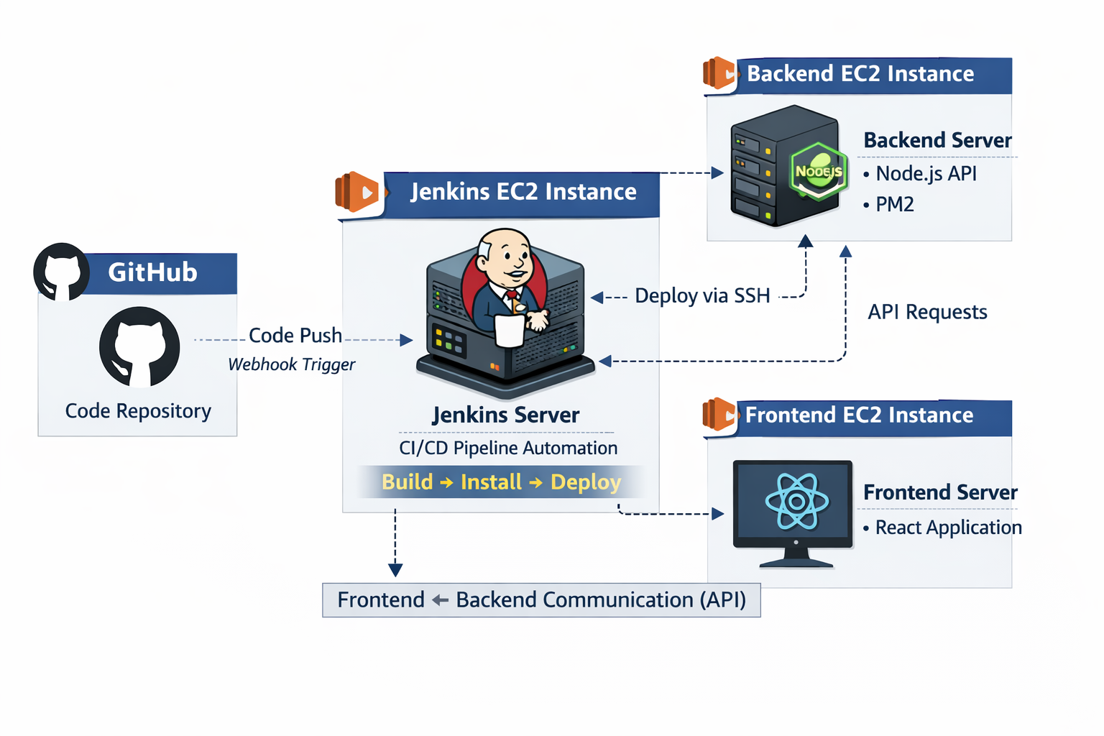
ARCHITECTURE

Slide 6
ARCHITECTURE
System consists of three EC2 instances: Jenkins, Backend, and Frontend
Source code is stored in GitHub repository
Code push triggers Jenkins pipeline using webhook
Jenkins executes CI/CD pipeline automatically
Pipeline includes build, install, and deployment steps
Jenkins connects to servers using SSH for deployment
Backend is deployed on EC2 instance using Node.js and PM2
Frontend is deployed on EC2 instance using React application
Frontend communicates with backend through API calls
Ensures automated, fast, and reliable deployment process

Slide 7
IMPLEMENTATION
Created multiple AWS EC2 instances for Jenkins, Backend, and Frontend
Installed and configured Jenkins on dedicated server
Set up SSH connection between Jenkins and application servers
Cloned project from GitHub repository to servers
Installed required dependencies using npm
Configured Jenkins pipeline for CI/CD automation
Automated backend deployment using PM2 process manager
Built and deployed frontend application on server
Tested complete workflow for successful deployment

Slide 8
ADVANTAGES
Automates deployment process using CI/CD pipeline
Reduces manual effort and human errors
Faster and efficient application updates
Easy to manage frontend and backend separately
Improves reliability and consistency of deployment
Scalable system using cloud infrastructure (AWS)

Slide 9
APPLICATIONS
Web application deployment in real-world projects
DevOps practices in software development industry
Continuous integration and deployment systems
Cloud-based application hosting and management
Useful for startups and scalable web platforms

Slide 10
Conclusion:
This project successfully demonstrates the development and deployment of a recipe sharing application using a CI/CD pipeline. By using Jenkins and AWS, the deployment process is automated, reducing manual effort and improving efficiency. The system ensures faster, reliable, and consistent updates of the application. This project also provides practical knowledge of DevOps concepts and shows how real-world applications can be deployed using modern tools and cloud infrastructure.

Slide 11
REFERENCES:
Jenkins Official Documentation – https://www.jenkins.io
AWS EC2 Documentation – https://aws.amazon.com/ec2
GitHub Documentation – https://docs.github.com
Node.js Documentation – https://nodejs.org
React Documentation – https://reactjs.org

Slide 12
Thank You....!!!!

