Slide 1
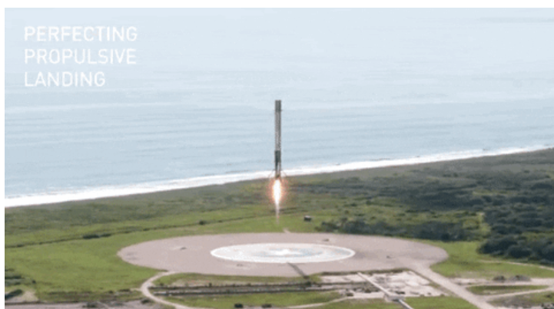






Falcon9 first stage landing analysis
Amit Sain
20th Feb ,2023

Slide 2



OUTLINE
Executive Summary
Introduction
Methodology
Results
Visualization – Charts
Dashboard
Discussion
Findings & Implications
Conclusion
Appendix

Slide 3
EXECUTIVE SUMMARY
Data collection via SpaceX API, SQL and Web scrapping
Data clean up and analysis
Interactive map using folium
Machine learning model for prediction
Best model identification

Slide 4

INTRODUCTION
SpaceX is the only private company in the world who dared to build reusable rockets
Many times the reusable falcon 9 rockets's first stage landing gets failed
We will use data dump from the SpaceX API as data source for our analysis
We will explore all the factors involved in success and failure of the landing.

Slide 5
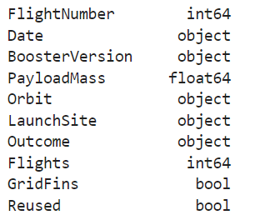
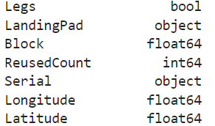
Data collection & Data wrangling
Data collection :
We read the source CSV file using panda library
df = pd.read_csv("https://cf-courses-data.s3.us.cloud-object-storage.appdomain.cloud/IBM-DS0321EN-SkillsNetwork/datasets/dataset_part_1.csv")
Columns & Data types

Slide 6
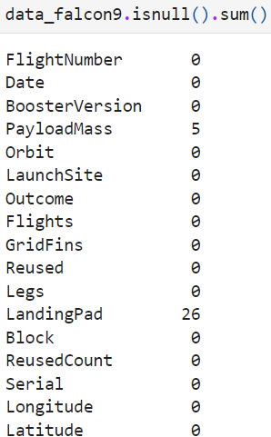
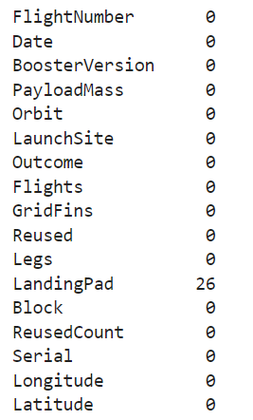
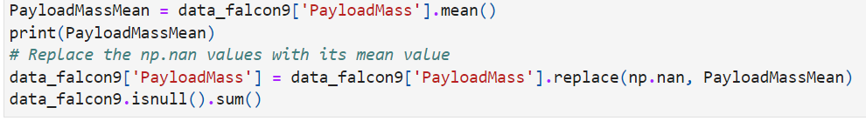
Data collection & Data wrangling
Payloadmass and LandingPad have null values
We are replacing null value of payloadmass with average value of that field.

Slide 7
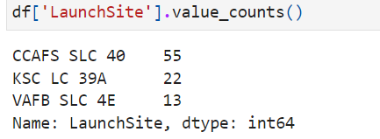
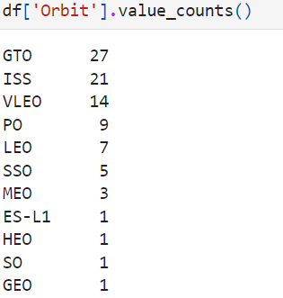
Data collection & Data wrangling
Number of launch site:
Number of Orbit

Slide 8
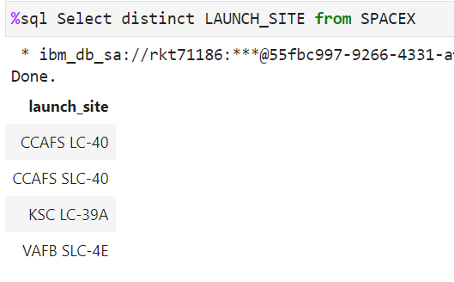
EDA with SQL
Number of Launch sites:

Slide 9
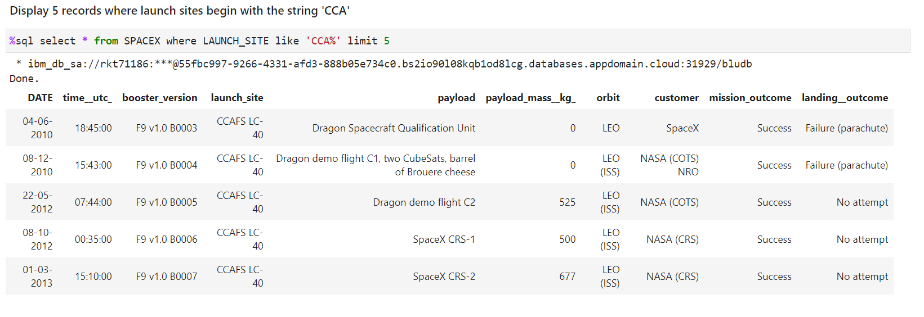
EDA with SQL

Slide 10
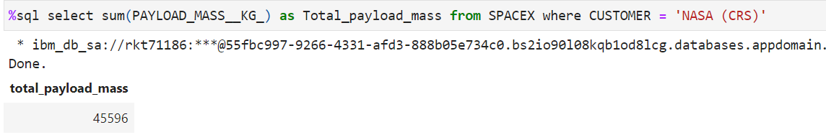
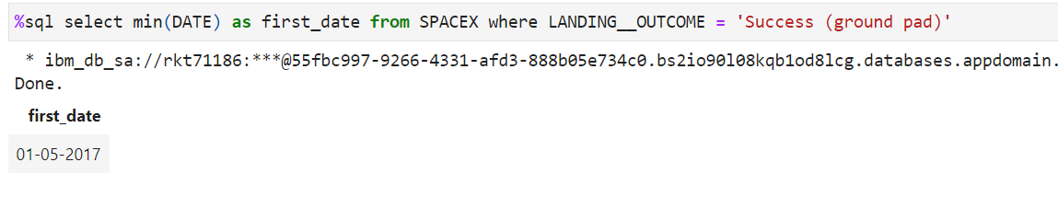
EDA with SQL
Total payload mass of NASA (CRS) :
1st successful land in ground pad:

Slide 11
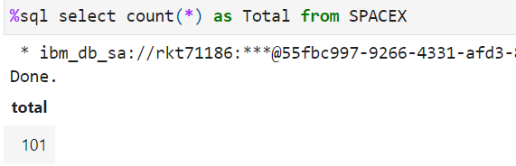
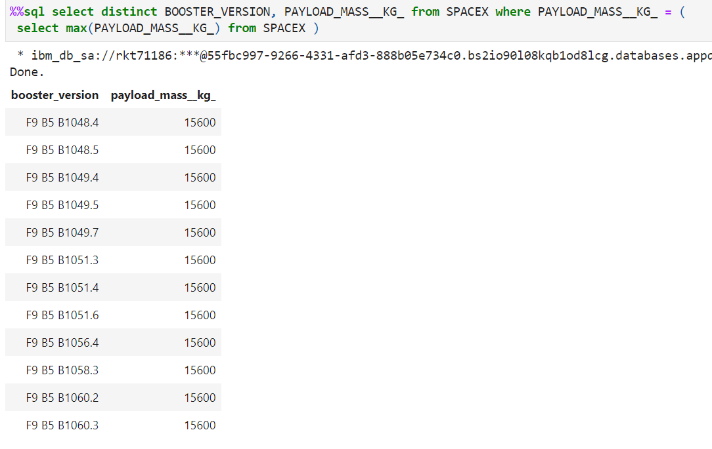
EDA with SQL
Total record count in dataset:
Booster carries maximum payload

Slide 12
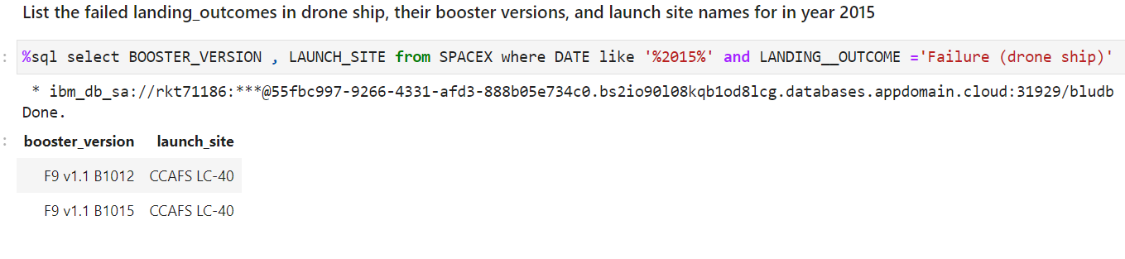
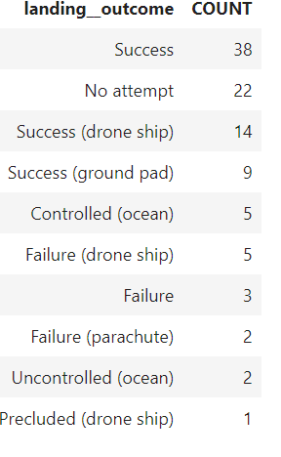
EDA with SQL
List the failed landing_outcomes in drone ship ->
<---Landing outcomes

Slide 13
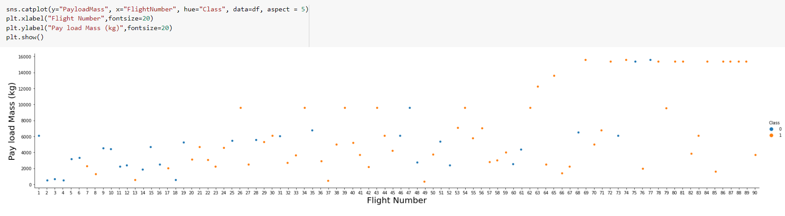
EDA with visualization
Flight number Vs Payload mass

Slide 14
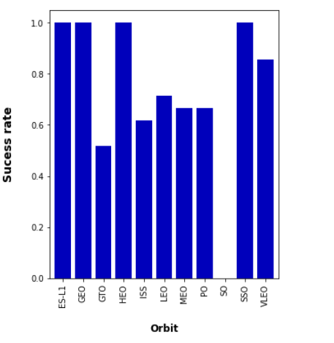
EDA with visualization
Orbit Vs Success rate

Slide 15
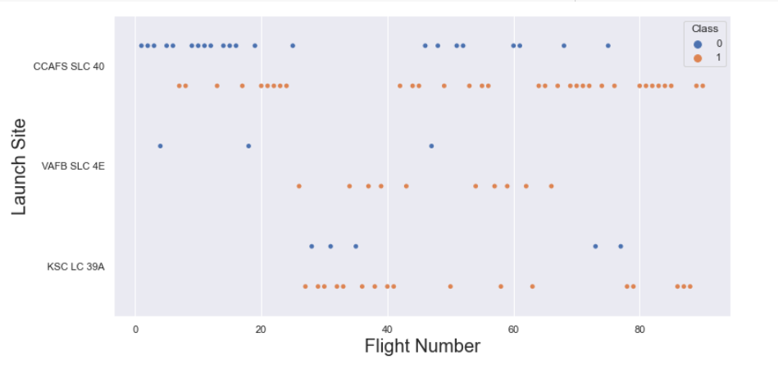
EDA with visualization
Flight Number Vs Launch site

Slide 16
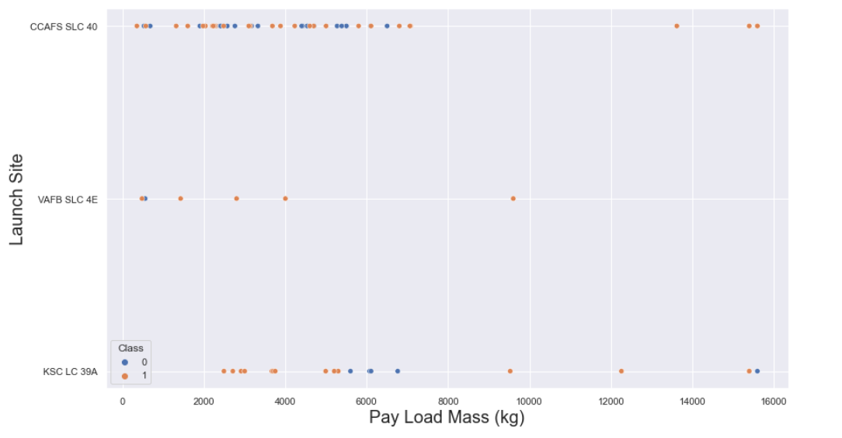
EDA with visualization
Payload mass vs Launch Site

Slide 17
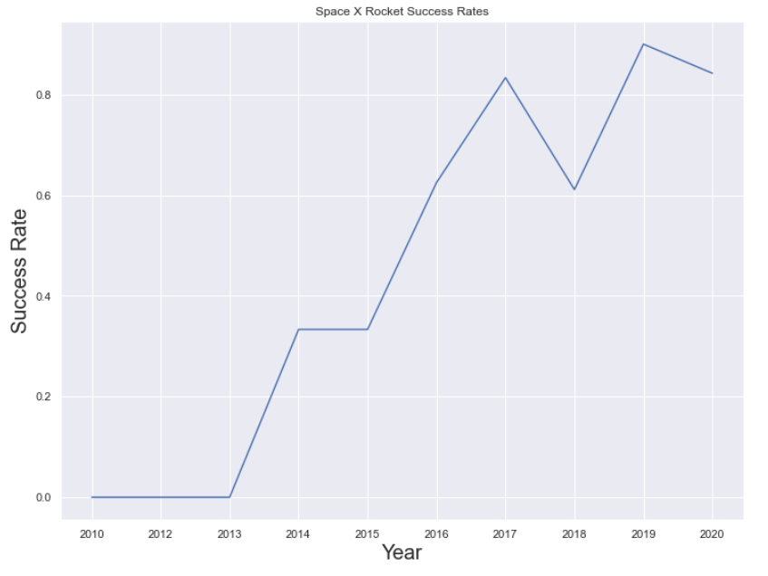
EDA with visualization
Payload mass vs Launch Site

Slide 18
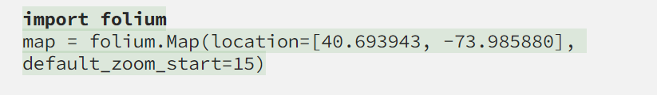
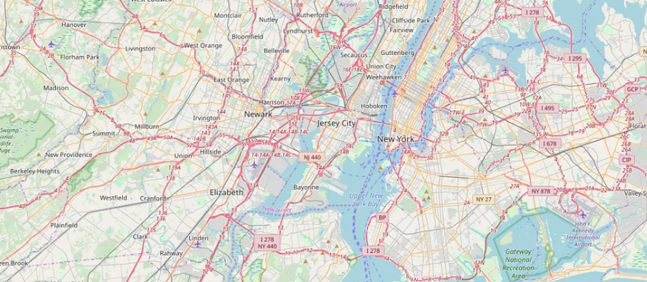
Interactive map using Folium

Slide 19
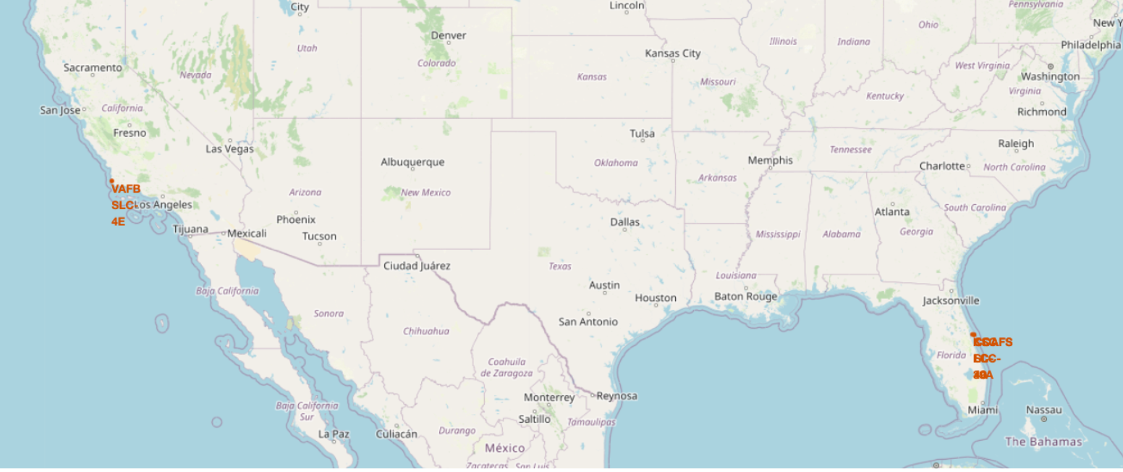
Interactive map using Folium

Slide 20
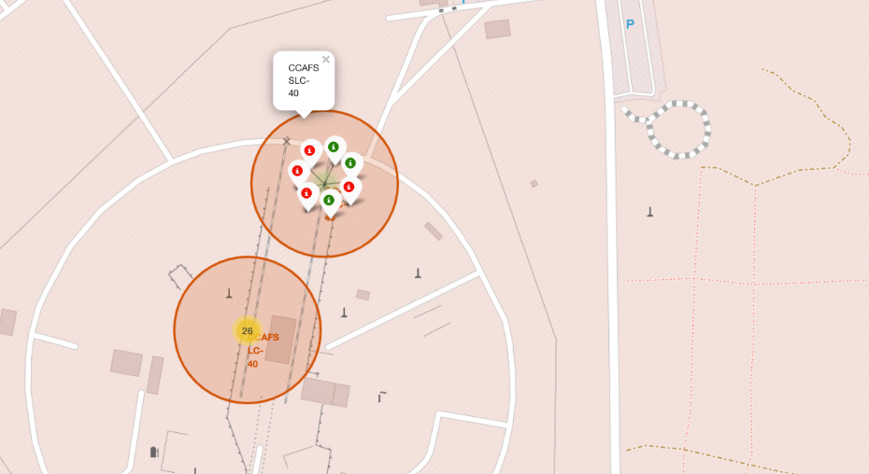
Interactive map using Folium

Slide 21
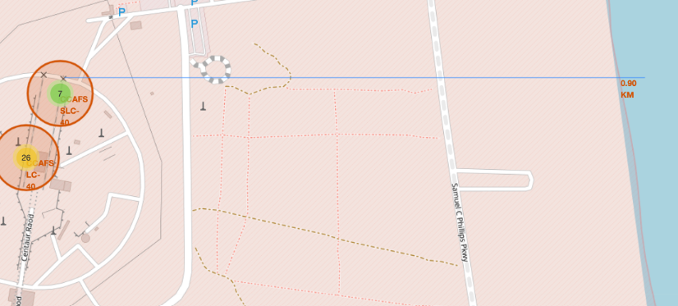
Interactive map using Folium

Slide 22
Predictive analysis methodology
We have used below methods to predict the accuracy:
Logistic regression
SVM
KNN
Decision Tree

Slide 23


Machine Learning

Slide 24


Machine Learning

Slide 25
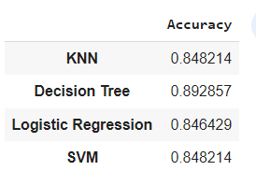
Machine Learning

Slide 26

CONCLUSION
After 2013 success rate has been improved
ES-L1, GEO, HEO,SSO have 100 % success rate
Increasing PayloadMass has an impact of decreasing rate of success
Among all the machine learning model decision tree model predicts with more accuracy

