Slide 1
Data Analytics For Business Decision Making
DATA 2204-03
Regularization
Assignment 4
Professor – Ritwick Dutta
Prepared By:
Amit Singh Bisht (100881017)
27th March 2023

Slide 2
Rational Statement
Mr. John Hughes has a dataset called possum_dataset.csv which contains 105 datapoints having 6 independent and one dependent output variable called ‘total_l’. He wants to develop a regularization optimized model in order to successfully predict the output variable.

Slide 3
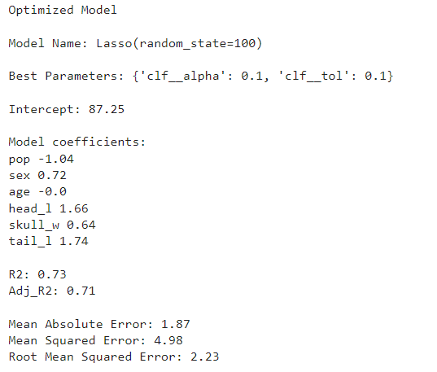
Lasso Optimization
The Adj R2 score, which evaluates how much of the data's variability is explained by the model, can be used to assess a model's accuracy. With an Adj R2 score of 0.71 (71%), the model in this instance is reasonably accurate.
The average error between expected and actual values is measured using the MAE metric. The MAE value in this instance is 1.87, which is 10% below the mean value of the target variable total l. This shows that the model could be reliable.

Slide 4
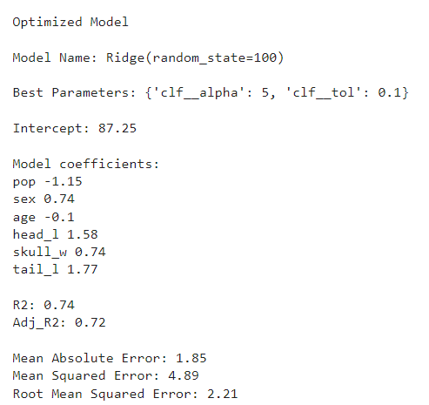
Ridge Optimization
The Adj R2 score, which evaluates how much of the data's variability is explained by the model, can be used to assess a model's accuracy. With an Adj R2 score of 0.72 (72%), the model in this case is reasonably accurate.
The absolute difference between the projected value and the actual value is known as the Mean Absolute Error, which has a value of 1.85 and represents the size of the average error we can predict from forecasting (MAE). The MAE value being less than 10% of total l's mean value (87.088462). This suggests that the model might work.

Slide 5
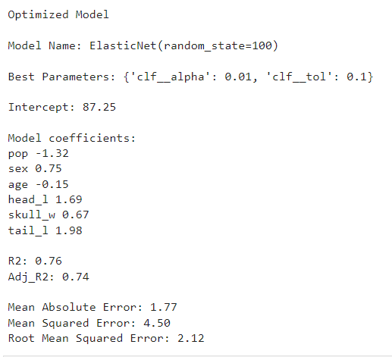
Elastic Net Optimized Model
Adj_R2 score of 0.74( 74% ) is used to determine the accuracy of the model. This number indicates that the model is 74% accurate.
The absolute difference between the expected value and the actual value is known as the Mean Absolute Error, which has a value of 1.77 and represents the size of the normal error we can expect from predicting (MAE). The MAE value being less than 10% of total l's mean value (87.088462). This suggests that the model might work.

Slide 6
Champion Model Post Analysis
“Elastic Net”
“Elastic Net” turns out to be the best model for this dataset as it has the best accuracy out of all three models.

Slide 7
THANK YOU

