Slide 1
MVP IMPLEMENTATION ROADMAP
QR
LIBRARY
A practical plan to build your first working
school-library management app with an AI editor.
CORE PRODUCT RULE
One shared QR code per book title.
Track every copy through issue and return records.
VERSION 1.0 • SCHOOL LIBRARY PILOT • NOVEMBER 2026

Slide 2
01 / THE TARGET
Build one complete library workflow
The first version is successful when a librarian can register, identify, issue and return books without a paper register.
MVP FINISH LINE
EXAMPLE BOOK RECORD
A working loop, not a feature showcase.
Physics, Class XI
Author: NCERT • Shared QR token
Register a book title and enter how many copies the library owns.
10
7
3
Generate one QR code shared by all physical copies of that title.
TOTAL COPIES
AVAILABLE
ISSUED
Issue a copy to a registered student and store the due date.
Return the correct active borrowing record and update availability.
Available = Total copies − Active loans
Keep the first release focused on one library, one librarian role and quantity-based copy tracking.

Slide 3
02 / PRODUCT RULE
One QR per title, many physical copies
The QR identifies the book record. The database tracks how many copies are available or currently borrowed.
ONE BOOK RECORD
Register once
1
Physics, Class XI
Enter title, author and total copies (example: 10).
2
Generate once
ONE SHARED QR
Create one stable QR token for the book title.
Physical copy 1
3
Print for every copy
Physical copy 2
Print the same QR label and attach it to all 10 copies.
Physical copy 3
Physical copy 4
4
Track transactions
Physical copy 5
Each loan creates one active borrowing record.
Same title QR label is placed on each copy.
Important limitation: scanning a shared QR cannot tell which exact physical copy is in someone’s hand.

Slide 4
03 / END-TO-END FLOW
The librarian’s daily workflow
Design the app around this simple sequence. Every screen should help complete one of these actions.
1
2
3
4
5
6
7
LOGIN
REGISTER
QR LABEL
STUDENT
SCAN
ISSUE / RETURN
UPDATED
Librarian signs in
Add book + copy count
Generate and print
Find student record
Open the book record
Save the transaction
Availability changes
ISSUE
RETURN
Create a loan record with book, student, issue date and due date.
Choose the correct active loan and set its return date.
The dashboard should calculate the live totals from active loan records, not from manually edited counters.

Slide 5
04 / FEATURE SCOPE
Protect the MVP from feature creep
Build only what proves the core library workflow. Add convenience features after a real librarian tests it.
BUILD IN VERSION 1
NOT IN VERSION 1
Single librarian login and protected app pages
Student accounts or a student-facing app
Add, edit, search and view book titles
SMS, WhatsApp or email reminders
Total copy count + one shared QR per title
Fine calculation and online payments
Generate / download / reprint the shared QR
AI book recommendations or chatbot
Add and search students
Multiple school branches / complex roles
Issue, return and view active loan history
Offline mode and mobile app packaging
Dashboard with total, available and issued copies
Advanced analytics and custom reports
Do not start the next feature until the previous workflow works end to end.

Slide 6
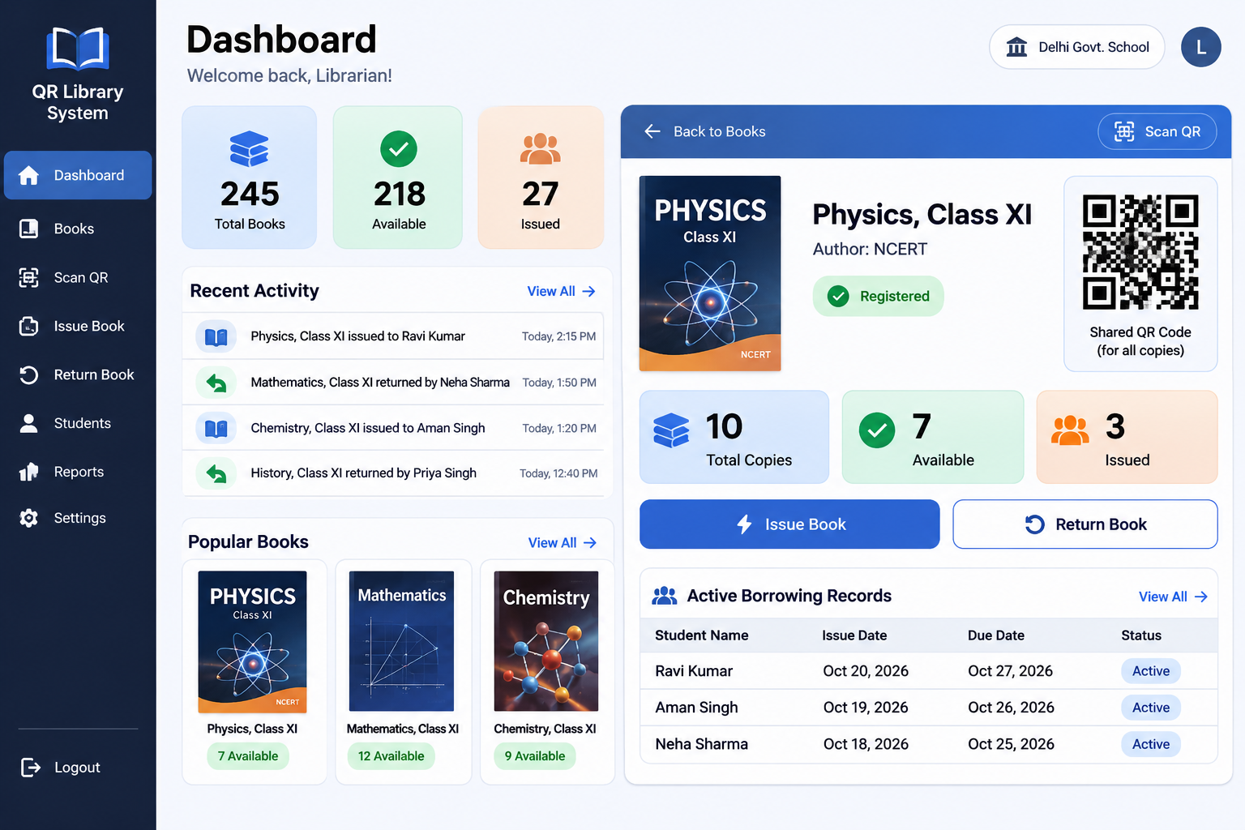
05 / SCREEN PLAN
Five screens are enough for the first release
Use the generated dashboard concept as a visual direction, then build a responsive working interface.
01
Dashboard
Inventory totals, recent actions and shortcuts.
02
Books
Search, register, edit and open book details.
03
Book details
Shared QR, copy counts and active loans.
04
Students
Admission number, name and class / section.
05
Scan / transaction
Scan or enter token, then issue or return.
The screenshot is a design reference, not a finished application.

Slide 7
06 / DATA MODEL
Use three core tables and derive the counters
Avoid storing the same number in multiple places. A single source of truth prevents inventory counts drifting out of sync.
BOOKS
STUDENTS
LOANS
id (primary key)
id (primary key)
id (primary key)
title
admission_no (unique)
book_id (foreign key)
author
1
full_name
1
student_id (foreign key)
subject / category
class_section
issued_at
many
many
total_copies
created_at
due_at
qr_token (unique)
returned_at (nullable)
created_at
issued_by
ACTIVE LOANS = returned_at is empty • ISSUED = count of active loans • AVAILABLE = total_copies − issued
Supabase Auth stores the librarian login. Do not create login accounts for students in this MVP.

Slide 8
07 / RULES THAT MUST BE CORRECT
The shared QR changes the return workflow
Because every copy has the same code, the librarian must identify the correct borrowing record during a return.
WHEN A QR IS SCANNED
VALIDATION RULES
1
Resolve the title
Never allow issued copies to exceed total copies.
Look up the unique QR token and open the matching book.
Do not reduce total_copies below current active loans.
2
Show available actions
Returning must close one selected loan, not all loans for that title.
Display title, total / available / issued counts.
Keep the QR token stable when title metadata or copy count changes.
3
Issue
Select student, set due date and create one loan record.
QR contains only a random identifier or app route, never student data.
If camera scanning fails, allow manual token entry or book search.
4
Return
Select the exact active loan, then close it.
Shared QR = title-level identification. Per-copy tracking can be added later by assigning a unique code to each physical copy.

Slide 9
08 / RECOMMENDED STACK
Choose a small, boring, easy-to-debug stack
This combination works well for a browser-based MVP and keeps database, login and deployment manageable.
FRONT END
React + Vite
Screens, routing and app state
HOW THE PARTS CONNECT
Tailwind CSS
Responsive layout and reusable components
LIBRARIAN
Browser UI
STYLING
AUTH
Supabase Auth
BACK END
Supabase
Postgres database + librarian authentication
DATA
Postgres + RLS
QR TOOLS
qrcode.react + html5-qrcode
Generate the label and read it with a camera
QR
Token → book record
HOSTING
Vercel
Deploy the web app over HTTPS
Keep the Supabase service-role key off the browser. Use environment variables and Row Level Security.
Use JavaScript first if TypeScript slows you down. Add complexity only when the MVP is working.

Slide 10
09 / DEVELOPMENT ROADMAP
Build in seven small phases
Give your AI editor one bounded task at a time. Run the app and test before moving to the next phase.
Project setup
Students
0
Create repo, app shell, env example and routes.
1 focused session
4
Student registration, search and validation.
1 session
UI foundation
Issue + return
1
Sidebar, header, dashboard and responsive cards.
1–2 sessions
5
Create and close loans; compute availability.
2 sessions
Database + login
Scan + release
2
Supabase schema, auth and access rules.
1–2 sessions
6
Camera/manual scan, tests, deploy and pilot.
2 sessions
Books + QR
3
Book CRUD, copy count and shared QR print view.
2 sessions
RULE: Do not ask the AI editor to build the entire application in one giant prompt.

Slide 11
10 / COPY-READY AI EDITOR PROMPTS
Prompt 1: scaffold and database
Paste one prompt at a time. Ask the editor to explain changed files and exact run commands after each phase.
PROMPT A / PROJECT FOUNDATION
PROMPT B / SUPABASE DATA + AUTH
Build the foundation for a school library web app called QR Library.
Use React + Vite and JavaScript. Use Tailwind CSS for styling.
Create a responsive light-theme admin layout with sidebar navigation,
header, dashboard route and placeholder pages for Books, Students,
Scan QR, Issue / Return and Settings.
Do not add fake backend logic. Keep components reusable.
Create a clean folder structure and an .env.example file.
Run the app and fix build errors before stopping.
Do not implement all features yet.
Connect this app to Supabase. Create SQL migrations for:
books(id, title, author, subject, total_copies, qr_token, created_at),
students(id, admission_no UNIQUE, full_name, class_section, created_at),
loans(id, book_id FK, student_id FK, issued_at, due_at, returned_at NULL, issued_by).
Use Supabase Auth for one librarian account. Add Row Level Security
so anonymous users cannot read or change library data and authenticated
librarians can use the app. Never expose the service-role key in the browser.
Provide setup steps and a safe .env.example. Do not store issued/available
counters as duplicated fields; calculate them from active loan records.
Before continuing: create the Supabase project, run the SQL migration and verify librarian login works.

Slide 12
11 / COPY-READY AI EDITOR PROMPTS
Prompt 2: books, transactions and scanner
These prompts encode the quantity-based inventory rule. Review the logic before trusting generated code.
PROMPT C / BOOKS + SHARED QR
PROMPT D / STUDENTS + ISSUE / RETURN + SCAN
Build the Books module. Librarian can add, edit, search and view a book.
Registration fields: title, author, subject/category and total_copies.
Generate ONE stable random qr_token per book title, not one per copy.
Show a QR preview and a print/download label. The same QR is attached
to every physical copy of that title. Changing total_copies must NOT
change the token. Show total, issued and available counts on book details.
Issued = number of loans where returned_at is null.
Available = total_copies - issued. Block invalid or negative counts.
Build student search/registration and the issue-return workflow.
Issue: choose a book, choose a student, set due date, create one loan.
Do not allow issue when available copies are zero.
Return: show all active loans for the scanned book title; librarian
selects the correct student/loan and confirms return. Close only that loan.
Add QR camera scanning for the book qr_token and manual token entry fallback.
After scanning, require librarian authentication and open the book record.
Handle camera denial, invalid tokens, loading and error states.
Make copy-count updates safe against over-issuing.
Test with sample data first. Never test by entering real student records before school approval.

Slide 13
12 / QUALITY GATE
Do not call it “done” until these tests pass
The hardest bugs are usually inventory edge cases, permissions and returns that close the wrong record.
FUNCTIONAL ACCEPTANCE TESTS
SECURITY + PRIVACY CHECKS
Register a title with 10 copies and one QR token.
Only authenticated librarian can access records.
Create 3 active loans: dashboard shows 7 available, 3 issued.
RLS denies anonymous access to books, students and loans.
Issue while available = 0: app blocks the action.
Service-role secret is never bundled into front-end code.
Return one selected loan: available rises by exactly 1.
QR stores only an opaque token, not a student name or ID.
Invalid QR token shows a useful error, not a blank page.
Collect only student fields required by the librarian.
Reducing total copies below active loans is blocked.
Use HTTPS for camera scanning and deployed access.
Search by title and student admission number works.
Get school approval before using real student information.
Ask the AI editor to add tests and fix the underlying bug. Do not just hide an error message.

Slide 14
13 / RELEASE PLAN
Deploy carefully, then pilot with a small set of books
A school pilot is for validating the workflow, not proving that every possible feature exists.
BEFORE DEPLOY
DEPLOY
SCHOOL PILOT
Test locally with sample books and students.
Deploy the React app to Vercel.
Ask the librarian to review the process.
Check phone camera permission and manual fallback.
Connect the production Supabase project.
Start with 20–30 approved sample books.
Confirm database backups and environment variables.
Confirm HTTPS, login and database access rules.
Print shared QR labels and test scanning.
Use a separate demo/test dataset.
Test issue/return on a real phone and desktop.
Collect feedback and fix blockers before scaling.
MVP IS COMPLETE WHEN: one librarian can register → scan → issue → return → verify accurate copy counts.
Obtain school permission before entering real student data or attaching labels to school-owned books.

