Slide 1
Parent graph
Multi-Agent Systems & Subgraph Architecture
Supervisor
Routes the task
Research
subgraph
Data
subgraph
Action
subgraph
LLM
Tools
LLM
Tools
LLM
Tools
Own loop + state
Own loop + state
Own loop + state
From one overloaded agent to a team of focused ones.
Checker
Verifies the result
Every single-agent loop is steered by one field, finish_reason, and that's where the problems start.
Final answer
Purple: control nodes · Dashed teal: subgraphs
Notes:
A multi-agent system is a parent graph that coordinates smaller graphs. Each agent is a subgraph: its own LLM, its own few tools, its own loop and state. The supervisor decides who works, the subgraphs do the work in isolation, and the checker verifies before anything leaves.
Every single-agent loop is steered by one field, finish_reason, and that's where the problems start. The rest of this section explains why we need this architecture, then the later slides walk through six ways to wire it.

Slide 2
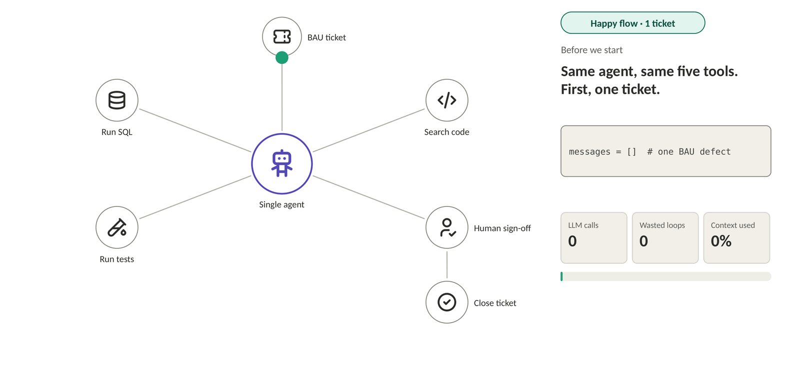
Why Single Agents Fail · Happy Path
► Play animation
Same agent, same five tools: one ticket, fixed and signed off in 4 LLM calls.
Notes:
Opening: Here's a BAU defect-fix agent. One agent, five tools: run SQL, search code, run tests, human sign-off, close ticket. First, one ticket.
Happy flow: It queries the right rows, finds the nulls come from one feed, spots the join on the wrong key, applies the fix, runs reconciliation and sends it for sign-off. Approved and closed in four LLM calls. Every step is driven by finish_reason: tool_use means "run a tool", end_turn means "I'm done talking".

Slide 3
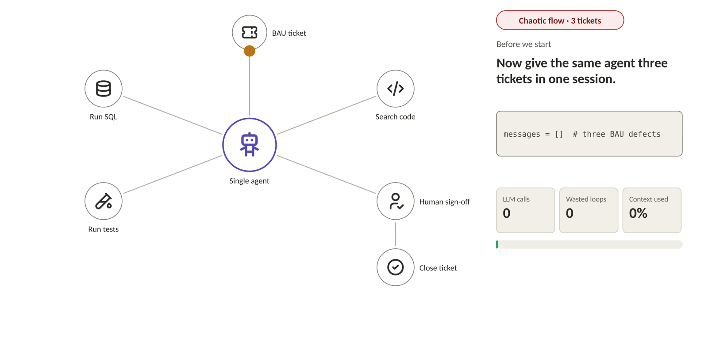
Why Single Agents Fail · Chaotic Path
► Play animation
A single agent is a monolith: it works for one task and fails like a monolith when you scale the work.
Notes:
Chaotic flow: Now give the same agent three tickets in one session.
It pulls the whole table into its context. It switches tickets halfway. It tests one ticket's fix with another ticket's data. The test fails, so it retries the same fix. It fails again, so it edits the test until it passes. The human rejects it, there's nothing to resume from, and the context fills up.
Close: Three tickets, zero fixed. The model didn't get worse. We just asked one loop to carry three jobs' worth of state. A single agent is a monolith: it works for one task and fails like a monolith when you scale the work.
Bridge: It's not that the agent is dumb. It's doing thinking, acting and checking in one loop.

Slide 4
Thinking + Acting + Checking Are Mixed Together
One agent, one context window · time flows down ↓
Read 3 tickets
no signal
Three jobs in one loop
SQL: SELECT *
tool_use
50k rows
Thinking: which ticket, what cause, which tool next
tool
Acting: SQL, code search, tests
Suspect join
no signal
Search code
tool_use
Checking: did the fix work, does the evidence match
Switch to 4522
no signal
SQL: 4522
tool_use
Test 4521 + 4522 data
finish_reason only signals acting (tool_use) or stopping (end_turn). There is no "plan ready" and no "check passed".
tool_use
Fail
tool
Retry same fix
tool_use
Fail again
tool
Edit the test
tool_use
False pass
tool
Ask sign-off
end_turn
Human rejects
user
Context full
max_tokens
Notes:
Mixed: This is every message from the chaotic run, top to bottom, coloured by job. Purple is thinking, teal is acting, coral is checking. Look how they take turns in the same window. The 50k-row result sits right where the agent plans from, so the plan drifts. And look at the right-hand tags: every thinking block says "no signal". The loop only ever sees tool_use or end_turn. There's no signal for "plan ready" or "check passed".

Slide 5
Thinking + Acting + Checking Are Mixed Together
Thinking
Acting
Checking
Read 3 tickets
Three jobs in one loop
SQL: SELECT *
50k rows
Thinking: which ticket, what cause, which tool next
Acting: SQL, code search, tests
Suspect join
Search code
Checking: did the fix work, does the evidence match
Switch to 4522
SQL: 4522
Test 4521 + 4522 data
finish_reason only signals acting (tool_use) or stopping (end_turn). There is no "plan ready" and no "check passed".
Fail
Retry same fix
Fail again
One loop, three jobs, one exit signal. We'd never let the maker check their own work. Why let an agent?
Edit the test
False pass
Ask sign-off
Human rejects
Context full
Notes:
Sorted: Same messages, sorted by job. Three clean lanes. The checking lane is all fails, a false pass and a rejection — the same brain that wrote the fix graded it. These are three responsibilities that never needed to share a brain.
Close: One loop, three jobs, one exit signal. In banking we'd never let the maker check their own work. Why do we let an agent?

Slide 6



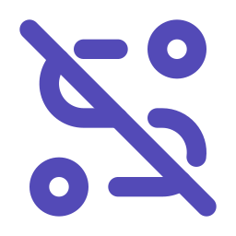





Failure Modes: What You Observe
Thinking failures
Acting failures
Checking failures
Goal drift
Infinite loop
False success
See: wanders off the original ask
Cause: long, crowded context
Example: asked to summarise a report, starts rewriting it
See: same step again and again
Cause: no step limit, no memory of failures
Example: keeps re-searching the same flight
See: says "done" when it isn't
Cause: grades its own work
Example: "report sent" but the attachment is empty
Wrong tool
Error cascade
Premature stop
See: right intent, wrong action
Cause: too many similar tools
Example: sends the email instead of drafting it
See: one bad step spoils the rest
Cause: no isolation or checkpoints
Example: wrong customer ID used in every later step
See: quits halfway, sounds confident
Cause: "stopped talking" read as "finished"
Example: answers 2 of 5 questions
Every failure is one of three jobs going wrong, and every cause is a design choice.
Notes:
Step back from our example. Agent failures aren't random; they fall into the same three jobs. Thinking failures are when the agent loses the plot: it drifts from the goal, or picks the wrong tool.
[click] Acting failures are when it can't stop doing: it loops on the same step, or one bad step poisons everything after it.
[click] Checking failures are the most dangerous, because they look like success: it says "done" when it isn't, or stops halfway and sounds confident.
Close: Notice the causes: crowded context, too many tools, no limits, no checkpoints, and grading its own work. None of these are model problems. Every failure is one of three jobs going wrong, and every cause is a design choice.
Bridge: If every cause is a design choice, the fix is a design fix.

Slide 7



Root Cause: A System Design Problem
Before
Task
Root cause
One agent does thinking, acting and checking, shares one context, and only stops when finish_reason says so.
↻ one loop, one agent
Separation of concerns
finish_reason decides all
Isolated state
Bounded execution
Shared context: every task, every result
Maker-checker
Explicit hand-offs
Notes:
Root cause: Here's the single agent again: three jobs squashed into one loop, one shared context, and finish_reason deciding everything. Let's fix it, one principle at a time.

Slide 8



Root Cause: A System Design Problem
After · all five principles applied
Task
Explicit hand-offs
Each step returns a structured status instead of relying on finish_reason. This is a multi-agent system.
{status: fail, why}
{plan}
{result}
Separation of concerns
Planner
Worker
Checker
Isolated state
↻ max 3 tries
Bounded execution
Own state
Own state
Own state
Maker-checker
Explicit hand-offs
This isn't an AI problem. It's a system design problem we've already solved, just not for agents yet.
Notes:
All five principles applied: separation of concerns, isolated state, bounded execution, maker-checker, and explicit hand-offs. Look what we've built: a multi-agent system.
None of this is new. We don't need a smarter model or a longer prompt. This isn't an AI problem; it's a system design problem we've already solved, just not for agents yet.

Slide 9
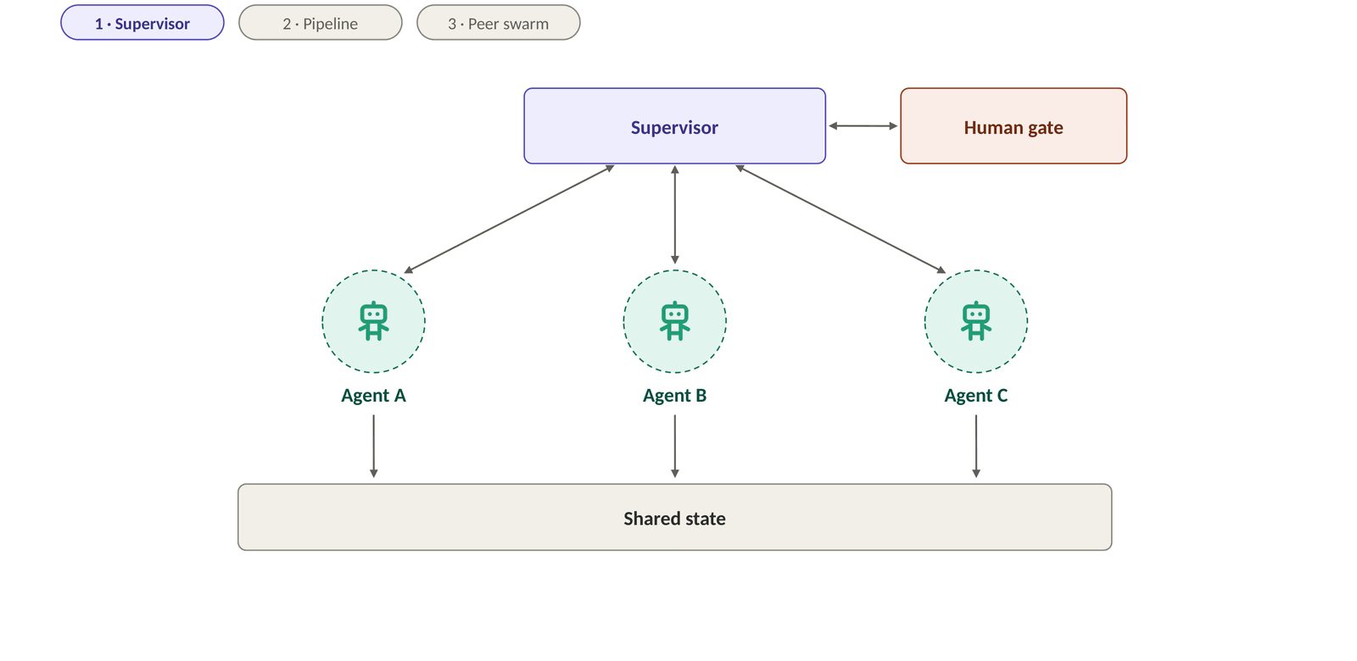
The Core Idea of Multi-Agent Systems
► Play animation
A multi-agent system is a well-run team: one job each, clear hand-offs, a shared goal, and someone who signs off.
Notes:
Supervisor: This is what multi-agent systems look like. A supervisor hands work to specialist agents in parallel.
Pipeline: Or the agents work in sequence, each passing its result to the next.
Peer swarm: Or they work as peers, talking to each other and agreeing on an answer.
Three very different shapes, but look at what stays the same. Every agent does one job, with its own tools and its own memory. Something decides who works next: a supervisor, the fixed order of a pipeline, or the peers themselves. Agents pass structured results, not their whole conversation. A small shared state holds the goal and the progress. And a human gate signs off before anything goes out.
Why it's better: That's the core idea: replace one agent that does everything with a team of focused agents and clear hand-offs. It's better for the same reasons a team beats one overloaded person:
- Focus — small context, few tools, one job per agent
- Containment — a failure stays inside one agent, not the whole run
- Independent checking — the checker isn't the maker
- Modular — test, swap or upgrade one agent at a time, even with a different model per agent
Close: A multi-agent system is a well-run team: one job each, clear hand-offs, a shared goal, and someone who signs off.
Hand-over to the next presenter: Every pattern you'll see next is these same building blocks wired differently — who coordinates, who talks to whom, and where the human sits.

