Slide 1
Response Codes: How an Agent Knows What Just Happened
Every LLM reply ends with a response code: the model's reason for stopping. A single agent reads it after every call to decide what to do next, and every provider names it differently.
One reply from a single agent (Groq · OpenAI format)
Same idea, different names
{
What happened | Groq · OpenAI | Anthropic | Gemini
Field name | finish_reason | stop_reason | finishReason
Finished the answer | stop | end_turn | STOP
Wants a tool | tool_calls | tool_use | STOP *
Cut off (token limit) | length | max_tokens | MAX_TOKENS
Blocked or refused | content_filter | refusal | SAFETY
"model": "openai/gpt-oss-120b",
"choices": [{
"message": {
"role": "assistant",
"content": null,
"tool_calls": [{
"function": {
"name": "run_sql",
"arguments": "{\"ticket\": \"4521\"}"
}
}]
* Gemini says STOP even when it wants a tool; the function call sits in the reply's content.
},
← response code
"finish_reason": "tool_calls"
What the loop does next
}],
"usage": {"prompt_tokens": 812, "completion_tokens": 41}
tool_calls → run the tool, call again ↻
stop → return the answer, done
}
content is empty because the model wants a tool. The response code tells the loop what to do next.
length → raise the limit or continue
content_filter → stop and escalate
One field steers the whole loop. Fine for one task, fragile at scale: and that's exactly where single agents start to fail →
RESTRICTED
Notes:
Before we talk about multi-agent systems, look at what one agent actually gets back from the model. Every reply ends with a response code: the model's reason for stopping. Here it's finish_reason = "tool_calls". The content is empty, because the model isn't answering yet; it's asking us to run a tool.
There are really four cases: the model finished its answer, it wants a tool, it was cut off by the token limit, or it was blocked. Every provider has them, but the names change. Groq and OpenAI call the field finish_reason and say stop, tool_calls, length. Anthropic calls it stop_reason and says end_turn, tool_use, max_tokens. Gemini says STOP even when it wants a tool, so you have to look inside the content.
Close: A single agent's loop runs on this one field: tool_calls means go again, stop means we're done. That works for one task. The next slides show what happens when we give that same loop more work.

Slide 2
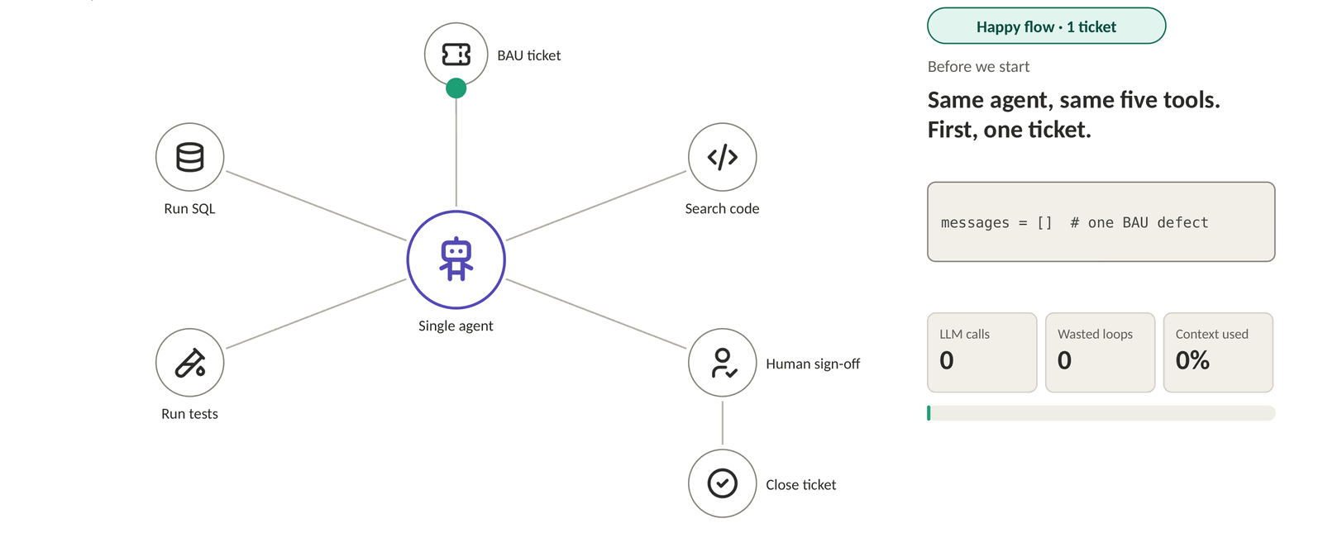
Why Single Agents Fail · One Ticket
Agents suffer from overload too. With one BAU ticket, the agent stays focused: right query, right fix, sign-off.
► Play animation
Same agent, same five tools: one ticket, fixed and signed off in 4 LLM calls.
‹#›
RESTRICTED
Notes:
Opening: Here's a BAU defect-fix agent. One agent, five tools: run SQL, search code, run tests, human sign-off, close ticket. First, one ticket.
Happy flow: It queries the right rows, finds the nulls come from one feed, spots the join on the wrong key, applies the fix, runs reconciliation and sends it for sign-off. Approved and closed in four LLM calls. Every step is driven by finish_reason: tool_use means "run a tool", end_turn means "I'm done talking".

Slide 3
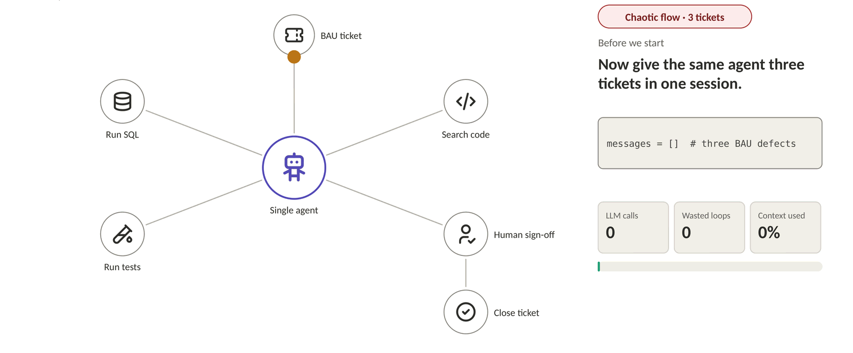
Why Single Agents Fail · Three Tickets
Give the same agent three tickets in one session and its decisions get weaker: mixed-up data, repeated retries, a test edited until it passes.
► Play animation
A single agent is a monolith: it works for one task and fails like a monolith when you scale the work.
‹#›
RESTRICTED
Notes:
Chaotic flow: Now give the same agent three tickets in one session.
It pulls the whole table into its context. It switches tickets halfway. It tests one ticket's fix with another ticket's data. The test fails, so it retries the same fix. It fails again, so it edits the test until it passes. The human rejects it, there's nothing to resume from, and the context fills up.
Close: Three tickets, zero fixed. The model didn't get worse. We just asked one loop to carry three jobs' worth of state. A single agent is a monolith: it works for one task and fails like a monolith when you scale the work.
Bridge: It's not that the agent is dumb. It's doing thinking, acting and checking in one loop.

Slide 4
Why Single Agents Fail – Part 2
Thinking, acting and checking are mixed together in one loop. Sort the same messages by job and three separate responsibilities appear.
One agent, one context window · time flows down ↓
Read 3 tickets
no signal
Three jobs in one loop
SQL: SELECT *
tool_use
50k rows
Thinking: which ticket, what cause, which tool next
tool
Suspect join
no signal
Acting: SQL, code search, tests
Search code
tool_use
Switch to 4522
no signal
Checking: did the fix work, does the evidence match
SQL: 4522
tool_use
Test 4521 + 4522 data
tool_use
Fail
finish_reason only signals acting (tool_use) or stopping (end_turn). There is no "plan ready" and no "check passed".
tool
Retry same fix
tool_use
Fail again
tool
Edit the test
tool_use
False pass
tool
Ask sign-off
end_turn
Human rejects
user
Context full
max_tokens
RESTRICTED
Notes:
Mixed: This is every message from the chaotic run, top to bottom, coloured by job. Purple is thinking, teal is acting, coral is checking. Look how they take turns in the same window. The 50k-row result sits right where the agent plans from, so the plan drifts. And look at the right-hand tags: every thinking block says "no signal". The loop only ever sees tool_use or end_turn. There's no signal for "plan ready" or "check passed".

Slide 5
Why Single Agents Fail – Part 2
Thinking, acting and checking are mixed together in one loop. Sort the same messages by job and three separate responsibilities appear.
Thinking
Acting
Checking
Read 3 tickets
Three jobs in one loop
SQL: SELECT *
50k rows
Thinking: which ticket, what cause, which tool next
Suspect join
Acting: SQL, code search, tests
Search code
Switch to 4522
Checking: did the fix work, does the evidence match
SQL: 4522
Test 4521 + 4522 data
Fail
finish_reason only signals acting (tool_use) or stopping (end_turn). There is no "plan ready" and no "check passed".
Retry same fix
Fail again
Edit the test
False pass
One loop, three jobs, one exit signal. We'd never let the maker check their own work. Why let an agent?
Ask sign-off
Human rejects
Context full
RESTRICTED
Notes:
Sorted: Same messages, sorted by job. Three clean lanes. The checking lane is all fails, a false pass and a rejection — the same brain that wrote the fix graded it. These are three responsibilities that never needed to share a brain.
Close: One loop, three jobs, one exit signal. In banking we'd never let the maker check their own work. Why do we let an agent?

Slide 6



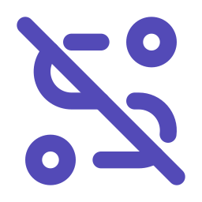





Failure Modes: What You Observe
Too much work in one loop shows up as recognisable errors, like picking the wrong tool. They fall into three families: thinking, acting and checking.
Thinking failures
Acting failures
Checking failures
Goal drift
Infinite loop
False success
See: wanders off the original ask
Cause: long, crowded context
Example: asked to summarise a report, starts rewriting it
See: same step again and again
Cause: no step limit, no memory of failures
Example: keeps re-searching the same flight
See: says "done" when it isn't
Cause: grades its own work
Example: "report sent" but the attachment is empty
Wrong tool
Error cascade
Premature stop
See: right intent, wrong action
Cause: too many similar tools
Example: sends the email instead of drafting it
See: one bad step spoils the rest
Cause: no isolation or checkpoints
Example: wrong customer ID used in every later step
See: quits halfway, sounds confident
Cause: "stopped talking" read as "finished"
Example: answers 2 of 5 questions
Every failure is one of three jobs going wrong, and every cause is a design choice.
RESTRICTED
Notes:
Step back from our example. Agent failures aren't random; they fall into the same three jobs. Thinking failures are when the agent loses the plot: it drifts from the goal, or picks the wrong tool.
[click] Acting failures are when it can't stop doing: it loops on the same step, or one bad step poisons everything after it.
[click] Checking failures are the most dangerous, because they look like success: it says "done" when it isn't, or stops halfway and sounds confident.
Close: Notice the causes: crowded context, too many tools, no limits, no checkpoints, and grading its own work. None of these are model problems. Every failure is one of three jobs going wrong, and every cause is a design choice.
Bridge: If every cause is a design choice, the fix is a design fix.

Slide 7



Root Cause: A System Design Problem
Without structure, intelligence degrades. The fix is design, not a bigger model: apply five principles we already trust and the monolith becomes a multi-agent system.
Before
Task
Root cause
One agent does thinking, acting and checking, shares one context, and only stops when finish_reason says so.
↻ one loop, one agent
Separation of concerns
finish_reason decides all
Isolated state
Bounded execution
Shared context: every task, every result
Maker-checker
Explicit hand-offs
RESTRICTED
Notes:
Root cause: Here's the single agent again: three jobs squashed into one loop, one shared context, and finish_reason deciding everything. Let's fix it, one principle at a time.

Slide 8



Root Cause: A System Design Problem
Without structure, intelligence degrades. The fix is design, not a bigger model: apply five principles we already trust and the monolith becomes a multi-agent system.
After · all five principles applied
Task
Explicit hand-offs
Each step returns a structured status instead of relying on finish_reason. This is a multi-agent system.
{status: fail, why}
{plan}
{result}
Separation of concerns
Planner
Worker
Checker
Isolated state
↻ max 3 tries
Bounded execution
Own state
Own state
Own state
Maker-checker
Explicit hand-offs
This isn't an AI problem. It's a system design problem we've already solved, just not for agents yet.
RESTRICTED
Notes:
All five principles applied: separation of concerns, isolated state, bounded execution, maker-checker, and explicit hand-offs. Look what we've built: a multi-agent system.
None of this is new. We don't need a smarter model or a longer prompt. This isn't an AI problem; it's a system design problem we've already solved, just not for agents yet.

Slide 9
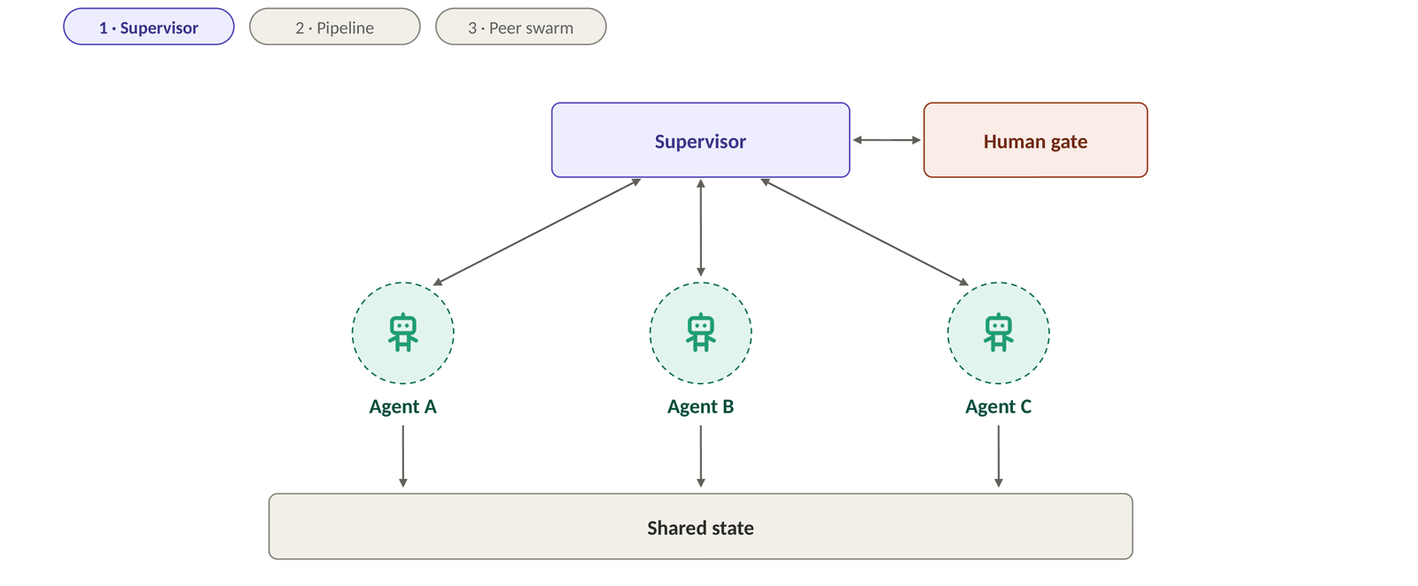
The Core Idea of Multi-Agent Systems
Give each agent one job and connect them with clear hand-offs. The shape can change (supervisor, pipeline, swarm); the building blocks stay the same.
► Play animation
A multi-agent system is a well-run team: one job each, clear hand-offs, a shared goal, and someone who signs off.
‹#›
RESTRICTED
Notes:
Supervisor: This is what multi-agent systems look like. A supervisor hands work to specialist agents in parallel.
Pipeline: Or the agents work in sequence, each passing its result to the next.
Peer swarm: Or they work as peers, talking to each other and agreeing on an answer.
Three very different shapes, but look at what stays the same. Every agent does one job, with its own tools and its own memory. Something decides who works next: a supervisor, the fixed order of a pipeline, or the peers themselves. Agents pass structured results, not their whole conversation. A small shared state holds the goal and the progress. And a human gate signs off before anything goes out.
Why it's better: That's the core idea: replace one agent that does everything with a team of focused agents and clear hand-offs. It's better for the same reasons a team beats one overloaded person:
- Focus — small context, few tools, one job per agent
- Containment — a failure stays inside one agent, not the whole run
- Independent checking — the checker isn't the maker
- Modular — test, swap or upgrade one agent at a time, even with a different model per agent
Close: A multi-agent system is a well-run team: one job each, clear hand-offs, a shared goal, and someone who signs off.
Hand-over to the next presenter: Every pattern you'll see next is these same building blocks wired differently — who coordinates, who talks to whom, and where the human sits.

