Slide 1


Liferay Layout

Slide 2
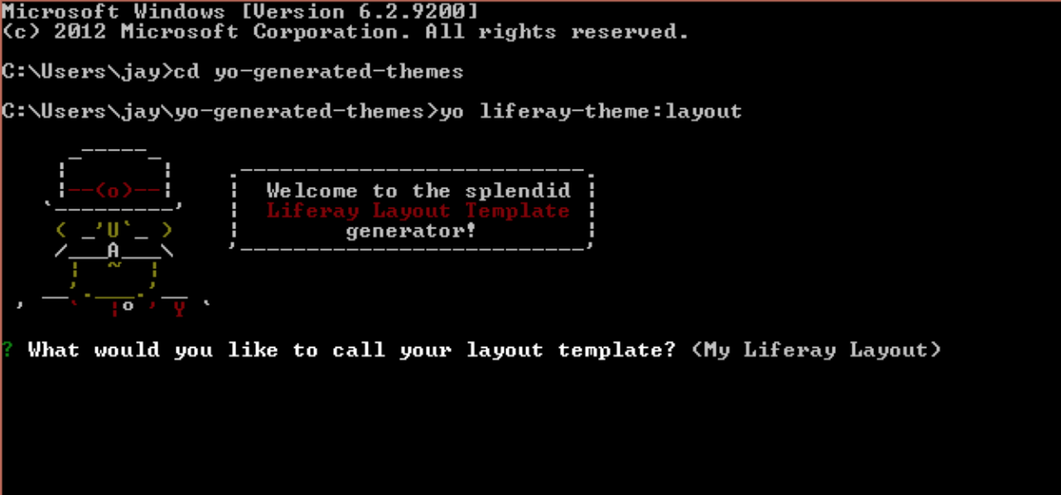
Layout - Creation
Navigate to directory where you want to create layout templates
Run the command: yo liferay-theme:layout

Slide 3
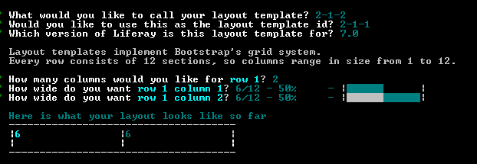
Layout Name and ID
Provide the layout name and layout Id. In this tutorial, we are going to create 2-1-2 layout( 3 rows (2 columns-1-2 columns)) . For the first row give the number columns and select column width also

Slide 4
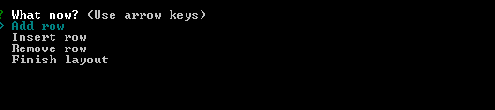
You will get interactive window to add, edit and delete rows in the layouts

Slide 5
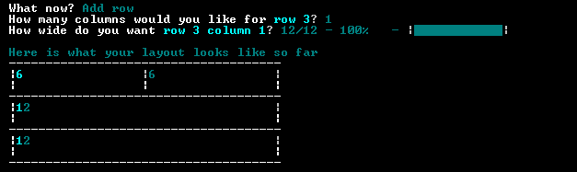
Enter the number columns and width for each columns

Slide 6
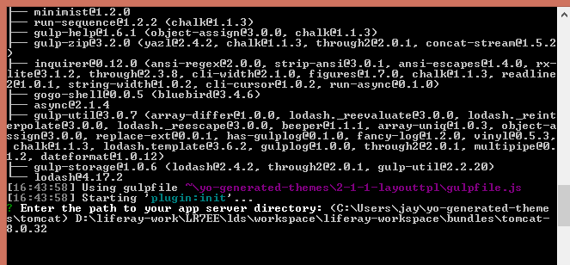
After completing this, select finish layout Enter the path to your server directory. Give complete path up to tomcat directory to deploy automatically

Slide 7
It will create json – where you can edit the path of that
Deploy the war file using gulp task : gulp deploy You can change the deployment directory and other configurations in “liferay-plugin.json” that can be found in root directory of layout templates.
After above deploy command, Layout will be available in the server and you can use this Layout under your project.

Slide 8
Thanks!!

