Slide 1
AI-Driven Dual-Module System for Predicting Coated-Fertilizer Nutrient Release and Optimizing Crop Recommendations
COURSE PROJECT — FINAL REVIEW
Data Science Programming | CSI3001
Department of M.Tech Integrated Data Science | Academic Year 2024–29
TEAM MEMBERS
Amit Kumar
Reg. No: 24MID0155
Mohammad Afaan Sherief
Reg. No: 24MID0178
Bhumi Kumari
Reg. No: 24MID0216
Faculty / Guide: Padma Priya M
Notes:
Introduce the team and the project in one sentence: we built a two-stage machine-learning system that first predicts how fast a coated fertilizer actually releases nitrogen in the field, then uses that prediction to recommend which fertilizer to apply, how much, and when.

Slide 2



Problem Statement
Coated (controlled-release) urea is sold with a fixed release window, e.g. "90 days", measured in the lab at 25 °C. In the field, release speeds up in hot, wet soil and slows in cool, dry soil, so nitrogen arrives too early or too late for the crop.
Why a data-driven solution?
Release depends non-linearly on temperature, moisture, rainfall and coating
Soil-test charts give one static rate and ignore in-season weather
Only 30–50% of applied nitrogen is taken up by crops
Who uses it
Farmers
Agronomists & extension officers
Fertilizer advisory & agri-tech apps
40–126 days
actual release time of a "90-day" product across 90% of the 11,000 field scenarios in our data
Notes:
The label on a coated fertilizer is a lab number. The chart shows the same 90-day product under three climates: hot and wet soil releases 80% of its nitrogen by day 44, cool and dry soil only by day 173. Across our dataset the real duration ranges from 40 to 126 days. Farmers and advisors have no tool that adjusts for this, which is why we need a model rather than a lookup table.

Slide 3
Objectives
OBJECTIVE
MEASURED BY
RESULT
Predict real-time nutrient release
from soil temperature, moisture, rainfall, pH and coating thickness
R² on the 20% test set
1
R² 0.98 – 0.99
Recommend the right fertilizer type
7 products, including 3 coated-urea grades
Test accuracy (ceiling 88.4%)
2
85.7% accuracy
Recommend amount and timing
kg/ha of product and days to the next application
R² on the 20% test set
3
R² 0.99 / 0.98
Synchronize release with crop demand
outperform the static 25 °C manufacturer rating
Coated-urea timing error (MAE)
4
22.4 → 4.0 days
Deliver a usable tool
command-line predictor and notebook with input checks
Automated tests
5
13 / 13 passing
Notes:
Each objective maps to the problem and is measured on data the models never saw during training. All five were achieved; the green pills are the final test-set numbers that we will show in the results section.

Slide 4





Proposed Solution
FIELD & FERTILIZER INPUTS
Soil temperature
MODULE 1
Nutrient Release Prediction
Polynomial LR · Decision Tree · Random Forest
Practical outcome
Right product, dose and date for each field, so nitrogen arrives when the crop needs it
Predicted release rate
+ synchrony index
Soil moisture
Rainfall
Soil pH
MODULE 2
Fertilizer Recommendation Engine
XGBoost · step 1: type → step 2: amount & timing
OUTPUTS
Coating thickness
Fertilizer type
Amount (kg/ha)
CROP INPUTS
Crop type · Growth stage · Initial N-P-K · Soil pH
Timing (days)
Notes:
Input to processing to model to output. Module 1 turns field conditions into a release rate for a standard 90-day coated urea. That rate, plus a synchrony index (how long the product will last divided by how many days of crop demand are left), goes into Module 2 together with the crop information. Module 2 first chooses the product, then sizes the dose and the date of the next application for that product.

Slide 5
Dataset
Dataset | Source | Size | Contents
Crop Recommendation | Real · Kaggle | 2,200 × 8 | N, P, K, pH, temperature, humidity, rainfall; 22 crops
Crop N-P-K requirements | Real · Harvestify | 22 × 6 | Target N, P, K per crop
Nutrient-release data | Generated · Module 1 | 11,000 × 11 | 6 field inputs → release rate, cumulative release
Recommendation data | Generated · Module 2 | 11,000 × 14 | Crop, stage, N-P-K, pH, release → type, amount, timing
How release is simulated (no public field dataset exists)
Each real field record → 5 season scenarios (soil temp, moisture, coating, days)
Temperature: Q10 = 1.8, +10 °C ≈ halves release time (Brown et al., 1966)
Coating: 90 days at 65 µm; dry soil slows release; S-shaped Weibull curve
Noise: 6% batch variability, measurement noise, 3% label disagreement
Median 70 days; 90% of fields 40–126 days. The generated data reproduces the 50–120 day swing in our problem statement.
Notes:
Two real datasets give the soil and climate side: 2,200 Kaggle field records over 22 crops and a crop-wise N-P-K requirement table. Nobody publishes coated-fertilizer release measured under field weather, so we expanded each real record into five season scenarios and computed the release with relationships from the literature: Q10 of 1.8 for temperature, linear coating-thickness effect, a moisture limit, and a Weibull S-curve. We added noise so the models cannot simply memorise a formula. The histogram is our sanity check: a 90-day product lasts 40 to 126 days, matching the swing we set out to solve.

Slide 6






Data Preparation & Feature Engineering
Missing values
Duplicates
Outliers
0 missing cells in all four datasets (checked with isna()). No imputation needed.
0 duplicate rows in the real Kaggle data and in both generated datasets.
IQR rule flags high P, K and rainfall (e.g. apple and grape soils, K ≈ 200). Kept as genuine crop values; derived soil values clipped to 8–48 °C and 5–50%.
Encoding
Scaling
Feature engineering
One-hot: crop type (22), growth stage (4), fertilizer type (7). Fertilizer classes label-encoded for XGBoost.
StandardScaler before linear and polynomial regression. Trees and XGBoost use raw values (scale-invariant).
Soil temperature = air + 1–6 °C; soil moisture from humidity + rainfall; synchrony index = predicted release days ÷ crop days left.
Notes:
Be ready to explain each step. The real data is clean: no missing values and no duplicates. The IQR rule does flag high phosphorus and potassium, but those rows are apple and grape fields where such levels are normal, so removing them would delete two crops. Categorical inputs are one-hot encoded; linear models get standard scaling while tree models do not need it. The most useful engineered feature is the synchrony index, which tells Module 2 how well a product's release matches the crop's remaining demand.

Slide 7
Methodology
Model | Used in | Why it fits this problem
Linear / Polynomial Regression | Module 1 | Interpretable baseline; degree-3 terms capture the exponential temperature effect
Decision Tree | Module 1; Module 2 baseline | Non-linear and explainable; gives feature importance
Random Forest | Module 1 benchmark; Module 2 | Averages 300 trees → lower variance, robust to outliers
XGBoost | Module 2 (final) | Gradient-boosted trees; strongest on tabular data with feature interactions
TRAINING & VALIDATION PROCESS
1
80/20 train–test split (stratified by fertilizer type)
2
5-fold cross-validation on the 80% training set
3
Select the best model by mean CV score
4
Evaluate once on the held-out 20% test set
5
Compare with the static system and an ablation without Module 1
Metrics Regression: MSE · RMSE · MAE · R² Classification: accuracy · macro-F1 · confusion matrix
Notes:
We followed the deck's plan: linear regression and decision trees for Module 1, random forest and XGBoost for Module 2, with a decision tree as the Module 2 baseline. The important methodological point: the test set is touched only once. Model choice is made by 5-fold cross-validation inside the training data, so the reported test scores are not optimistic. We also built an ablation without Module 1 to prove the first module adds value.

Slide 8
Model Implementation
Model | Key hyperparameters
Linear Regression | StandardScaler → ordinary least squares
Polynomial LR | PolynomialFeatures(degree = 3) → OLS
Decision Tree (M1) | GridSearchCV: max_depth {6, 10, 14, None}, min_samples_leaf {1, 5, 10} → best leaf = 5
Random Forest | 300 trees; min_samples_leaf 1 (classifier) / 2 (regressor)
XGBoost classifier | 400 trees, max_depth 6, learning_rate 0.08, subsample 0.9, colsample 0.9
XGBoost regressors | 500 trees, max_depth 6, learning_rate 0.06 (amount & timing)
Decision Tree (M2) | max_depth 14, min_samples_leaf 3 (baseline)
Pipeline integration · src/pipeline.py
rate = module1.predict(field) # % / day
X['predicted_release_rate'] = rate
X['synchrony_index'] = (80 / rate) / days_left
product = xgb_type.predict(X) # step 1
X['fertilizer_type'] = product
amount = xgb_amount.predict(X) # step 2
timing = xgb_timing.predict(X)
TOOLS & LIBRARIES
Python 3.9
pandas 2.3
NumPy 2.0
scikit-learn 1.6
XGBoost 2.1
Matplotlib 3.9
joblib
pytest
Project code src/ (8 modules) · main.py (end-to-end run, ~2 min) · predict.py (CLI app) · Smart_Fertilizer_Project.ipynb · tests/ (13 tests)
Notes:
Hyperparameters were either grid-searched (Module 1 decision tree) or set to standard values for this data size. The code snippet is the heart of the system: Module 1's prediction becomes two input columns for Module 2, and Module 2 predicts the product before sizing the dose, because the right amount depends on which product is applied. The project is 8 Python modules plus main.py, predict.py, a notebook and 13 tests.

Slide 9
Results: Module 1, Nutrient Release
Release rate (% per day)
Best: Polynomial LR (deg 3)
R² 0.981 · RMSE 0.124 · MAE 0.087
Cumulative release (%)
Best: Random Forest
R² 0.987 · RMSE 3.96 · MAE 2.66
What the results show
Plain linear regression underfits (R² 0.811): temperature acts exponentially
Coating thickness (57%) and soil temperature (40%) drive release-rate predictions
Evaluated on the 20% held-out test set (2,200 rows); best model chosen by 5-fold CV R².
Notes:
Module 1 has two targets. For the daily release rate, polynomial linear regression wins with R² 0.98: once squared and cubed terms are added, linear regression can model the exponential temperature effect. For cumulative release, which also depends on time, the random forest wins with R² 0.987. Decision-tree feature importance confirms the physics: coating thickness and soil temperature explain about 97% of the release rate.

Slide 10
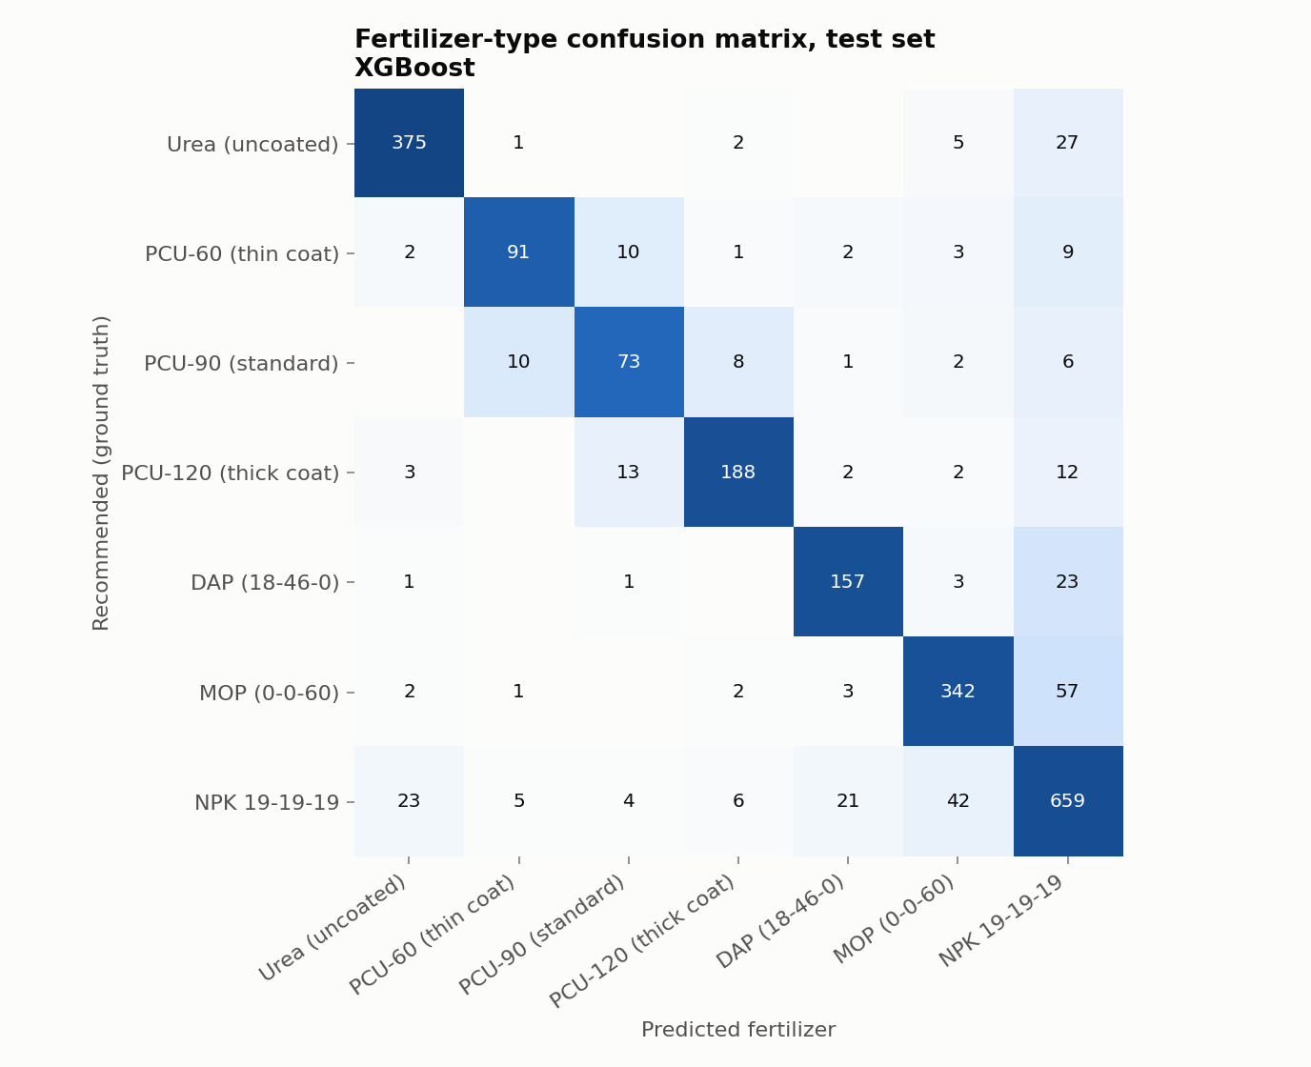
Results: Module 2, Recommendation Engine
Best model: XGBoost. Highest 5-fold CV score on all three targets; 85.7% accuracy vs a 88.4% ceiling set by label noise.
Most errors are between neighbouring coat grades or with the general NPK product.
Notes:
XGBoost is the best model for every Module 2 target under cross-validation, so it is our final model. Type accuracy is 85.7%. That sounds modest, but even the exact rule that labelled the data only reaches 88.4% because we injected realistic disagreement, so XGBoost is close to the best possible. Given the recommended product, amount and timing reach R² 0.99 and 0.98. If the product prediction is wrong the dose is also wrong, so end-to-end R² is 0.76 for amount and 0.83 for timing; be ready to explain this.

Slide 11
Results: Existing Static System vs Proposed
82%
lower timing error for coated urea than the manufacturer's static 25 °C rating (22.4 → 4.0 days)
Does Module 1 matter? (ablation)
Coated-grade accuracy: 71% → 80%
Timing R²: 0.90 → 0.98
Type accuracy: 83.6% → 85.7%
Without → with Module 1's predicted release
System | Timing MAE (all) | Timing MAE (coated) | Amount MAE
Existing static system | 9.2 days | 22.4 days | 12.6 kg/ha
ML without Module 1 | 4.4 days | 8.4 days | 9.0 kg/ha
Proposed dual-module system | 2.4 days | 4.0 days | 8.4 kg/ha
Notes:
This is the result that answers the problem statement. We gave the static system, an ML model without Module 1, and our full system the same recommended product, and measured how far each one's application date is from the agronomically correct date. For coated urea the static 25 degree rating is off by 22 days on average; our system is off by 4. The ablation shows the gain really comes from Module 1: without the predicted release rate, coat-grade accuracy drops from 80% to 71% and timing error doubles.

Slide 12
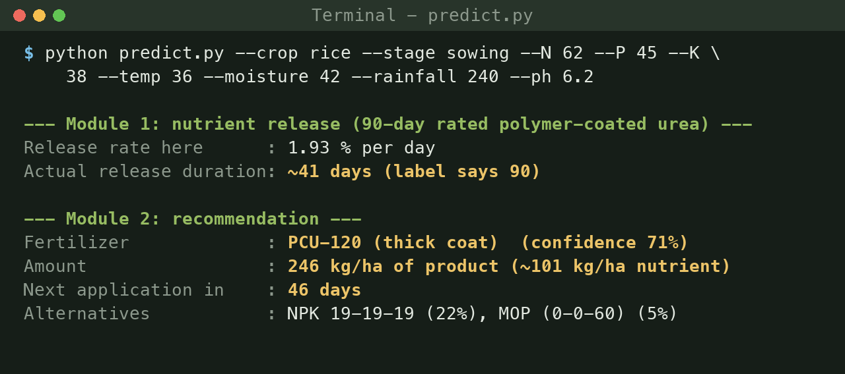
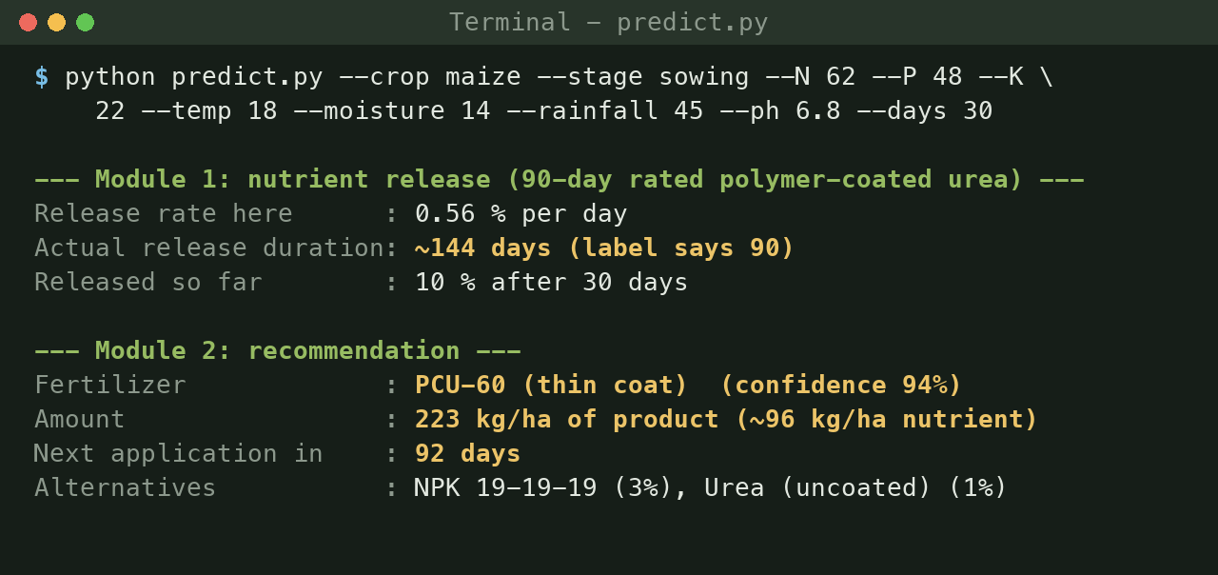



Application / Output
Hot, wet rice field (36 °C) → thick-coat PCU-120: a "90-day" product would run out in ~41 days
Cool, dry maize field (18 °C) → thin-coat PCU-60: only 10% released after 30 days
Before application
Advisor enters soil test and weather → product, dose and date
During the season
Re-run with current weather to reschedule the next top-dressing
Built-in safety
Inputs outside the training range are flagged as extrapolations
Notes:
These are real outputs of predict.py, our command-line application. Live demo option: run python predict.py with no arguments and it asks for each input interactively. Point out that the two fields get opposite coat grades: in hot soil the standard 90-day product would be exhausted in 41 days, so the system picks the thickest coat; in cool, dry soil it picks the thinnest. The notebook Smart_Fertilizer_Project.ipynb shows the whole pipeline if the faculty wants to see code.

Slide 13


Challenges & Solutions
No public dataset of field release
Combined real Kaggle field data with literature-based release simulation
Dose depends on the product (amount R² only 0.77)
Chained models: predict type first, then amount and timing for it (R² 0.99)
Unfair comparison with the static system
Evaluated every system on the same recommended product
Coat grades confused (~75% accuracy)
Engineered a synchrony index from Module 1's output (+3 points)
Risk of optimistic test scores
Selected models by 5-fold CV; test set used only once
Notes:
Each row is a real problem we hit and fixed. The most instructive one is the second: our first amount model had R² of only 0.77 because the dose for an NPK blend is more than twice the dose for urea; once Module 2 predicts the product first and then sizes the dose for that product, R² rises to 0.99.

Slide 14

Conclusion & Future Scope
KEY FINDINGS · ALL 5 OBJECTIVES ACHIEVED
Future scope
Calibrate Module 1 with lysimeter or incubation release measurements
Live weather-forecast API and IoT soil sensors
More products: sulphur-coated urea, coated P & K, inhibitors
Mobile app in regional languages for farmers
Optimise for fertilizer cost and expected yield
Module 1 predicts field release with R² 0.98–0.99, replacing the fixed "90-day" label
XGBoost picks the product with 85.7% accuracy (ceiling 88.4%) and sizes dose and timing with R² ≥ 0.98
Coated-urea timing error falls 82% vs the static rating (22.4 → 4.0 days)
Module 1 is what makes the difference: removing it costs 9 points of coat-grade accuracy
Limitation: release behaviour and labels are simulated from published relationships; field validation is the next step.
Notes:
Summarise in three sentences: the release model works, the recommender is close to the best achievable, and together they cut coated-urea timing error by 82% compared with today's static practice. Be upfront about the limitation: our release data is simulated from published physics, so the next step is calibrating Module 1 with measured field or lab release curves.

Slide 15
References
DATASETS
1. A. Ingle, "Crop Recommendation Dataset," Kaggle. kaggle.com/datasets/atharvaingle/crop-recommendation-dataset
2. Harvestify: crop-wise N-P-K requirement table. github.com/Gladiator07/Harvestify
RESEARCH PAPERS (CONT.)
8. X. Li, "Global trends and current advances in slow/controlled-release fertilizers," Computers and Electronics in Agriculture, 220, 2024.
9. M. Padhiary, "Enhancing precision agriculture: A comprehensive review of machine learning and AI in farming operations," Computers and Electronics in Agriculture, 234, 2024.
10. T. M. C. Maaz, "A review of research and innovation on novel fertilizers for efficient nutrient management," Nature Food, 6(3), 155–168, 2025.
11. A. Ravindran, "Advancements and challenges in controlled-release fertiliser," J. Controlled Release, 380, 2025.
RESEARCH PAPERS
3. M. J. Brown, R. E. Luebs, P. F. Pratt, "Effect of temperature and coating thickness on the release of urea from resin-coated granules," Agronomy Journal, 58, 175–178, 1966.
4. T. S. Tanaka et al., "Can machine learning models provide accurate fertilizer application recommendations?," Precision Agriculture, 25(4), 1839–1856, 2024.
5. I. Kassem et al., "Polymer-coated slow/controlled-release granular fertilizers: Fundamentals and research trends," Progress in Materials Science, 144, 2024.
6. S. Swain et al., "Proportional impact prediction model of coating material on polymer-coated fertilizers," Scientific Reports, 14, 2024.
7. S. Goyil, "Controlled-release fertiliser: Recent developments and future prospects," J. Controlled Release, 366, 233–249, 2024.
SOFTWARE & DOCUMENTATION
12. F. Pedregosa et al., "Scikit-learn: Machine learning in Python," JMLR, 12, 2825–2830, 2011.
13. T. Chen, C. Guestrin, "XGBoost: A scalable tree boosting system," Proc. ACM KDD, 2016.
14. pandas, NumPy, Matplotlib and joblib documentation.
15. Team prototype: github.com/Amit-kr04/Smart-fertilizer-project
Notes:
Dataset sources first: the Kaggle Crop Recommendation dataset and the Harvestify requirement table. The 1966 Agronomy Journal paper is the basis for our temperature effect; the remaining papers are from our zeroth review.

