Slide 1


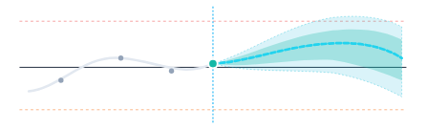
SYS.MOD // BIO-DIGITAL TWIN v2.4
[CONFORMAL QUANTILE REGRESSION ENGINE]
SYNTHETIC RESEARCH ONLY
NOT FOR CLINICAL USE
SYNTHETIC SUBJECT // TWIN-ID #AT-040
95% CONF.
Longitudinal State-Space + Conformal Prediction
Next-Gen Computational Endocrinology & Uncertainty Quantification
AarogyaTwin-X
GLUCOSE (mg/dL)
HORIZON: +120 MIN FORECAST
CGM
Clinician Research Digital Twin for Longitudinal Glucose Forecasting & Conformal Risk Estimation
— Historical CGM
-- Point Forecast
■ Conformal Set
Multi-Horizon CGM Trajectory
Coverage Bounds (1 - α)
In-Silico Replay
PRED. MEDIAN
CONF. BOUND
EXCURSION RISK
134 mg/dL
[98, 169]
LOW (4.2%)
T40
TEAM NAME
TEAM MEMBERS
INSTITUTION / COLLEGE
team40
AMIT, HANSRAJ
ARYA COLLEGE OF ENGINEERING AND IT
Not a diagnostic device. Not clinical validation. Not medical advice.

Slide 2



The Healthcare Problem
3 critical failures in current diabetes AI systems
185 mg/dL
80–95%
NO SIGNAL
one number, zero range
of CGM alarms are false
CGM disconnects or degrades
Overconfident Point Estimates
Alert Fatigue Crisis
Sensor Dropout Hallucination
No uncertainty range — just one confident number
Doctors and nurses start ignoring ALL alarms
Traditional AI keeps predicting from stale or missing data
Insulin taken on a wrong number → hypoglycemic shock risk
Critical real alerts get missed among the noise
Fabricated forecasts look confident — but are dangerous
Studies show single-point forecasts cause dangerous over-correction
Worse patient outcomes despite more technology
No system says “I don’t know” when data is unreliable
The common thread: none of today’s systems tell you how sure they are.
Notes:
Three failure modes in today’s diabetes AI. 1) Overconfident point estimates: the system says “your sugar will be 185 mg/dL” with no uncertainty range, a patient doses insulin on a number that may be wrong, and the result can be hypoglycemic shock. Studies show single-point forecasts lead to dangerous over-correction. 2) Alert fatigue: hospital CGM alarms run at 80–95% false positives, so clinicians start ignoring all alarms and real critical alerts get lost in the noise. More technology, worse outcomes. 3) Sensor dropout hallucination: when a CGM disconnects or its signal degrades, traditional AI keeps predicting from stale or missing data. The forecasts look confident but are fabricated, and no system ever says “I don’t know”. Common thread to close on: none of these systems tell you how sure they are.

Slide 3





AarogyaTwin-X: Our Solution
4 key innovation pillars
PILLAR 01 · FORECAST
PILLAR 02 · UNCERTAINTY
Multi-Horizon Forecasting
90% Conformal Uncertainty Band
Calibrated forecast heads at 30, 60 and 120 minutes
Split-conformal prediction intervals
Not just one number — three named time horizons
Mathematical 90% coverage guarantee
Past-only temporal features (zero future leakage)
Doctor sees range [92–122 mg/dL], not just “107”
PILLAR 03 · SAFETY
PILLAR 04 · SANDBOX
Safety Abstention
What-If Scenario Sandbox
When CGM data is stale (>15 min) or dropped
Clinician adjusts Activity (0–30 min) + Carbs (0–100g)
System REFUSES to predict
See prospective glucose trajectory changes
Returns explicit warning: “Data too stale — abstained”
Explicit disclaimer: “Not medical advice”
Better to stay silent than give a dangerous wrong answer
Bounded assumptions, not treatment recommendations
Notes:
AarogyaTwin-X answers the three failures with four innovation pillars. 1) Multi-horizon forecasting: calibrated forecast heads at 30, 60 and 120 minutes, so clinicians get three named horizons instead of one number. Features are past-only, so there is zero future leakage. 2) A 90% conformal uncertainty band: split-conformal prediction intervals with a mathematical 90% coverage guarantee. The doctor sees a range like 92–122 mg/dL, not just “107”. 3) Safety abstention: when CGM data is stale (more than 15 minutes) or dropped, the system refuses to predict and returns an explicit warning, “Data too stale — abstained”. Better to stay silent than give a dangerous wrong answer. 4) What-if scenario sandbox: the clinician adjusts activity (0–30 min) and carbs (0–100g) and sees the prospective glucose trajectory change. It carries an explicit “Not medical advice” disclaimer and uses bounded assumptions, not treatment recommendations.

Slide 4




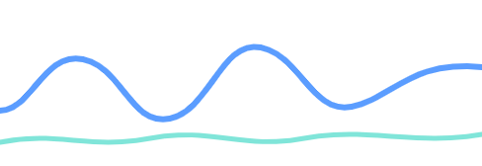
System Architecture
4 layers, from data to dashboard
LAYER 1
LAYER 2
LAYER 3 · PARALLEL
LAYER 4
Data Input Layer
Feature Engineering & Safety Gate
ML Engine Core
Presentation Layer
Synthetic Patient Cohort
Past-Only Temporal Lag Vectors
Forecast Engine
FastAPI Local REST API
HistGradientBoostingRegressor
/api/health
60 patients
× 5 days
Rolling windows of glucose, slope, HR, meals
30m / 60m / 120m heads
/api/patients
Causal-in-time adaptive residual personalization
/api/twin/{id}
Strict causal boundary: NO future data access
/api/simulate
CGM Glucose (5-min intervals)
/api/metrics
Heart Rate, HRV
raw signals
temporal features
Uncertainty Engine
predictions + intervals
Sleep Duration
JSON responses
Split-Conformal Prediction
Activity/Steps
90% target coverage bands
React + TypeScript Dashboard
Meal/Carbohydrate Intake
Calibrated on separate patient cohort
Sensor Freshness Checker
Patient Replay Timeline
Static Profile (Age, BMI, HbA1c)
Forecast + Conformal Band Charts
CGM age check (>15 min = STALE)
Missing data fraction calculator
Event Risk Engine
Dropout Abstention Alerts
Logistic Fusion Classifier
Scenario Sandbox Simulator
Decision: PREDICT or ABSTAIN
Platt Sigmoid Probability Calibration
interactive visualization
Sustained >180 mg/dL event detection
Clinician view
Notes:
The architecture has four layers, flowing left to right. Layer 1, data input: a synthetic patient cohort of 60 patients over 5 days, with CGM glucose at 5-minute intervals, heart rate and HRV, sleep duration, activity and steps, meal and carbohydrate intake, and a static profile (age, BMI, HbA1c). Raw signals flow into Layer 2, feature engineering and the safety gate: past-only temporal lag vectors (rolling windows of glucose, slope, heart rate and meals, with a strict causal boundary and no future data access), plus a sensor freshness checker that flags CGM data older than 15 minutes as stale, computes the missing-data fraction, and decides to predict or abstain. Temporal features then feed Layer 3, the ML engine core, which runs three engines in parallel: the forecast engine (HistGradientBoostingRegressor with 30, 60 and 120 minute heads and causal-in-time adaptive residual personalization), the uncertainty engine (split-conformal prediction, 90% target coverage, calibrated on a separate patient cohort), and the event risk engine (logistic fusion classifier with Platt sigmoid calibration, detecting sustained readings above 180 mg/dL). Predictions and intervals go to Layer 4, the presentation layer: a local FastAPI REST API (health, patients, twin by id, simulate, metrics) that returns JSON responses to a React and TypeScript dashboard with a patient replay timeline, forecast and conformal band charts, dropout abstention alerts, and the scenario sandbox simulator, giving the clinician an interactive visualization.

Slide 5
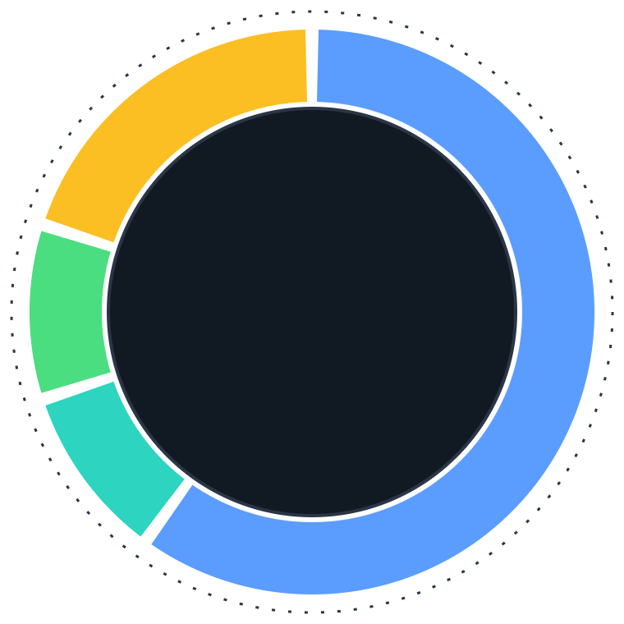

Zero Data Leakage:
Patient-Disjoint Evaluation Design
0 patients shared across splits
36 Training Patients
60%
Model learns glucose patterns
6 Probability Tuning Patients
10%
60
Platt sigmoid calibration for event risk
PATIENTS
6 Interval Calibration Patients
10%
Split-conformal prediction band widths
12 Held-Out Test Patients
20%
NEVER seen during training — final evaluation only
KEY GUARANTEE
STUDY SETUP
No patient appears in more than one split. Training patients are NEVER used for calibration or testing. This eliminates identity leakage and temporal leakage that plague most healthcare AI benchmarks.
TOTAL
60 patients × 5 days = 300 patient-days
SAMPLING
5-minute observation grid (1,440 steps/day)
SEED
Deterministic (seed 2026) for full reproducibility
Notes:
Patient-disjoint evaluation: the 60 patients (5 days each, 300 patient-days in total) are split so that no patient appears in more than one split. 36 patients (60%) train the model to learn glucose patterns. 6 patients (10%) tune probabilities with Platt sigmoid calibration for event risk. 6 patients (10%) calibrate the prediction intervals, setting the split-conformal band widths. 12 patients (20%) are held out and never seen during training; they are used for the final evaluation only. Training patients are never used for calibration or testing, which removes identity leakage and temporal leakage that affect most healthcare AI benchmarks. Observations sit on a 5-minute grid, and the whole pipeline is deterministic with seed 2026 for full reproducibility.

Slide 6
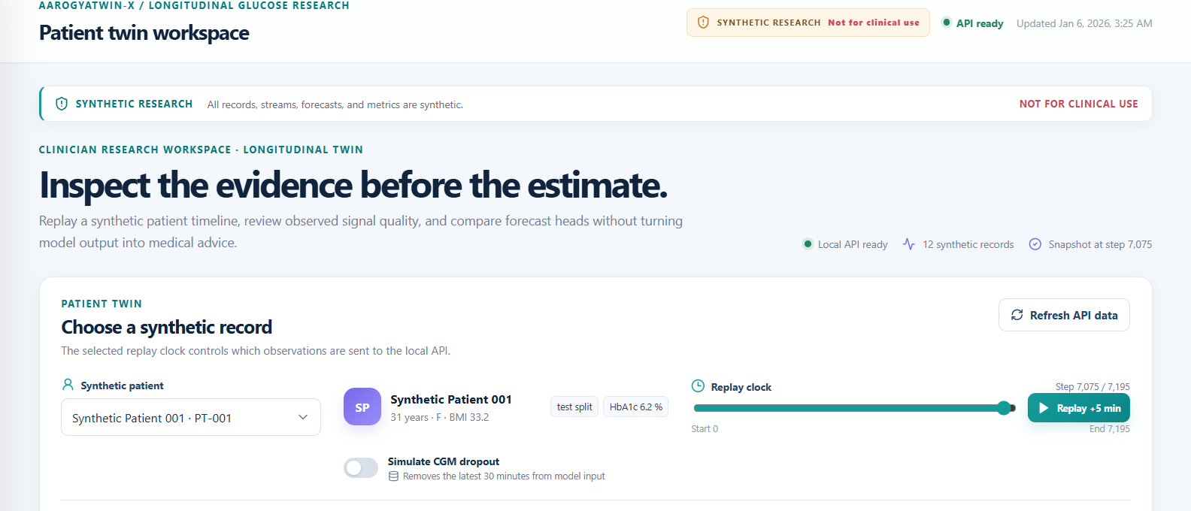
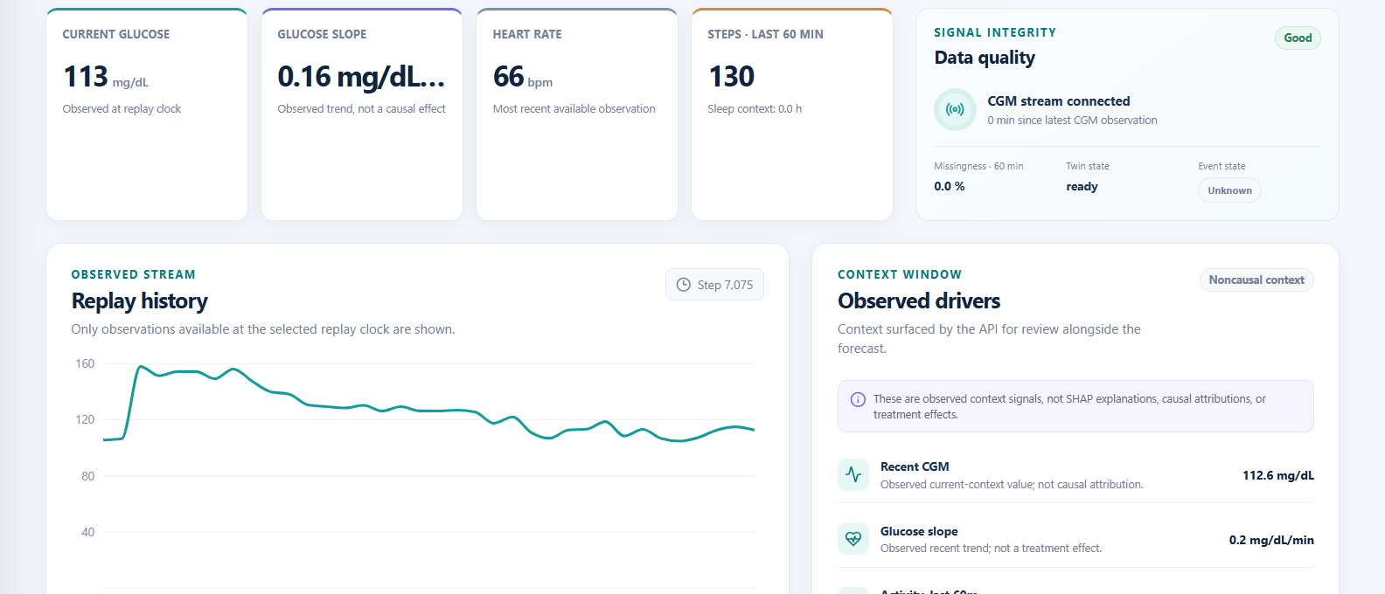
Live Dashboard: Patient Twin Overview
Synthetic data, not for clinical use
5
Patient Selection & Replay Controls
1
Patient dropdown: Select any held-out test patient
2
Replay Clock slider: Scrub through 5-day timeline
3
Replay +5 min button: Advance exactly one sensor reading
4
Simulate CGM Dropout toggle: Test sensor failure behavior
5
API Ready badge: Backend connection confirmed
2
6
test split tag: This patient was never used in training
1
6
3
4
1
2
3
Real-Time Telemetry & Signal Quality
4
1
Current Glucose: 113 mg/dL (live reading)
2
Glucose Slope: 0.16 mg/dL/min (stable trend)
3
Heart Rate: 66 bpm (resting)
6
4
Signal Integrity: CGM connected, 0% missing data
5
5
Replay History chart: Past observed glucose curve
6
Observed Drivers: Context signals (not causal explanations)
Notes:
Two views of the working dashboard, which runs locally on synthetic data. Top: patient selection and replay controls. Pick a held-out test patient from the dropdown (the “test split” tag confirms the patient was never used in training), scrub the replay clock through the 5-day timeline, advance one sensor reading at a time with Replay +5 min, and flip the Simulate CGM dropout toggle to test how the system behaves when the sensor fails. The API ready badge confirms the backend connection. Bottom: telemetry and signal quality. Current glucose is 113 mg/dL with a slope of 0.16 mg/dL per minute, heart rate is 66 bpm, and the signal integrity panel shows the CGM connected with 0% missing data. The replay history chart shows the past observed glucose curve, and the observed drivers panel lists context signals, not causal explanations.

Slide 7
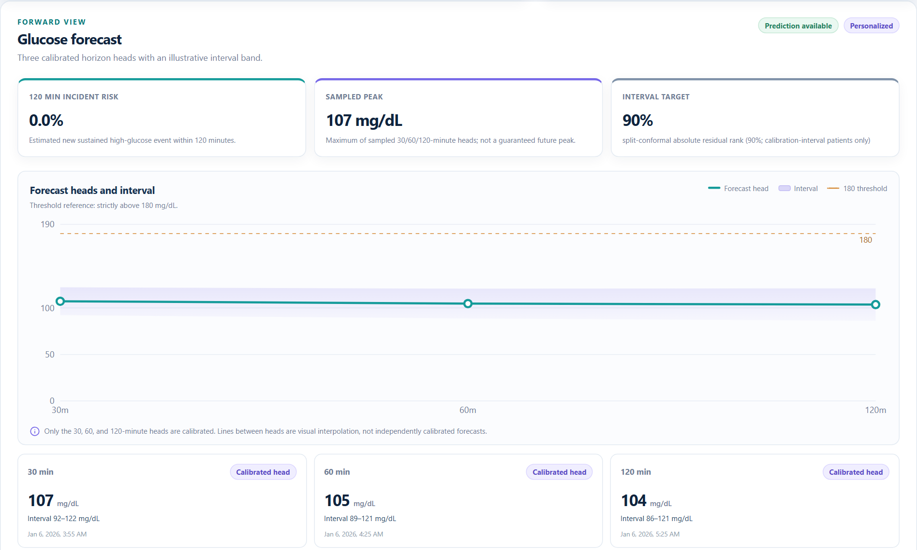
Forward Forecast: Conformal Prediction in Action
30 / 60 / 120 Minute Calibrated Forecast with 90% Confidence Band
1
2
3
1
120-Min Incident Risk: 0.0% — No sustained hyperglycemia expected
2
Sampled Peak: 107 mg/dL — Maximum predicted glucose across horizons
6
3
Interval Target: 90% — Split-conformal coverage guarantee
4
5
4
Three forecast dots: Calibrated predictions at exactly 30m, 60m, 120m
5
Light blue shaded band: 90% conformal prediction interval
7
6
Orange dotted line: 180 mg/dL clinical hyperglycemia threshold
7
Note: Lines between dots are visual interpolation, not calibrated predictions
KEY NUMBERS
30 MIN
60 MIN
120 MIN
107 mg/dL
105 mg/dL
104 mg/dL
Range 92–122 mg/dL
Range 89–121 mg/dL
Range 86–121 mg/dL
Notes:
The forward forecast for one held-out synthetic patient. The model gives three calibrated heads at exactly 30, 60 and 120 minutes: 107, 105 and 104 mg/dL, each with a 90% split-conformal interval (92–122, 89–121 and 86–121 mg/dL). The 120-minute incident risk is 0.0%, so no sustained hyperglycemia is expected, and the sampled peak across the three horizons is 107 mg/dL. The dashed orange line is the 180 mg/dL threshold. The shaded band is the conformal prediction interval. The line between the dots is visual interpolation only; just the three heads are calibrated.

Slide 8




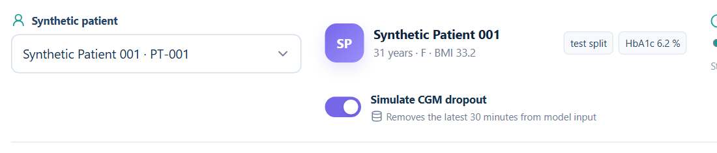
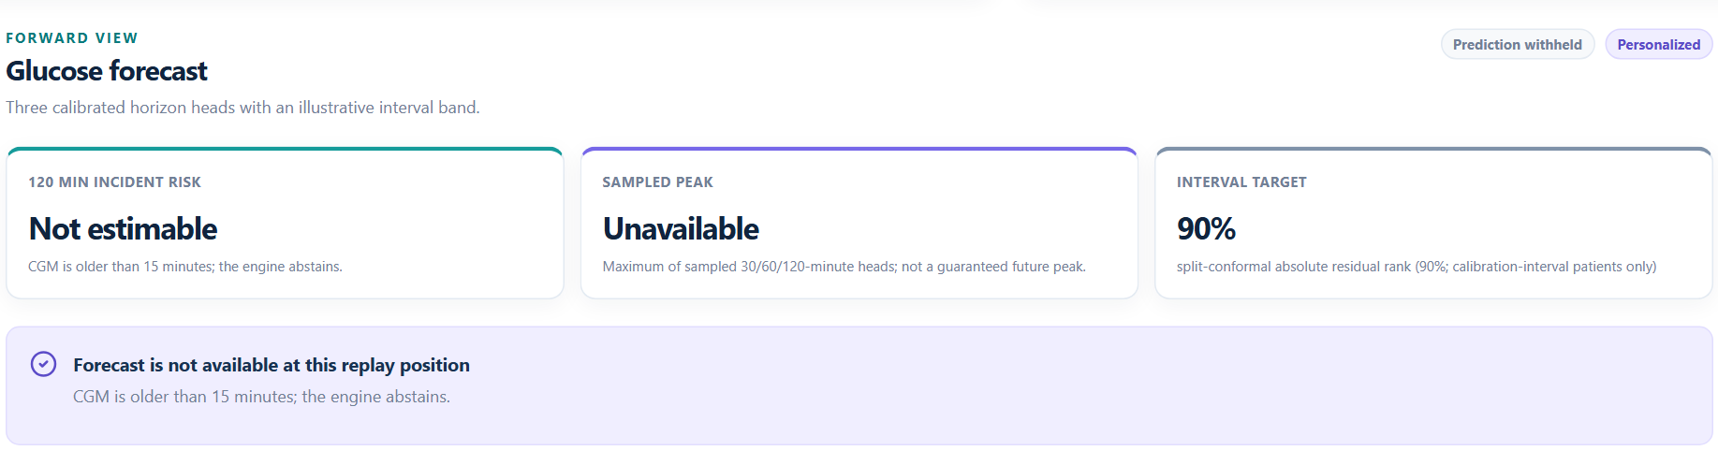
The Game Changer: Intentional Abstention
TRADITIONAL AI
AAROGYATWIN-X
Sensor Drops → AI Keeps Guessing
Sensor Drops → System Abstains
VS
CGM disconnected for 30 minutes
CGM stale >15 minutes detected
Model uses stale data to hallucinate prediction
Forecast fields become NULL
Clinician sees confident number → acts on it
Warning: “Prediction abstained — CGM data too stale”
Result: Dangerous wrong insulin dose
Result: Clinician knows to wait for fresh data
DROPOUT TOGGLE: ON
ENGINE ABSTAINS
In medical AI, staying silent when uncertain is a thousand times safer than giving a confident wrong answer.
Notes:
The game changer is intentional abstention. Left, a traditional model: the CGM sensor drops for 30 minutes, but the model keeps predicting from stale data and hallucinates a forecast. The clinician sees a confident number, acts on it, and the result can be a dangerous wrong insulin dose. Right, AarogyaTwin-X: it detects that the CGM is stale for more than 15 minutes, forecast fields become null, and the dashboard shows “Prediction abstained — CGM data too stale”, so the clinician knows to wait for fresh data. The two screenshots at the bottom are from the real dashboard: the Simulate CGM dropout toggle switched on, which removes the latest 30 minutes from model input, and the forecast view showing the risk as not estimable, the peak unavailable and the message that the engine abstains. Close with the line: in medical AI, staying silent when uncertain is far safer than giving a confident wrong answer.

Slide 9
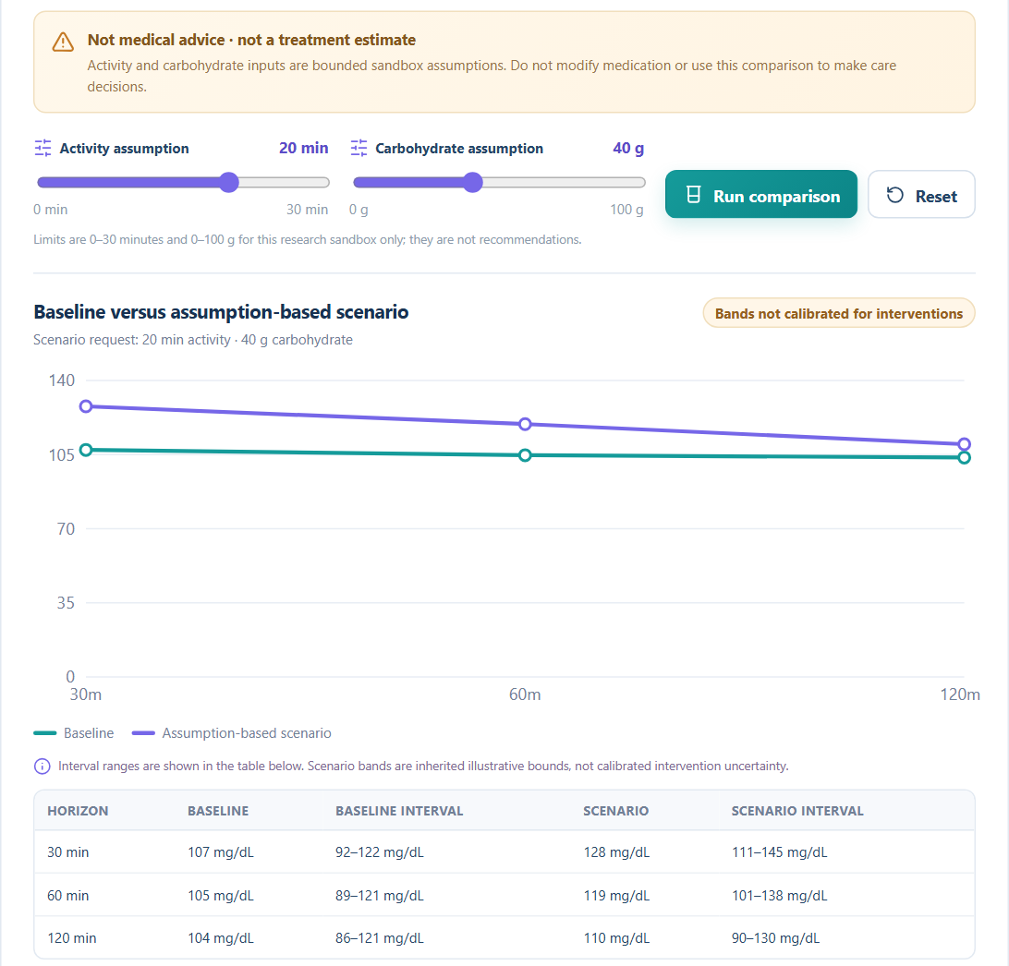

Clinician What-If Scenario Sandbox
Unvalidated sandbox, synthetic data
5
What each control does
1
Activity Assumption slider: 0 to 30 minutes of exercise
1
2
3
4
2
Carbohydrate Assumption slider: 0 to 100 grams of carbs
3
Run Comparison button: Sends scenario to API, overlays result
4
Reset button: Clear scenario back to baseline
5
Safety Warning: “Not medical advice — not a treatment estimate”
6
Baseline vs Scenario comparison: Two curves overlaid
6
Use Case Examples
SCENARIO
CLINICIAN ASKS
“Patient wants to eat 40g carbs (2 rotis)”
→
“How much will glucose spike?”
“Patient can walk for 20 minutes”
→
“Will walking offset the carb spike?”
“Combine both”
→
“Net effect of meal + exercise?”
All scenario outputs are bounded sandbox assumptions. They are NOT treatment effects, medication recommendations, or clinical dosing guidance.
Notes:
The what-if sandbox lets a clinician explore bounded assumptions on top of the current forecast. Two sliders set an activity assumption (0 to 30 minutes of exercise) and a carbohydrate assumption (0 to 100 grams). Run comparison sends the scenario to the API and overlays the result on the baseline; Reset clears it back to baseline. The amber warning is always on screen: not medical advice, not a treatment estimate. In the screenshot, a 20-minute activity plus 40 g carbohydrate scenario moves the forecast from 107, 105 and 104 mg/dL at the baseline to 128, 119 and 110 mg/dL, and the table lists the intervals for each horizon. Example uses: a patient wants to eat 40 g of carbs (about 2 rotis), so how much will glucose spike? The patient can walk for 20 minutes, so will walking offset the spike? Combine both for the net effect of meal plus exercise. Close on the disclaimer: all outputs are bounded sandbox assumptions, not treatment effects, medication recommendations or dosing guidance. The scenario bands are inherited illustrative bounds and are not calibrated for interventions.

Slide 10



Quantitative Evaluation on Held-Out Test Patients
Forecast Accuracy & Uncertainty Coverage
HORIZON
MAE
RMSE
CONFORMAL COVERAGE (TARGET: 90%)
INTERVAL WIDTH
30 min
7.21 mg/dL
9.76 mg/dL
89.95%
30.04 mg/dL
60 min
7.85 mg/dL
10.42 mg/dL
89.36%
32.08 mg/dL
120 min
8.38 mg/dL
11.00 mg/dL
90.00%
34.93 mg/dL
Event Risk Calibration (Before → After Platt Scaling)
METRIC
BEFORE CALIBRATION
AFTER CALIBRATION
IMPROVEMENT
AUROC
0.94330
0.94330
(ranking preserved)
Brier Score
0.05035
0.02437
51.6% better
Log Loss
0.18466
0.13559
26.6% better
ECE
0.05814
0.02387
58.9% better
All results are from 12 held-out test patients (60 patient-days) that were NEVER used during training or calibration.
Notes:
Results on the 12 held-out test patients, 60 patient-days, none of which were used for training or calibration. Table one: forecast accuracy and uncertainty coverage. MAE is 7.21, 7.85 and 8.38 mg/dL and RMSE is 9.76, 10.42 and 11.00 mg/dL at 30, 60 and 120 minutes. The 90% conformal intervals cover 89.95%, 89.36% and 90.00% of observations, so coverage lands on the 90% target, with interval widths of 30.04, 32.08 and 34.93 mg/dL. Table two: event risk calibration before and after Platt scaling. AUROC is unchanged at 0.94330 because the ranking is preserved. Brier score improves from 0.05035 to 0.02437 (51.6% better), log loss from 0.18466 to 0.13559 (26.6% better), and expected calibration error from 0.05814 to 0.02387 (58.9% better). Coverage of 89.36% at 60 minutes is just under the nominal 90%; be ready to describe it as within sampling tolerance on 12 patients.

Slide 11




Future Roadmap: From Prototype to Clinical Validation
COMPLETED
NEXT · IN PROGRESS
FUTURE
VISION
PHASE 1
PHASE 2
PHASE 3
PHASE 4
Synthetic Prototype
Real-World Dataset Validation
Live Sensor Integration
Clinical Research Partnership
60-patient synthetic cohort validation
Dexcom G7 / Libre 3 real-time API integration
OhioT1DM dataset (12 real Type-1 diabetes patients)
IRB-approved clinical pilot study
Conformal calibration + Platt probability scaling
Live streaming CGM → real-time inference pipeline
Partner with endocrinology department
D1NAMO wearable glucose dataset
Full dashboard with abstention + scenario sandbox
Edge deployment on Raspberry Pi / hospital workstation
Formal calibration on diverse patient populations
Cross-cohort generalization testing
6/6 automated tests passing
Regulatory pathway exploration (Software as Medical Device)
Today: a research prototype on synthetic data. Goal: validation on real patients under clinical oversight.
Notes:
The roadmap has four phases. Phase 1, the synthetic prototype, is complete: the 60-patient synthetic cohort validation, conformal calibration with Platt probability scaling, the full dashboard with abstention and the scenario sandbox, and 6 of 6 automated tests passing. Phase 2, in progress next, is real-world dataset validation on OhioT1DM (12 real Type-1 diabetes patients) and the D1NAMO wearable glucose dataset, with cross-cohort generalization testing. Phase 3 is live sensor integration: real-time Dexcom G7 and Libre 3 APIs, a streaming CGM to real-time inference pipeline, and edge deployment on a Raspberry Pi or hospital workstation. Phase 4 is the clinical research partnership: an IRB-approved pilot study with an endocrinology department, formal calibration on diverse patient populations, and exploring the regulatory pathway for Software as a Medical Device. Phases 3 and 4 have dashed borders because they are planned, not started. Today the system is a research prototype on synthetic data only.

Slide 12
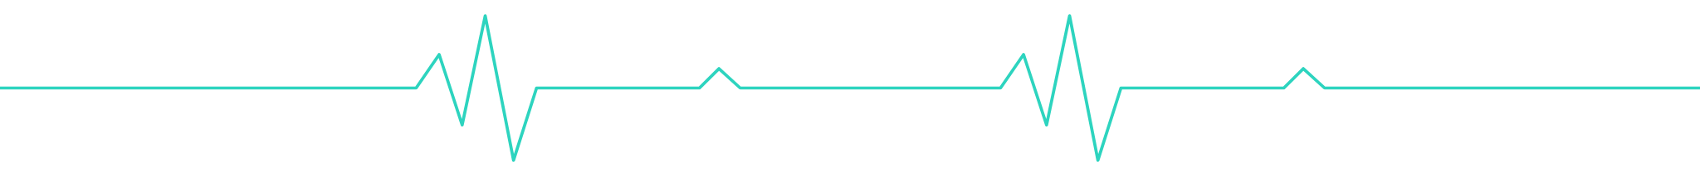





Thank You!
AarogyaTwin-X — Forecasts with evidence, not unsupported certainty.
GITHUB REPOSITORY
https://github.com/Amit-kumar-Yadav14/AarogyaTwin-X
TEAM
DEMO VIDEO
team40
https://youtu.be/3ck4XbOvc_Y
AMIT, HANSRAJ
LICENSE
ARYA COLLEGE OF ENGINEERING AND IT
MIT Open Source
“In healthcare AI, the courage to say ‘I don’t know’ is the most important feature you can build.”
Questions & Answers
Notes:
Thank you. AarogyaTwin-X forecasts with evidence, not unsupported certainty: calibrated multi-horizon forecasts, a 90% conformal band, intentional abstention when the sensor data cannot be trusted, and a bounded what-if sandbox, all evaluated on patients the model never saw. Replace the bracketed placeholders with the real GitHub username and demo video link before presenting. The project is MIT licensed. Team40: Amit and Hansraj, Arya College of Engineering and IT. Close on the line that the courage to say “I don’t know” is the most important feature in healthcare AI, then open for questions.

