Slide 1
Geocoder
Mapping Ireland.

Slide 2
What is geocoding
Provide geographical co-ordinates corresponding to a location.
Mercy Mounthawk School,
Tralee,
Kerry
52.2821, -9.7222

Slide 3
What is geocoding
Many ways to represent same address. Spell checking is hard.
HAYESTOWN LITTLE, Rathaspick, wexford.
Little Hayestown, Rathaspick, wexford.
Rd. Little Hayestown, Rathospick, wexford.
Little hayestown road, Rathaspick, wex.

Slide 4
process
Pre-Process Data
Extract relevant columns, Lower case string.
Word cloud
Count common words like North, South, etc. in townland.
It’s all about the search
A clever County and Townland search.
Latitude & longitude
Map EPSG:2157 to EPSG:4326

Slide 5
Pre-process data
Convert all data to lower string and remove special characters.
Rath-Healy, “Cork”
Dun Chaoin, Baile Bhiocaire (Vicarstown), Tralee, kerry
rath healy cork
dun chaoin baile bhiocaire vicarstown tralee kerry

Slide 6
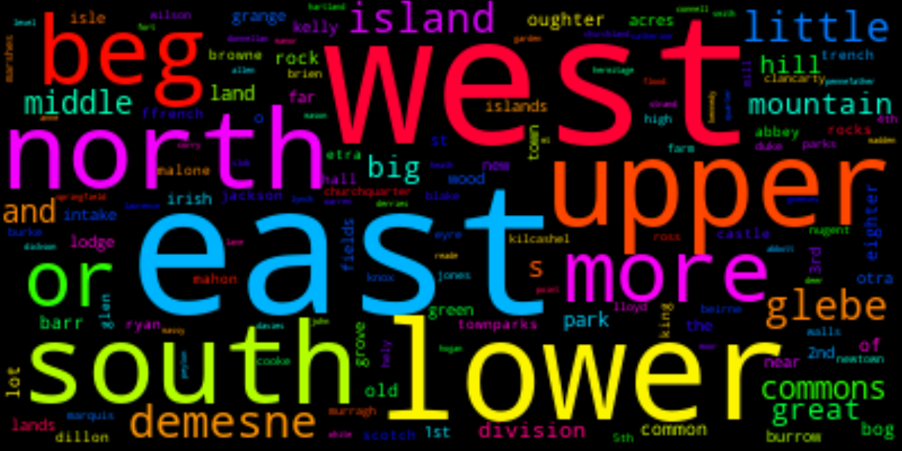
Word cloud

Slide 7
search
Search for county. Then town. Then prefix + town + suffix.
Address: Rath-Healy Road, Fermoy, cork
[‘rath’, ‘healy’, ‘road’, ‘Fermoy’, ‘cork’]

Slide 8
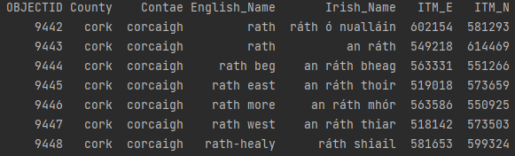
Search(2)
[‘rath’, ‘healy’, ‘road’, ‘Fermoy’, ‘cork’]

Slide 9
Search flexibility
New Address: East Rath Road, Fermoy, cork

Slide 10
Convert itm to latitude and longitude

Slide 11
advantages
Word Count catches local common words as opposed to only global ones.
Covers a lot of combinations.
Generates many search options and Prioritizes them.

Slide 12
disadvantages
Many rules. Can become error prone very quickly.
No house number support.
Uses only csv and not Spatial data.
Better spell check needed.

Slide 13
Thank you.

