Slide 1
Project title
Submitted in the partial fulfillment for the award of the degree of
BACHELOR OF ENGINEERING
IN
INFORMATION SECURITY
Submitted by:
AMIT KUMAR
20BCS3502
Under the Supervision of:
NISHU BANSAL
Department of AIT-CSE
DISCOVER . LEARN . EMPOWER

Slide 2
Outline
Introduction to Project
Problem Formulation
Objectives of the work
Methodology used
Results and Outputs
Conclusion
Future Scope
References

Slide 3
Introduction to Project
As we are all well aware of the issues people face while going for a treatment in India despite being at a prestigious position in the medical filed and during this desperate time of corona it is no doubt people are completely dependent on hospitals and clinics for treatment. So, the question arises why getting treatment from hospital and clinic near your house is so difficult here, and there are two main reasons for this besides other issues, first poor infrastructure and second one lack of concern or poor management.

Slide 4
So, by the means of this project on clinic management system we have tried our best to get rid of the problems faced in the management system in hospitals and clinic which will not only help in easing the management part for the clinic but also the patient to get quick diagnosis in case of emergency and otherwise so that more time can be spent on treatment rather than wasting it on availing the treatment.

Slide 5
Problem Formulation
In today’s era, the rush of patients in the hospital is very high, due to which it becomes very difficult for the hospital management to handle the patients. Like in the olden days, many hospitals still do their hospital work on paper, due to which they have to face many problems like storage of documents, finding the files, renewal of the staff data and many more. Therefore, it becomes difficult for the hospital to extract the old information like medical treatment history of its patients, they find it difficult to extract the file of one patient out of thousands of patients. The higher authority of the hospital finds it difficult to manage its staff data.

Slide 6
There are many difficulties faced by the management to manage the staff in manual way. Most of the hospital staff check their roster in the morning and then they lie down for their work due to which people get upset. Patients are not treated on time. To get treatment, patients have to wait in long lines and wait for their turn, which causes a lot of trouble to them. People have trouble in giving money because most of the people come to the hospital in emergency and they have cards and online payment methods instead of cash to pay the fees of hospital. There are many problems faced by the patients, staff and management in manual way.

Slide 7
Objectives
The proposed research is aimed to carry out work leading to the development of an approach for smooth and easy management of clinic and hospital data. The proposed aim will be achieved by dividing the work into following objectives:
To understand and explore various types of issues related to data management including data storage and its accessibility.
To study and analyze various data management techniques that are suitable for smoothen the process data management.
To design and develop the technique for data management for clinic and hospital by.
To enhance the process of data accessibility and storage.

Slide 8
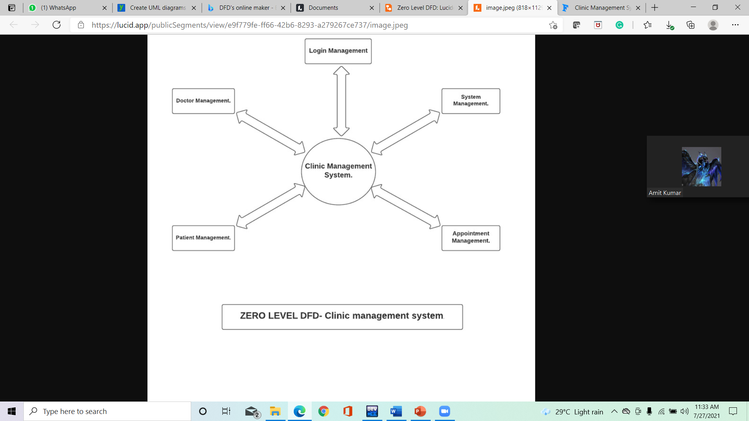
Methodology used

Slide 9
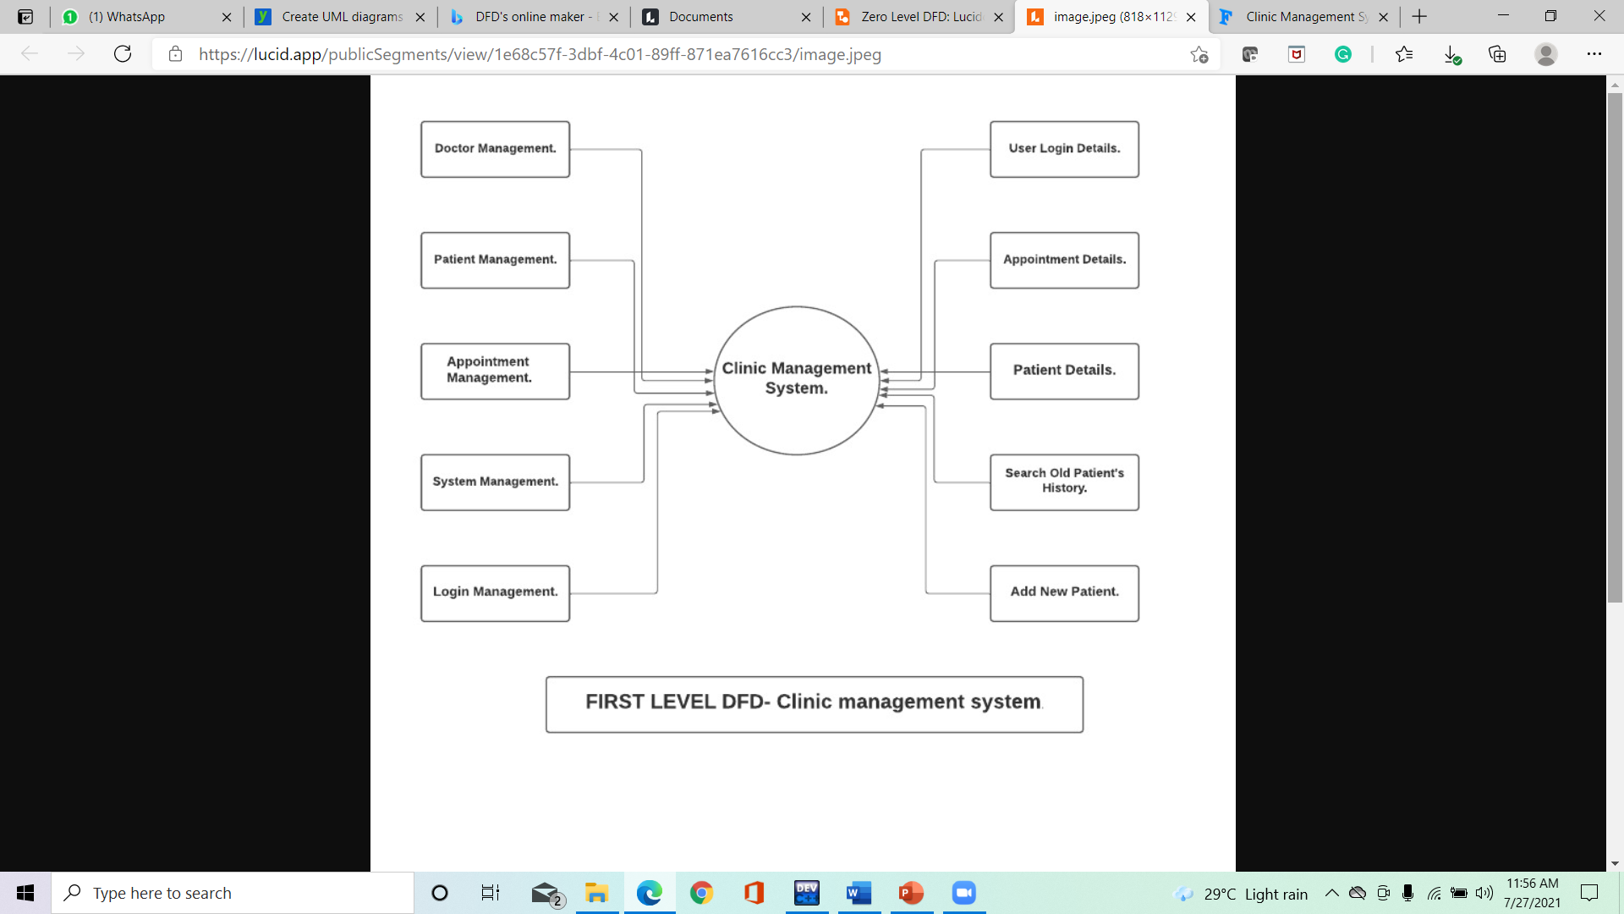

Slide 10
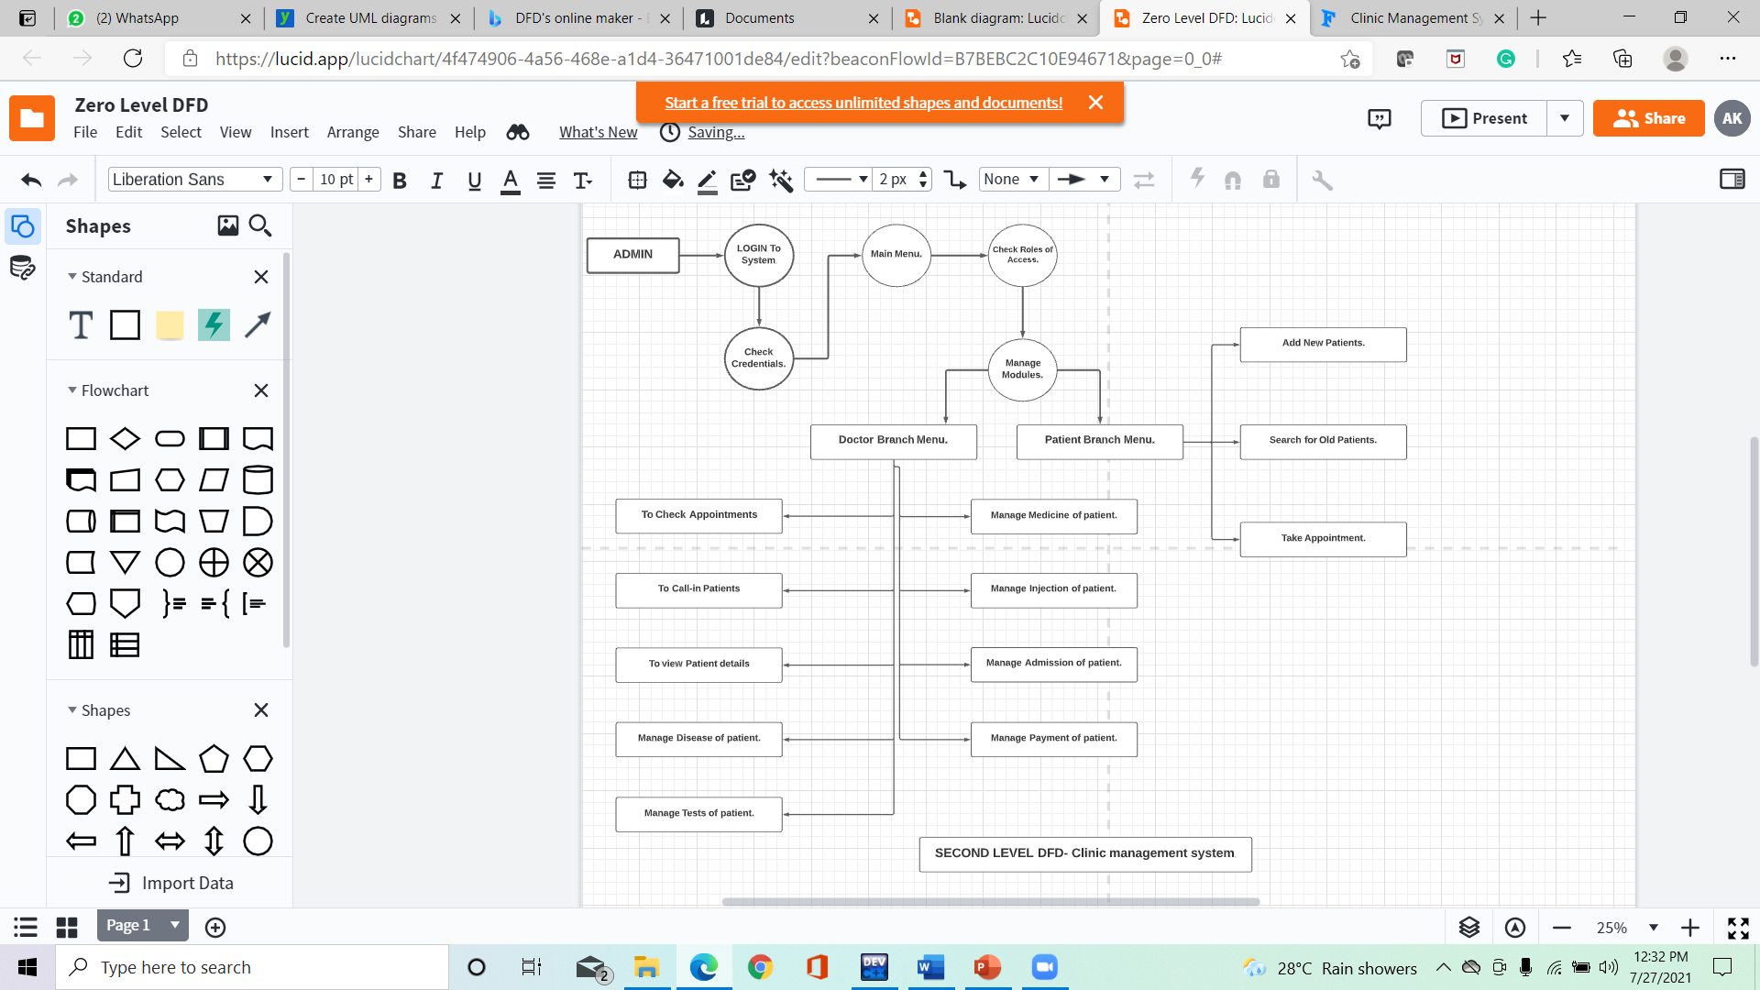

Slide 11
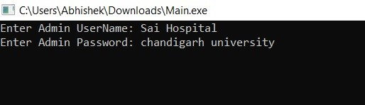
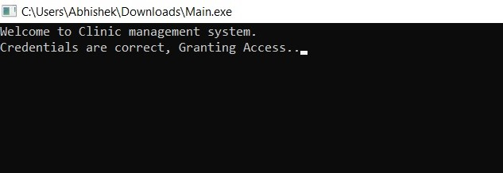
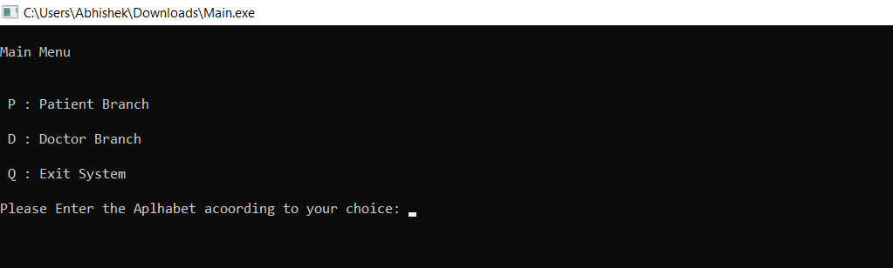
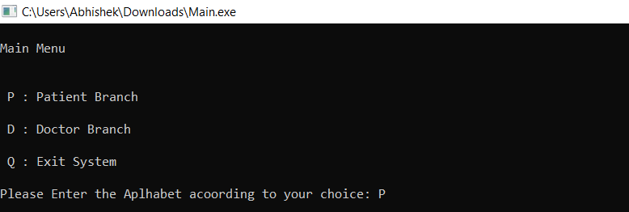
Results and Outputs
1. Login Page
2. Welcome View
3. Main Menu
4. Enter ‘P’

Slide 12
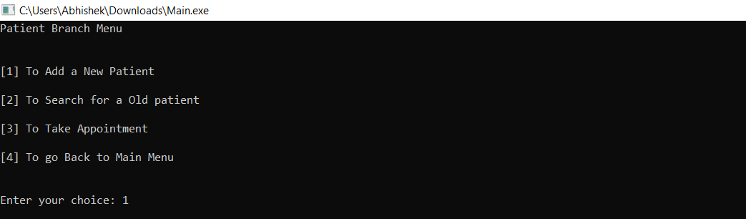
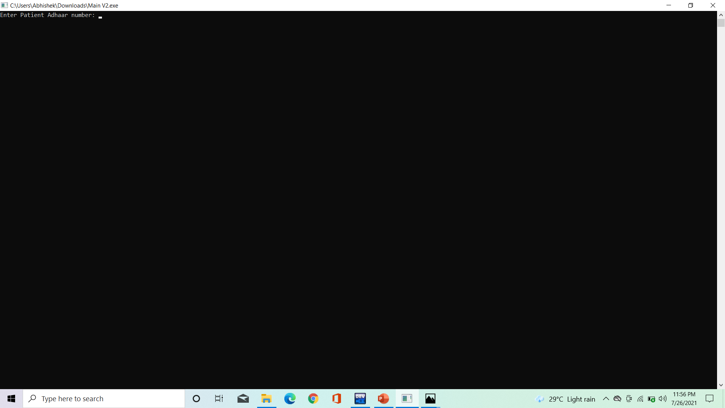
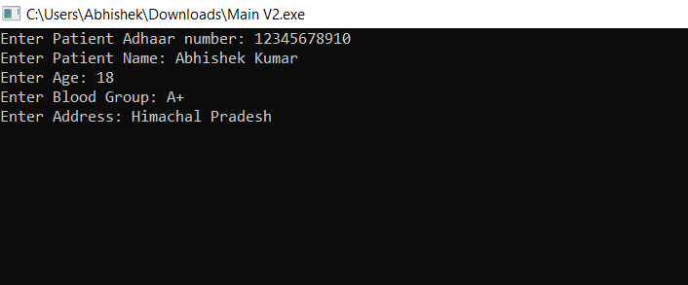
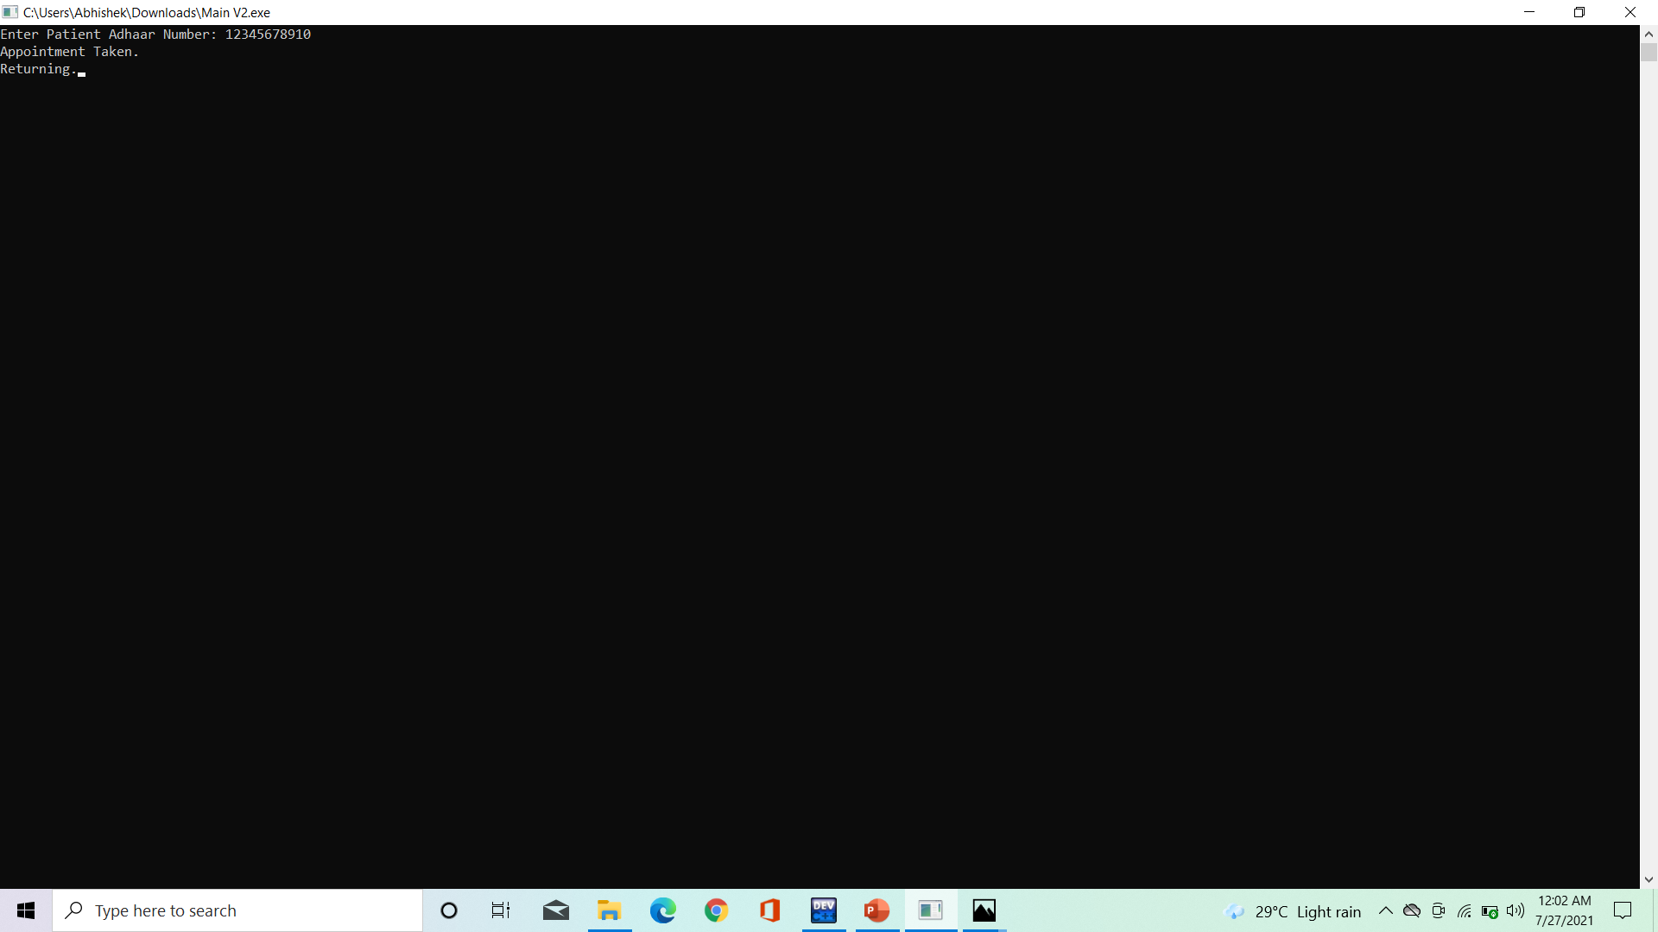
5. Patient Branch Menu.
6. Add New Patient.
7. Entering details of new patient.
8. Enter 3 to take appointment.

Slide 13
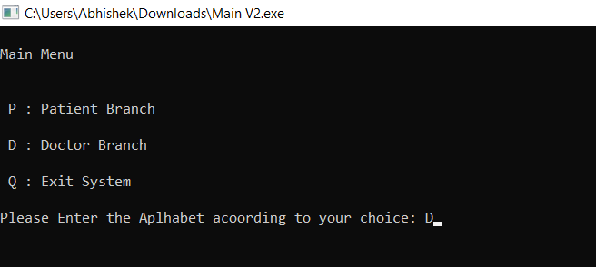
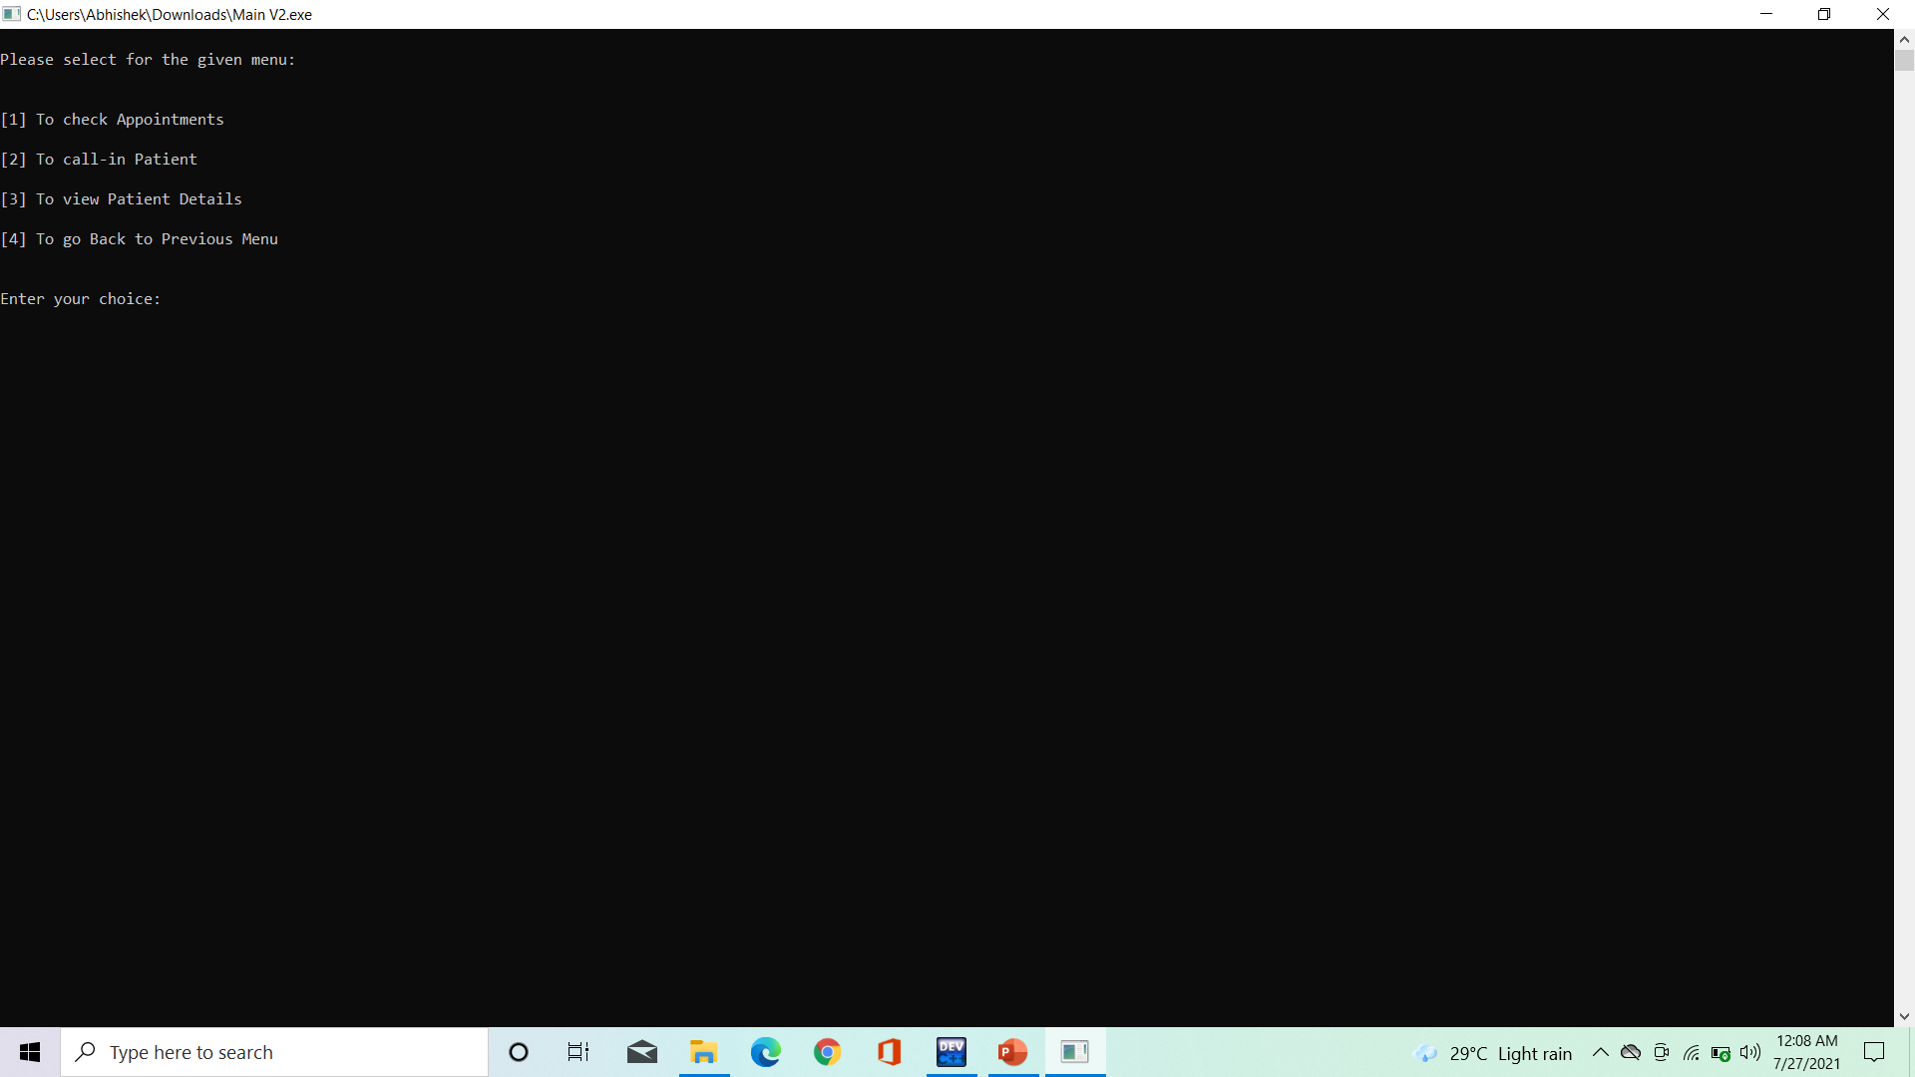

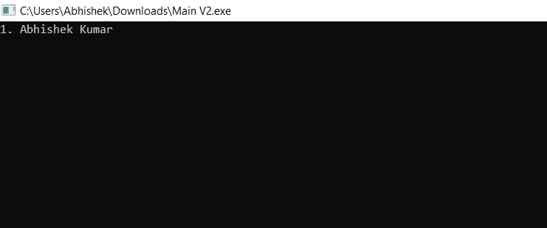
9. Enter D to view Doctor Branch.
10. Doctor Branch Menu
11. Enter 1 to check Appointment.
12. Appointments on screen

Slide 14

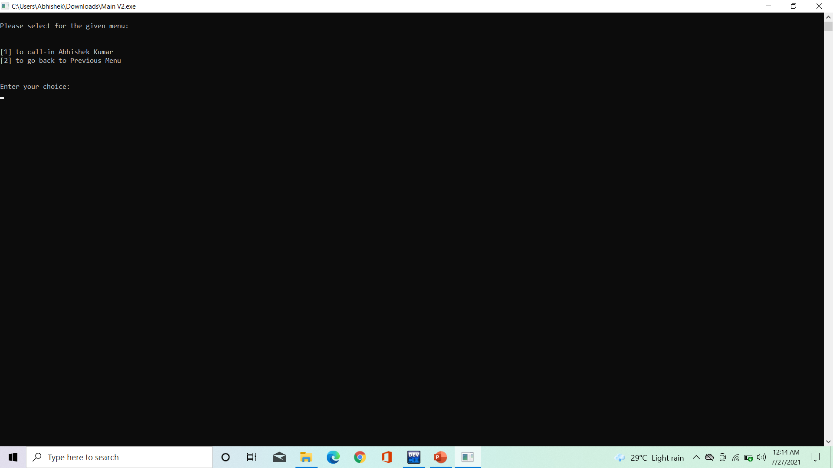
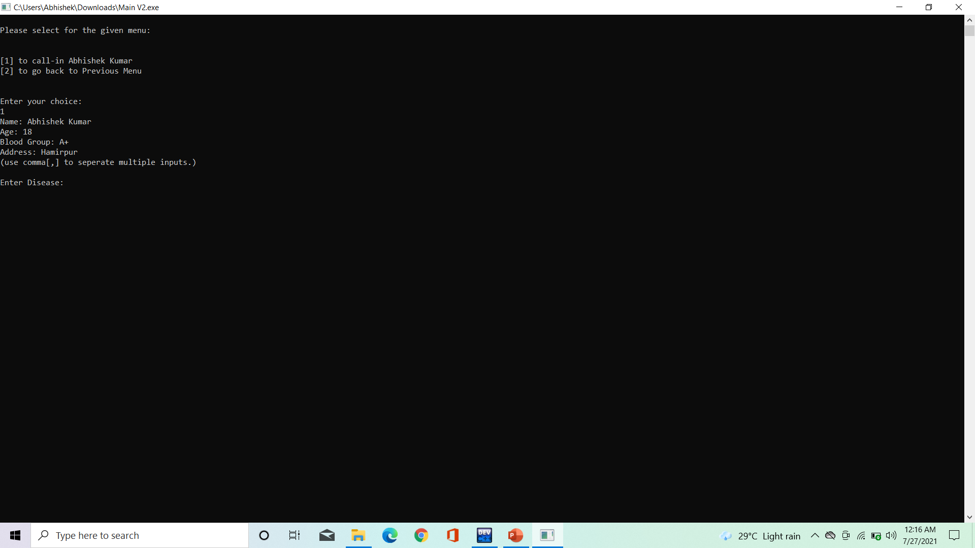
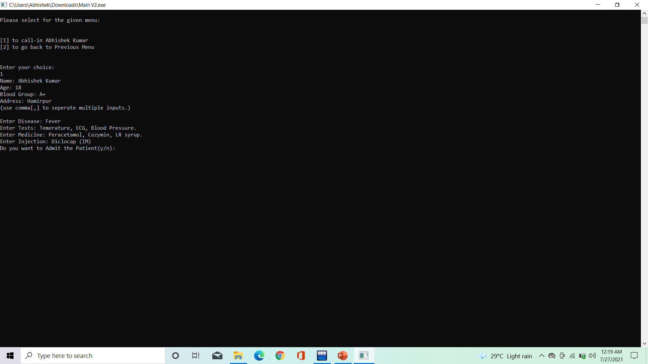
13. Enter 2 to call-in patient.
14. Enter according to preference.
15. Details which are saved reflects here.
16. Enter Patient treatment details.

Slide 15
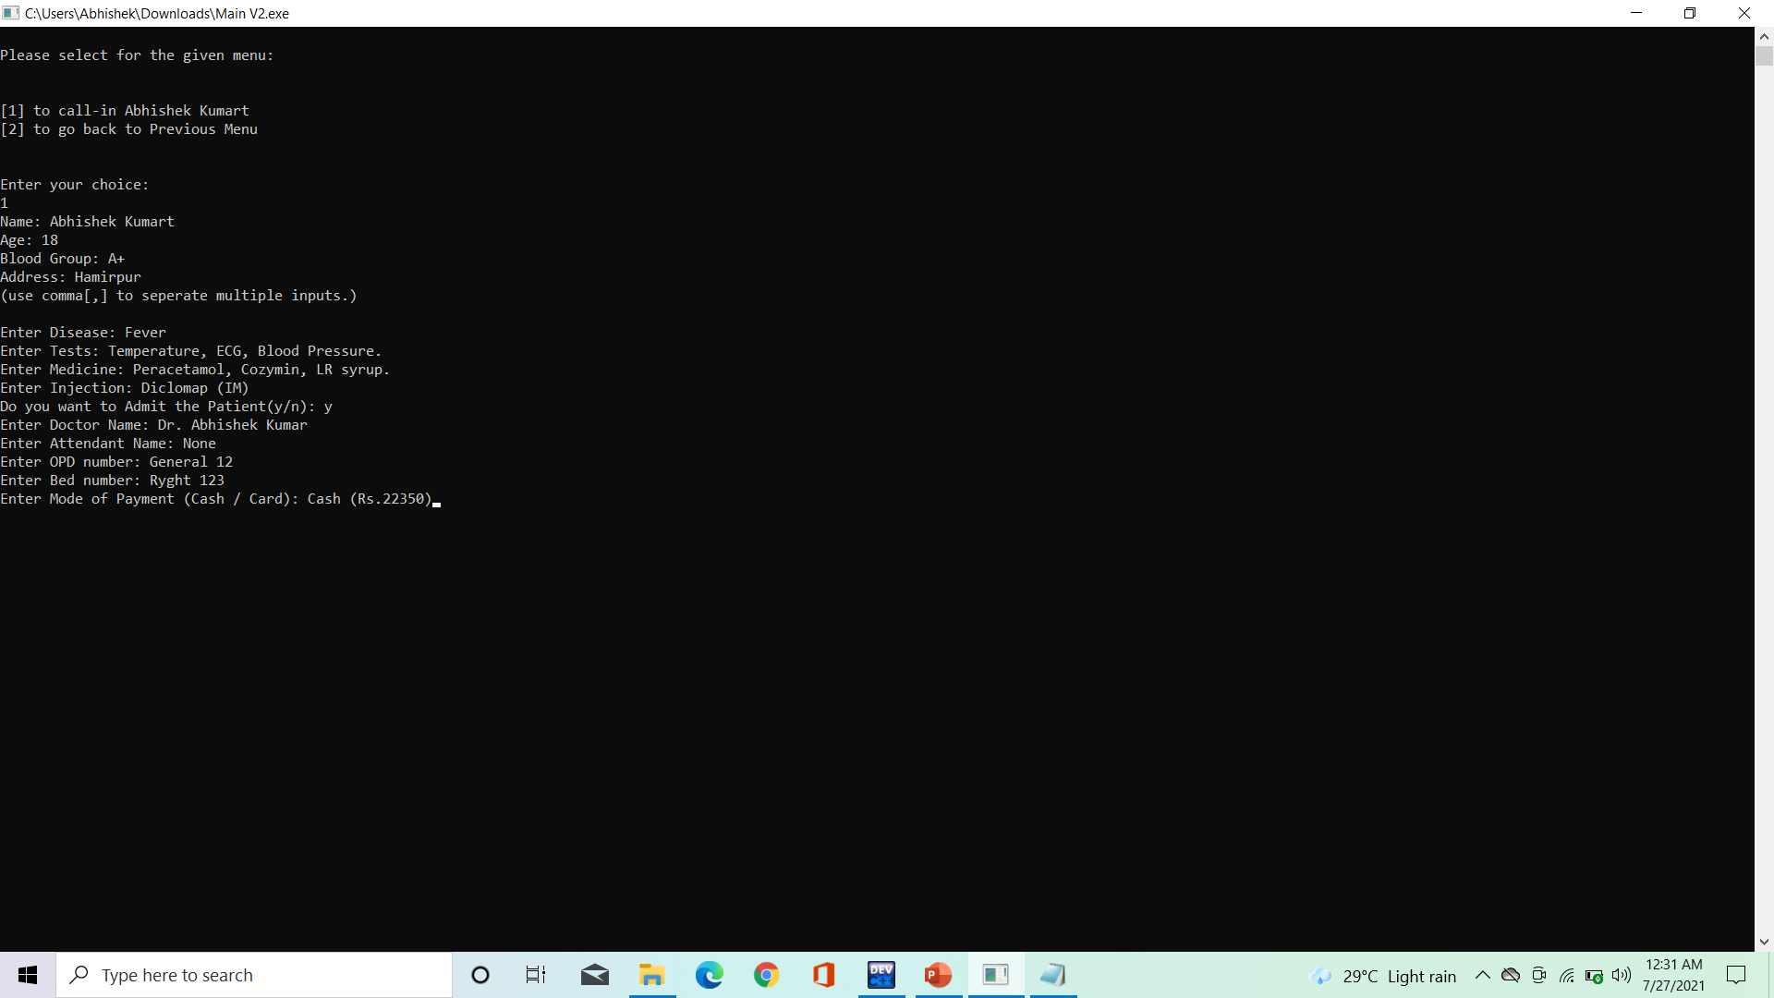
17. Admit Patient Details.

Slide 16
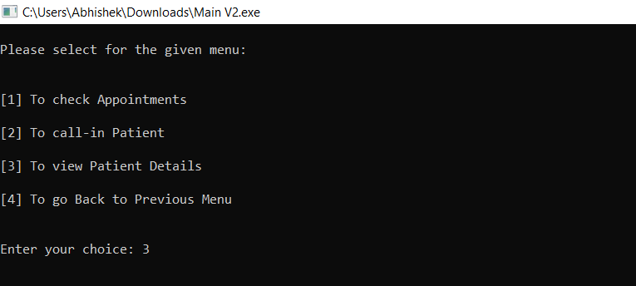
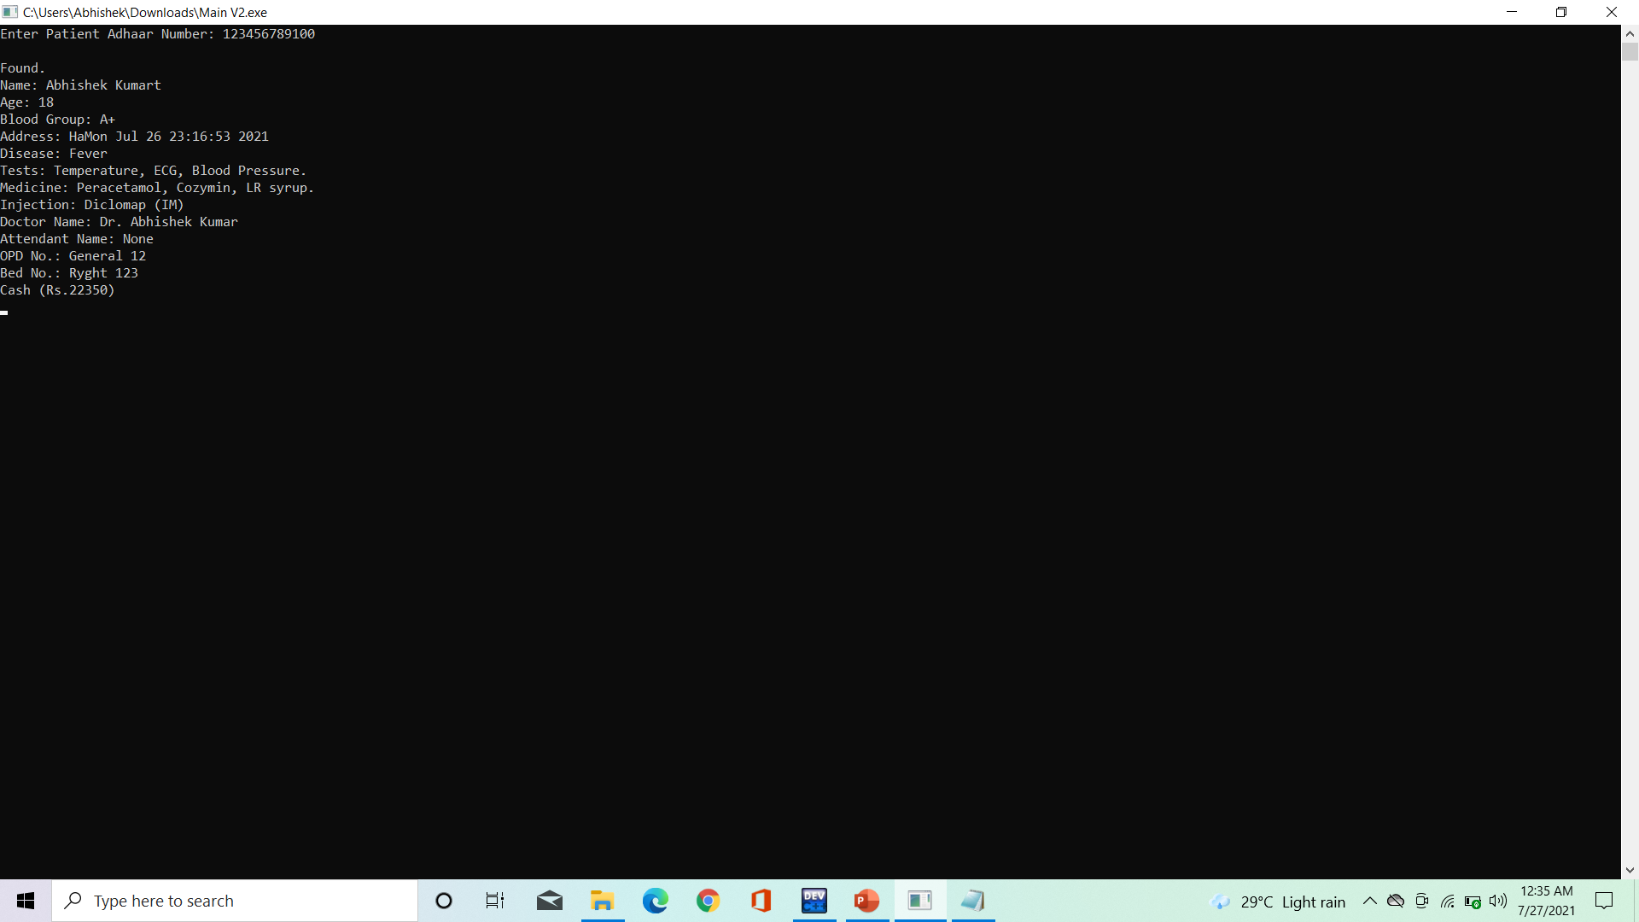
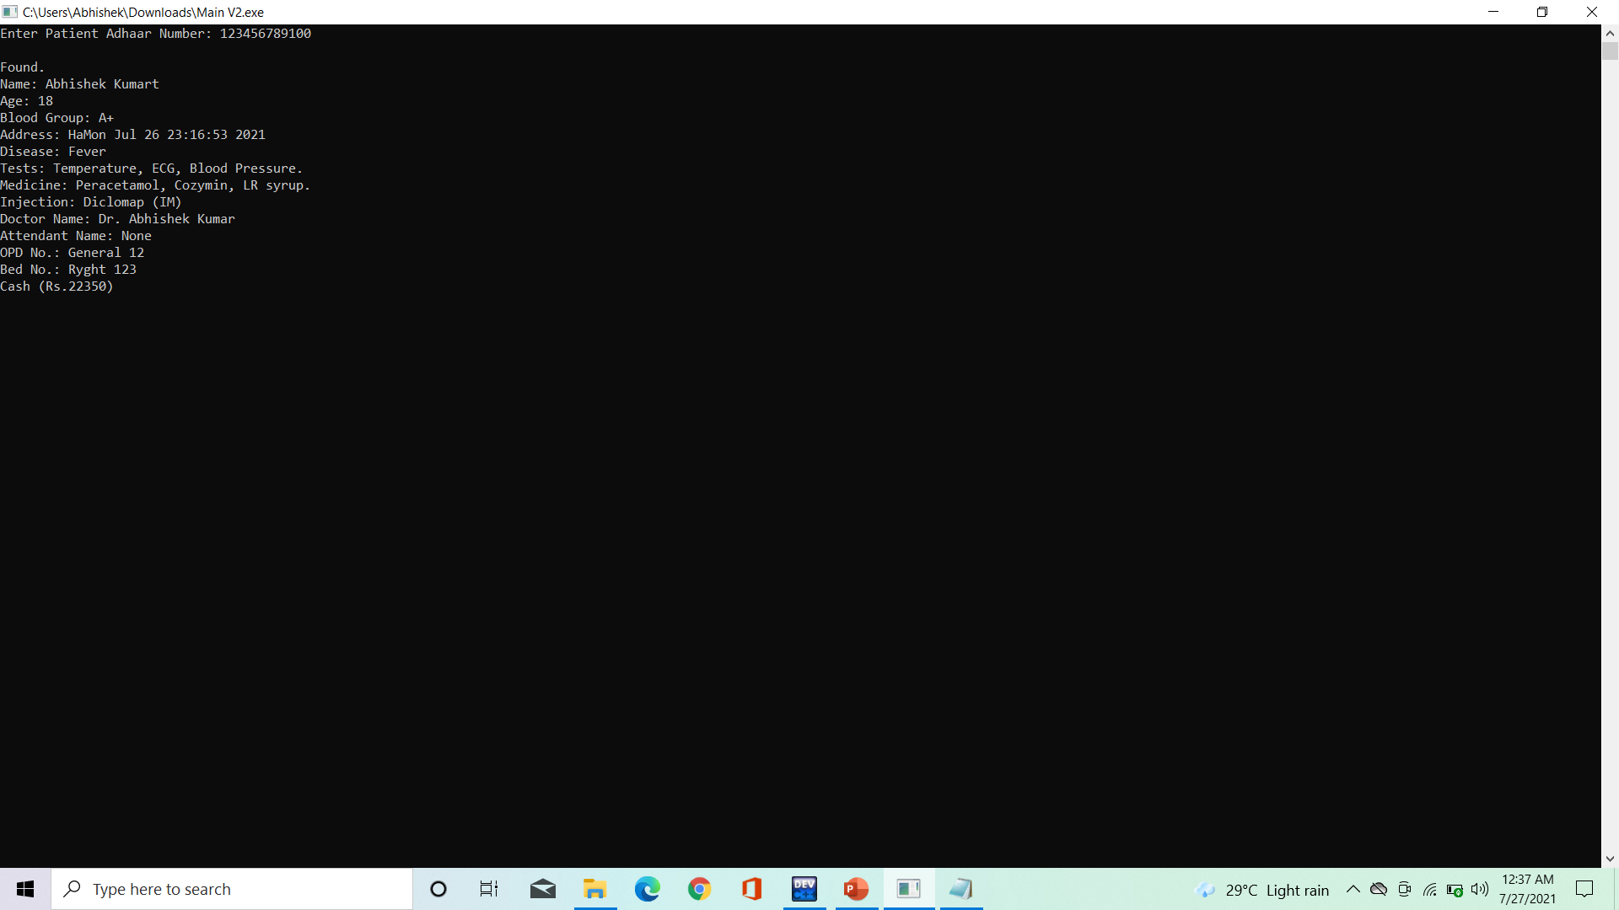

18. To view patient detail (Enter 3).
19. Enter Aadhaar to view the details.
20. Found Details.
21. Enter 4 to go back.

Slide 17

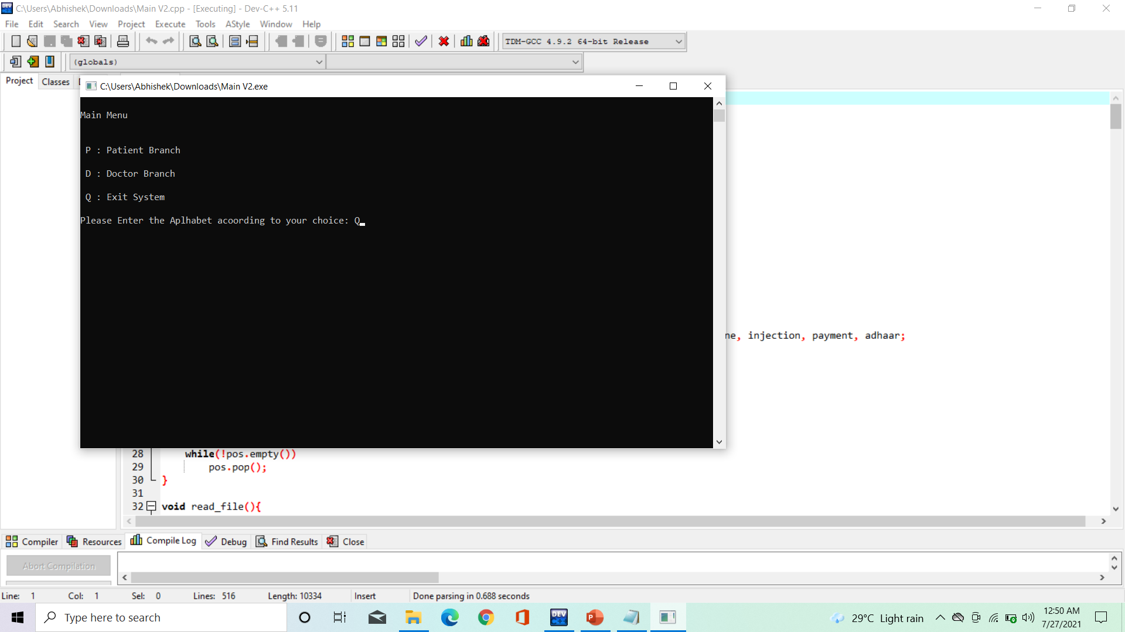
22. Enter P.
23. Enter 2 to search any detail.
24. Details of Patients.
25. Enter Q to exit system.

Slide 18

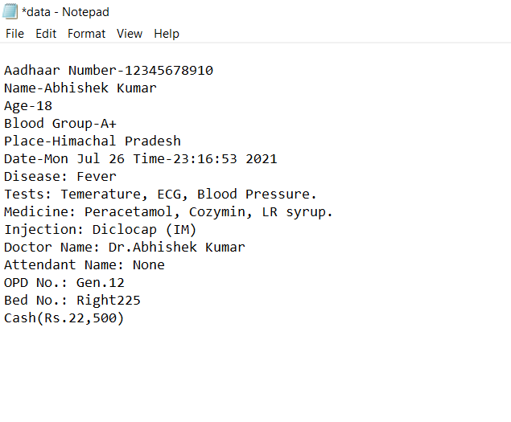
26. Welcome to Login Page.
27. Data saved as file in system.

Slide 19
Conclusion
The project Clinic Management System is for computerizing the working in a clinic or hospital. It is a great improvement over the manual system. The computerization of the system has speed up the process. In the current system, the front office managing is very slow. The clinic managing system was thoroughly checked and tested with dummy data and thus is found to be very reliable. The program takes care of all the requirements of an average clinic or hospital and is capable to provide easy and effective storage of information related to patients that come up to the clinic. It generates test reports and also provides the facility for searching the details of the patient. It also provides billing facility in cash or card on the basis of patient's status. The program also provides the facility of doctor's appointment requirement.

Slide 20
Future Scope
Our project the Clinic Management System is the most useful software. It is the solution to all the problems that we are facing in today’s era. Whether it is the problem of keeping the files in the store rooms or to search the history of the patient’s chronic disease. Today every single person in this world needs a quick solution to his problem. In earlier times patient used to stand in long queues to get their treatment done in the hospital. Now they will get rid of this long queues, they have to just fix their appointment with the doctor using our software. He will come to the doctor on the scheduled time and get his treatment done. By this patients will not cause much congestion in the hospital. In our software, the staff will not have to go through old files to extract patient information. They just have to search the Aadhaar Number of patient and get their whole information.

Slide 21
References
Vectors:- https://www.youtube.com/watch?v=wKDvMcJiEPM&ab_channel=CodeWithHarry
Vectors:- https://www.cplusplus.com/reference/vector/vector/?kw=vector
fstream:- C++ fstream | How fstream work in C++ | Examples | Advantages (educba.com)
iostream:- C++ Library - <iostream> - Tutorialspoint
Stack:- Stack in C++ STL with Example (guru99.com)
File Handling:- File Handling in C++ (tutorialride.com)
Queue:- C++ Queue – javatpoint
Conio.h:- Everything about conio.h library functions in C/C++ · Tech Support Whale

