Slide 1

FINAL REVEIW
DESIGN AND DEVELOPMENT OF AUTOMATIC COLOUR SORTING MACHINE FOR CASHEW
Under the Guidance of Prof. MONALI SURYAWANSHI
Group Number :- 50
Student Name(PRN) (Seat No):-
Pawar A. D. (71924303D ) (B150080952) Wadme R. G. (71924320D) (B150081020) Magar S. P. (71702139E) (B150080910) More V. K. (71924293C) (B150080925)

Slide 2
CONTENT
Introduction
Problem Statement & Objective
Literature review
Methodology
Proposed view design
Isometric view of model and Drafting
Simulation
Component, Specification & Calculation
Power Consumption
Future Scope & Expected Key Outcomes
Advantages, Application & References

Slide 3
INTRODUCTION
Machines can perform highly repetitive tasks better than humans. Worker fatigue on assembly lines can result in reduced performance, and cause challenges in maintaining product quality. An employee who has been performing an inspection task over and over again may eventually fail to recognize the color of product. Automating many of the tasks in the industries may help to improve the efficiency of manufacturing system.
The purpose of this model is to design and implement a system which automatically separates products based on their color.

Slide 4
PROBLEM STATEMENT
To Study the concept of Automatic sensor machine.
To Design and develop Automatic color sorting machine for cashew.

Slide 5
OBJECTIVE
To design and develop semi-automated colour sorting machine for cashew which will help the food industry in sorting out the materials effectively.

Slide 6
LITERATURE REVIEW
Sr. No | Name of Authors | Name of paper | Journal | Reamrk
1 | Mostafa KhojastehnazhandMahmoud Omid | Development of a lemon sorting system based on color and size | African Journal of Plant Science Vol. 4(4) | In this paper, author represented a novel approach for development of a sorting system for grading lemon based on color and size.
2 | Ch.Shravani, G. Indira, V. Appalaraju | Arduino Based Color Sorting Machine using TCS3200 Color Sensor | International Journal of Innovative Technology and Exploring Engineering (IJITEE) | In this paper, author explained working of sorting machine with the help of tcs 3200 color sensor which detects the color of material and seperates it into good or bad slot.

Slide 7
Sr. No | Name of Authors | Name of paper | Journal | Reamrk
3 | S. V. Rautu, A. P. Shinde, N. R. Darda,A. V.Vaghule, C. B.Meshram, S.S.Sarawade | Sorting of Objects Based on Color, Weight and Type on A Conveyor Line Using PLC | IOSR Journal of Mechanical and Civil Engineering (IOSR-JMCE) | In this paper, authors explains about system which would increase the production rate and accuracy of material handling systems with the use of PLC.
4 | Sanjay Prakash Dabade | Automatic Sorting Machine Using Conveyor Belt | International Journal of Innovative and Emerging Research in Engineering | In this paper, author studies main task of sorting components according to the sizes which consist of conveyor belt, which reduces the efforts of material handling.

Slide 8
METHODOLOGY
Literature review
Identification of the problem
Finding solution of the problem
Data collection
Design of product
Market survey for required components
Purchase of required components system
Manufacturing and assembly
Testing and experimentation

Slide 9
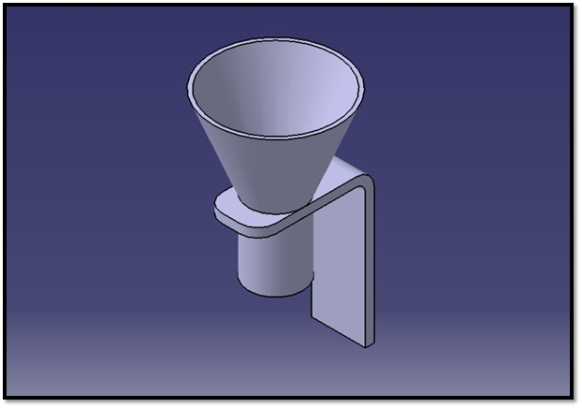
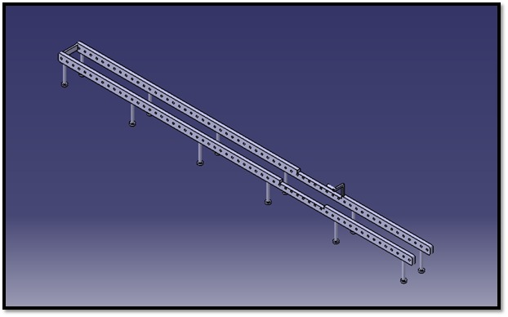
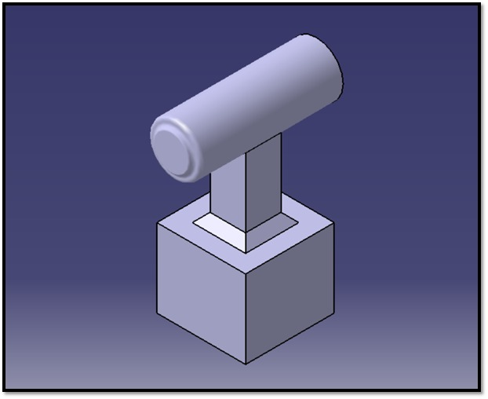
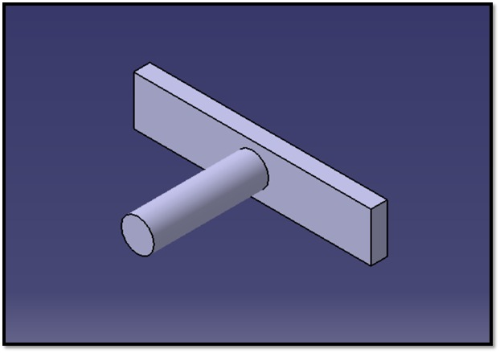
PROPOSED DESIGN VIEW
Hoper
Base
Piston Base
Piston Rod

Slide 10
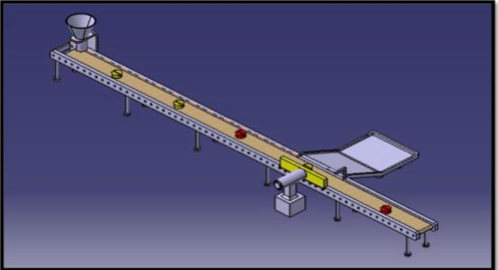
ISOMETRIC VEIW OF MODEL

Slide 11
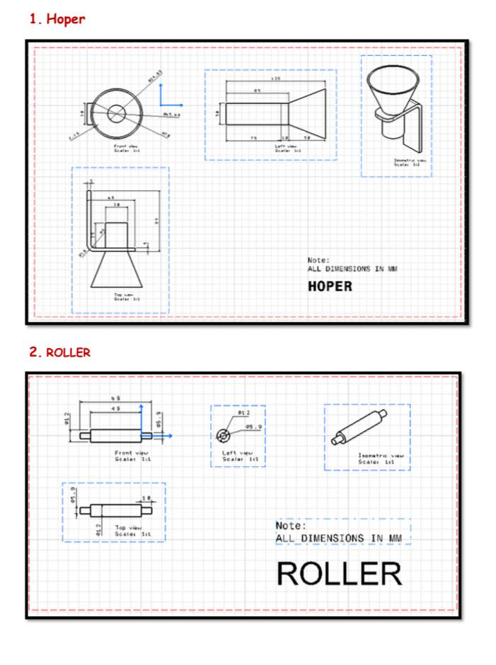
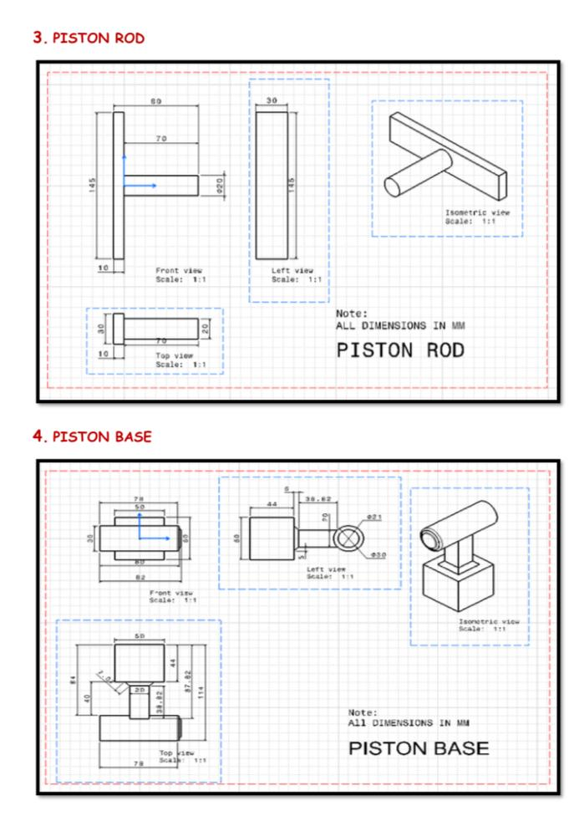
Drafting Model

Slide 12
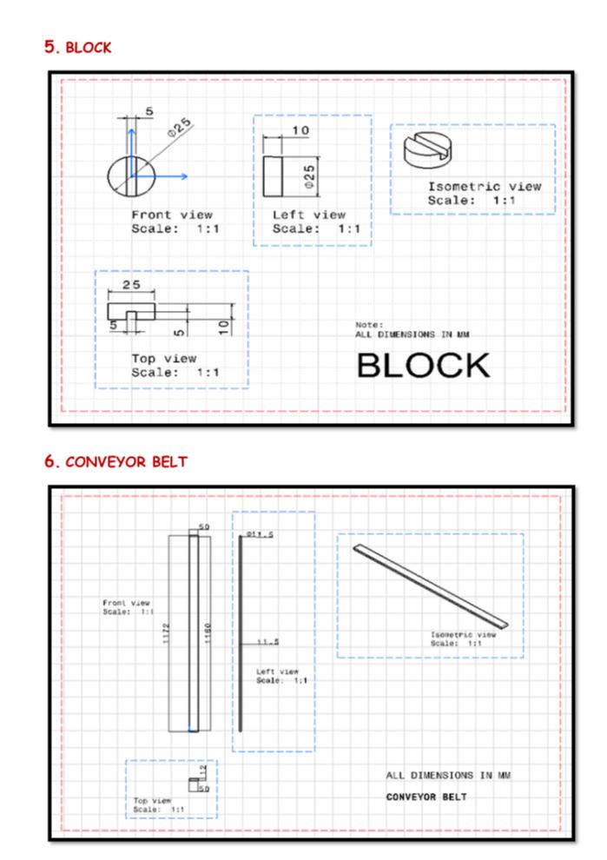
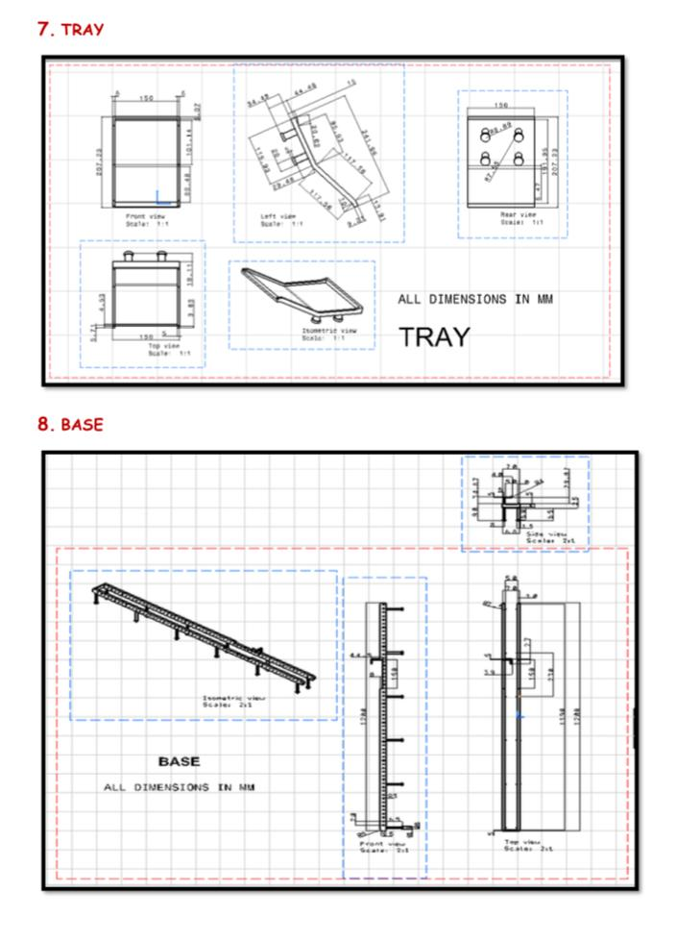

Slide 13
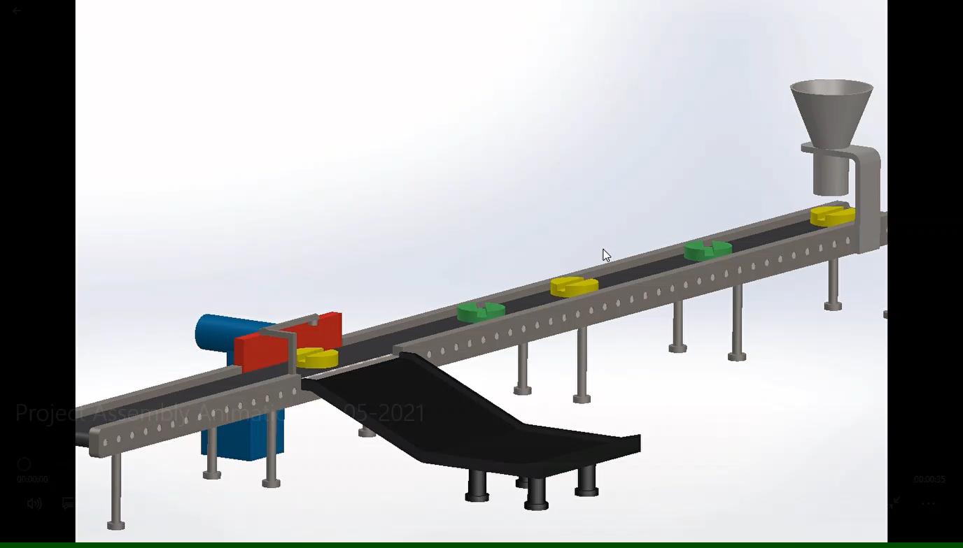
SIMULATION

Slide 14
COMPONENTS, SPECIFICATION & CALCULATION
1) Arduino mega
.
Microcontroller | ATmega1280
Operating Voltage | 5V
Input Voltage (recommended) | 7-12V
Input Voltage (limits) | 6-20V
Digital I/O Pins | 54 (of which 15 provide PWM output)
Analog Input Pins | 16
DC Current per I/O Pin | 40 mA
DC Current for 3.3V Pin | 50 mA
Flash Memory | 128 KB of which 4 KB used by bootloader
SRAM | 8 KB
EEPROM | 4 KB
Clock Speed | 16 MHz

Slide 15
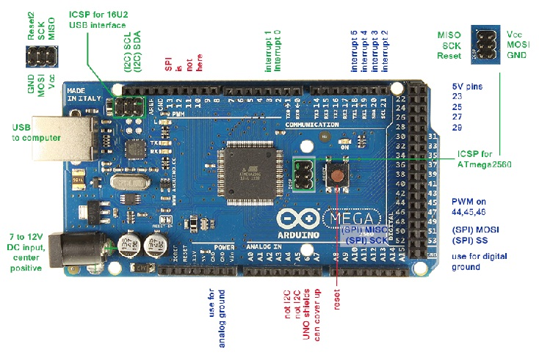

Slide 16
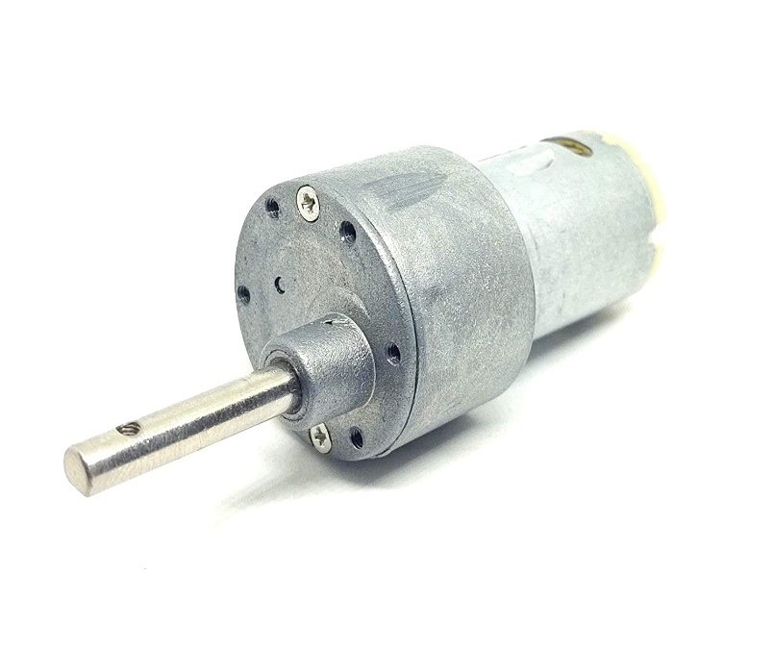
2) GEAR MOTOR
Package Include - 1 x DC Motor
Voltage: 6V to 18V
It has RPM: 30
Torque Range: 10 - 15 Kg-cm
Metal Gear

Slide 17
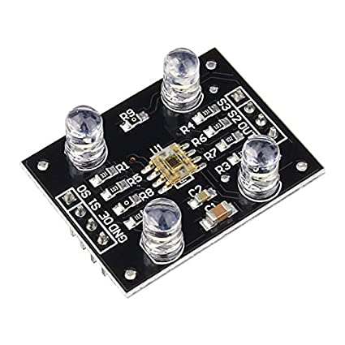
3) SENSOR (Colour Sensor TCS320)
Power: DC 3 to 5.5V
Size: 31.6 (mm) x24.4
Interface: Digital TTL
High Resolution conversion of light Intensity To Frequency
Programmable Colour and Full-Scale Output frequency
Communicate Directly to microcontroller

Slide 18
The module requires only a single supply voltage between 2.7V and 5.5V – making it compatible with nearly all common microcontrollers, including PICs, AVRs, ARM, Arduino and more!
Header one on the left side of the board
S0: Output frequency scaling selection input (along with S1)
S1: Output frequency scaling selection input (along with S0)
OE: Output Enable – if held low, the output of the module is turned on
GND: Ground – connect to 0V
Header two on the right side of the board
S3: Photodiode type (along with S2)
S2: Photodiode type (along with S3)
OUT: Output – A square wave appears here showing the intensity of the detected colour
VCC: Power – connect to 2.7V-5.5V

Slide 19
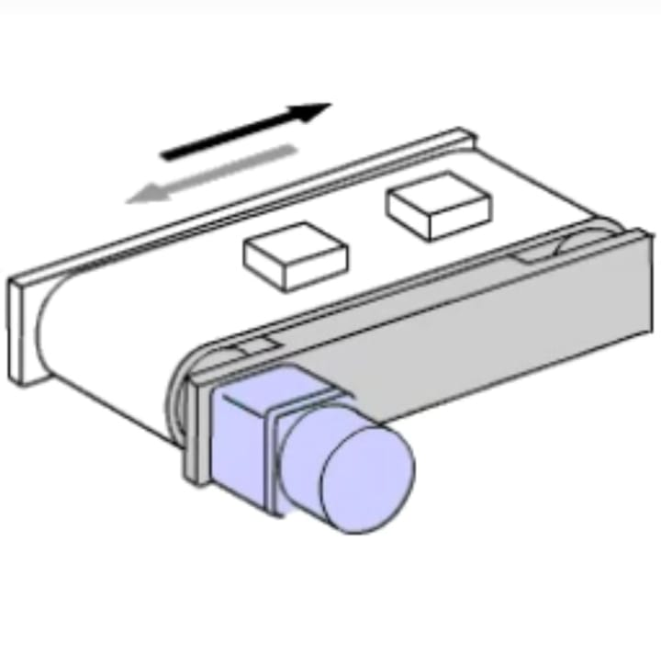
4) CONVEYOR
MODEL | Requirement
Direction of movement | Left to Right
Speed | 12 Mtr/Min. Up to 12 feet
Power supply | 50 Hz upto 12 feet long
Belt width | 9 to 12 inch as per requirement
Belt Details | Thickness 2 to 4 mm
Belt material | PVC, endless 2ply sandwich

Slide 20
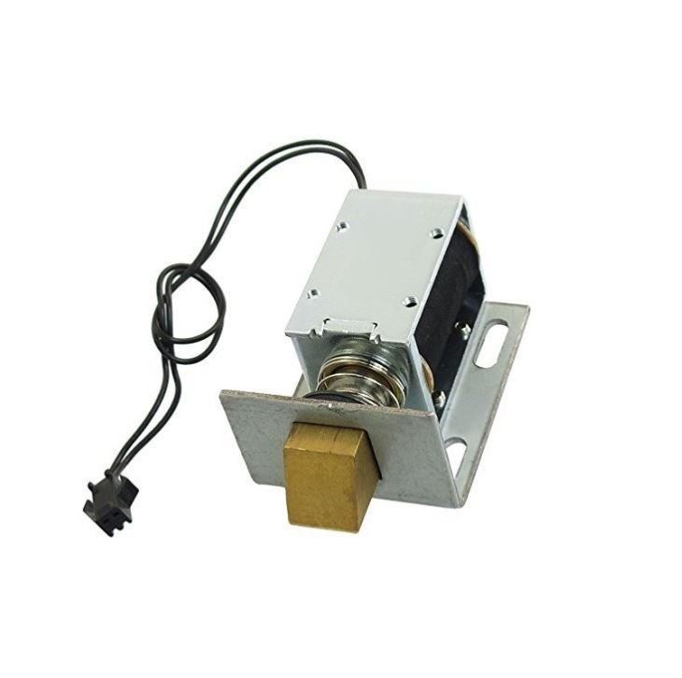
5) SOLENOID ACTUATOR
Model | 1240-12V 1kg
Rated Operating Voltage (VDC) | 12
Stroke | 20 mm
Holding Force (N) | 15
Cable Length (cm) | 20
Operation Mode | Normally Closed
Dimensions (mm) LxWxH | 42 x 55 x 32
Weight(gm) | 210

Slide 21
6)RELAY MODULE
Vcc Pin : As its name suggests, it is a 5V relay. That means it requires 5V DC to operate. Hence, connect the 5v DC power supply to this pin.
Ground Pin : Connect it with the ground terminal of 5V power supply. Furthermore, if you are driving a relay module with a microcontroller, also connect this pin with the ground terminal of the microcontroller.
Common Pin: This terminal is connected with the load that we want to switch with the relay module.

Slide 22
NC Pin : As the name of the normally close terminal suggests, it is normally connected with the COM pin and forms a closed circuit. But this normally closed connection breaks when the relay is activated by applying an active high or active low signal to the signal pin of the relay module from a microcontroller.
NO Pin: This pin is normally open unless we apply an activation signal to the signal pin of the 5V single channel relay module. In this case, the COM pin breaks its connection with the NC pin and makes a connection with the NO pin.

Slide 23
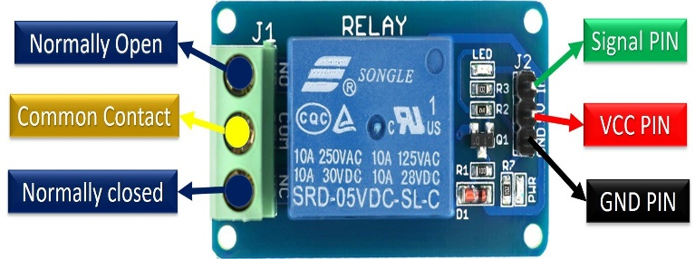

Slide 24
CALCULATION
Velocity Ratio
Diameter of Driving Pulley (D1) = 12mm
Diameter of Driven Pulley (D2) = 12mm
Thickness of belt (t) = 4mm
Rotational speed of Driving Pulley (N1) = 30 RPM
Rotational speed of Driven Pulley (N2) = 22 RPM
Velocity Ratio (VR) = N2/N1 = D1+t/D2+t
22/30 = 12+4/12+4
Velocity Ratio = 0.73

Slide 25
Linear Velocity
Linear velocity of Driving pulley
Diameter of Driving Pulley (D1) = 12mm
Rotational speed of Driving Pulley (N1) = 30 RPM
Linear velocity (V1) = πD1N1/60
= π * 0.012 * 30 / 60
V1 = 0.018 m/s

Slide 26
Linear velocity of Driven pulley
Diameter of Driving Pulley (D2) = 12mm
Rotational speed of Driving Pulley (N2) = 22 RPM
Linear velocity (V1) = πD2N2/60
= π * 0.012 * 22 / 60
V1 = 0.013 m/s
Slip
Slip = Linear velocity of Driving pulley - Linear velocity of Driven pulley
= 0.018 – 0.013
Slip = 0.005

Slide 27
POWER CONSUMPTION
TOTAL POWER REQUIRMENT
Arduino Wattage 0.27 watts
Tcs colour sensor Wattage 0.3w
Relay Wattage 0.35w
Motor Wattage 90w
Solonide Wattage 05w
Total Power Consumption is upto 100W

Slide 28
FUTURE SCOPE
The microcontroller can be replaced with PLC.
We can also add a counter for counting the number of products .

Slide 29
EXPECTED KEY OUTCOMES
Obtaining a machine which sorts the application
Saves time of industry
Saves labour cost
Improves accuracy of sorting hence results in more production.

Slide 30
ADVANTAGES
Reduce labour by automation.
Less time required to sort the product.
As the whole system is performed by machine there is less possibility of mistake.

Slide 31
APPLICATION
Food industry.
Agricultural products scaling and grading.

Slide 32
CONCLUSION
The automatic sorting machine using conveyor belt is basically useful for sorting the products in the industry specifically large scale industries where mass production is carried out. The machine also reduces the efforts of the workers by reducing the time spent for material handling. The application area of this machine is very wide in industries where automation is built.

Slide 33
REFERENCES
[1] Jyotsna U Bailoor, Mathias Christen Sunny, Karthik R Anchan, Melston Joyel Tauro, Mr. Ganesh Shetty, “Cashew Nuts sorting”.
[2] Aseem Bhope, Nikita Deshmukh, Upendra Sai, Ms. Mousami Vanjale,“cashew Nuts Sorting”, International Engineering Research Journal (IERJ), Special Issue Page 101-104, 2020 ISSN 2395- 1621 [2020]
[3] Mostafa Khojastehnazhand Mahmoud Omid, “Development of a lemon sorting system based on color and size”, African Journal of Plant Science Vol. 4(4)

Slide 34
[4] S. V. Rautu, A. P. Shinde, N. R. Darda,A. V.Vaghule, C. B.Meshram, S.S.Sarawade,” Sorting of Objects Based on Colour, Weight and Type on A Conveyor Line Using PLC”, IOSR Journal of Mechanical and Civil Engineering (IOSR-JMCE)
[5] Sanjay Prakash Dabade,” Automatic Sorting Machine Using Conveyor Belt”, International Journal of Innovative and Emerging Research in Engineering.
[6] Chandra Sekhar Nandi, Bipan Tudu, and Chiranjib Koley, Member, IEEE, “A Machine Vision-Based Maturity Prediction System for Sorting of Harvested Mangoes”, IEEE transactionson instrumentation and measurement, vol. 63, no. 7, july 2014.
[7] Y V Aruna, 2015. “Automatic convey or System with InProcess Sorting Mechanism” International Journal of Engineering Research and Applications, ISSN: 2248- 9622, vol. 5, Issue 11.

Slide 35
[8] Yeow Khang Yung, 2011. ‟Color Sorting System with Robot Arm‟‟ Faculty of Electronic and Computer Engineering University Technical Malaysia Melaka.
[9] Samesh Habib, Akira Okada and Sho Ichii,“Effect of cutting direction on machining of carbon fibre reinforced plastic by electrical discharge machining process”, Int. J. machining and machinability of materials, Vol.13, No.4, 2013, pp 414-427.

Slide 36
THANK YOU

