Slide 1
Course : Applied Computational Fluid Dynamics – ME615
Problem: The external flow problem of flow past a 2-D body using OpenFoam.
Shape : Thin plate (or rectangular) with plate oriented at perpendicular to the flow.
Aim:
Model description with the governing differential equations and boundary conditions.
Instructing the user step-by-step about preparation of geometry and mesh in Gmsh.
Discuss the solver options chosen and the reasons for the choice.
Result :
Grid independence analysis and the choice of final mesh size.
Flow streamlines and vectors with an analysis of flow behavior in key regions.
Effect of Reynolds number on coefficients of lift and drag and on the frequency of vortex shedding.
1

Slide 2
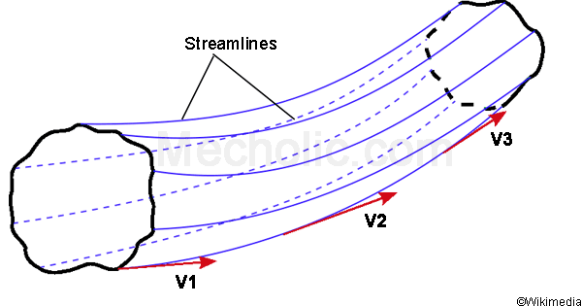
Flow Streamlines:
Flow streamlines represent the path that a fluid particle follows in steady-state flow. Each streamline is tangent to the velocity vector at every point along its path. Streamlines help visualize the direction of fluid flow and identify patterns within the flow field.
Key Characteristics:
Streamlines never intersect.
Closer streamlines indicate higher flow velocity.
Diverging or converging streamlines indicate changes in flow velocity.

Slide 3
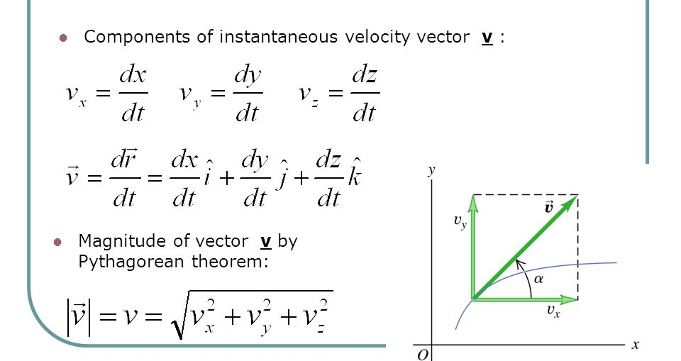
Velocity Vectors:
Velocity vectors represent the magnitude and direction of the fluid velocity at a specific point in the flow field. These vectors can be plotted at different locations to create a vector field, providing a comprehensive view of the flow behavior.
Key Characteristics:
The length of the vector represents velocity magnitude.
The vector direction indicates the flow direction at that point.
Vectors can be used to calculate local acceleration and streamline curvature.

Slide 4
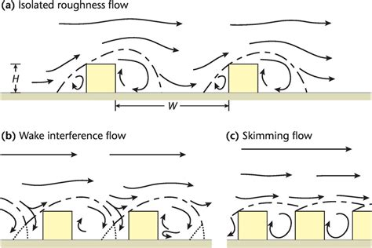
Analysis of Flow Behavior in Key Regions:
Constriction/Contraction:
Streamlines and vectors converge in regions of constriction.
Velocity increases due to reduced cross-sectional area.
High-velocity jets and potential turbulence may occur.
Expansion/Divergence:
Streamlines and vectors diverge in regions of expansion.
Velocity decreases due to an increased cross-sectional area.
Lower pressure zones and potential vortex formation may occur.
Boundary Layers:
Near solid surfaces, boundary layers develop.
Streamlines parallel to the surface in a laminar flow.
Turbulence may disrupt the regular pattern in turbulent flows.
Vortex Formation:
Circular streamlines or vectors indicate vortex formation.
Vortices can enhance mixing or induce undesirable effects.
Understanding vortex behavior is crucial in various applications.
Obstacles and Wake:
Flow separation occurs behind obstacles.
Wake regions exhibit slower velocities and turbulent flow.
Understanding wakes is crucial in aerodynamics and hydrodynamics.

Slide 5
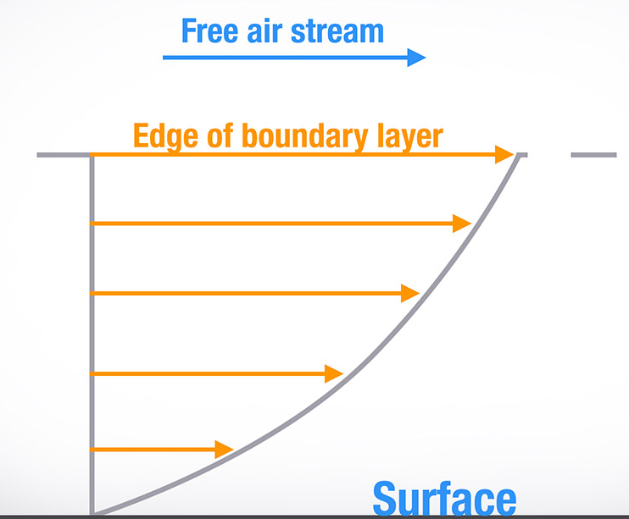
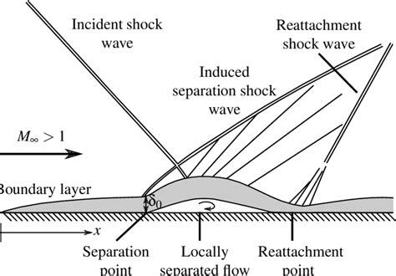
6. Transitions:
Transition from laminar to turbulent flow affects behavior.
Sudden changes in velocity or direction impact flow stability.
Boundary layer transitions influence heat and mass transfer.
7. Shock Waves:
In compressible flows, shock waves form at high velocities.
Shock waves indicate abrupt changes in flow properties.
Understanding shock behavior is vital in aerodynamics and propulsion

Slide 6
Workflow
Basics of Problem
Geometry BCs and
Solver setting Run solver
Post-processing

Slide 7
Geometry & mesh creation using Gmsh
Gmsh is an open-source software Geometry: first create a rectangular domain 10x10;
Thin plate at (2,5) Add points [(2,3), (2,7), (2.25,7) and (2.25,3) make lines, create plane surface, extrude
Demonstrate the use of ‘Edit script’ and ‘Reload script’ options by changing dimensions using it Mesh 1D then 2D
Refine mesh around plate using Mesh-Define-Size at points to change mesh size for points around plate / change the characteristic length for points making the plate in .geo file directly.
Add physical surfaces with names for boundaries Add Physical Volume Generate 1D, 2D, 3D mesh and save in version 2 ASCII format (which is readable by gmsh To Foam).
Discuss project files
Run check Mesh to check mesh quality

Slide 8
More meshing & Specifying Boundary Cond’s
Copy ‘cavity’ folder structure in a new place, take physical Properties file out and delete constant folder
Move .msh file into cavity folder and run gmshToFoam to generate mesh in OpenFOAM format
Constant folder should be generated again with mesh details. Move physical Properties file back into the constant folder
Edit boundary file: Top and bottom type wall; In and Out type patch; Front Back empty. No physical type needed.
Edit p and U files in 0 folder, which contains BCs for the variables
P: type zero Gradient on walls; type fixed Value on Outlet with value uniform 0; Front Back type empty.
U: type no Slip on walls; Front Back type empty; type fixed Value on inlet with value uniform (1 0 0).
Run check Mesh to check mesh quality

