Slide 1
Tuning-parameters
Integrating process – the house

Slide 2
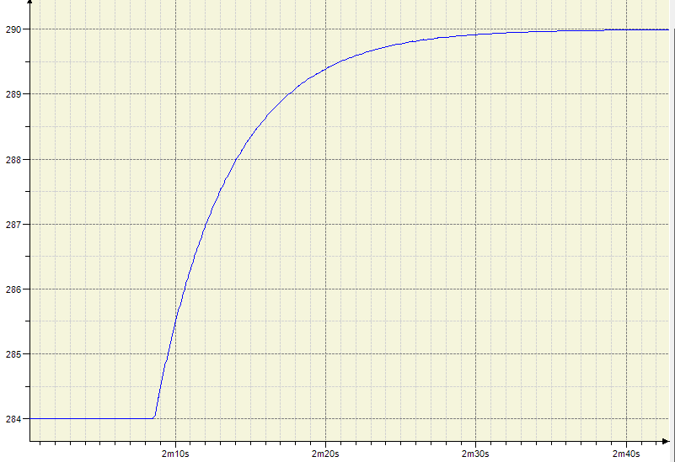
Temperature [K]
dPV
What is seen here is the PV dynamics after a step made in the CO (Controller output). The change was from 400 to 1000, i.e. dCO = 1000 – 400 = 600
dPV = 290 – 284 = 6
Time constant T = 5 s
Dead time L = zero
Using these values we get the following PID parameters (moderate lambda, i.e. 2*T)
Kp = 50
Ti = 10
Td = 0
63%
Time constant
Time [s]

