Slide 1

SMART
VEHICLE SEARCH!
Search On The Go!
Notes:
To use this title animation slide with a new image simply 1) move the top semi-transparent shape to the side, 2) delete placeholder image, 3) click on the picture icon to add a new picture, 4) Move semi-transparent shape back to original position, 5) Update text on slide.

Slide 2
A digital, smart and cost-efficient solution to find
Lost/Stolen Vehicles in minimal time.
—Developed By
BITS PLEASE
Lovely Professional University, Punjab

Slide 3
INTRODUCTION
OBJECTIVE
To help people and the government by providing a smart tech-based solution for searching missing vehicles on the road, providing E-payment options and for enhanced traffic management by doing traffic report analysis.
Hassle-free monitoring and searching of vehicles on the road.
What do we offer?
Online Portal to file a theft report.
Vehicle Detection and Search.
E-Payment options to pay at highway tolls and parkings.
Traffic Report Generation.
Customer Feedback Portal.

Slide 4
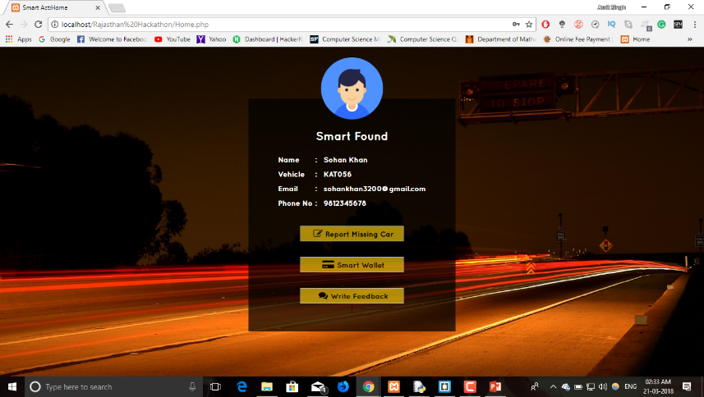
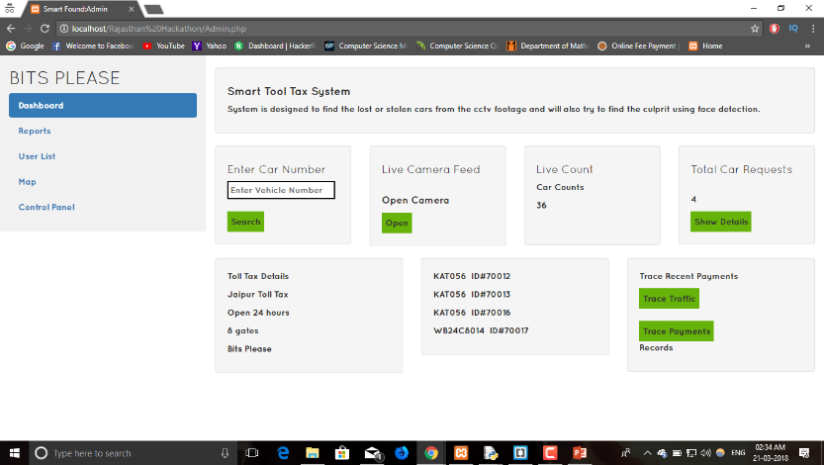
VEIWS
USER PANEL
ADMINISTRATOR PANEL
USER PANEL
ADMIN PANEL

Slide 5
TECHNOLOGY
USED
Machine Learning Techniques : Image Processing and Data Analytics
Front End : HTML, CSS, JavaScript, BootStrap, PHP
Back End : Python 3.6.0, PHP 5.2
Libraries : PyTessaract, NumPy, OpenCV, Twilio, Matplotlib
API’s Used : Twilio Messaging API
Database : MySQL

Slide 6
HOW DOES IT WORK ?
1
2
3
4
5
User/Admin makes a request to perform vehicle search.
Live Recording Video is broken into number of Frames.
The Number Plate Detection Algorithm detects the number plate of the vehicle in the frame.
The Optical Character Recognition Algorithm extracts the number plate as a string of characters.
If a match is found, an Alert Message is sent to the owner and the authorities.
Reference : The basics you can find anywhere 5 Steps To Successful Storytelling Published on April 5, 2014 Featured in: Marketing & Advertising

Slide 7
ADDITIONAL
MODULES
SMART E-PAYMENT SYSTEM
Makes it easier to make payments at a Toll-Tax Area and at authorized vehicle parking's.
TRAFFIC REPORT GENERATOR
Bar Graphs/Histograms are generated after detecting no. of vehicles that pass from a specific road, traffic signal or a toll tax.

Slide 8
THANK YOU

