Slide 1
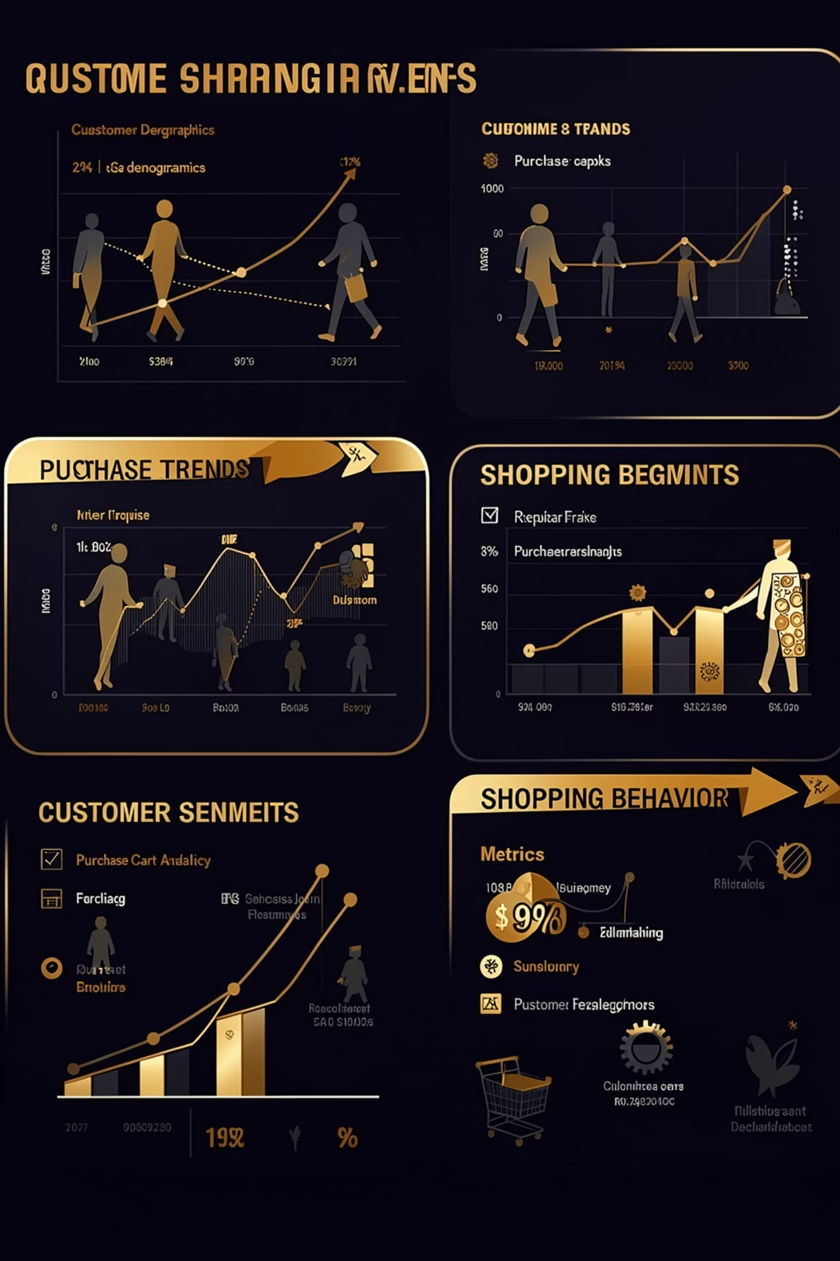
Customer Shopping Behavior Analysis
3,900 purchases — 18 features — insights to guide strategy

Slide 2

Dataset Summary
Rows & Columns
Key Features
Rows: 3,900 · Columns: 18
Demographics, Purchase details, Behavior metrics
Missing Data
37 values missing in Review Rating

Slide 3





EDA & Preparation (Python)
Load & Inspect
pandas: df.info(), describe()
Clean & Impute
Imputed Review Rating by category median
Engineer Features
age_group, purchase_frequency_days
DB Integration
Loaded cleaned DataFrame to PostgreSQL

Slide 4
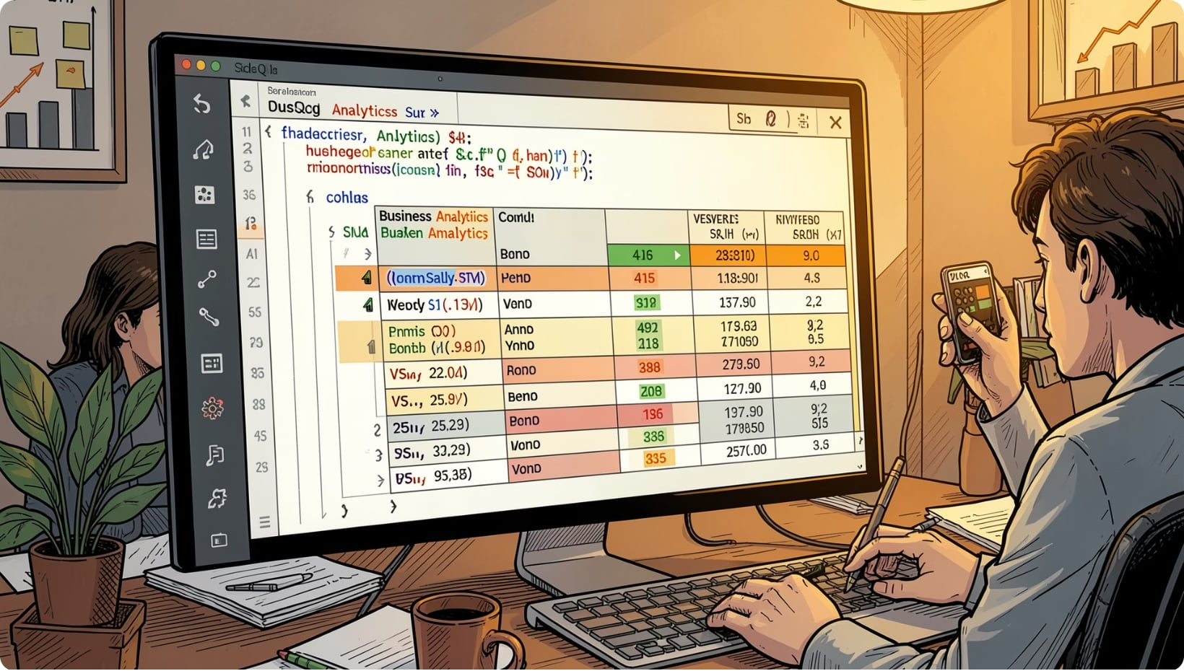
SQL Analysis — Revenue & Segments
Revenue by Gender
Subscribers
Yes: 1,053 (total rev 62,645) · No: 2,847 (total rev 170,436)
Female: 75,191 · Male: 157,890
Age Groups (Revenue)
Young Adult 62,143 · Middle-aged 59,197 · Adult 55,978 · Senior 55,763

Slide 5





Top Products & Ratings
Gloves
Sandals
Boots
Hat
Avg Rating 3.86 — Top-rated
Avg Rating 3.84
Avg Rating 3.82
Avg Rating 3.80
Skirt
Avg Rating 3.78

Slide 6

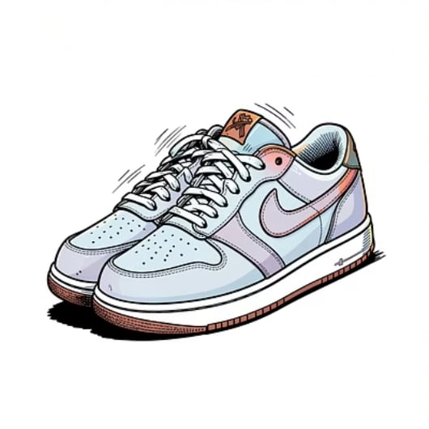




Discounts & High-Spenders
839
64
Users
Avg Discount
High-spending discount users identified
Per user
90%
Top Discount
Highest observed rate
High-spending discount users — 839 rows identified
Examples: customer_id 2 spent 64; 3 spent 73; 4 spent 90; 20 spent 90
Top discounted categories: Hat, Sneakers, Coat, Sweater, Pants
Review discount policy vs. margin impact

Slide 7
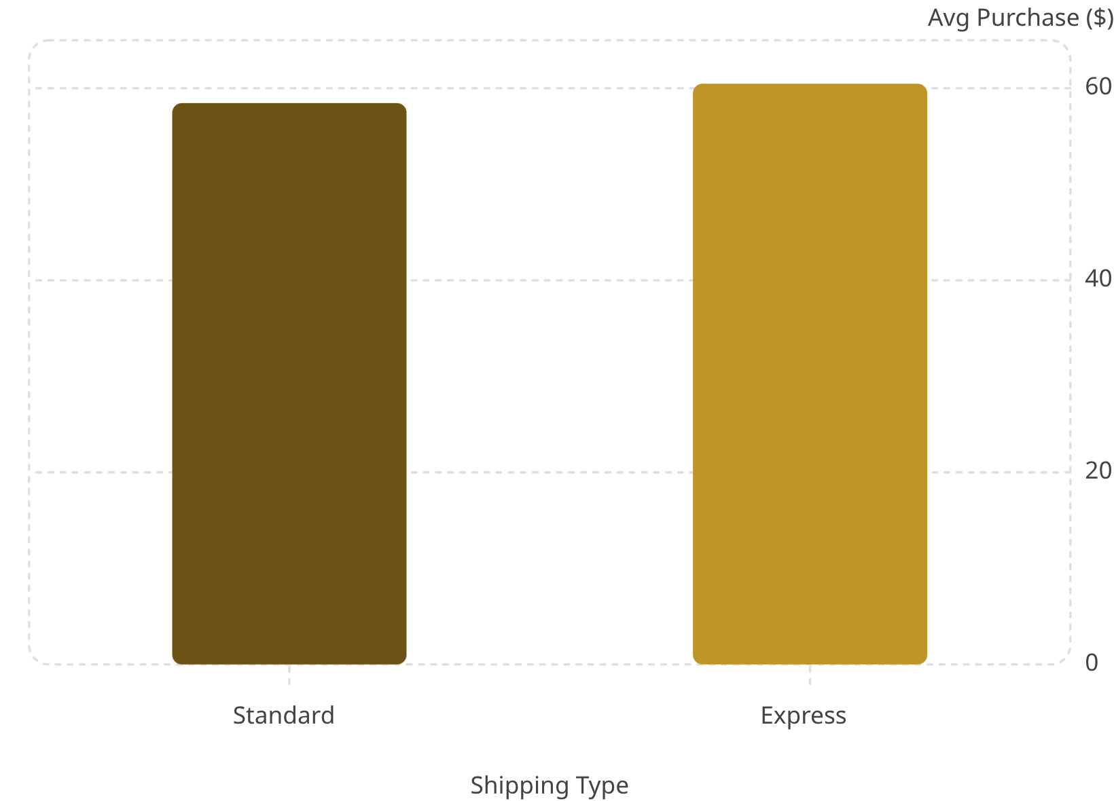
Shipping & Purchase Patterns
Frequency & Payment
Most common payment: PayPal · Frequency: Every 3 Months
Subscribers vs Repeat Buyers
Repeat buyers: 3,116 loyal; 83 new; 701 returning

Slide 8

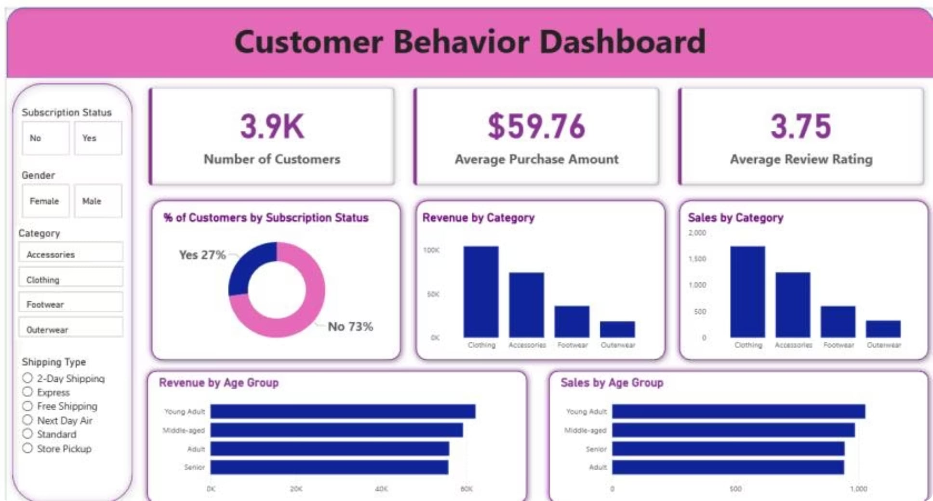


Power BI Dashboard Highlights
Subscriptions
Yes 27% · No 73%
Revenue by Category
Clothing 100K · Accessories 50K · Footwear 25K · Outerwear 10K
Sales by Age
Young Adult top contributor

Slide 9
Business Recommendations
Boost Subscriptions
Loyalty Programs
Review Discounts
Product Positioning
Reward repeat buyers to increase loyalty
Balance sales lift with margin control
Promote exclusive subscriber benefits
Highlight top-rated, best-selling items
Targeted Marketing
Focus on high-revenue age groups & express users

