Slide 1
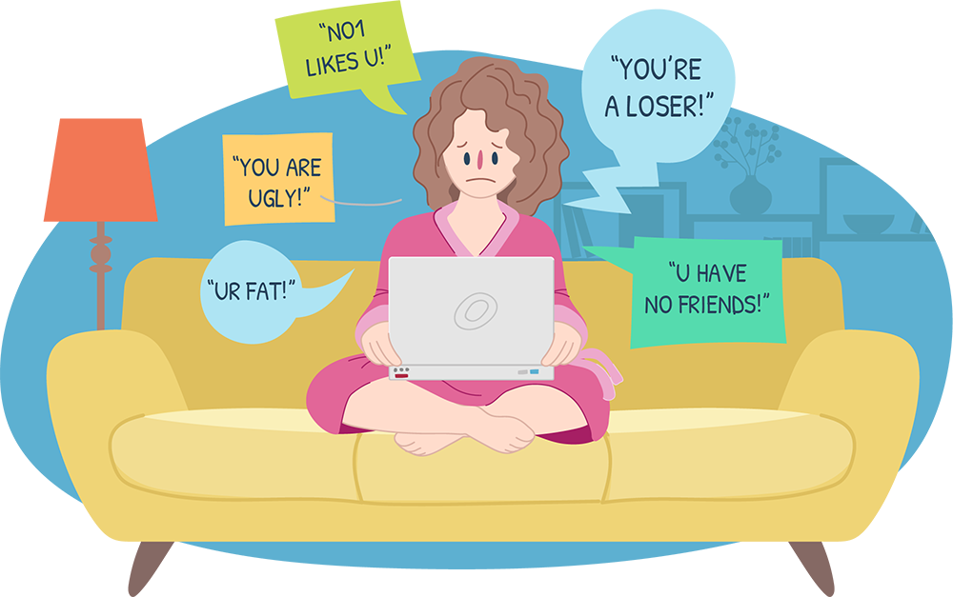
NLP PROJECT : CYBER BULLYING CLASSIFICATION

Slide 2
TABLE OF CONTENTS :
Introduction & Problem Statement
Technology Stack
Methodology
Text Analysis:
Gender Based Bullying
Religion Based Bullying
Age Based Bullying
Ethnicity Based Bullying
Results:
Multinomial Naïve Bayes Classifier
Bert Model Classifier

Slide 3
Introduction & Problem statement :
UNICEF issued a warning on April 15th, 2020, in reaction to the increased risk of cyberbullying during the COVID-19 pandemic.
Cyberbullying statistics are appalling:
36.5 percent of middle and high school kids have been cyberbullied
87 percent have witnessed cyberbullying, with consequences ranging from poor academic performance to depression and suicidal ideation
We can combat this by creating models to automatically flag potentially harmful tweets as well as break down the patterns of hatred.

Slide 4
Technology stack :
The technology stack I used to develop the machine learning model are :
pandas library
numpy library
matplotlib library
seaborn library
sklearn library
pytorch library
nltk library
transformers library

Slide 5
Methodology :
Importing the required libraries and then loading the data set obtained from Kaggle in google colab.
Creating word cloud and displaying most frequent unigram and bigram. Data cleaning, stemming, lemmatizing is performed on tweet texts.
Target variable is label encoded then split the data set into train(70%),test(20%) and validation(10%) set then we oversampled the train data using RandomOverSampler because the dataset was imbalanced.
Fit and transform the dataset using CountVectorizer and TfidfTransformer and then multinomial naïve bayes classifier is applied and classification report and confusion matrix is printed.
Tokenized the tweets using bert tokenizer by importing bert-base-cased model. Created BertClassifier model then trained the model and then evaluated the model using test data.

Slide 6
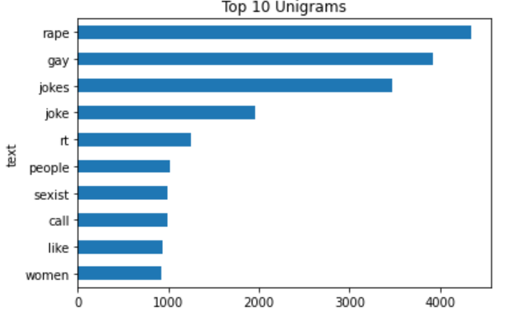
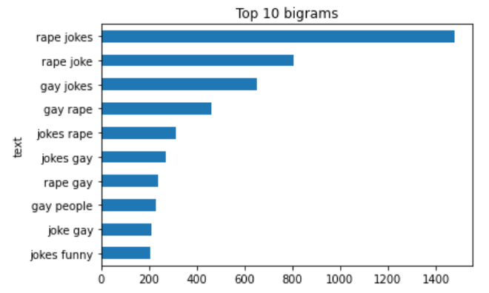
Gender BASED BULLYING :
Top 10 Unigrams
Top 10 Bigrams

Slide 7
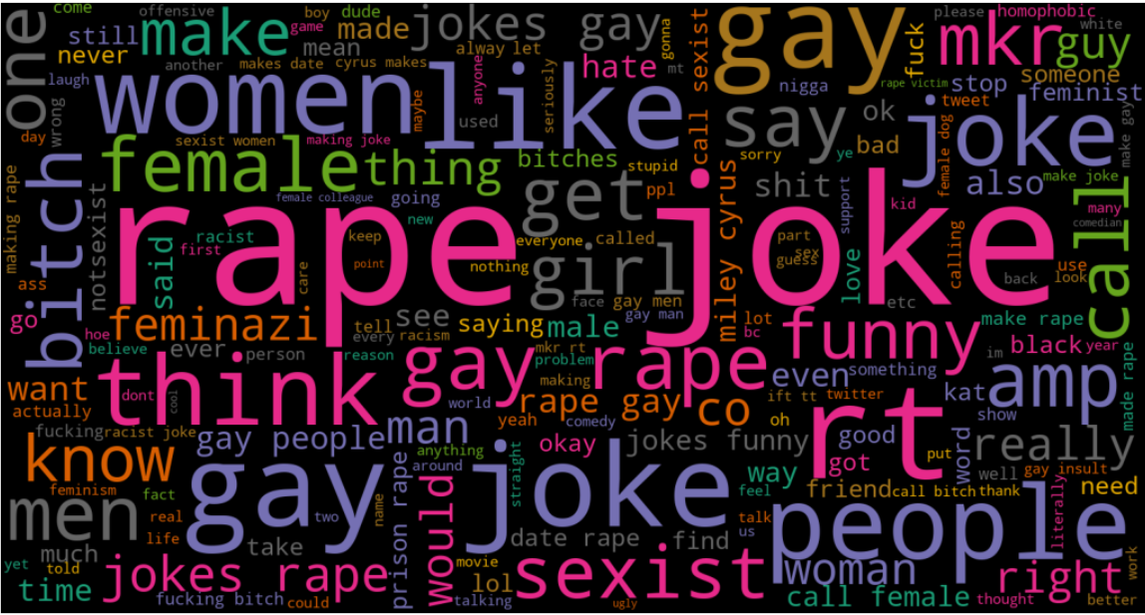

Slide 8
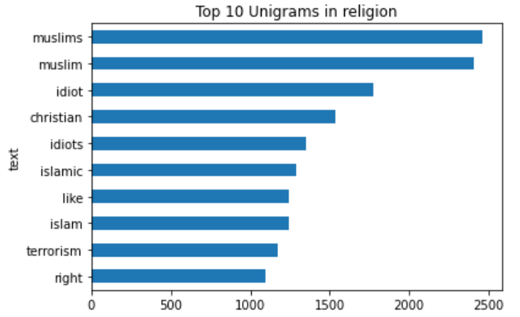
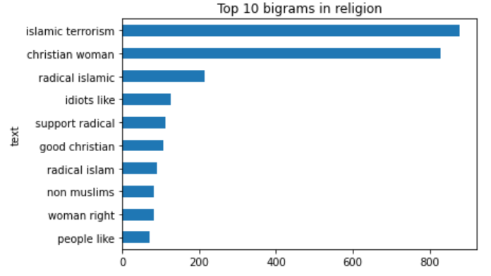
RELIGION BASED BULLYING :
Top 10 Unigrams
Top 10 Bigrams

Slide 9
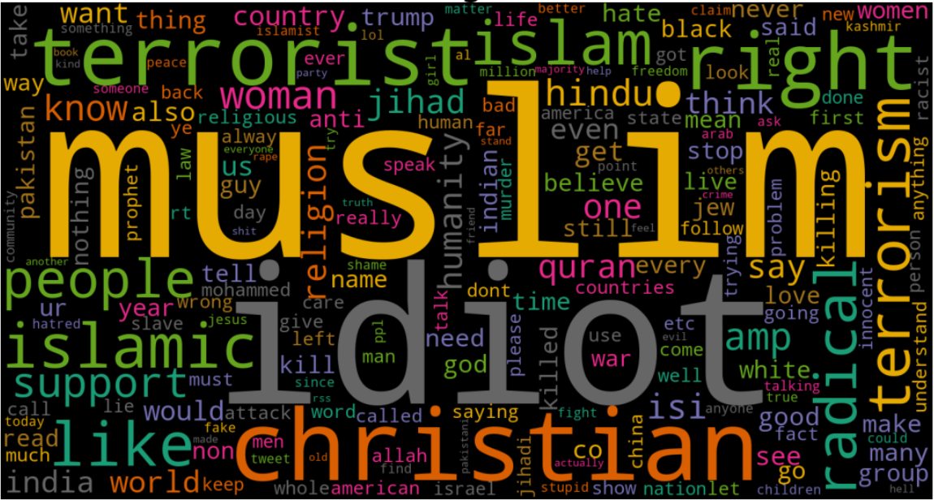

Slide 10
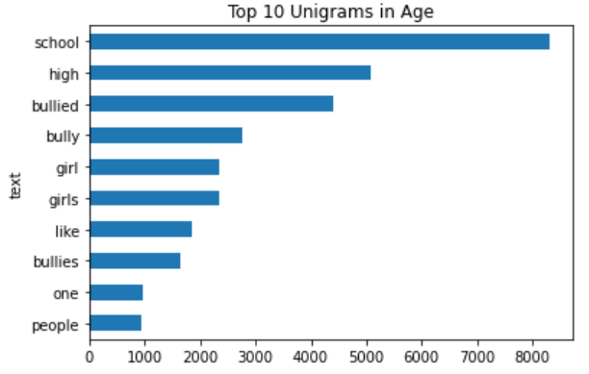
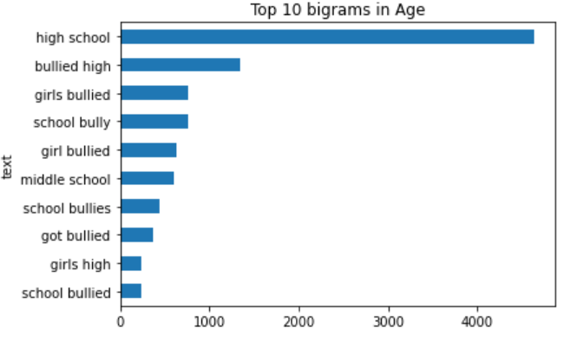
AGE BASED BULLYING :
Top 10 Unigrams
Top 10 Bigrams

Slide 11
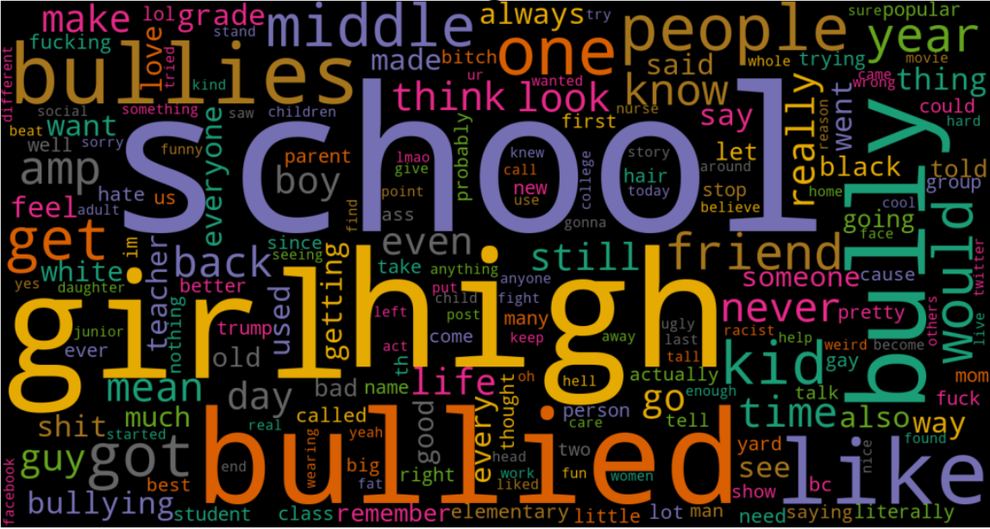

Slide 12
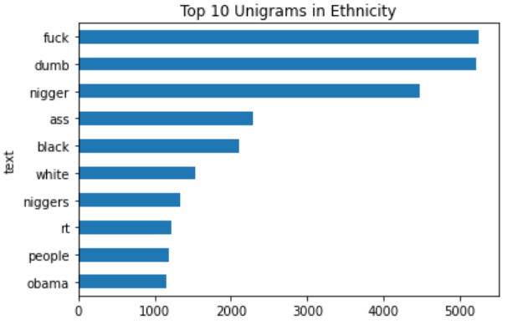
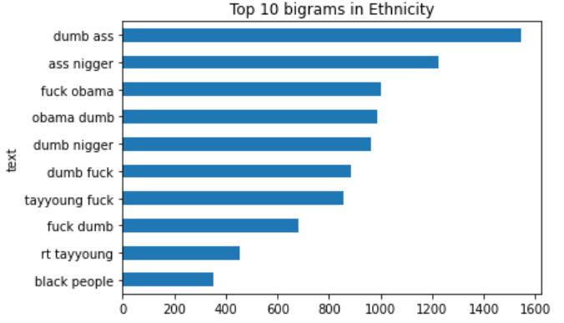
ETHNICITY BASED BULLYING :
Top 10 Unigrams
Top 10 Bigrams

Slide 13
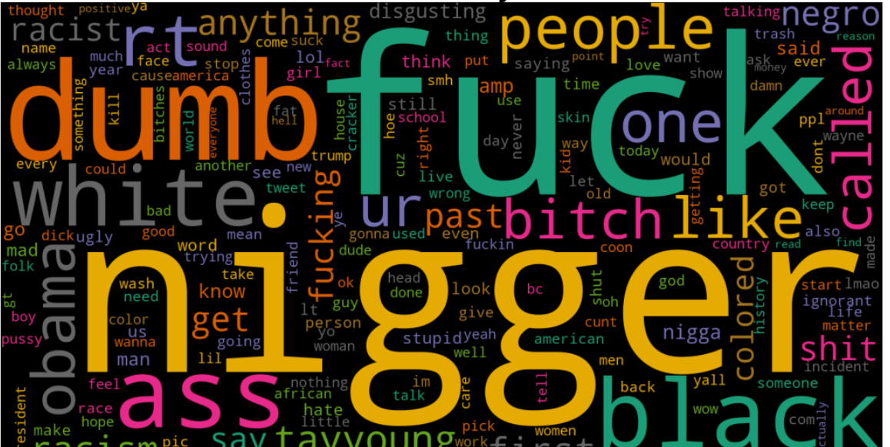

Slide 14
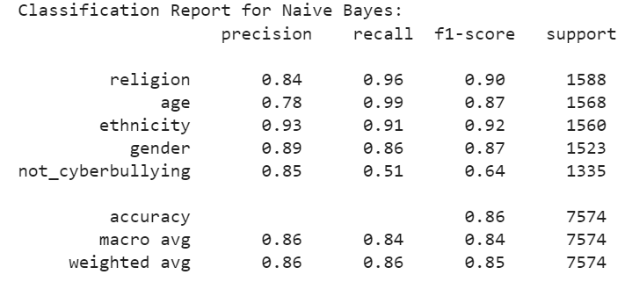
RESULT OF MULTINOMIAL NAÏVE BAYES CLASSIFIER :
The performance scores of the algorithm is good, with an overall accuracy of 86%. We can observe how the predictions for the more populated classes have very high F1 scores (over 87%), while for the class "not_cyberbullying" the score is 64%

Slide 15
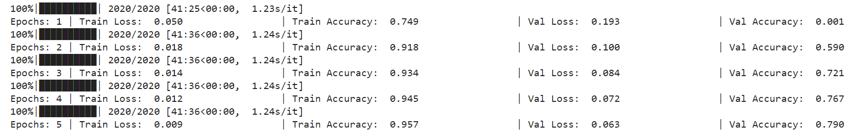
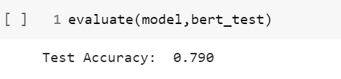
RESULT OF BERT MODEL CLASSIFIER:
The model was trained for 5 EPOCH with training accuracy of 95.7% & validation accuracy of 79%.
The model was tested on test data and 79% test accuracy was achieved.

Slide 16


