Slide 1

MACHINE LEARNING PROJECT : HEART FAILURE PREDICTION

Slide 2
TABLE OF CONTENTS :
Introduction & Problem Statement
Data Overview
Technology Stack
Methodology
Class comparison of target variable
Checking outliers
Relationship of some independent variables with dependent variable
Correlation matrix
Chi-squared test
Result table
Business Aspects

Slide 3
Introduction & Problem statement :
Cardiovascular diseases are a group of disorders involving the heart and blood vessels and one of the leading causes of death globally, according to the American Heart Association.
In 2019, cardiovascular diseases took the lives of nearly 18 million people, accounting for 32% of deaths worldwide (World Health Organization, 2021). 85% of these deaths were due to heart attacks and strokes, with 38% among people under the age of 70.
Early detection is critical in the treatment and management of cardiovascular diseases, wherein machine learning can be a powerful tool in detecting a potential heart disease diagnosis.
The notion is to develop a Gradient Boosting model to predict the presence of cardiovascular disease and identify some of the most important predictors using Boruta-Shap package.

Slide 4
Data overview :
The Heart Disease data used in this study is a synthesis of data sets sourced from the UCI Machine Learning Repository and contains 11 features that can be used to predict the presence of heart failure, a common cardiovascular disease that greatly increases the risk of a CV-related death.
The target variable is a binary attribute indicating a diagnosis of Heart Failure when HeartDisease=1.

Slide 5
Technology stack :
The technology stack I used to develop the machine learning model are :
pandas library
numpy library
matplotlib library
seaborn library
sklearn library
scipy library
lightgbm library
BorutaShap library

Slide 6
Methodology :
Importing the required libraries and then loading the data set obtained from Kaggle in jupyter notebook.
All attributes were mapped to correct data types and statistically described.
Exploratory Data Analysis were performed on both numeric and categorical columns and then correlations between attributes were calculated.
Performed Chi-squared test on all categorical columns to check the significance of that attribute.
There were no missing values in the data set, yet I replace the missing values in Cholesterol column that were entered as 0’s with the mean value.
Removed the outliers, using boxplot and IQR method and kept two datasets, one without outliers and another with the outliers and then all the categorical features are encoded using dummy encoding method.
Split both the data set into train(60%),test(20%) and validation(20%) set and then standardize the features using StandardScaler.
Important features were selected using Boruta-Shap package along with the Light GBM model.
Random Forest, Adaboost, XGBoost and LightGBM model were built over both the datasets (with and without outliers) using 5-fold cross validation and in the end, the model with best metrics performance will be selected.

Slide 7
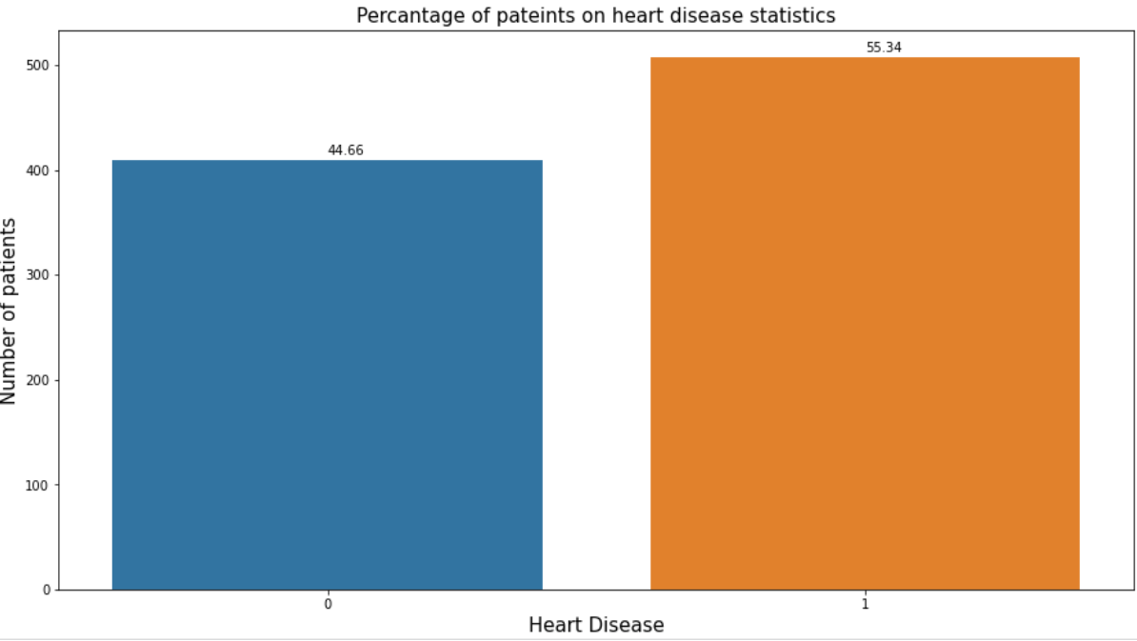
class comparison of target variable :
As we can see the plot here, the dependent variable is kind of balanced class.

Slide 8
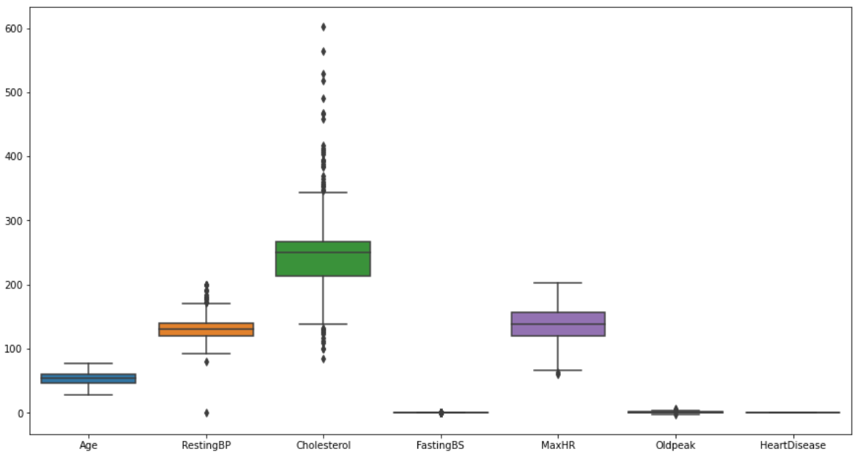
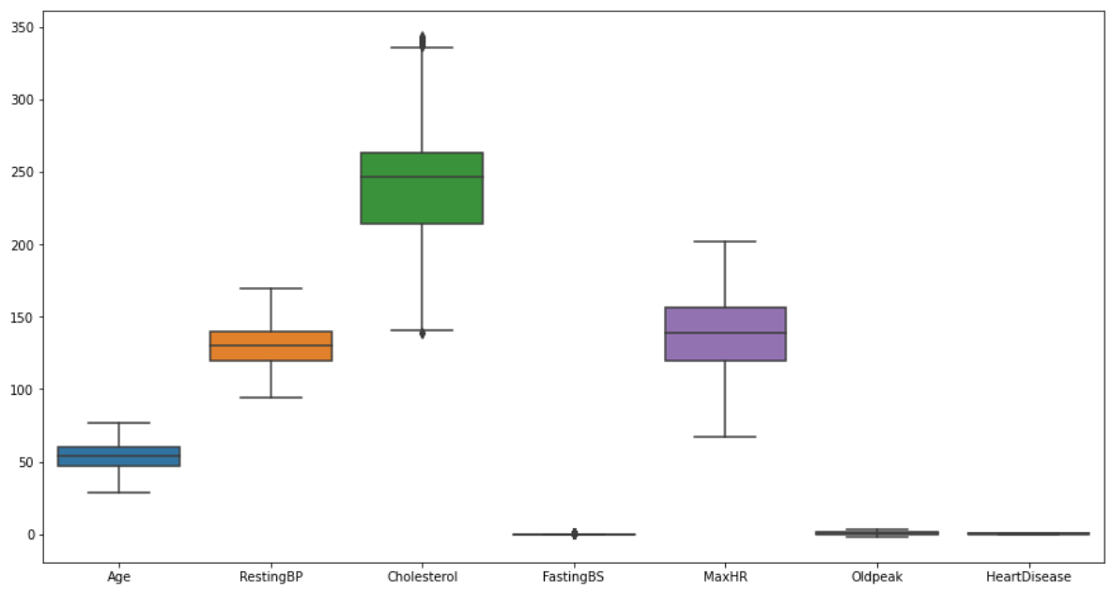
Checking outliers :
Boxplot before removing outliers
Boxplot after removing outliers

Slide 9
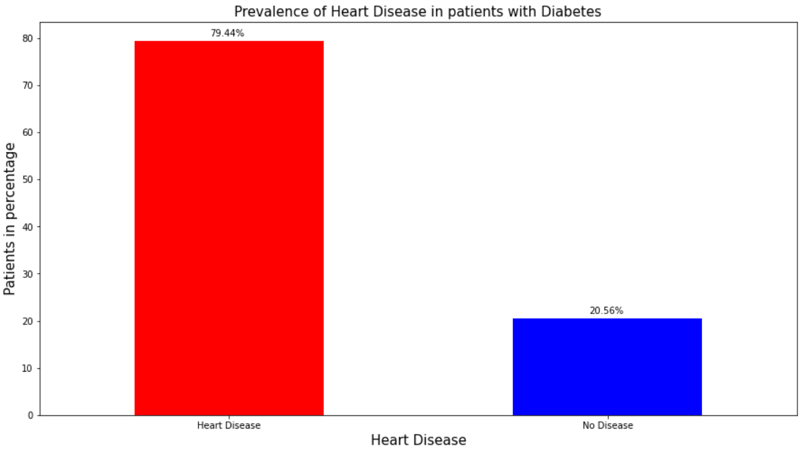
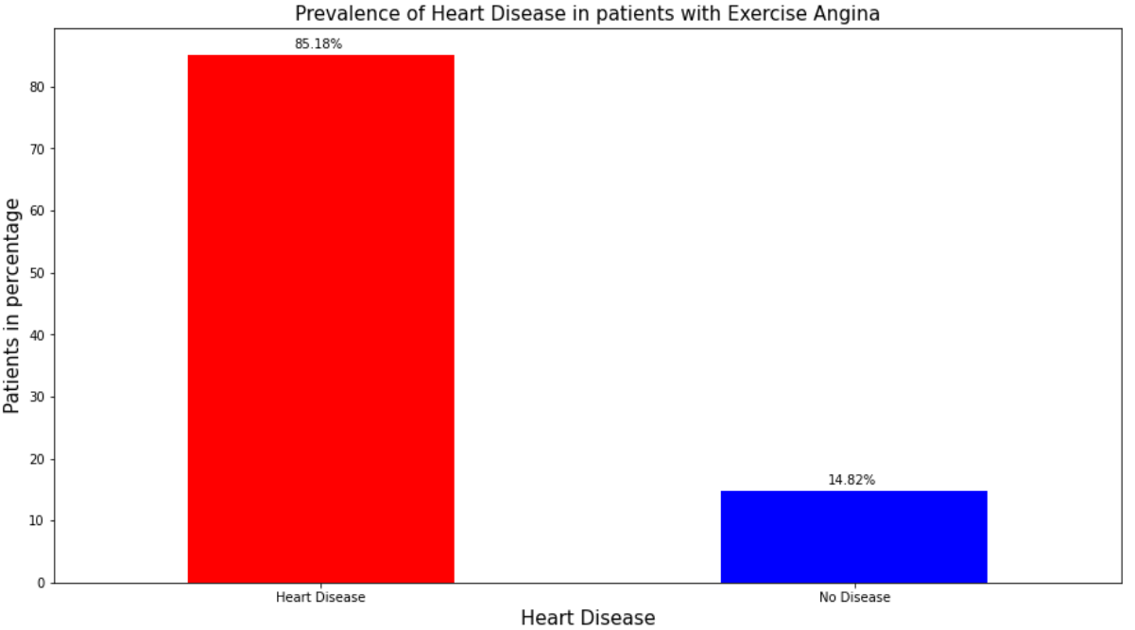
Relationship of some attributes with respect to target variable (HeartDisease) :
Prevalence of Heart Disease in patients with diabetes
Prevalence of Heart Disease in patients with exercise angina
In patients with diabetes, nearly 80% have heart disease.
The prevalence of heart disease is even higher in patients with exercise angina at over 85%.

Slide 10
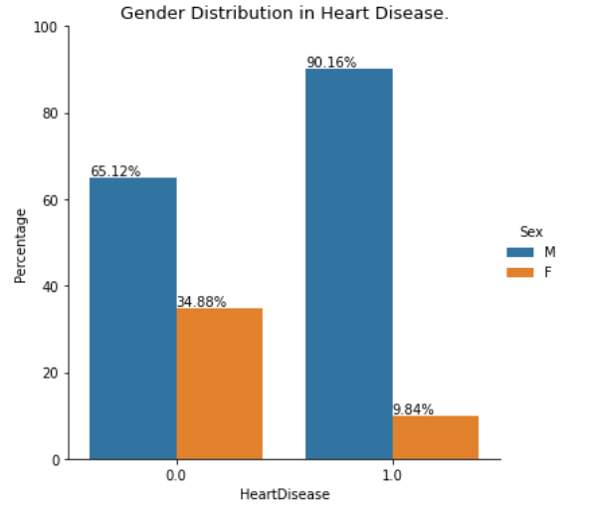
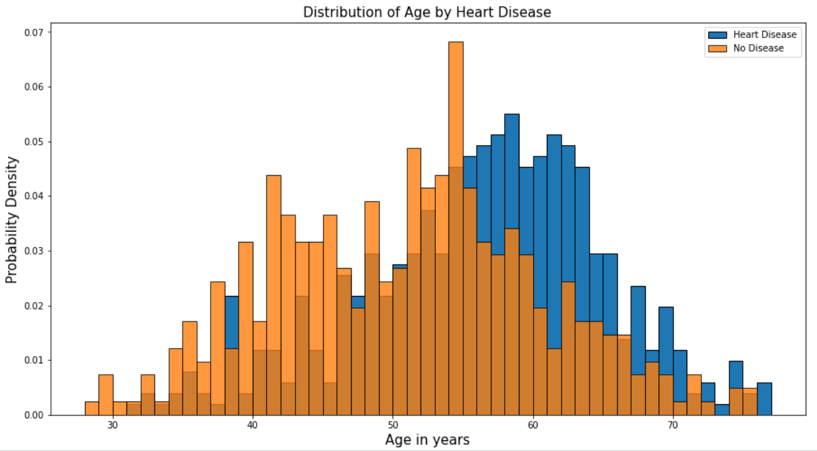
Gender distribution in heart disease
Distribution of age by heart disease
Among patients with heart disease, the absence of chest pain (asymptomatic) is the most common at over 77%. In addition, heart disease is more prevalent in men than women, occurring at a rate of nearly 9 to 1 in patients with a cardiovascular diagnosis.
In patients with heart disease, there are majority of patients between the ages of 51 to 62. In patients without heart disease, there are majority of patients within a younger age range of 43 to 57.

Slide 11
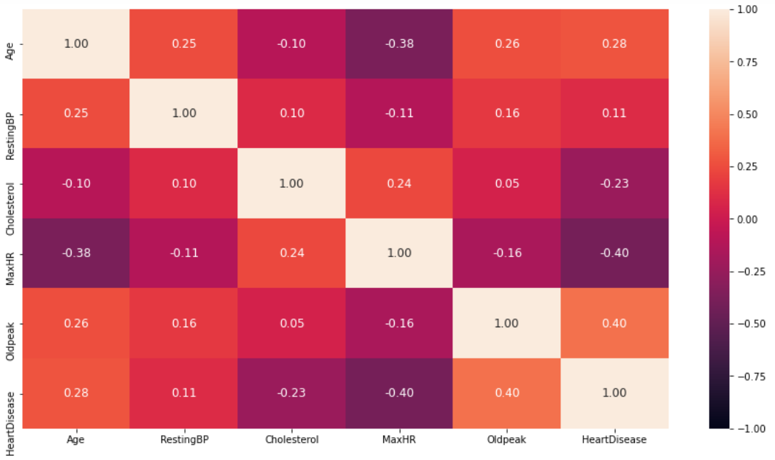
Correlation matrix of independent variable along with dependent variable :
Based on the correlation, HeartDisease has the moderate positive association to OldPeak (correlation = 0.4) and the moderate negative association to MaxHR (correlation = -0.4). There is also a moderate negative relationship between Age and MaxHR of -0.38. As age increases, heart rate tends to decrease.

Slide 12
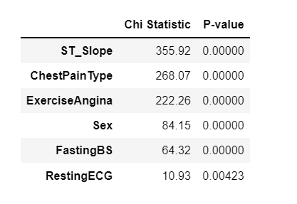
CHI-squared test :
Based on the chi-squared results, all discrete variables have a significant association to Heart Disease with a p-value < 0.05 and will therefore be included as predictors in the models.

Slide 13
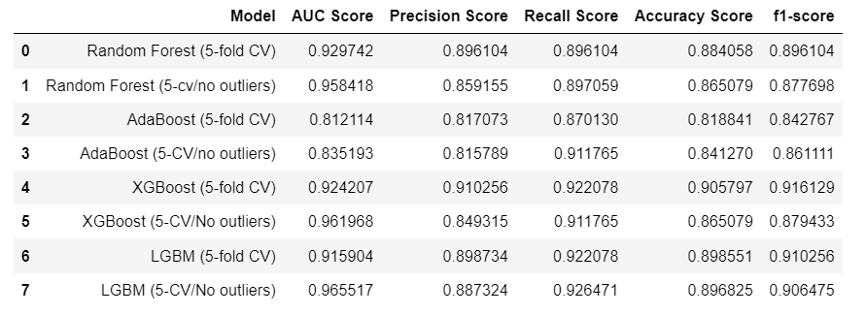
Result table :
Here I have used Boruta-Shap package to select the most important predictors. Some of the most important predictors in the model were patient's Age, Cholesterol, Oldpeak, MaxHR, ST Slope, and Chest Pain type. In selecting the best model, Light GBM provided the best results overall on both data set with and without outliers but the AUC score of the model on the data set without outliers is better than the model on the data set with outliers. So, we can use the last model in the result table for early detection and diagnosis of heart disease with an overall F1-Score of 90.6% and an accuracy of 89.7%.

Slide 14
Business aspects :
Heart failure is a chronic disease characterized by a variety of unpleasant outcomes, such as poor QoL, recurrent hospitalization, high mortality and significant cost burden. A significant deterrent of the above-mentioned serious consequences is early diagnosis, as well as early prediction of adverse events. Toward this direction the application of machine learning techniques means the above model will contribute significantly.
It will be helpful to doctors as well as patients to do the early diagnosis and prevention before any severe issues arise.
we can prepare a user interface like an app and user can enter the necessary attributes and it will tell the user if there is any risk of heart failure and then the patients can consult accordingly.
There is a scope of model improvement like adding new important attributes or feature engineering or use different ML techniques for modelling to improve the accuracy.

Slide 15

THANK YOU !

