Slide 1
Sign Language to Text Conversion

Slide 2
Project Under Supervision of Dr. Anjali Gautam
Efforts by -
Amit Singh ( IIT2019045 )
Abhishek Raj ( IIT2019058 )
Sanidhya Gupta ( IIT2019074 )
Aastha Singh ( IIT2019078 )
Ritik Kumar ( IIT2019088 )

Slide 3

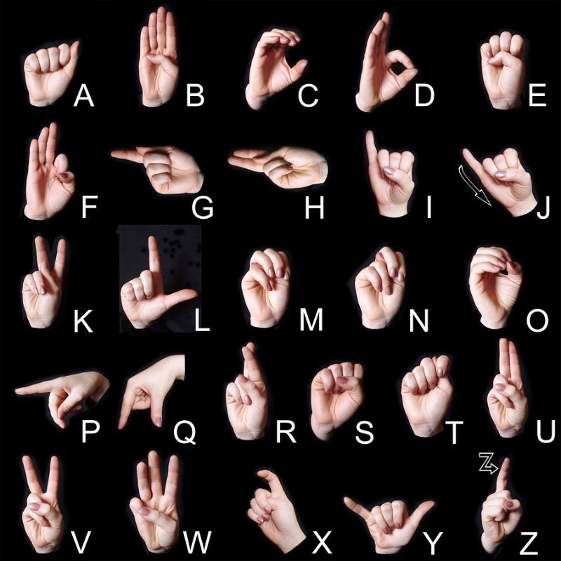
Abstract
Our project aims to create a computer application and train a model which when shown a real time video of hand gestures of American Sign Language shows the output for that particular sign in text format on the screen.

Slide 4
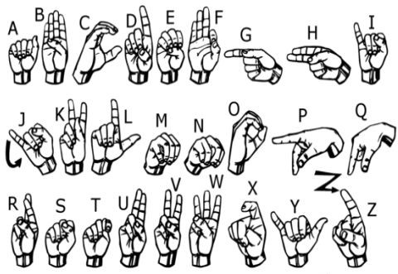
Contents
Introduction
Motivation
Problem Statement
Literature Survey
Datasets
Implementation and Methodology
Results
Future Scope
Conclusion
References

Slide 5
INTRODUCTION
Communication with hearing impaired people has become an issue in our nation. Proper communication is necessary for building a good and developed nation.
From the world total population there are about 466 million people who have impaired hearing loss (approximately 5% of world population) out of 466 million people 34 million of those are under 18 according to WHO.

Slide 6
2. MOTIVATION
The aim is to develop a user friendly human computer interfaces (HCI) where the computer understands the human sign language.
There are various sign languages all over the world, namely American Sign Language (ASL), French Sign Language, British Sign Language (BSL), Indian Sign language, Japanese Sign Language and work has been done on other languages all around the world.

Slide 7
3. PROBLEM STATEMENT
Understanding the exact context of symbolic expressions of hearing impaired people is the challenging job in real life until unless it is properly specified. So we have to design a model which will help these hearing impaired people for communication.

Slide 8
4. LITERATURE SURVEY

Slide 9
This section presents detailed review of previous methods used for sign language conversion.
Abraham E. et.al. [7] year of publication 2019 proposed a work in which 40 samples each for 26 Indian Sign Language gestures containing reading of accelerometer , gyroscope and flex were recorded and then LSTM ( Long Short- Term Memory ) algorithm is applied. They have achieved a high accuracy of 98%, but it has one limitation that it is one way, no record of relative position of both hands.
Chandra M.M. et.al. [3], (2019 ) proposed a work in which 22 ASL symbols and 11 ISL gestures were used. They have applied SVM ( Support Vector Machine ) standard machine learning algorithm on this dataset and achieved an average accuracy of 98.3%. But it has limitations that only single hand can be used for translation, it is a one way translator.

Slide 10
Zhou Z. et. al. [4] (2020) has work on 11 ASL symbols. He used PCA ( Principal component Analysis ) and multi - class SVM algorithm to classify them. It is also a one way translator.
Krishna Hari K B [6] ( 2021 ) , have applied different machine learning algorithms like SVM, CNN and RNN on Indian Sign language dataset generated by them. This dataset contains 42 classes ( 26 for alphabets, 9 for numbers 1-9 and 7 for english words ) . They have compared each results obtained after applying each algorithm and finds the efficient among these three algorithms. Among them SVM has the highest training and testing accuracy (97% ) followed by CNN (88.9% ) and the by RNN ( 82.3% ).
Kohsheen Tiku [5] ( 2020 ), they have applied SVM algorithm on ASL kaggle dataset which we have used for comparison , and they have achieved an average accuracy of 97%..
BIAO XU [17] , year of publication 2021, worked on the Chinese Sign Language USTC-SLR dataset. They have classified symbols using LSTM algorithm and achieved average testing accuracy of 86%.

Slide 11
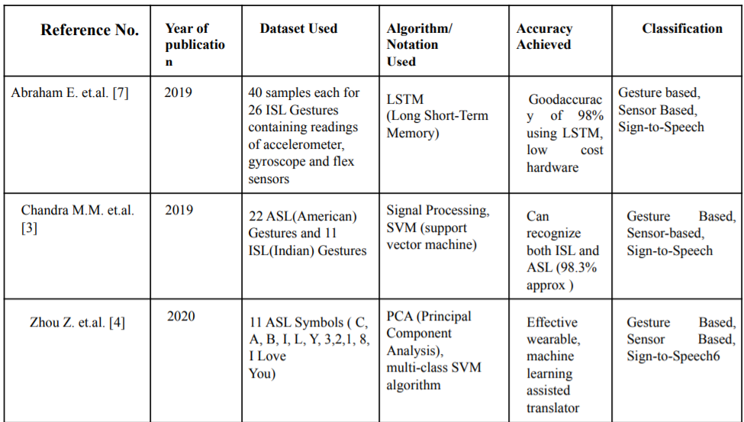

Slide 12
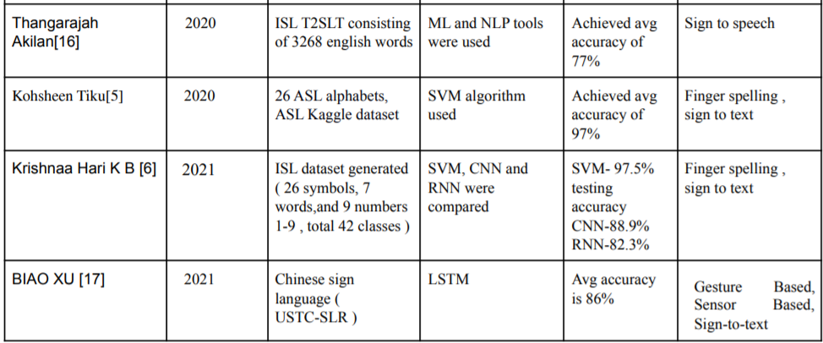

Slide 13
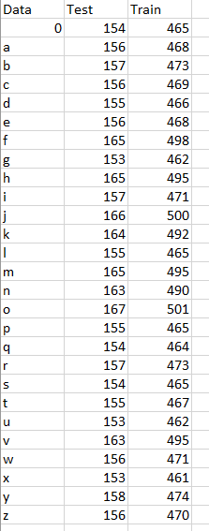
5. DATASET
5.1 Generation Of our Own Dataset
We have captured different images for training and testing the model.
For the training part we have captured images around 450-500 images of each character
For the testing part we have captured images around 150-200 images of each character
Total images for testing part :- 4268
Total images for training part:- 12845
128*128 image pixels

Slide 14
5.2 American Sign Language Kaggle Dataset
A publicly available data set which we used in our project is ASL Kaggle dataset.
Link : https://www.kaggle.com/grassknoted/asl-alphabet
This dataset size is 1.12 GB
It contains colored images of each different symbols
There are two folders in it , the first one contains a training dataset and the second one contains testing data.
Training Folder contains 30 folders for each alphabet along with del , space and nothing symbol.
Each folder contains 3000 colored images.
Total images in training folder :- 81000
Testing folder contains 28 colored images of all alphabets along with nothing and blank symbol images in it.
The dataset consists of multiple grayscale 28x28 image pixels.

Slide 15
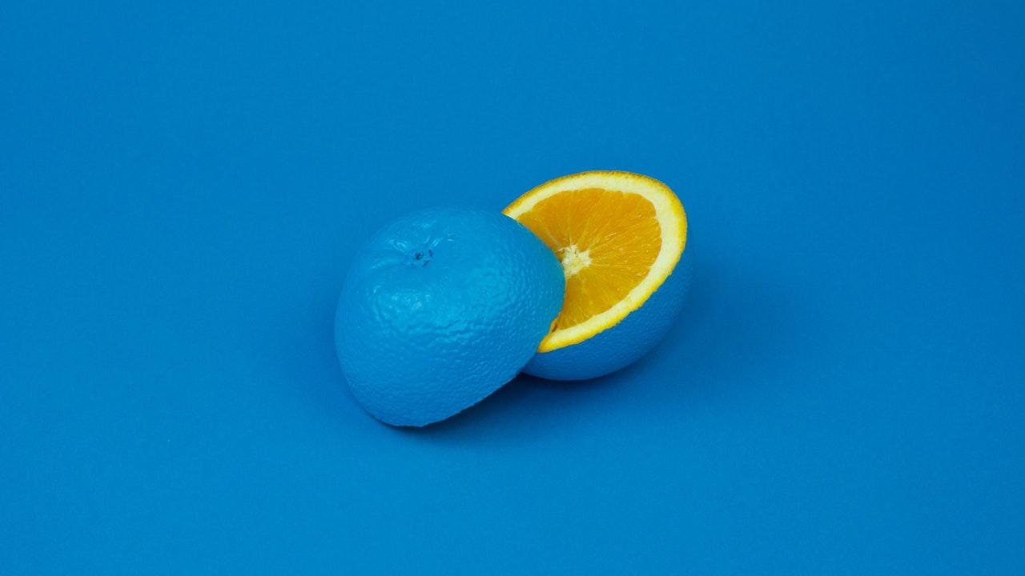
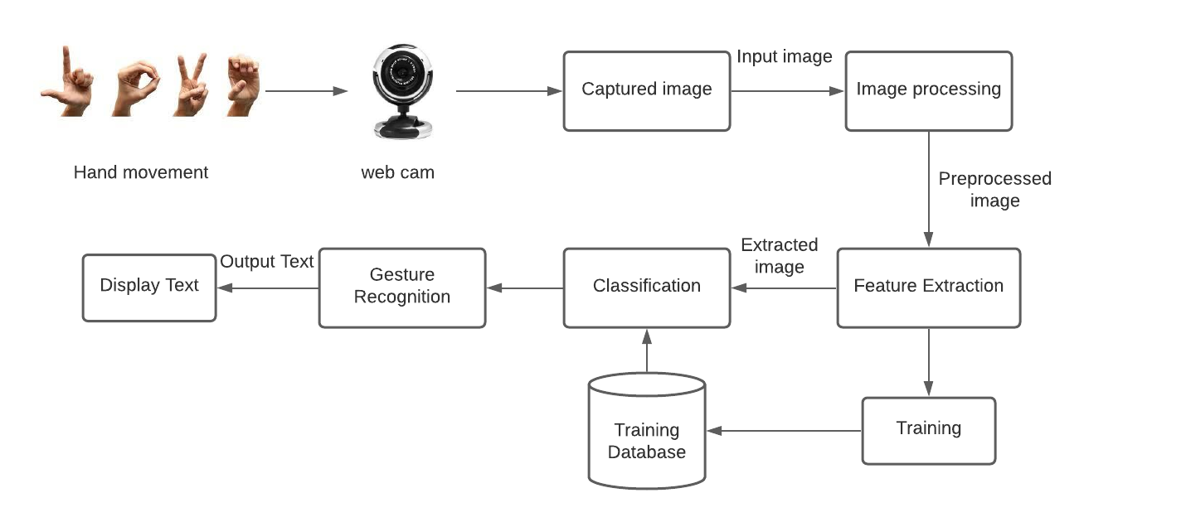
6. IMPLEMENTATION AND METHODLOGY

Slide 16
6.1 DATASET GENERATION
For the project we tried to find already made datasets but we couldn’t find dataset in the form of raw images that matched our requirements.
All we could find were the datasets in the form of RGB values.
Hence we decided to create our own data set.
We used Open computer vision (OpenCV) library in order to produce dataset
Firstly, we captured around 400 - 500 images of each of the symbol in ASL (American Sign Language) for training purposes and around 150 - 200 images per symbol for testing purpose.

Slide 17
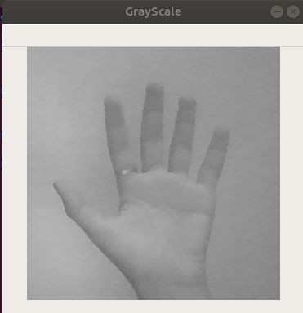
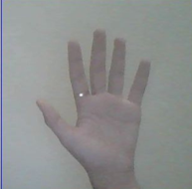
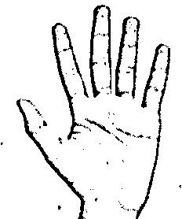
Capturing Raw Image
Gray Scale Image
Image Post Gaussian Blur

Slide 18
6.2 Gesture Classification
Layer 1
Layer 2
Classify between Similar Symbols
Classify between 27 Symbols

Slide 19
Algorithm Layer 1:
Apply gaussian blur filter and threshold to the frame taken with opencv to get the processed image after feature extraction.
This processed image is passed to the CNN model for prediction and if a letter is detected for more than 50 frames then the letter is printed and taken into consideration for forming the word.
Space between the words are considered using the blank symbol.

Slide 20
Algorithm Layer 2:
We detect various sets of symbols which show similar results on getting detected.
We then classify between those sets using classifiers made for those sets only.
In our testing we found that following symbols were not showing properly and were giving other symbols also :
For D
For U
For I
For S
: R and U
: D and R
: T, D, K and I
: M and N

Slide 21
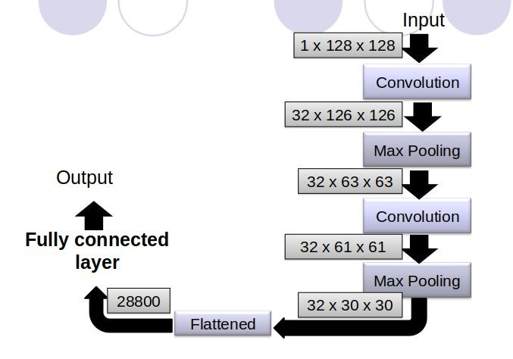
Our CNN Classifier Model

Slide 22
Finger Spelling Sentence Formation
Whenever the count of a letter detected exceeds a specific value and no other letter is close to it by a threshold we print the letter and add it to the current string(In our code we kept the value as 50 and difference threshold as 20).
Otherwise we clear the current dictionary which has the count of detections of present symbol to avoid the probability of a wrong letter getting predicted.
Whenever the count of a blank(plain background) detected exceeds a specific value and if the current buffer is empty no spaces are detected.
In other case it predicts the end of word by printing a space and the current gets appended to the sentence below.

Slide 23
Auto Correct Feature
A python library Hunspell_suggest is used to suggest correct alternatives for each (incorrect) input word and we display a set of words matching the current word in which the user can select a word to append it to the current sentence.This helps in reducing mistakes committed in spellings and assists in predicting complex words.

Slide 24
7. RESULTS
 | Kaggle dataset | Our own Dataset
Training Accuracy | 86.09% | 97.35%
Testing Accuracy | 91.19% | 98.35%

Slide 25
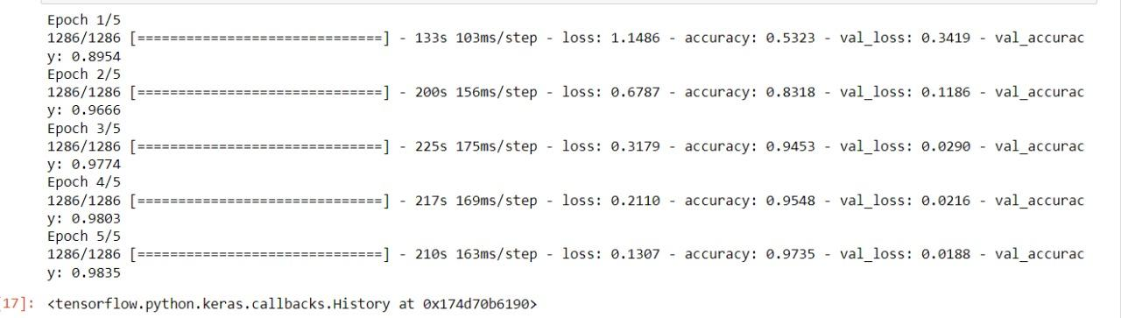
Accuracy achieved on our own data set :
Training accuracy : 97.35% Testing Accuracy : 98.35%

Slide 26
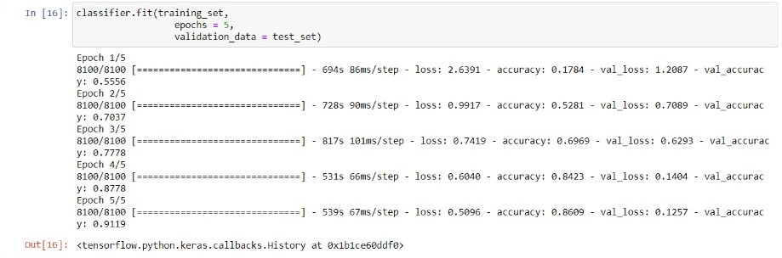
Accuracy achieved on ASL kaggle data set :https://www.kaggle.com/grassknoted/asl-alphabet
Training accuracy : 86.09% Testing Accuracy : 91.19%

Slide 27
8.Challenges Faced
We couldn’t find a dataset with raw images of all the asl characters so we made our own dataset.
Second issue was to select a filter for feature extraction. We tried various filter including binary threshold, canny edge detection, gaussian blur etc. ,of which gaussian blur filter was giving better results.
Issues were faced relating to the accuracy of the model we trained in earlier phases which we eventually improved by increasing the input image size and also by improving the dataset.

Slide 28
9 . Limitations
The model works well only in good lighting conditions.
Plain background is needed for the model to detect with accuracy.

Slide 29
Software Requirements
Python 3.6.6
Tensorflow 1.11.0
OpenCV 3.4.3.18
NumPy 1.15.3
Matplotlib 3.0.0
Hunspell 2.0.2
Keras 2.2.1
PIL 5.3.0

Slide 30
Future Scope
We are planning to achieve higher accuracy even in case of complex backgrounds by trying out various background subtraction algorithms.
We are also thinking of improving the preprocessing to predict gestures in low light conditions with a higher accuracy.

Slide 31
Conclusion
In this project, a functional real time vision based american sign language recognition for D&M people have been developed for asl alphabets.
We achieved an accuracy of 98.3% on our dataset and 91.19% on ASL dataset.
Prediction has been improved after implementing two layers of algorithms in which we verify and predict symbols which are more similar to each other.

Slide 32
References
[1] D. Singh, “Text to sign language,” Thapar University, 2016. ( 3.1 )
[2] J. Huang, W. Zhou, H. Li, and W. Li, ‘‘Sign language recognition using 3D convolutional neural networks,’’ in Proc. IEEE Int. Conf. Multimedia Expo (ICME), Jun. 2015, pp. 1–6. (3.4 )
[3] Chandra, M.M., Rajkumar, S. and Kumar, L.S., 2019, October. Sign Languages to Speech Conversion Prototype using the SVM Classifier. In TENCON 2Ol9-2Ol9 IEEE Region lO Conference (TENCON) (pp. 1803-1807). IEEE. ( 3.5 )
[4] Zhou, Z., Chen, K., Li, X., Zhang, S., Wu, Y., Zhou, Y., Meng, K., Sun, C., He, Q., Fan, W. and Fan, E., 2020. Sign-to-speech translation using machine-learning-assisted stretchable sensor arrays. Nature Electronics, 3(9), pp.571-578. ( 3.6 )
[5] Kohsheen Tiku, Jayshree Maloo 2020. Real-time Conversion of Sign Language to Text and Speech Proceedings of the Second International Conference on Inventive Research in Computing Applications (CIRCA-2020) IEEE Xplore Part Number: CFP20N67-ART; ISBN: 978-1-7281-5374-2 ( 3.2)
[6] Krishnaa Hari K B , Divyashree S , 2021. An Efficient Approach for Interpretation of Indian Sign Language using Machine Learning 2021 3rd International Conference on Signal Processing and Communication (ICPSC) | 13 – 14 May 2021 | Coimbatore ( 3.3 )
djsa

Slide 33
[7] Abraham, E., Nayak, A. and Iqbal, A., 2019, October. Real-Time Translation of Indian Sign Language using LSTM. In 2Ol9 Global Conference for Advancement in Technology (GCAT) (pp. 1-5). IEEE. ( table )
[8] Fatima, S., Agarwal, A. and Gupta, P., 2016, March. Different approaches to convert speech into sign language. In 2Ol6 3rd International Conference on Computing for Sustainable Global Development (INDIACom) (pp. 180-183). IEEE.
[9] Dhanjal, A.S. and Singh, W., 2019, February. Comparative Analysis of Sign Language Notation Systems for Indian Sign Language. In 2Ol9 Second International Conference on Advanced Computational and Communication Paradigms (ICACCP) (pp. 1-6). IEEE
[10] Verma, A. and Kaur, S., 2015. Indian sign language animation generation system for Gurumukhi script. International Journal of Computer Science and Technology, 6(3), pp.117-121.
[11] Ghanem, S., Conly, C. and Athitsos, V., 2017, June. A survey on sign language recognition using smartphones. In Proceedings of the lOth International Conference on PErvasive Technologies Related to Assistive Environments (pp. 171-176).
[12] Vij, P. and Kumar, P., 2016, August. Mapping Hindi Text To Indian sign language with Extension Using Wordnet. In Proceedings of the International Conference on Advances in Information Communication Technology & Computing (pp. 1-5).

Slide 34
13] Grif, M. and Manueva, Y., 2016, June. Semantic analyses of text to translate to Russian sign language. In 2Ol6 llth International Forum on Strategic Technology (IFOST) (pp. 286-289). IEEE.
[14] Dutta, K.K. and GS, A.K., 2015, December. Double handed Indian Sign Language to speech and text. In 2Ol5 Third International Conference on Image Information Processing (ICIIP) (pp. 374-377). IEEE.
[15] Bairagi, V.K., 2014. Gloves Based Hand gesture recognition using Indian Sign Language. International Journal of Latest Trends in Engineering and Technology, Vol.(8)Issue(4-1)(pp.131-137)
[16] Bhavinkumar Devendrabhai Patel, Harshit Balvantrai Patel, Manthan Ashok Khanvilkar, Nidhi Rajendrakumar Patel, and Thangarajah Akilan, Member, IEEE 2020 IEEE Canadian Conference on Electrical and Computer Engineering (CCECE) ( 3.1 ref)
[17] BIAO XU , , SHILIANG HUANG , AND ZHONGFU YE 2021 , National Engineering Laboratory for Speech and Language Information Processing, Institute of Statistical Signal Processing, University of Science and Technology of China, Hefei 230027, China

Slide 35
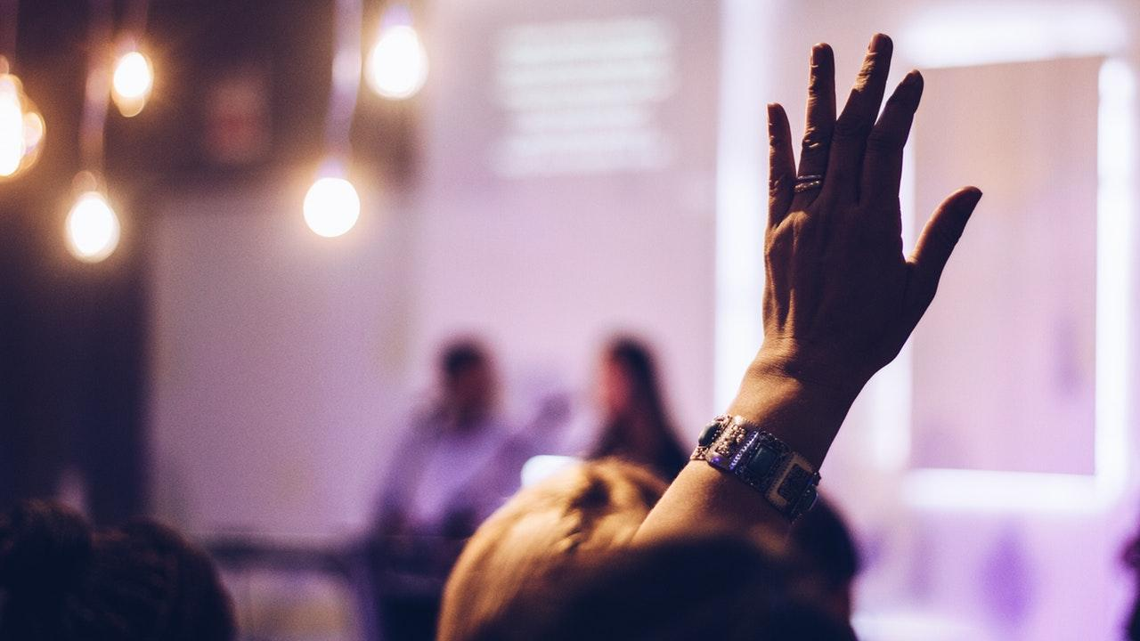
Thank You!!!

