Slide 1
Oracle v. Google
@August Penguin
August 2, 2013
Eli Greenbaum, Adv.
elig@arnon.co.il

Slide 2
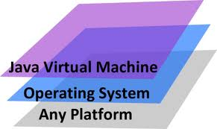
Java
Released in 1995 by Sun Microsystems, which was purchased by Oracle.
Applications are compiled to bytecode that can run on any Java Virtual Machine (JVM)
“Write once, run anywhere”

Slide 3

Android
Google acquired Android in 2005.
Mobile device operating system.
Most of the stack is open source, either GPL (Linux) or Apache licenses (Libraries, VM).

Slide 4
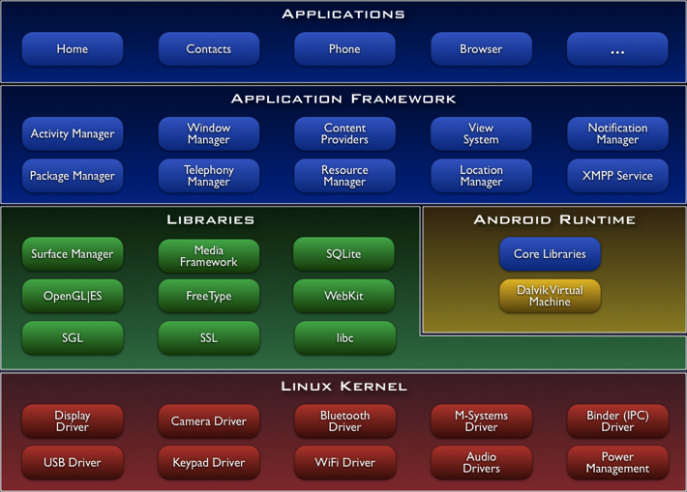
Android

Slide 5
Android
Mobile device operating system.
Google acquired Android in 2005.
Most of the stack is open source, either GPL (Linux) or Apache licenses (Libraries, VM).
“Dalvik” virtual machine is optimized for speed/memory constrained systems
Applications are mostly written in “java”, but Android is not interoperable with Java

Slide 6
Copyright
Protects expression not function …
….but value of the software is in the functionality, not in the expression.

Slide 7
Android

Slide 8
Android

Slide 9
Android

Slide 10
APIs
API
Java Source Code Implementation (OpenJDK)
Max ()
public static float max (float1, float2) {
if (a !=a) return a; // a is NaN
if ((a ==0.0f) && (b ==0.0f)
&& (Float.floatToIntBits(a) ==
negativeZeroFloatBits)) {
return b;
}
return (a >=b) ? a : b;
}

Slide 11
APIs
API
Android Source Code Implementation
Max ()
public static float max (float1, float2) {
if (f1>f2){
return f1;
}
if (f1<f2){
return f2;
}
/*if either arg is NaN, return NaN */
if (f1 != f2){
return Float.NaN;
}
/* max(+0.0,-0.0) == +0.0 */
/* Float.floatToRawIntBits(0.0f) == 0 */
if (Float.floatToRawIntBits(f1) !=0) {
return f2;
}
return 0.0f;
}

Slide 12
APIs
OpenJDK Source Code Implementation
Android Source Code Implementation
public static float max (float1, float2) {
if (a !=a) return a; // a is NaN
if ((a ==0.0f) && (b ==0.0f)
&& (Float.floatToIntBits(a) ==
negativeZeroFloatBits)) {
return b;
}
return (a >=b) ? a : b;
}
public static float max (float1, float2) {
if (f1>f2){
return f1;
}
if (f1<f2){
return f2;
}
/*if either arg is NaN, return NaN */
if (f1 != f2){
return Float.NaN;
}
/* max(+0.0,-0.0) == +0.0 */
/* Float.floatToRawIntBits(0.0f) == 0 */
if (Float.floatToRawIntBits(f1) !=0) {
return f2;
}
return 0.0f;
}

Slide 13
java.lang.Math.max()
sinh(double x) | random() | min(double a, double b) | hypot(double x, double y) | copySign(double magnitude, double sign) | abs(float a)
sqrt(double a) | rint(double a) | min(float a, float b) | IEEEremainder(double f1, double f2) | copySign(float magnitude, float sign) | abs(int a)
tan(double a) | round(double a) | min(int a, int b) | log(double a) | cos(double a) | abs(long a)
tanh(double x) | round(float a) | min(long a, long b) | log10(double a) | cosh(double x) | acos(double a)
toDegrees(double angrad) | scalb(double d, int scaleFactor) | nextAfter(double start, double direction) | log1p(double x) | exp(double a) | asin(double a)
toRadians(double angdeg) | scalb(float f, int scaleFactor) | nextAfter(float start, double direction | max(double a, double b) | expm1(double x) | atan(double a)
ulp(double d) | signum(double d) | nextUp(double d) | max(float a, float b) | floor(double a) | atan2(double y, double x)
ulp(float f) | signum(float f) | nextUp(float f) | max(int a, int b) | getExponent(double d) | cbrt(double a)
 | sin(double a) | pow(double a, double b) | max(long a, long b) | getExponent(float f) | ceil(double a)

Slide 14
java.lang.Math
StringBuilder | RuntimePermission | Math | Compiler | Boolean
System | SecurityManager | Number | Double | Byte
Thread | Short | Object | Enum<E extends Enum<E>> | Character
ThreadGroup | StackTraceElement | Package | Float | Character.Subset
ThreadLocal | StrictMath | Process | InheritableThreadLocal | Character.UnicodeBlock
Throwable | String | ProcessBuilder | Integer | Class<T>
Void | StringBuffer | Runtime | Long | ClassLoader

Slide 15
java.lang
javax.crypto.interfaces | java.security.spec | java.lang.reflect
javax.crypto.spec | java.sql | java.net
javax.net | java.text | java.nio
javax.net.ssl | java.util | java.nio.channels
javax.security.auth | java.util.jar | java.nio.channels.spi
javax.security.auth.callback | java.util.logging | java.nio.charset
javax.security.auth.login | java.util.prefs | java.nio.charset.spi
javax.security.auth.x500 | java.util.regex | java.lang.ref
javax.security.cert | java.util.zip | java.security
javax.security.sql | java.lang | java.security.acl
java.awt.font | java.lang.anotation | java.security.cert
java.beans | javax.crypto | java.security.interfaces
java.io

Slide 16
Java Licenses
Commercial License
But: Google would have royalty obligations
Specification License
But: Google could not “subset or superset”
General Public License v2 (OpenJDK)
But: Developers would need to think about GPL obligations

Slide 17

District Court
“The method specification is the idea. The method implementation is the expression. No one may monopolize the idea”
The structure, sequence and organization (SSO) of the API “is a command structure, a system or method of operation” and “cannot receive copyright protection”
But the decision is being appealed!

Slide 18
Is This Good for Open Source ?

Slide 19
Yes, but …

Slide 20
Is This Good for Open Source?
Many projects depend on open APIs
Linux – based on Unix APIs
Samba – based on Microsoft SMB/CIFS protocol
Any reimplementation of an existing language: Jruby (Ruby on JVM), Jython (Java classes in Python), IronPython (Python targeting .NET), IronRuby (Ruby targeting .NET), Mono for C#, etc..

Slide 21
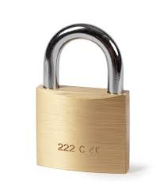
Open Source Needs Copyright
Proprietary software can be protected with:
Copyright
Trade secrets
Patents
Digital Rights Management
Open Source licenses require copyright

Slide 22
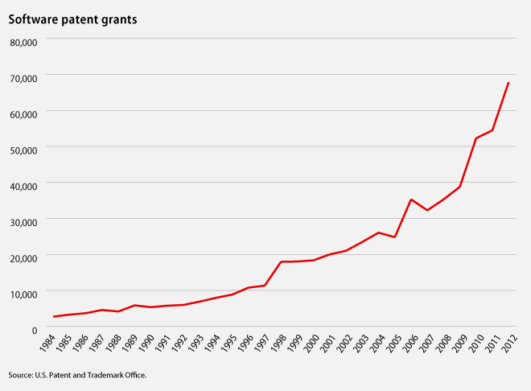
Copyrights v. Patents

Slide 23
Apache v. GPL
The Apache license tends to encourage broader community participation
….but may reflect unreasonable fear of GPL
….but has a greater risk of fragmentation
….but allows for proprietary forks

Slide 24
THANK YOU!
Eli Greenbaum
elig@arnon.co.il

