Slide 1
Influence of Cheap and Fast NVRAM on Linux Kernel Architecture
Leon Romanovsky
leon@leon.nu

Slide 2
Disclaimer
Everything in this lecture is my technology observations and should NOT be taken as an indication of any future my employee product plans.

Slide 3
Non-Volatile Read Access Memory
Disadvantages | Advantages | Type
Slow access time (compared to DRAM) Limited cell writes cycles | Already available in the device Price Large volumes Low power consumption | NAND (Flash)
Price Storage densities and capacity | Fast write access time Larger cell writes cycles than flash Low power consumption | FRAM
Not commercially available Requires extremely large investment in production | Fast as SRAM Not limited in cell writes cycles Scalable Low power consumption | MRAM
Not commercially available Depended on temperature Current soldering technique erased the chip Limited cell writes cycles Requires changes in production | Fastest write access Multiple state per bit Long retention period Radiation tolerance | PRAM
Notes:
FRAM - Ferro Random Access Memory
MRAM - Magnetoresistive Random Access Memory
PRAM - Phase change Random Access Memory - memristor

Slide 4
Highlights of NVRAM
Power efficient
Stays at RAM after power loss
Error correction
Fast read
Storage density/capacity
Byte-addressable access
Price

Slide 5
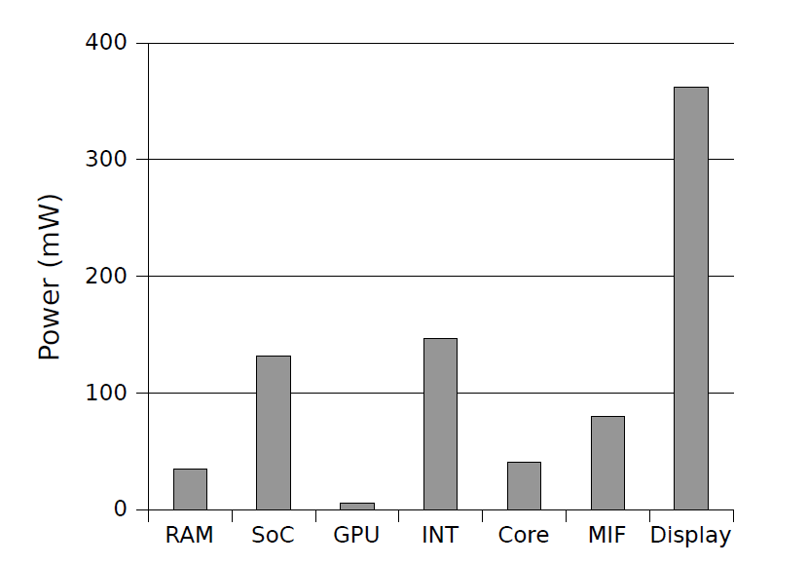
Power Estimation*
*Idle power in airplane mode.
The Systems Hacker’s Guide to the Galaxy Energy Usage in a modern Smartphone

Slide 6
Prices
Price Per GB | Price Per Unit | Model | Type
$11.12 $8 $6.25 | $88.99 $31.98 $50 | Kingston DDR3-2133 8GB Gigaram DDR3-2000 4GB Apple DDR3-1600 8GB | DRAM
$0.73 $0.61 | $375.95 $294 | Crucial SATA III 512GB OCZ 480GB | SSD
$0.46 $0.41 | $30 $12.99 | Lexar USB Stick 64GB Noname USB Stick 32GB | Flash
$0.04 $0.04 | $155.99 $114.90 | Seagate SATA 4TB Seagate SATA 3TB | Hard Drive
* Based on pricewatch.com street price

Slide 7
Memory Architecture
Unified Memory (UMA)
Non-Unified Memory (NUMA)
RAM
CPU2
CPU3
CPU1
CPU1
CPU2
RAM2
RAM1

Slide 8
System Architecture
Current
Future
CPU
RAM
Back storage (NVRAM, disks e.t.c)
CPU
Storage (NVRAM)

Slide 9
Changes in Linux Kernel
Memory management
Caches
Pages swaps
File storage
Security
Power handling

Slide 10
Memory Management
Designed for two regions:
Small and fast
Large and slow
No back storage
No need to remove pages
Out of memory (OOM) is the same as out of space
Pages won’t move
Different page granularity
No need in virtual addressing
No hardware protection
Different process separation

Slide 11
Memory Management Options
File system approach - virtual interfaces
Blocks layer is slow
Memory approach – change in kmalloc()
Adding new flag
Consumer needs specific address space.

Slide 12
File Storage
Process separation
Non-stop execution
Install/update/boot
Faults
Checkpoints/logs garbage collection
Security
Reliability
Corruption
Portability

Slide 13
PRAMFS
No need to cache (O_DIRECT flag)
Synchronous write (no blocking)
All pages are read-only to prevent data corruption
Temporal solution
Not in mainline

Slide 14
Summary
NVRAM is already available
It is going to be hottest topic in LKML
There is no simple solution

Slide 15
We are hiring.
leon@leon.nu

