Slide 1
BAR2308TT
A SSI chip with all the functionality of all basic Logic gates
---- Designed by Amit Barman

Slide 2
This chip provide us all the functionality of all basic logic gates- OR, AND, NOT, NOR, NAND, XOR, XNOR and Half adder.
This project is open source at here

Slide 3
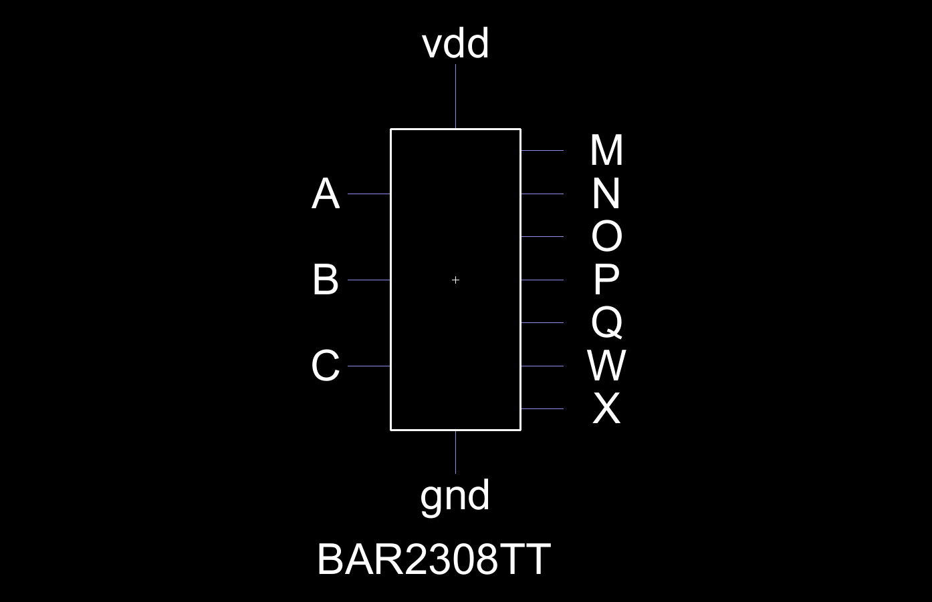
Icon of BAR2308TT

Slide 4
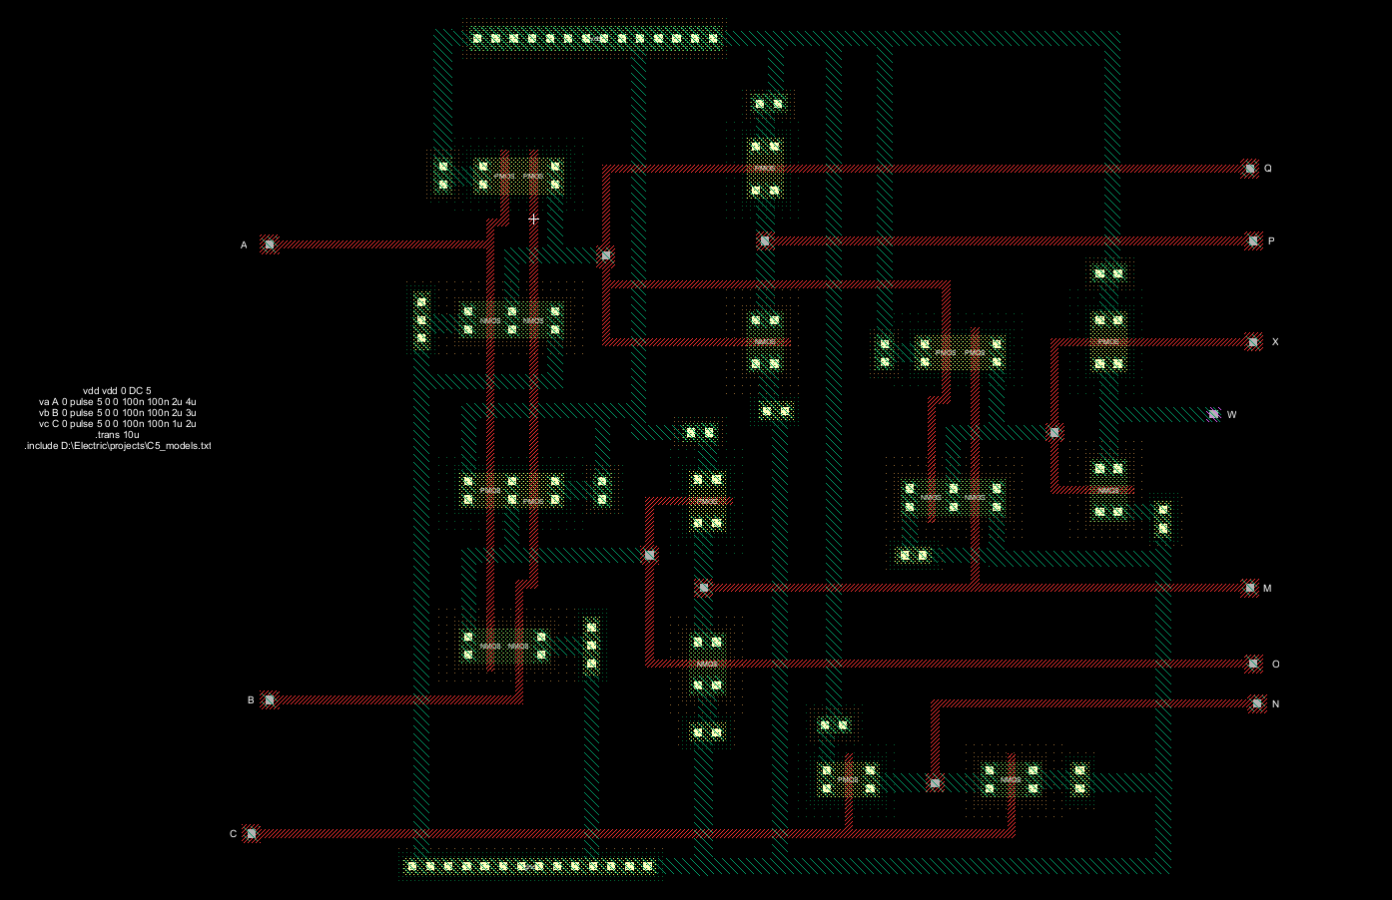
Layout of BAR2308TT

Slide 5
01
Use as OR gate
The A & B pin should be use as INPUT pin and P pin as an OUTPUT.

Slide 6
BAR2308TT as an OR gate
VDD
A(Input)
B(Input)
P = A+B(output)
GND

Slide 7
02
Use as AND gate
The A & B pin should be use as INPUT pin and M pin as an OUTPUT.

Slide 8
BAR2308TT as an AND gate
VDD
M = A.B(output)
A(Input)
B(Input)
GND

Slide 9
03
Use as NOT gate
The C pin should be use as an INPUT pin and N pin as an OUTPUT.

Slide 10
BAR2308TT as a NOT gate
VDD
N = C(output)
C(Input)
GND

Slide 11
04
Use as NOR gate
The A & B pin should be use as INPUT pin and Q pin as an OUTPUT.

Slide 12
BAR2308TT as a NOR gate
VDD
A(Input)
B(Input)
Q = A+B(output)
GND

Slide 13
05
Use as NAND gate
The A & B pin should be use as INPUT pin and O pin as an OUTPUT.

Slide 14
BAR2308TT as a NAND gate
VDD
A(Input)
O = A.B(output)
B(Input)
GND

Slide 15
06
Use as XOR gate
The A & B pin should be use as INPUT pin and X pin as an OUTPUT.

Slide 16
BAR2308TT as a XOR gate
VDD
A(Input)
B(Input)
X = A.B+A.B(output)
GND

Slide 17
07
Use as XNOR gate
The A & B pin should be use as INPUT pin and W pin as an OUTPUT.

Slide 18
BAR2308TT as a XNOR gate
VDD
A(Input)
B(Input)
W = (A.B+A.B)(output)
GND

Slide 19
08
Use as Half Adder
The A & B pin should be use as INPUT pin and X(sum) & M(carry) pin as OUTPUT.

Slide 20
BAR2308TT as a Half Adder
VDD
M = A.B(CARRY, output)
A(Input)
B(Input)
X = A.B+A.B(SUM, output)
GND

Slide 21
SIMPLE DESIGN
FUNCTIONALITY
COMPUTING POWER
OPEN SOURCE
This chip layout is Simple design of CMOS. I used here 20 CMOS and connected there as per equation.There is no resistors,inductors,capacitors etc.
Functionality of this IC chip (BAR2308TT) is very much important. One can use it as similar as any of the Logic gates – OR, AND, NOT, NOR, NAND, XOR, XNOR. He/She can also use it as Half adder.
Using as a Half adder one can also be able to make a computer(4-bit,8-bit). For that reason, one must be needed multiples BAR2308TT IC chips and needed to add as per equation.
It is an Open Source project. Although, I am going to create a License for it, but it will always for public use. Anyone can use it in their projects.

Slide 22
Equations
P = A + B
= (A+B)’’
P= Q’
M = A.B
= (A.B)’’
M = O’
N = C’
Q = (A+B)’
O = (A.B)’
X = A.B’ + A’.B
  = (A.B’ +A’.B)’’
  = ((A.B’)’.(A’.B)’)’
  = ((A’+B).(A+B’))’
  = (A.A’+A.B+A’.B’+B.B’)’
  = (A.B+A’.B’)’
  X = (A.B+(A+B)’)’

Slide 23
Equations
W = (A.B’ + A’.B)’
  = (A.B’)’.(A’.B)’
  = (A’+B).(A+B’)
  = A.A’+A.B+A’.B’+B.B’
  = A.B+A’.B’
  = A.B+(A+B)’
  = (A.B+(A+B)’)’’
  W = X’

Slide 24
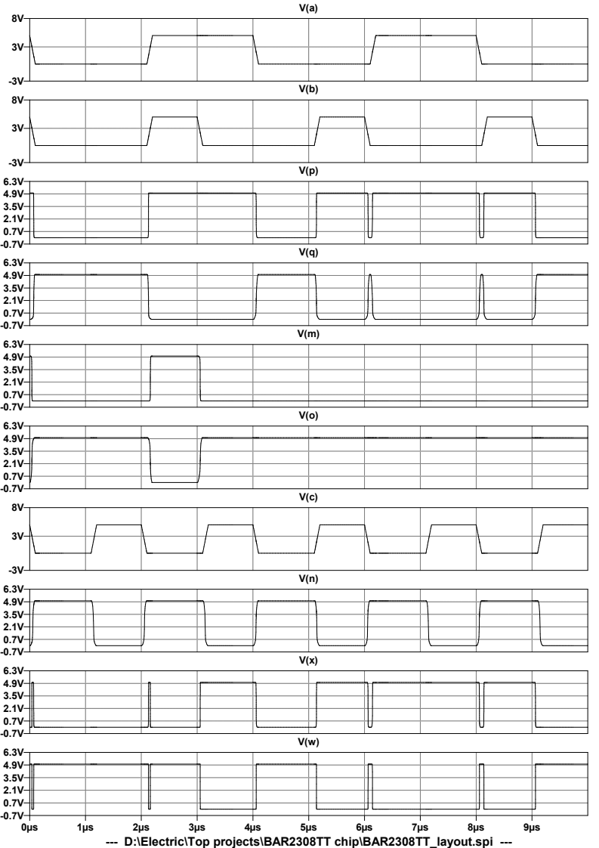
Simulations

Slide 25
Usability
This will generate many ideas in future.One can use it “All logic gates in one IC chips”.
Hope that it’s performance will be incresed.
Yeah, one can definitely share it with anyone.
Due to open source project, It will open to all. Anyone can use it as base chip.
It’s layout should not be changed. I have create a license for it.

Slide 26
THANK YOU
AMIT BARMAN linkdin : @AmitBarman99 twitter : @imamitbarman99 github : @AmitBarman99

