Slide 1
Deletion in BST

Slide 2

Contents :-
Deletion
In order traversal in BST
Sorting in BST
Insertion in BST
Random permutation
Recurrence Relation

Slide 3
Deletion in BST :-
Deleting x from a Tree T.
We can distinguish three cases
X has no children
X has one child
X has two children

Slide 4
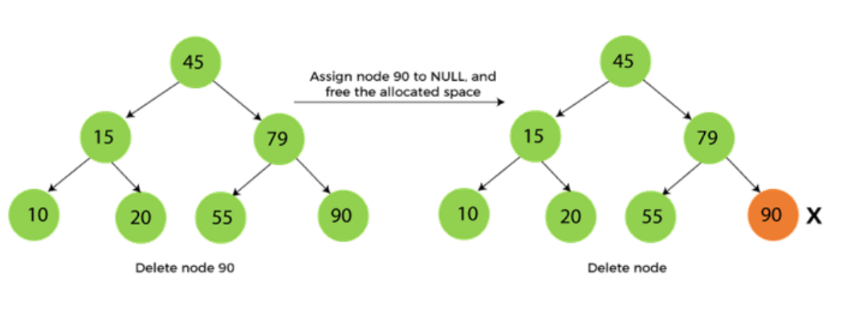
Deletion Case -1 :-
If X has no children just remove X.
suppose we have to delete node 90
as the node to be deleted is a leaf node
it will be replaced with NULL, and the allocated space will free.

Slide 5
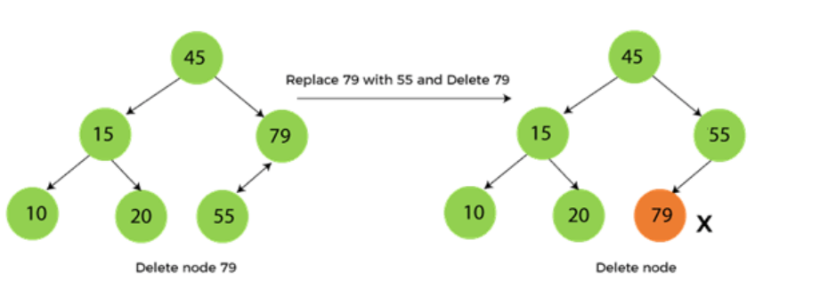
Deletion Case 2:-
Suppose we have to delete the node 79.
As the node to be deleted has only one child.
So, it will be replaced with its child 55.
So, the replaced node 79 will now be a leaf node that can be easily deleted.

Slide 6
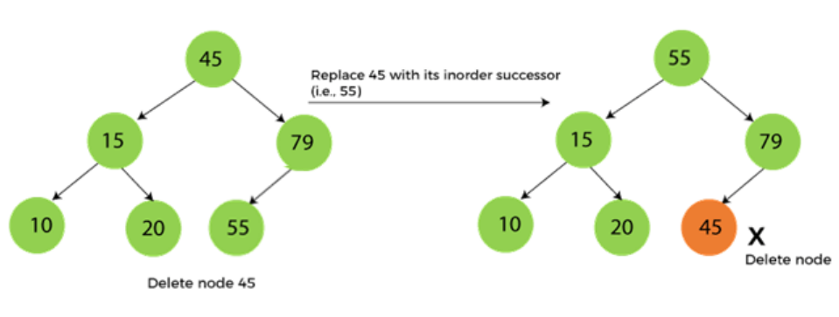
Deletion Case 3 :-
First, find the inorder successor of the node to be deleted.
suppose we have to delete node 45 that is the root node, as the node to be deleted has two children.
so it will be replaced with its inorder successor i.e. 55.
Now, node 45 will be at the leaf of the tree so that it can be deleted easily.

Slide 7
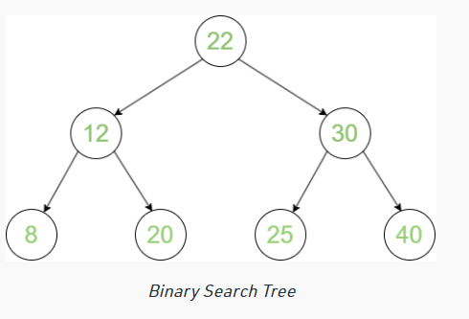
In order Traversal of BST :-
At first traverse left subtree then visit the root and then traverse the right subtree.
The inorder traversal of the BST gives the values of the nodes in sorted order.
Inorder of BST is always sorted.
8,12,20,22,25,30,40

Slide 8
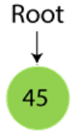
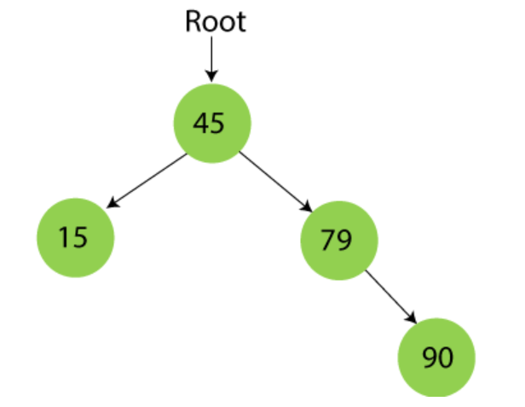
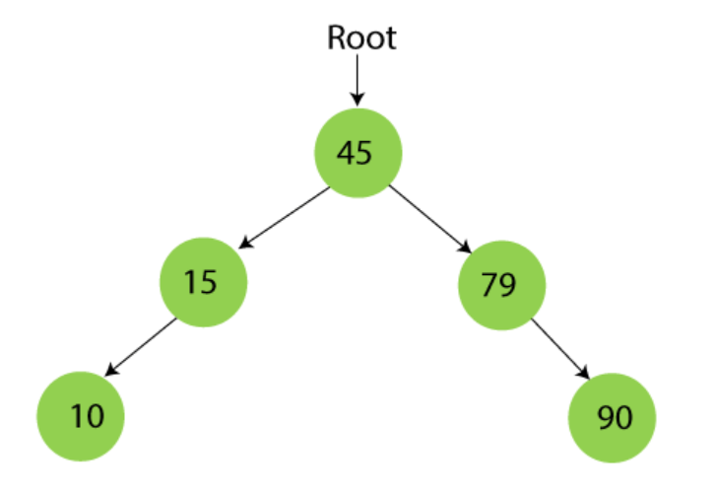
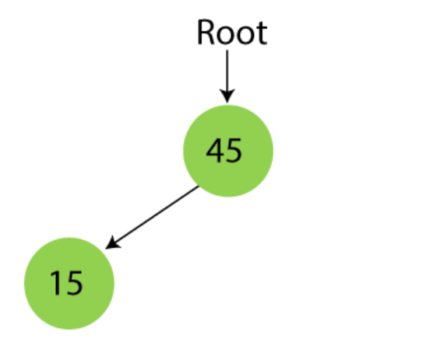
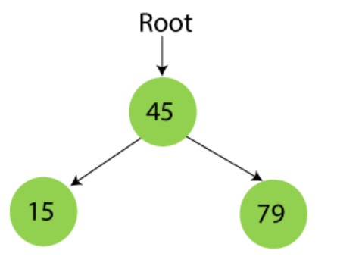
BST Sorting:-
Sort the following numbers
45,15,79,90,10
Build a BST
Call Inorder Treewalk
Results -> 10,15,45,79,90

Slide 9
Insertion in BST :-
In what order we should insert ?
We want to store numbers {1,2,3,..,n}
Total time taken to insert the elements will be equal to the sum of the level numbers of node.
Thus if numbers were inserted in ascending order we would get a tree of height n-1 in which there is one node at each level.
So total time for insertion in this case is :-
1+2+3+4+5+…+n-1=O(n²)

Slide 10
Insertion time for the random permutation:-
We will compute the average time taken to insert the keys in the order specified by n! permutations.
In other words, for each of the n! permutation we will compute the time taken to insert keys in that order and then compute the average.
Let T(n) denotes this quantity.

Slide 11
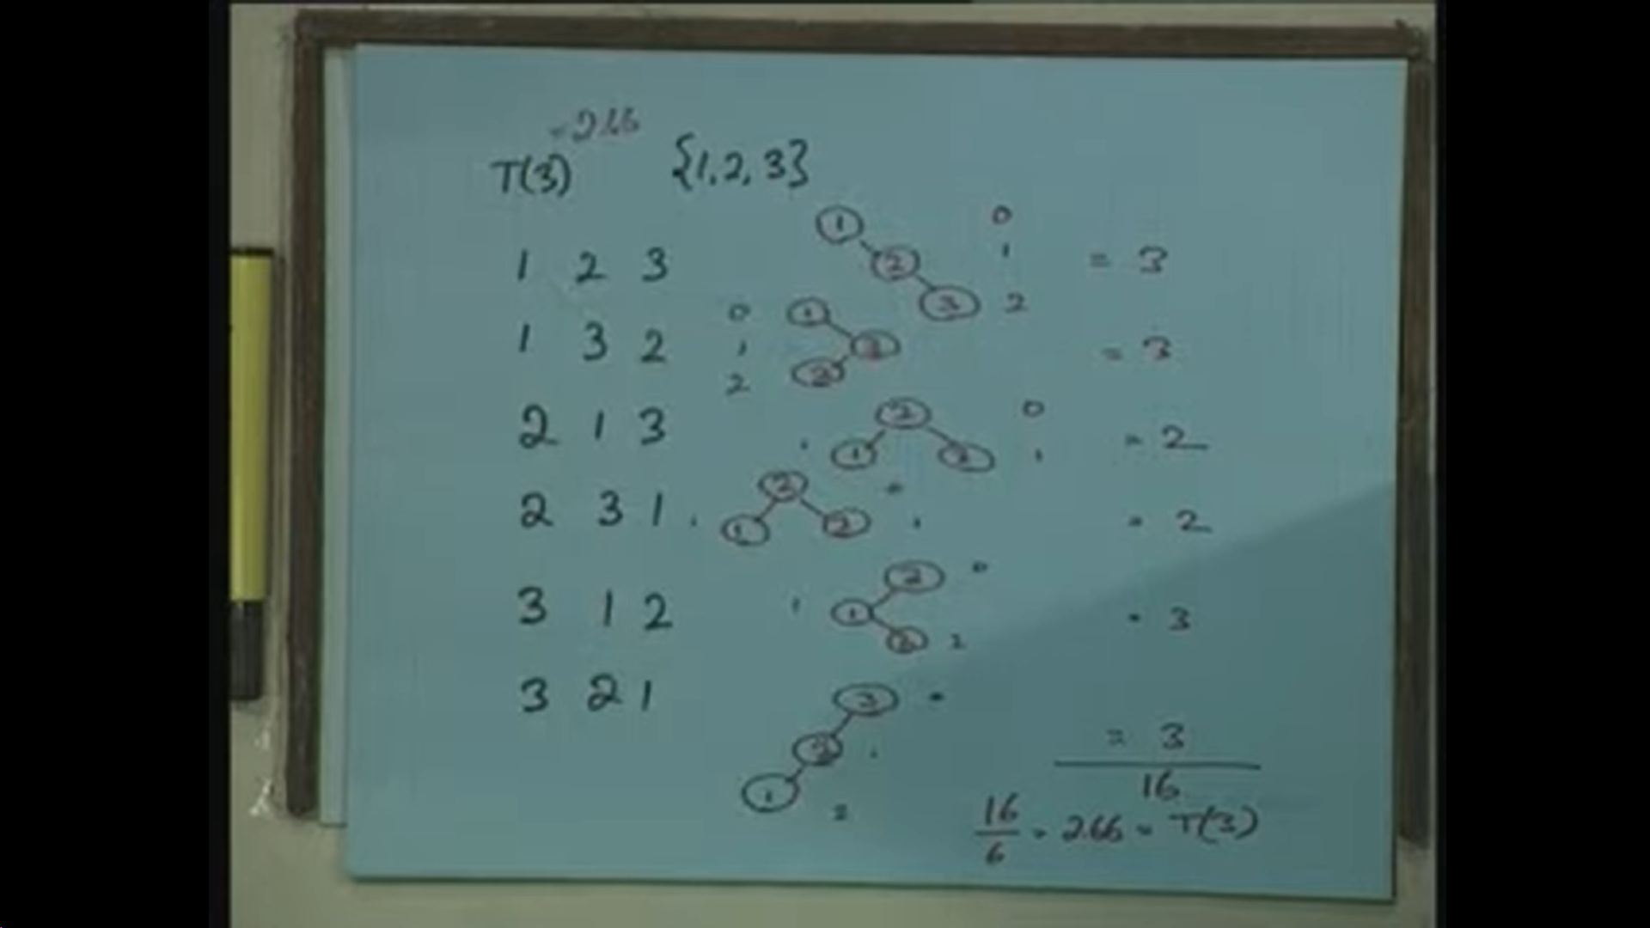
Let’s take an example:-

Slide 12
Inserting a random permutation:
First let’s examine the case when root node is fixed = i.
Of the n! permutations there are (n-1)! permutations in which the first element is i.
The tree formed in these instances has i as the root. The left subtree has keys 1 .. (i-1) and the right subtree has keys (i+1) .. n
Consider the ordering of keys 1 .. (i-1) in the (n-1)! permutations. All (i-1)! permutations appear and each occurs (n-1)! / (i-1)! times.
Recall that if we only had keys 1 .. (i-1) then average time taken to insert them is T(i-1).

Slide 13
Inserting a random permutation:
The average is taken over all permutations of 1 .. (i-1).
Hence total time to insert them all (i-1)! permutation is (i-1)!T(i-1).
When inserting keys 1 .. (i-1) into the left subtree, each tree has to be compared with the root.
This leads to an additional unit cost for each key.
So total time to insert all (i-1)! permutations is (i-1)! (T(i-1) + (i-1)).

Slide 14
Inserting a random permutation:
Since each permutation appears (n-1)!/(i-1)! times, total time to insert keys 1 .. (i-1) is (n-1)! (T(i-1) + (i-1))
Time to insert keys 1..(i-1) is (n-1)!(T(i-1) + (i-1))
Similarly time to insert keys (i+1) .. n is (n-1)!(T(n-i) + (n-i))
Total time to insert all n keys in permutations where the first key is i is (n-1)! (T(i-1) + T(n-i) + n-1)
Total time to insert all n keys in all n! permutations is (n-1)! ∑i =1 to n (T(i-1)+T(n-i)+ n-1)

Slide 15
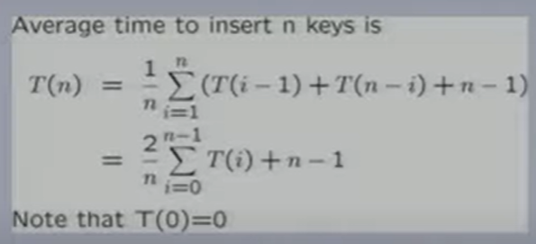
Average time to insert n keys:-
Average =Total time to insert all n keys / n !
We are expressing the value of function T() at point n in terms of the value of T() at points 0..n-1.
This is called recurrence relation

Slide 16
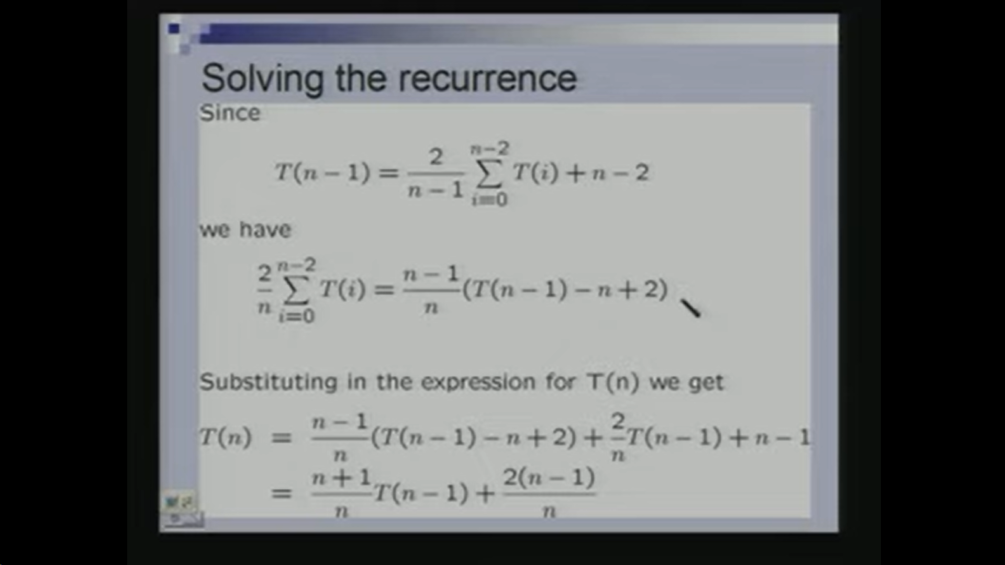
Solving the recurrence relation:

Slide 17
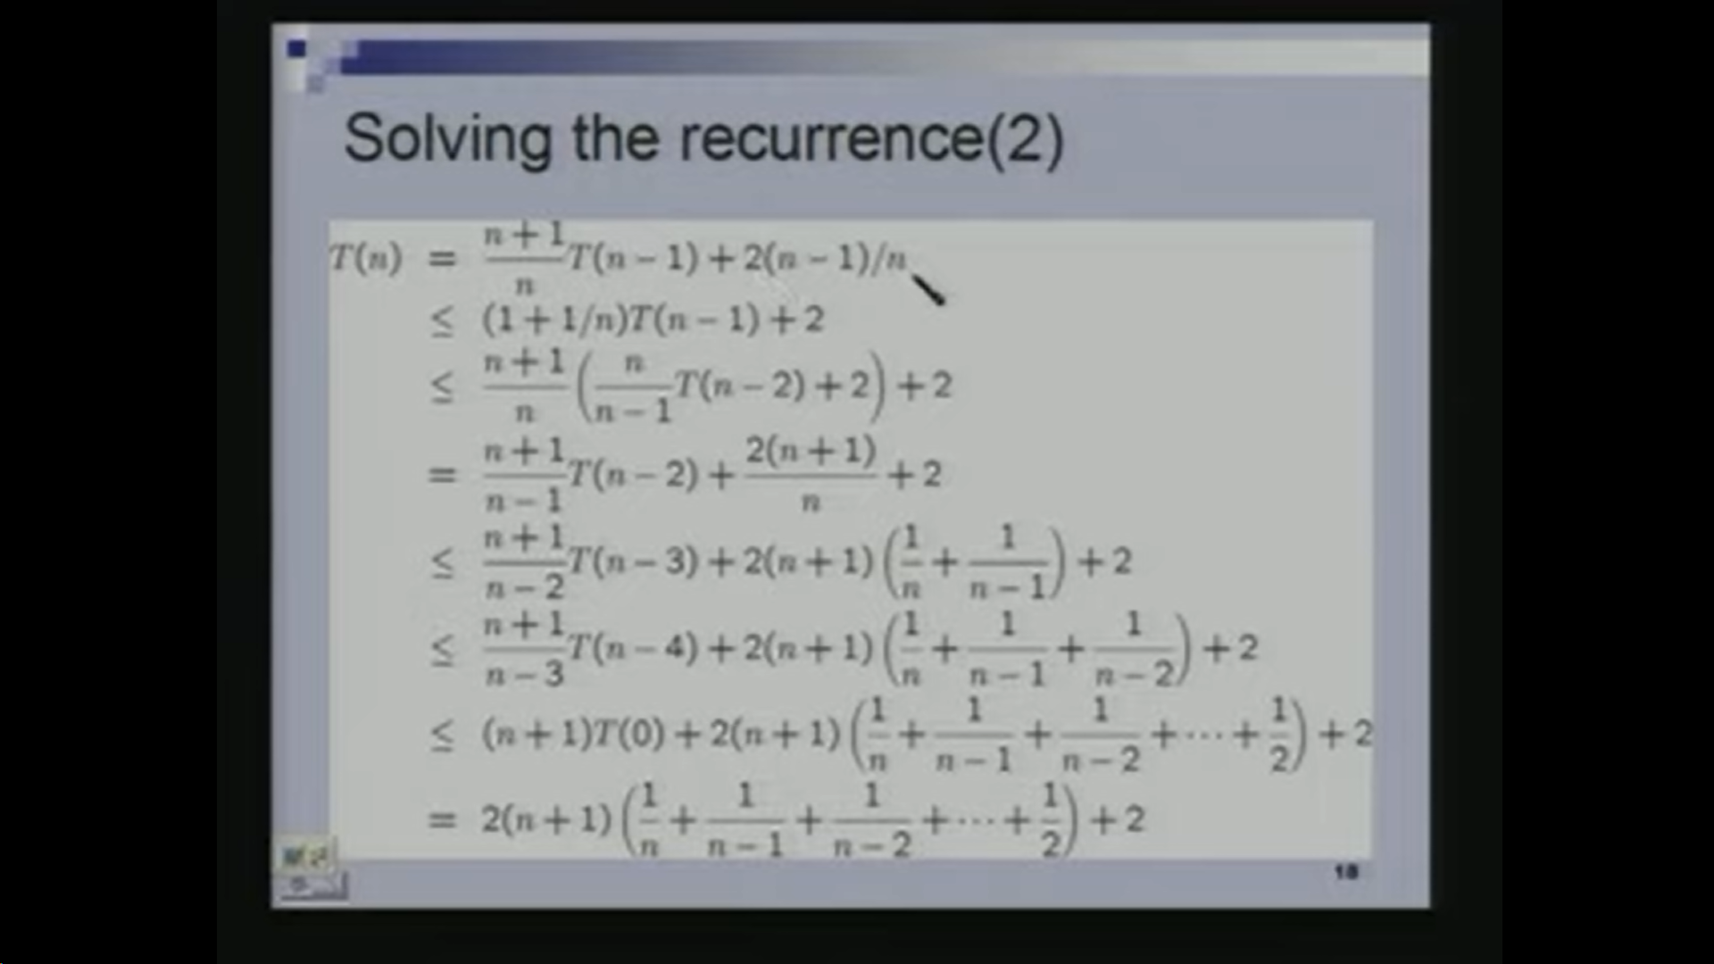
Solving the recurrence relation:

Slide 18
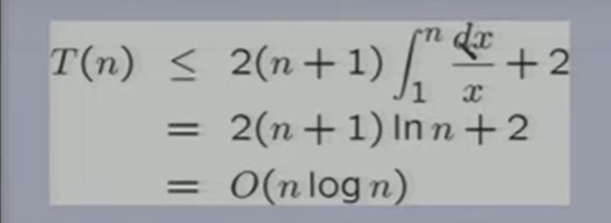
The final term :-
The sum of the harmonic series obtained is at most area under the curve f(x) = 1/x between limits 1 to n.
So, we compute T(n)= O(n logn).

Slide 19
Summary:-
To insert n keys in a BST which is initially empty requires.
O(n²) time in worst case.
O(n logn) time in best case.
O(n logn) time in average case. The average is taken over all n! different order.

Slide 20

Thank you!

