Slide 1
Hashing
Vivek & Suraj

Slide 2
Contents:-
Hash Function
Hash-code Maps
Compression Maps
Linear Probing
Lookup in Linear probing
Deletion in Linear probing
Double hashing
Analysis of Double hashing

Slide 3
Hash Function :-
choosing a good hash function :-
1.) Quick to compute.
2.) Distributes keys uniformly throughout the table.
3.) good hash function are very rare – birthday paradox.
How to deal with hashing non-integer keys :-
1.) Find some efficient way to convert it into Integers.
eg:- 84537-99991 remove hyphen to get 8435799991.
eg:- For a String add ASCII value of the characters.

Slide 4
Hash Function:-
The mapping of key to indices of a hash table is called a Hash
Function.
A Hash Function is usually composition of two maps, a Hash code
map and a compression map.
An essential requirement of a hash function is to map equal keys to
equal indices.
A “good” hash function minimizes the probability of collisions.
Hash code Map : Key -> integer
Compression Map : Integer ->[0,N-1]

Slide 5
Popular Hash Code Maps:-
Integer Cast : For numeric types with 32 bits or less , we can
reinterpret the bits of the number as an int.
component sum : - For numeric type with more than 32 bits (e.g Long and double), we can add the 32 bit components.
Why we can not use component sum for String ?
The number of collision is very high.
for eg : - The word DOG and GOD and same Component Sum.

Slide 6
Hash Code Map :-
Polynomial Accumulation :- for String of a natural language ,
Combine the Character Values (ASCII) a₀,a₁,………,a_{n-1} by
viewing them as the coefficients of a polynomial:
a₀+a₁X+…+ X^{n-1} a_{n-1}
The polynomial is computed with Horner’s rule, ignoring overflows
at fixed value of X :-
a₀+ x(a₁+x(a₂+…..x(a_{n-2}+ x(a_{n-1})….))
The choice of x= 33,37,39 or 41 gives us at most 6 collisions on
vocabulary of 50,000 English words.

Slide 7
Compression map:-
Use the remainder
h(k)= k mod m , k is the key and m is the size of table
Need to choose m
if m is a power of 2, h(k) gives at least e significant bits of k.
All key with same ending goes to the same place.
m prime(good)
helps ensure uniform distribution.
hash table for n=2000 char String
m=701
if we compute the we will get at most 3 element in the linked list.

Slide 8
Compression Map :-
Multiply, Add, Divide (MAD) :-
h(k1)=|a * k + b | mod N
eliminates patterns provided a is not a multiple of N.
Value of k will be last random number generated.
a and b are fixed number.

Slide 9
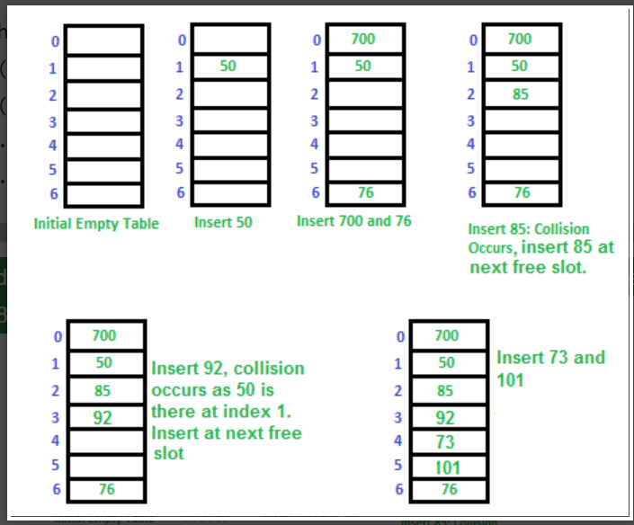
Linear Probing:
In linear probing, the hash table is searched sequentially that starts from the original location of the hash. If in case the location that we get is already occupied, then we check for the next location. The function used for rehashing is as follows: rehash(key) = (n+1)%table-size. For example, the typical gap between two probes is 1 . Let hash(x) be the slot index computed using a hash function and S be the table size
Let us consider a simple hash function as “key mod 7” and a sequence of keys as 50, 700, 76, 85, 92, 73, 101.

Slide 10
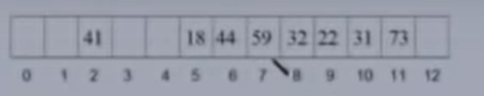
Lookup in Linear probing:-
To search for a key k we go to (k mod 13) and continue looking at successive locations till we find k or encounter an empty location
Successful search :- to search for 31 we go to
(31 mod 13) = 5 and continue onto location 6,7,8
Till we find 31 at location 10
Unsuccessful Search:- to search for 33 we go to
(33 mod 13) = 7 and continue till we encounter an empty location at 12 then we stop search as element is not in the hash table.

Slide 11
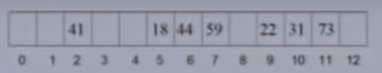
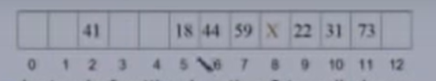
Deletion in Linear probing:-
To delete key 32 we first need to find it.
32 is find at location 8 . And what if we just set this location to null as an empty element.
Now if we search for 31 which is at location 10 in the hash table but we will encounter a null location before finding 31 so in that case the searching will be failed.
So instead of setting location 8 to null we can place a tombstone there (a marker).
When a lookup encounters a tombstone it ignores it and continue to search with next location.
↓
↓

Slide 12
Deletion in Linear probing:-
If insert comes across a tombstone it puts the element at that location and removes the tombstone.
To many tombstone degrades the performance so in the case of too many tombstone we Rehash.

Slide 13
Double hashing
Double hashing is a collision resolving technique in Open Addressed Hash tables. Double hashing uses the idea of applying a second hash function to key when a collision occurs.
h1(k) is the position where we first check for key k.
h2(k) determines the offset we use when searching for k.
In linear probing h2(k) was always 1.
If m is prime , we will then eventually examine each and every position of the table otherwise there can be a case when we cycle back to the first location which was occupied.

Slide 14
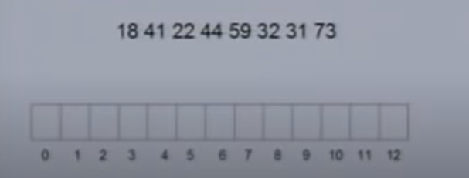
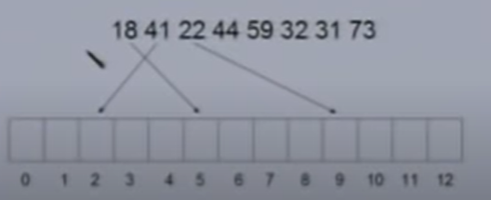
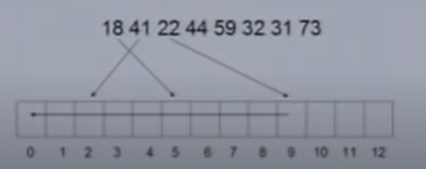
Double Hashing Example:-
h1(k) = k mod 13
h2(k) = 8 – (k mod 8 )
Initially 18 41 22 goes there location with only h1(k) no collision so far.
For 44 h1(k) = 44 mod 13 = 5 which is occupied so we use h2(k) = 8 – (44 mod 8) = 8 – 4 = 4
So we check for 5+4 = 9th location which is also occupied so we again jump for places and put the key at 0th index .
Keys:-

Slide 15
Advantages of Double hashing
The advantage of Double hashing is that it is one of the best
form of probing, producing a uniform distribution
of records throughout a hash table.
This technique does not yield any clusters.
It is one of effective method for resolving collisions.

Slide 16
Analysis of Double hashing:-
The load factor α is always < 1.
α =the number of elements / the hash table size ( n/m)
We assume for analysis that every probe looks at a random location in the table.
1- α fraction of the table is empty
Unsuccessful search:-
Expected number of probes required to find
a empty location (unsuccessful search) is 1/1- α.
If 1/10th of the is empty than on an avg we might need 10 probes to find a empty location .

Slide 17
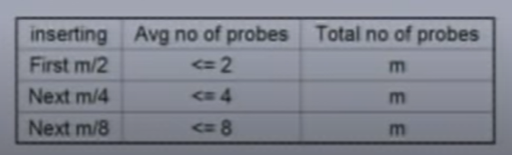
Successful Search
Average no. of probes for a successful search = Average no. of probes required for inserting all elements.
To insert an element we need to find an empty location.
For first m/2 elements the half of the table is empty so the expected number of probes required to insert will not be more than 2.
Same goes for next elements.

Slide 18
Analysis
No. of probes required to insert m/2+m/4+m/8+ ….. +m/2^{i}
elements = m * i .
After m * i probes 2^{-i} fraction of the table is empty.
No of probes required to leave 1 – α fraction of the table
empty = - m log (1 – α )
Average no of probes required to insert n elements is
–(m/n) log (1 – α ) = -(1/ α) log (1 – α ) .
Here m/n = 1/ α so we substitute it .

Slide 19
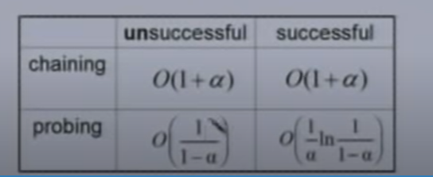
Comparison between chaining and probing
Load factor is α <1 for probing.

Slide 20
Thank you

