Slide 1
Employment Burnout Analysis (EBA) Project
CAPSTONE PROJECT
Presented By:
AMIT CHAUHAN SRM INSTITUTE OF SCIENCE AND TECHNOLOGY ECE

Slide 2
OUTLINE
Problem Statement
System Development Approach
Algorithm & Deployment
Result
Conclusion
Future Scope
References

Slide 3
Problem Statement
Employee burnout is a widespread issue, negatively impacting mental, emotional, and physical well-being.
Burnout results in decreased productivity, absenteeism, and increased turnover rates.
Predicting and identifying burnout early helps organizations take preventative actions to support employees.

Slide 4
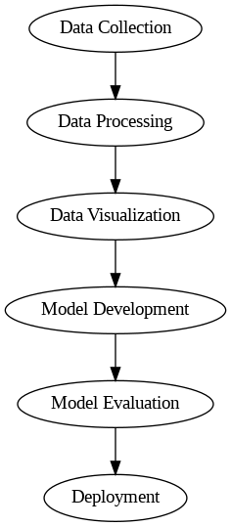
System Approach
Libraries Required
Data Processing:
Pandas
numpyVisualization: matplotlib,seaborn
Machine Learning: scikit-learn, xgboost, imbalanced-learn.
Model Evaluation: scikit-learn, matplotlib/seaborn
Deployment: Flask/Django, Docker, Heroku/AWS
System Requirements
Hardware:
Processor: Intel Core i5/i7 (or equivalent)
RAM: 8 GB (16 GB recommended)
Storage: 50 GB free space
Optional: GPU for faster training (NVIDIA with CUDA support)
Software:
Python 3.7+
Jupyter Notebook, VS Code/PyCharm
Operating System: Windows/Linux/macOS

Slide 5
Algorithm & Deployment
Data Loading: Import the dataset and explore its structure.
Data Preprocessing: Handle missing values, encode categories, and scale features.
Exploratory Data Analysis (EDA): Visualize data, analyze correlations, and detect outliers.
Feature Engineering: Create and select relevant features for model improvement.
Model Building: Split the data, train models (e.g., logistic regression, XGBoost), and validate using cross-validation.
Model Evaluation: Assess models using metrics like accuracy, precision, and ROC-AUC.

Slide 6
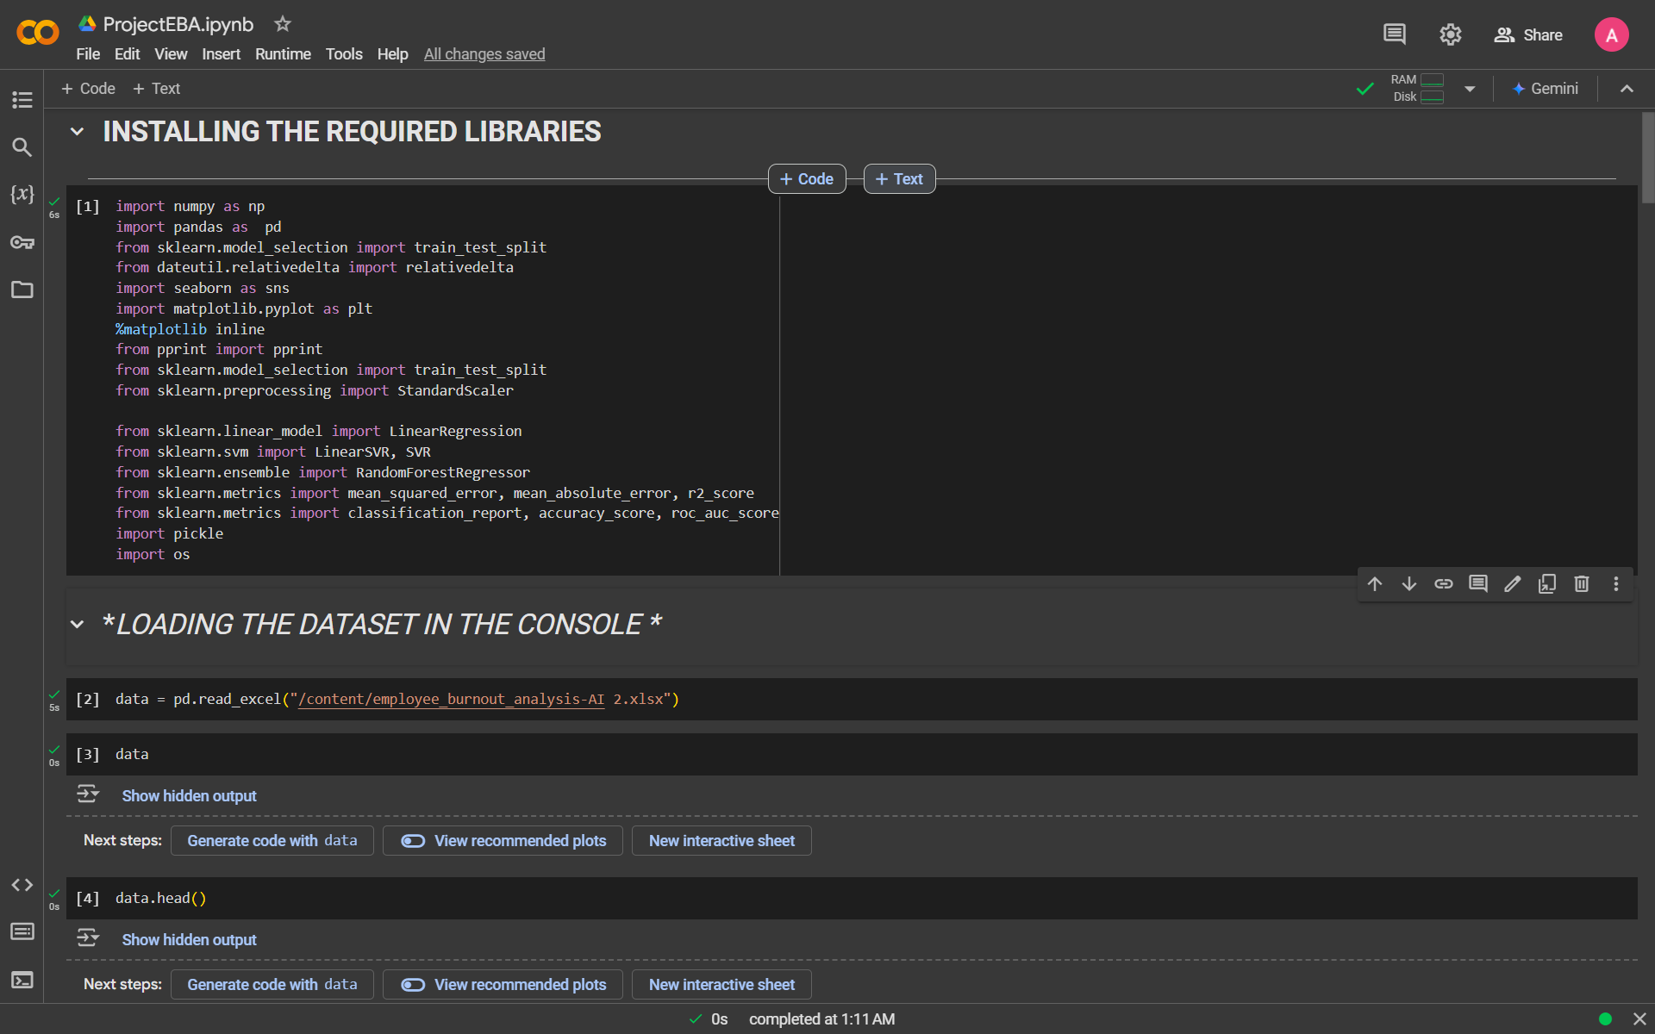
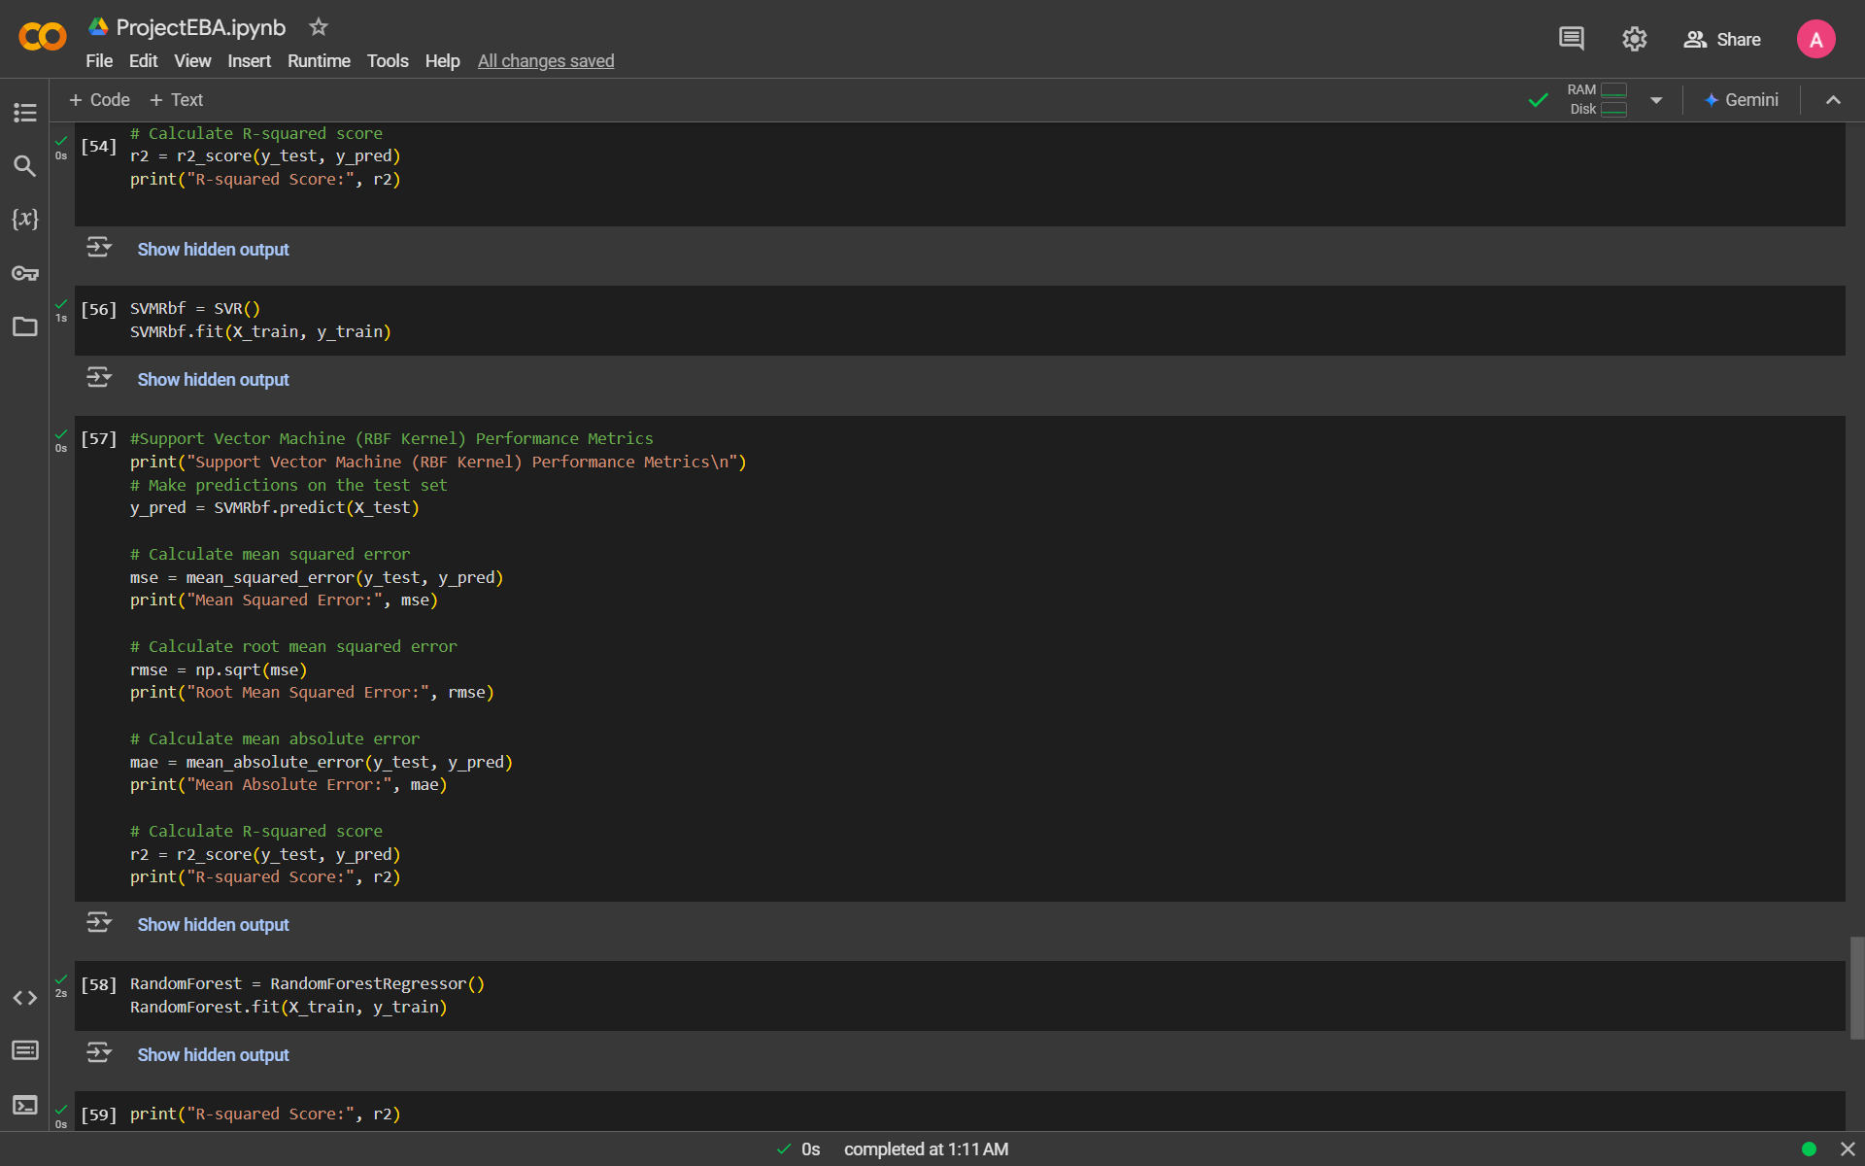
Result
ATTACHED THE 7 SNIPPETS OF CODE

Slide 7
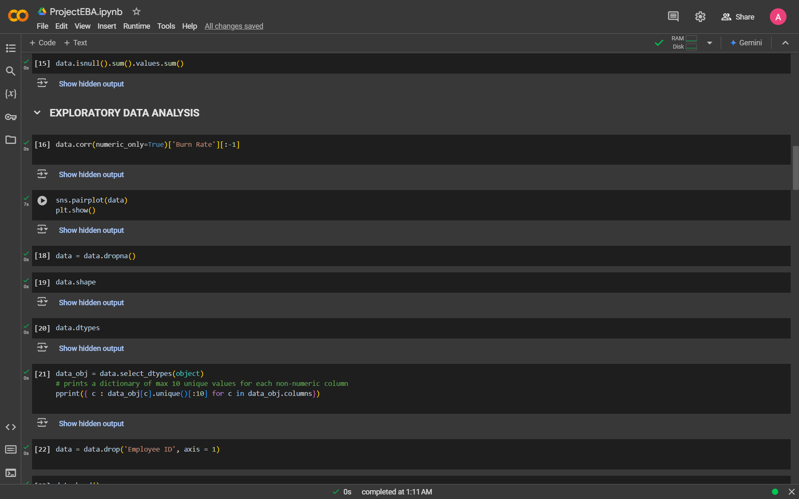
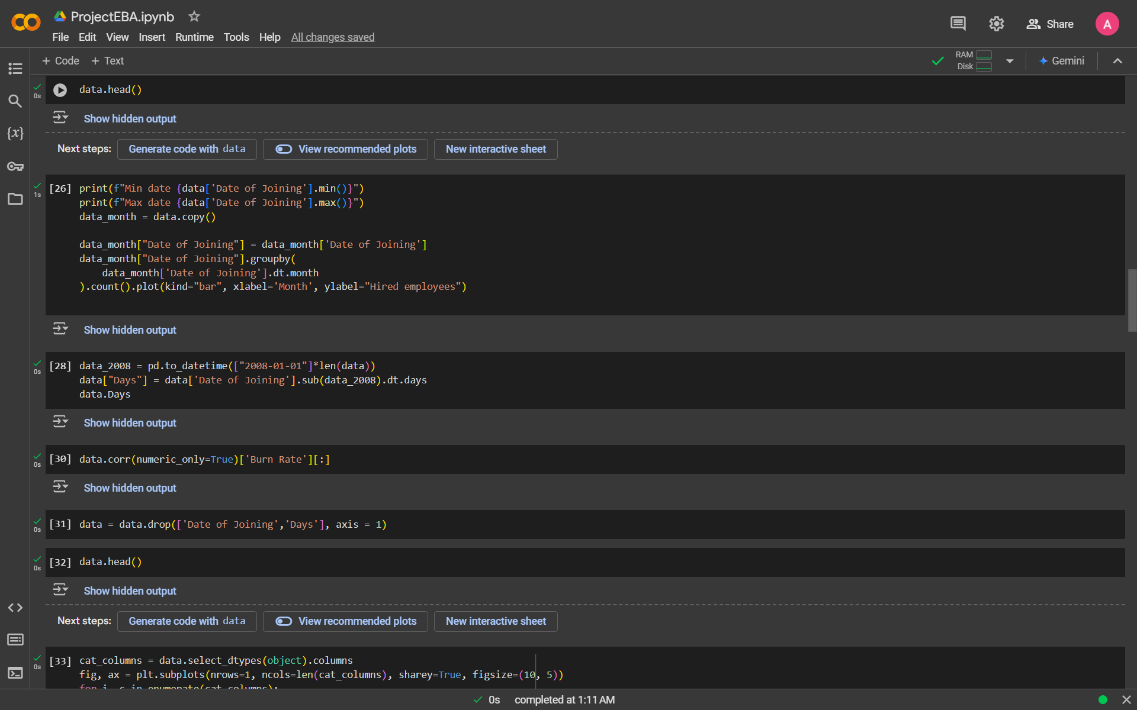

Slide 8
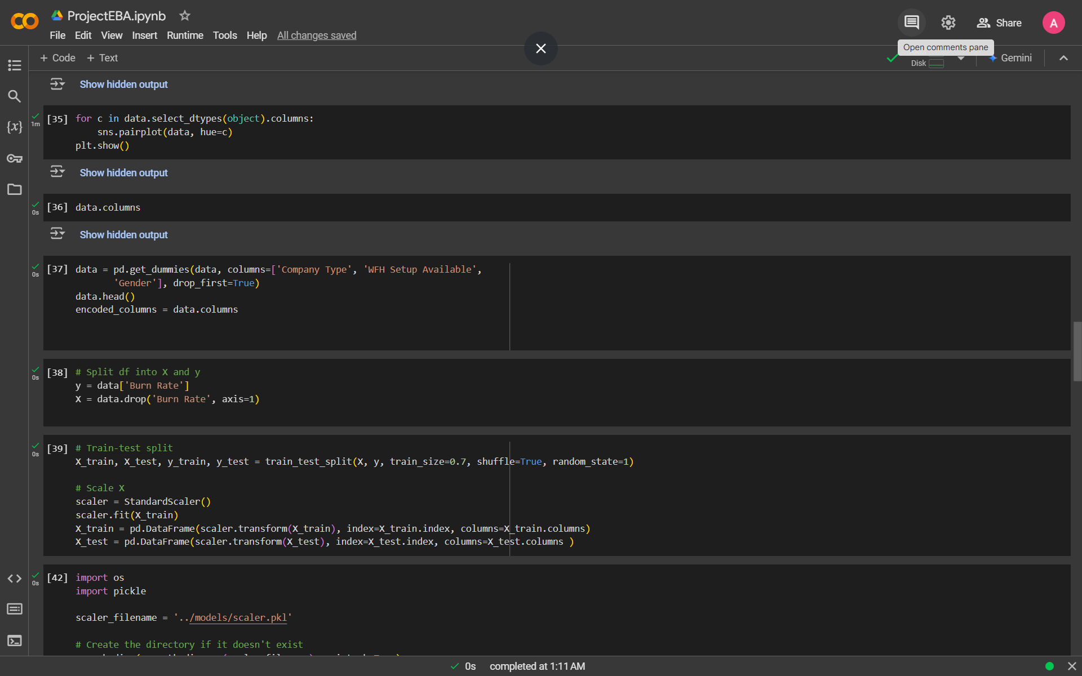
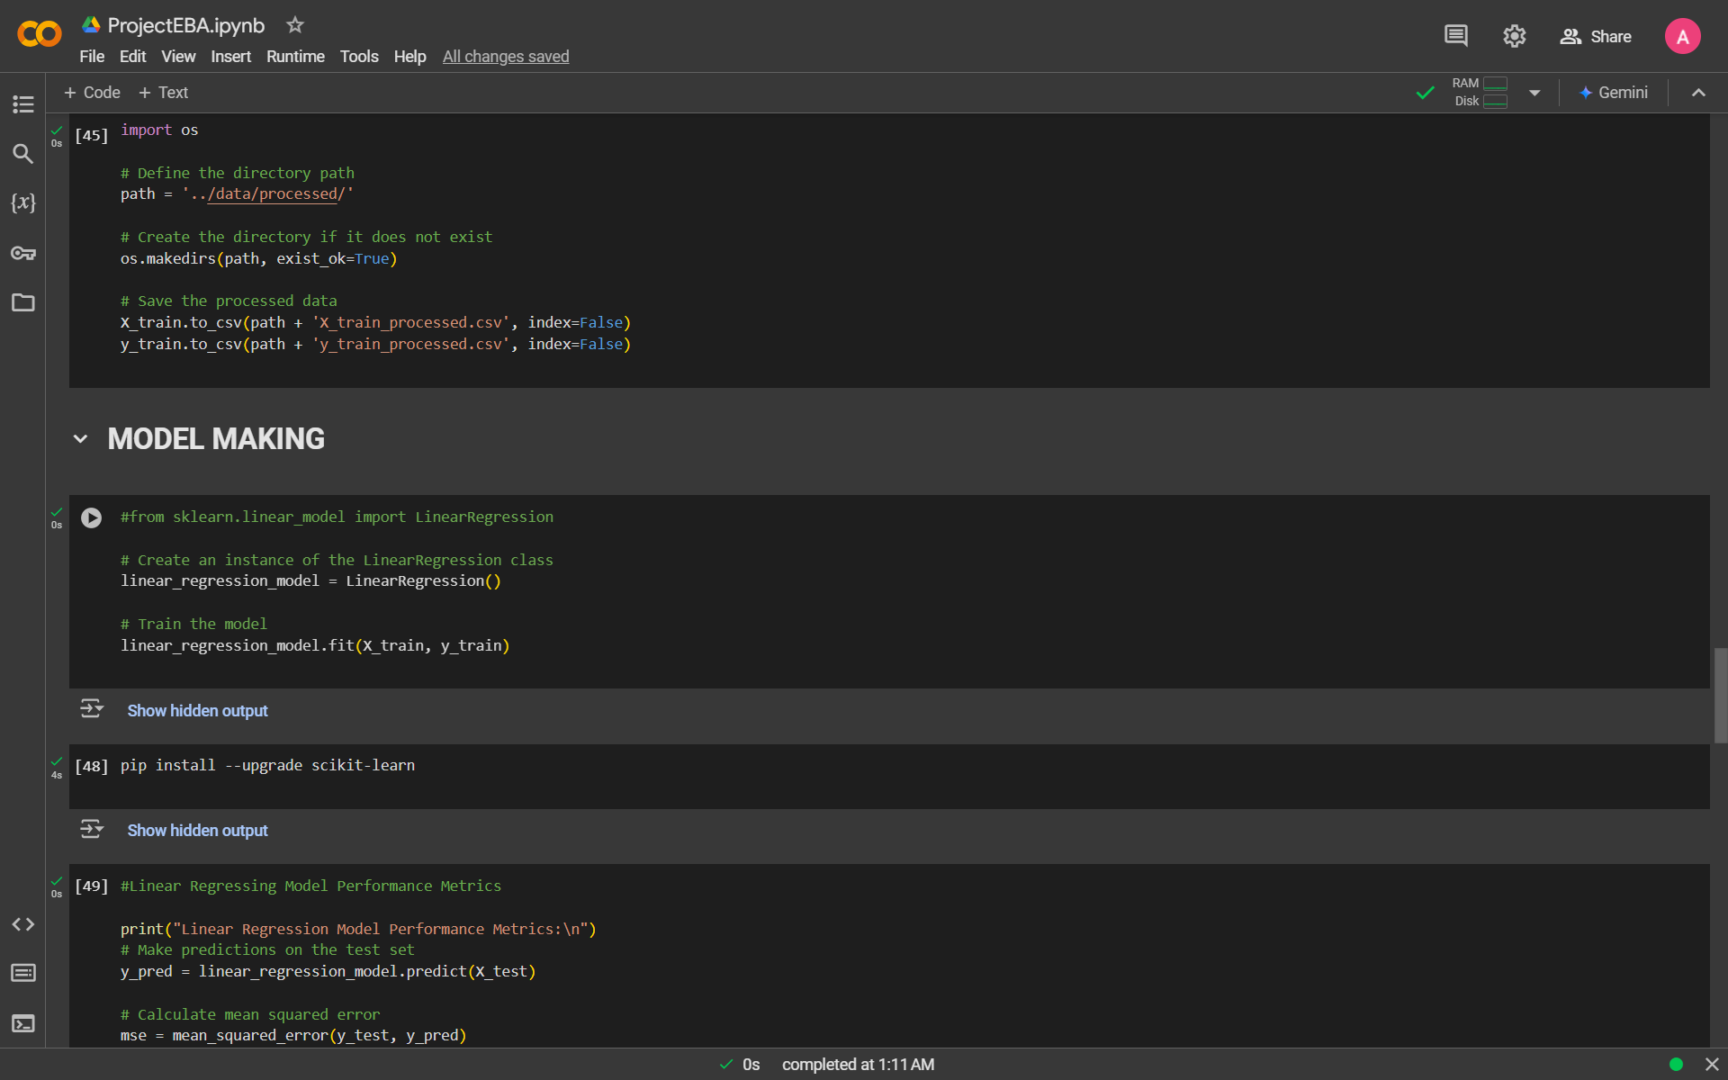

Slide 9
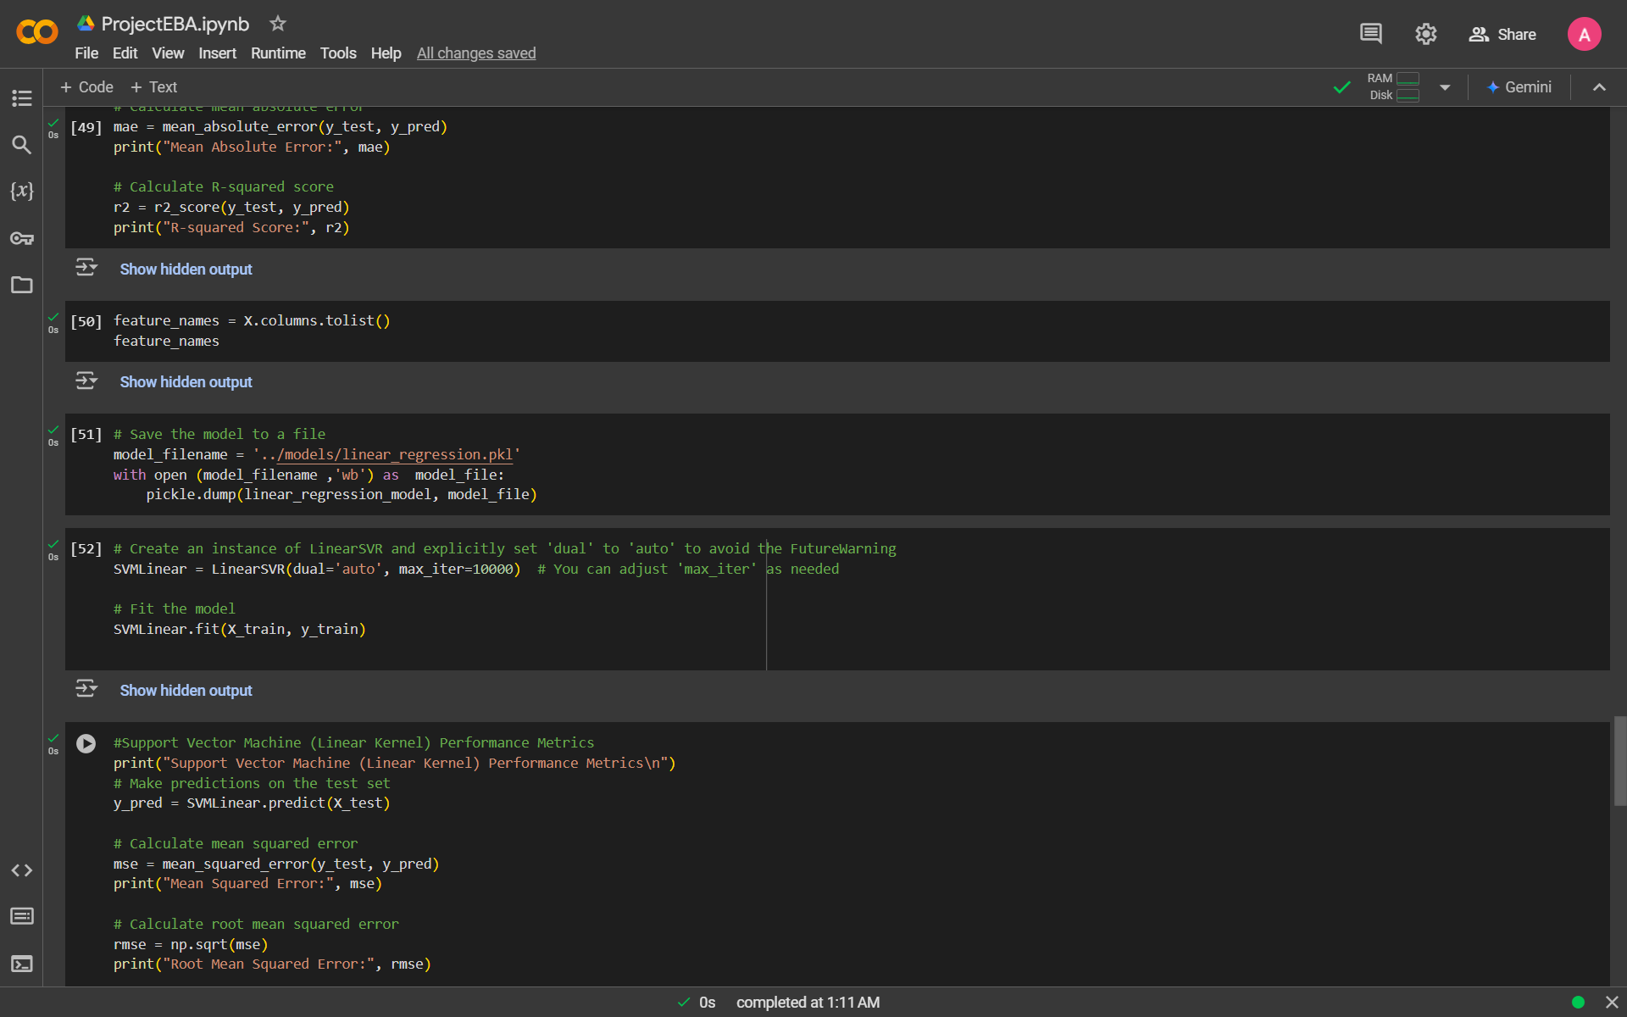
GITHUB LINK: https://github.com/AmitC04/EMPLOYMENT-BURNOUT-.git

Slide 10
Conclusion
Summary of the analysis, key findings, and the performance of the model.
Emphasize the importance of predicting employee burnout to mitigate its effects on organizations.
Briefly touch upon the limitations of the current model and the scope for further improvements.

Slide 11
Model Improvements: Explore more complex models, fine-tune hyperparameters, or consider deep learning approaches for better accuracy.
Data Collection: Gather more granular data (e.g., daily reports or continuous monitoring of employee well-being).
Real-time Deployment: Implement real-time prediction systems in organizations to monitor burnout risks continuously.
Future scope(Optional)

Slide 12
References
Key Resources :
IBM Technical sessions
Burnout studies
Online references: https://www.apa.org/monitor/2022/01/special-burnout-stress

Slide 13
THANK YOU

