Slide 1
Monthly Airbnb Demand Forecasting – Chicago
Presented By: Amit Chaulagain (B00127236)
Instructor: Prof. Dr. Md. Jabir Rahman
Course: IT 5413 – Forecasting

Slide 2
INTRODUCTION
Time series forecasting predicts future values using past data
Widely used in business and analytics
Airbnb demand shows seasonal patterns
Important for pricing and planning

Slide 3
OBJECTIVE
Analyze Airbnb demand data
Identify patterns (trend & seasonality)
Compare multiple forecasting models
Select the most accurate model

Slide 4
DATA & PREPARATION
Airbnb review data (proxy for demand)
Aggregated into monthly counts
Focus on recent years (post-2022)
Log transformation applied

Slide 5
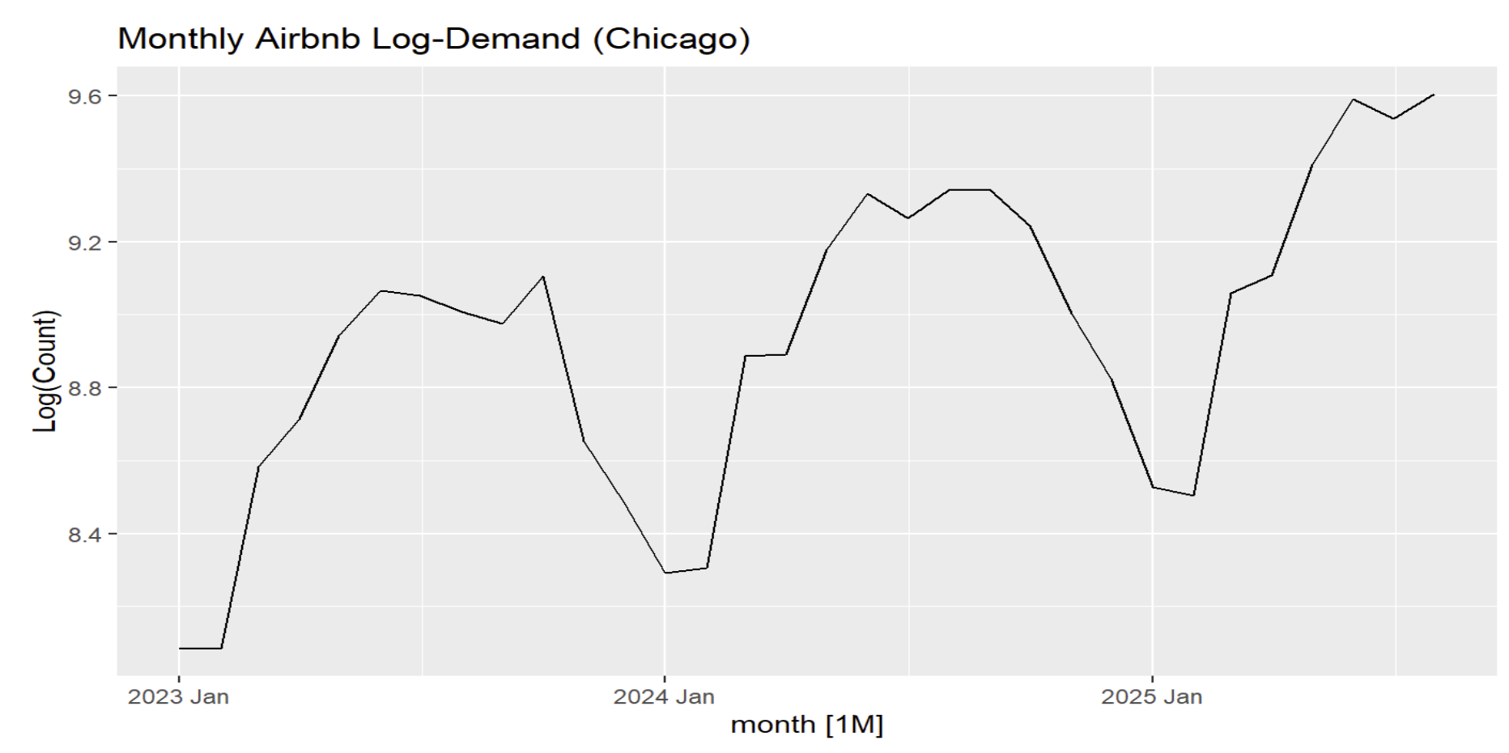
EXPLORATORY ANALYSIS
Upward trend observed
Strong seasonal patterns
Repeating yearly cycle

Slide 6
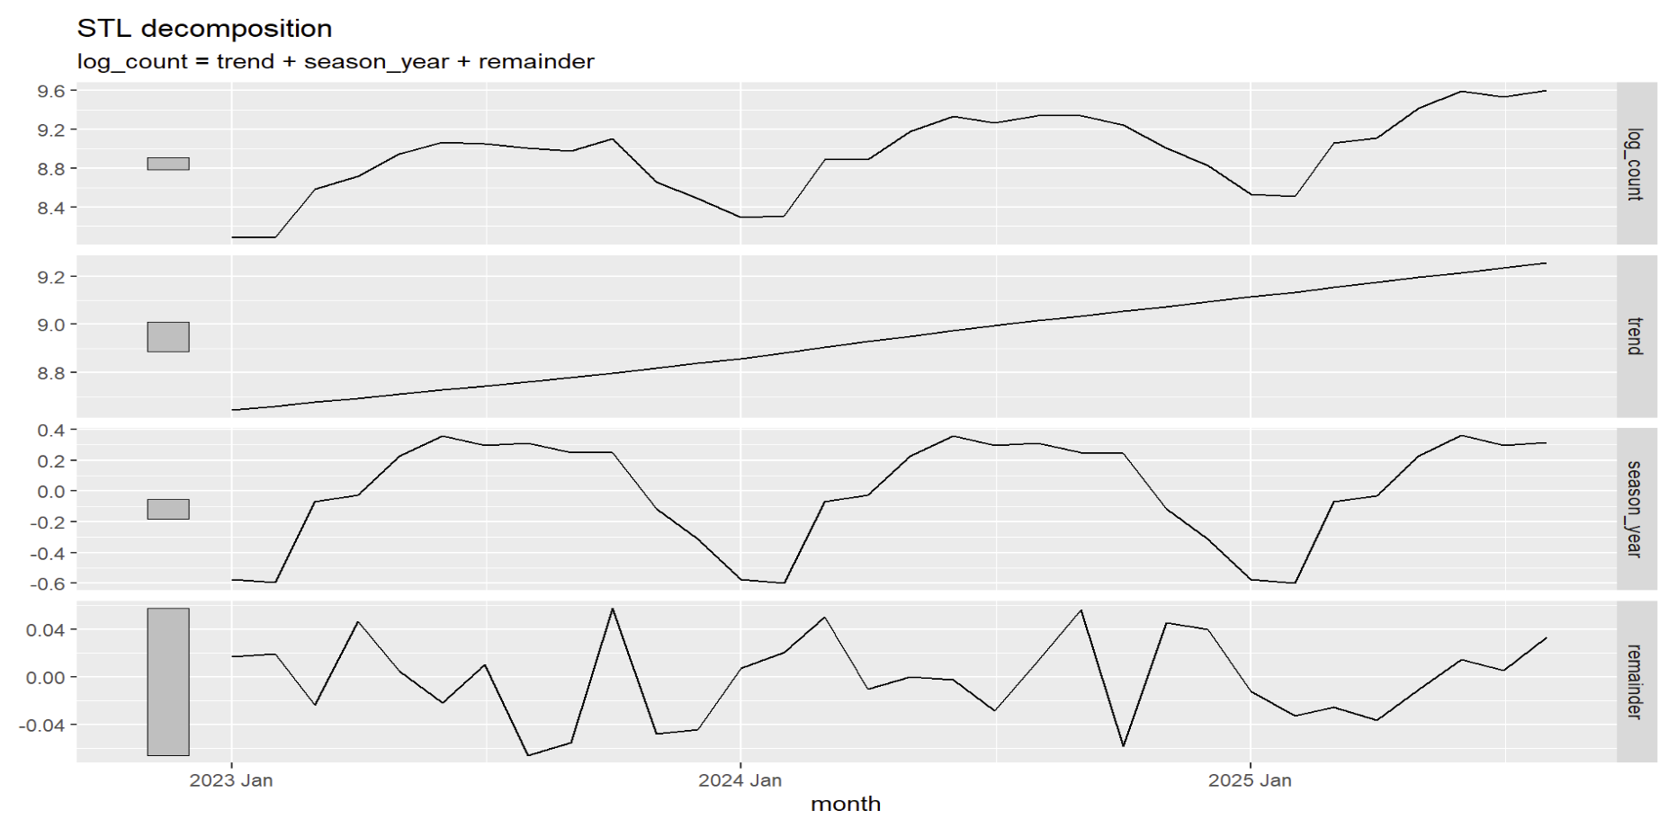
STL DECOMPOSITION
Data split into:
Trend
Seasonality
Residual
Strong seasonal component confirmed

Slide 7
MODELS USED
Baseline Models:
Mean
Naïve
Seasonal Naïve
Drift
Advanced Models:
ETS
ARIMA
STL + ETS
Neural Network (NNETAR)
Combination Model

Slide 8
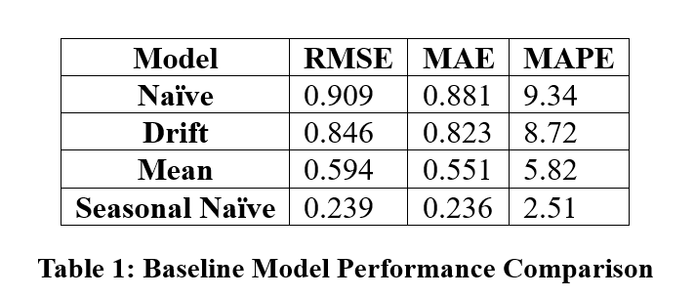
BASELINE RESULTS
High error across models
Seasonal Naïve performed best among them
Still significantly less accurate

Slide 9
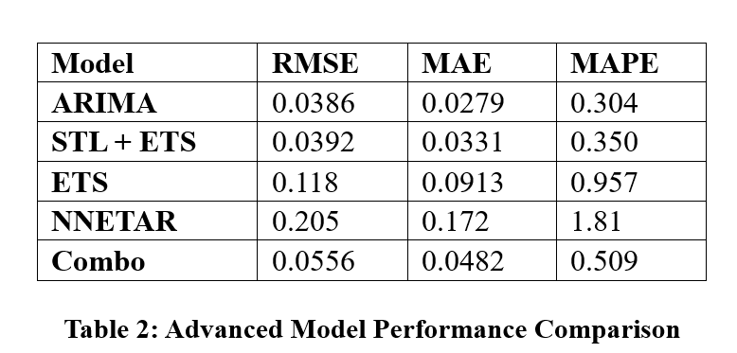
ADVANCED RESULTS
ARIMA performed best
STL + ETS close second
ETS moderate performance
Neural Network performed poorly

Slide 10
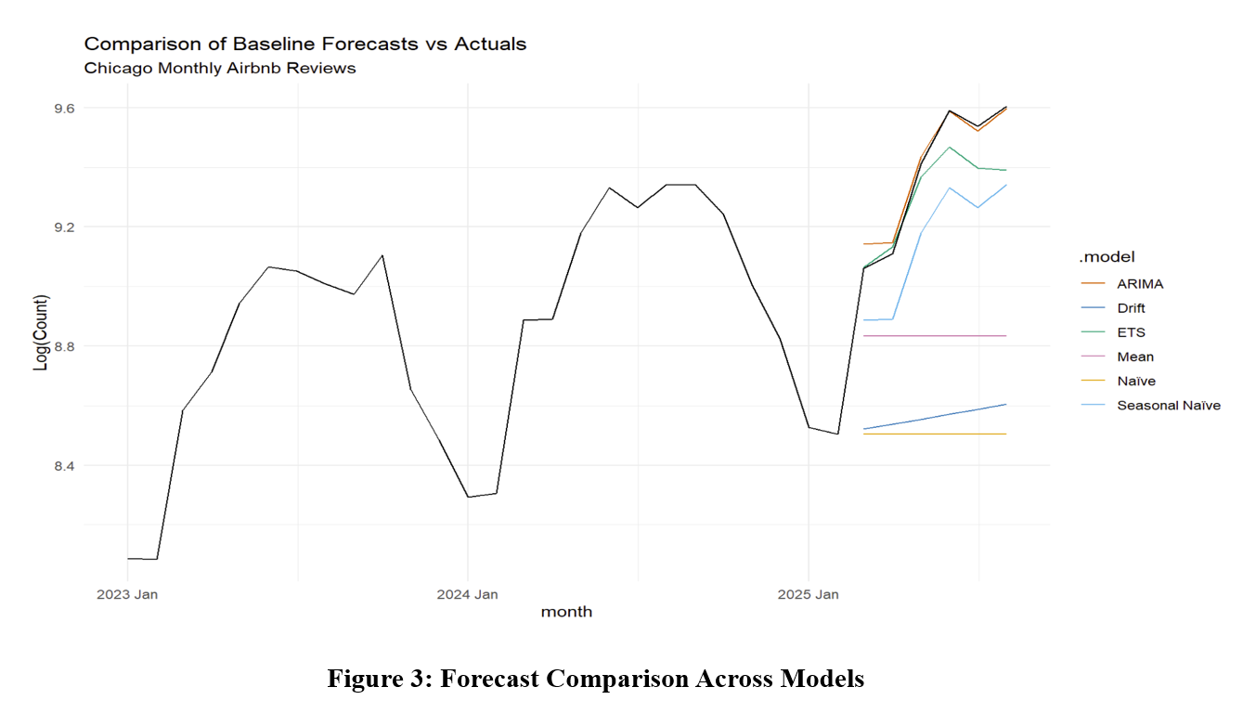
MODEL COMPARISON
ARIMA closely follows actual values
Other models show larger deviations
Confirms ARIMA superiority

Slide 11
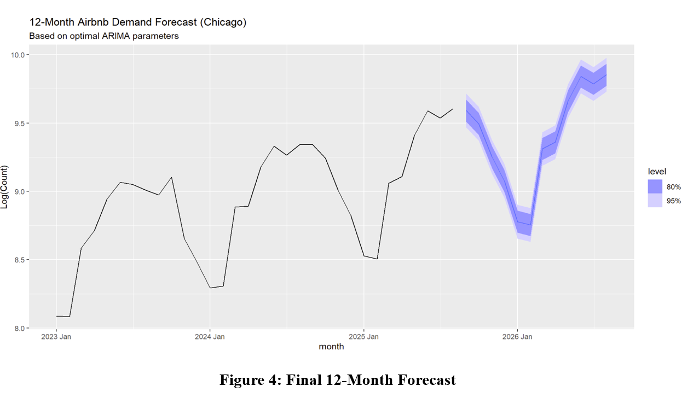
FINAL FORECAST
ARIMA used as final model
12-month forecast generated
Seasonal pattern continues
Stable and predictable demand

Slide 12
KEY FINDINGS
ARIMA is the best model
Seasonality is the key driver
Simple models performed poorly
Complex models did not improve accuracy

Slide 13
CONCLUSION
Accurate forecasting achieved
ARIMA captured data structure effectively
Results useful for:
Pricing strategies
Demand planning
Resource allocation

Slide 14
THANK YOU!!

