Slide 1
BHARATIYA ANTARIKSH HACKATHON 2026 · PROBLEM STATEMENT 7
AI-Enabled Detection of Exoplanets
from Noisy Astronomical Light Curves
Finding hidden worlds in the noise of TESS starlight
Idea / Concept Submission · Team [Team Name]
Submitted by: [Member Names]

Slide 2
PROBLEM UNDERSTANDING
The Challenge
Transit signals are tiny — brightness dips of only 0.01-1%, buried in noise.
Crowded fields cause stellar blending: foreground/background sources contaminate the aperture.
Detector response adds further intrinsic instrumental noise.
Eclipsing binaries, blends and starspots all produce dips that can mimic a real transit.
Disentangling these phenomena reliably, at scale, across 20-30k light curves per TESS sector, is the core difficulty.
A real transit dip — barely 1% deep — hiding inside instrument & blend noise
Same-looking dip, four different causes:
Planet transit · Eclipsing binary · Blended source · Starspot variability
2

Slide 3




OUR OBJECTIVE
Build One Pipeline, Four Outcomes
Detect & Classify
Estimate Parameters
Robustly flag periodic dips and sort them into transit / eclipsing binary / blend / other.
Fit light curves to recover orbital period, transit duration & transit depth.
Quantify Confidence
Visualize Results
Report SNR / significance for every detection and a class-confidence score.
Plot the raw and phase-folded light curve with the detected signal overlaid.
Why it matters for India: ISRO/IIST/Cambridge's proposed ExoWorlds mission — a JWST-class telescope for exoplanet atmosphere spectroscopy — needs exactly this kind of automated candidate vetting at scale; this pipeline is a direct prototype step toward it.
3

Slide 4





SYSTEM DESIGN
Proposed Pipeline
→
→
→
→
Raw TESS
Light Curves
Preprocessing
Periodic Search
Feature
Extraction
Classify + Fit
2-min cadence sector data from the MAST archive
Detrend stellar variability; clean outliers & gaps
BLS + TLS scan for box-shaped dips
Odd-even depth, shape, secondary eclipse, SNR
RF / XGBoost classifier and parameter estimation
PIPELINE OUTPUTS
Signal Class
Period · Duration · Depth
Confidence / SNR
Light-Curve Visualization
Why this design: each stage is explainable, not a black box — easier to debug, defend in the report, and extend later. Stage 4 also fuses TIC stellar parameters (radius, Teff) with light-curve features — the same idea behind NASA's newest vetters (ExoMiner++, 2025; ExoNet, 2026) — turning a periodic dip into a physically checkable planet radius and equilibrium temperature.
4

Slide 5

PERIODIC SIGNAL DETECTION
Two Complementary Search Algorithms
Box Least Squares (BLS)
Transit Least Squares (TLS)
astropy.timeseries.BoxLeastSquares
Hippke & Heller, 2019 — github.com/hippke/tls
Searches a period/duration grid for box-shaped flux drops
Fast — ideal for scanning thousands of light curves
Gives first-pass period, depth, duration & SNR
Fits a realistic, limb-darkened transit model (not just a box)
~17% more sensitive to small planets than BLS
Refines parameters & suppresses false positives
Strategy: BLS runs first for speed across the full dataset, then TLS refines the top candidates for higher-fidelity parameters — the same search-then-vet strategy behind NASA's current SOTA pipeline, ExoMiner++ (2025).
5

Slide 6


DISTINGUISHING THE CAUSES
Classification Framework
Planetary Transit
Eclipsing Binary
Flat, U-shaped dip with equal depth at every epoch; no secondary eclipse.
V-shaped dip, odd/even depth difference, often a visible secondary eclipse.
Blend / False Positive
Other / Stellar Variability
Centroid shifts during the dip; apparent depth changes with aperture size.
Non-periodic, or smoothly sinusoidal rather than box-shaped like a transit.
Classifier: Random Forest / Gradient-Boosted Trees on the organizers' curated labeled set — interpretable, label-efficient, with calibrated confidence scores. Stretch goal: a multimodal vetter in the spirit of NASA's current SOTA (ExoMiner++, 2025; ExoNet, 2026), fusing light-curve shape with TIC stellar parameters (radius, Teff) for a physical planet radius & equilibrium temperature.
6

Slide 7
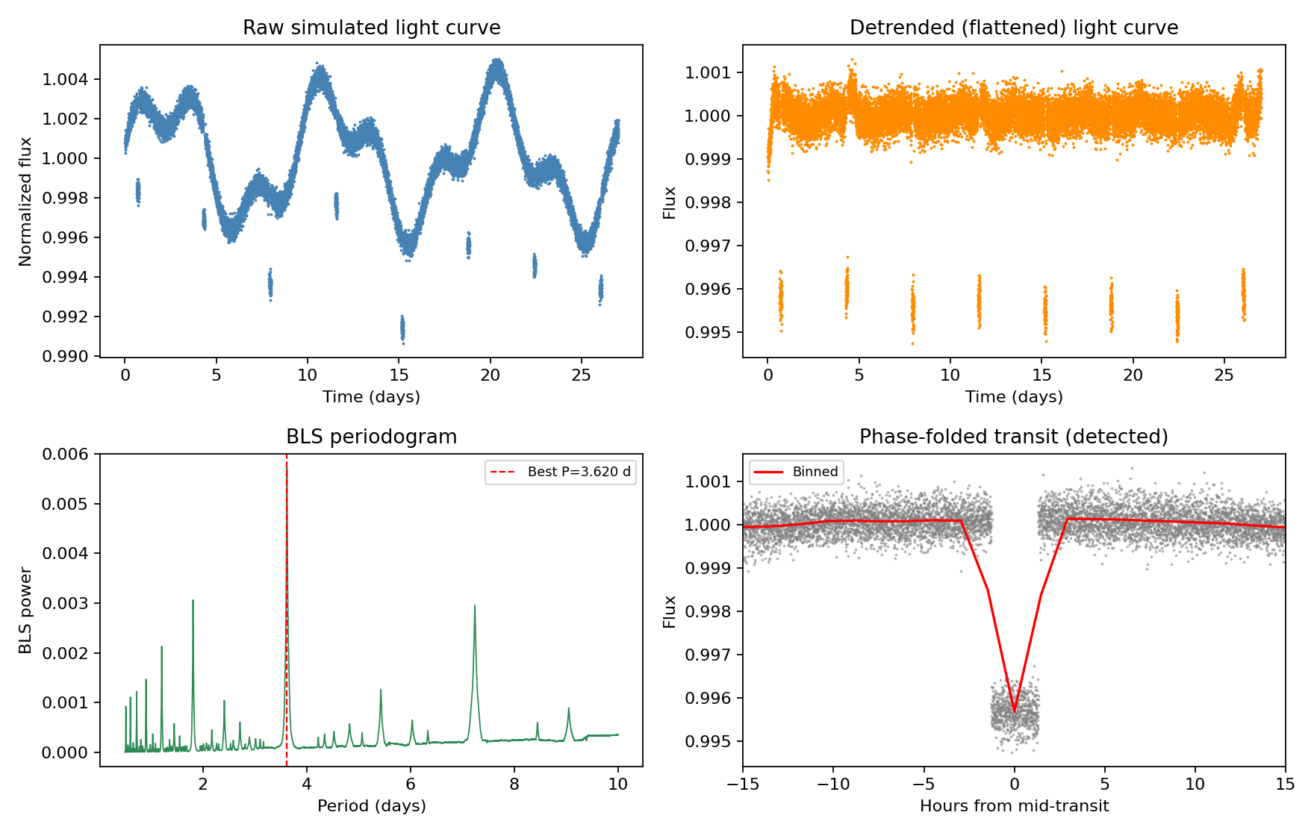
ALREADY VALIDATED
Proof of Concept on Simulated Data
Injected vs. Recovered
Parameter | Injected | Recovered
Period | 3.620 d | 3.620 d
Depth | 0.450% | 0.435%
Duration | 2.60 h | 2.52 h
SNR | — | ~336
A synthetic TESS-like light curve with an injected transit, run end-to-end through our detrending + BLS pipeline — confirming the core detection method before we touch real data.
7

Slide 8

TRUSTWORTHY OUTPUTS
Confidence & Uncertainty Handling
Detection significance
BLS SNR / TLS Signal Detection Efficiency (SDE) reported per candidate.
Classification confidence
Classifier class-probability is surfaced as the confidence score for each label.
Calibrated confidence
Probabilities are recalibrated (CalibratedClassifierCV) so a reported 80% confidence means ~80% empirical accuracy.
Parameter uncertainty
Bootstrap resampling gives error bars on period, depth & duration.
Injection-recovery testing
Synthetic transits of known depth/period are injected & re-detected to build a completeness curve vs. SNR.
Model reliability
K-fold cross-validation results are reported honestly in the final report.
8

Slide 9


EVERYTHING OPEN & REPRODUCIBLE
Tech Stack & Data Sources
Tools & Libraries
Data Sources
lightkurve — Search, download & manipulate TESS/Kepler light curves
Organizers' curated dataset
Labeled confirmed planets, false positives & eclipsing binaries — primary training set.
astropy.timeseries — Box Least Squares periodogram
transitleastsquares — TLS refinement & model fitting
MAST / TESS archive
archive.stsci.edu — raw sector light curves (~20-30k stars/sector, high cadence).
wotan — Light-curve detrending
NASA Exoplanet Archive
scikit-learn / XGBoost — Classification model
TOI dispositions used as supplementary labels & sanity checks.
pandas, numpy, matplotlib — Data wrangling & visualization
100% publicly available Python — no specialized software required.
9

Slide 10


WHO & WHEN
Team & Roadmap
Team [Team Name]
Roadmap
Data & Preprocessing — [Member Name]
1 Jul 2026
Idea / concept submission (this deck)
Signal Detection (BLS/TLS) — [Member Name]
20 Jul 2026
Final shortlist announced
ML Classification — [Member Name]
Visualization & Reporting — [Member Name]
21 Jul 2026
Induction & ISRO mentorship begins
6-7 Aug 2026
Grand Finale — full pipeline build
10

Slide 11
Thank You
Questions & feedback welcome
Team [Team Name] · Bharatiya Antariksh Hackathon 2026 · Problem Statement 7

