Slide 1
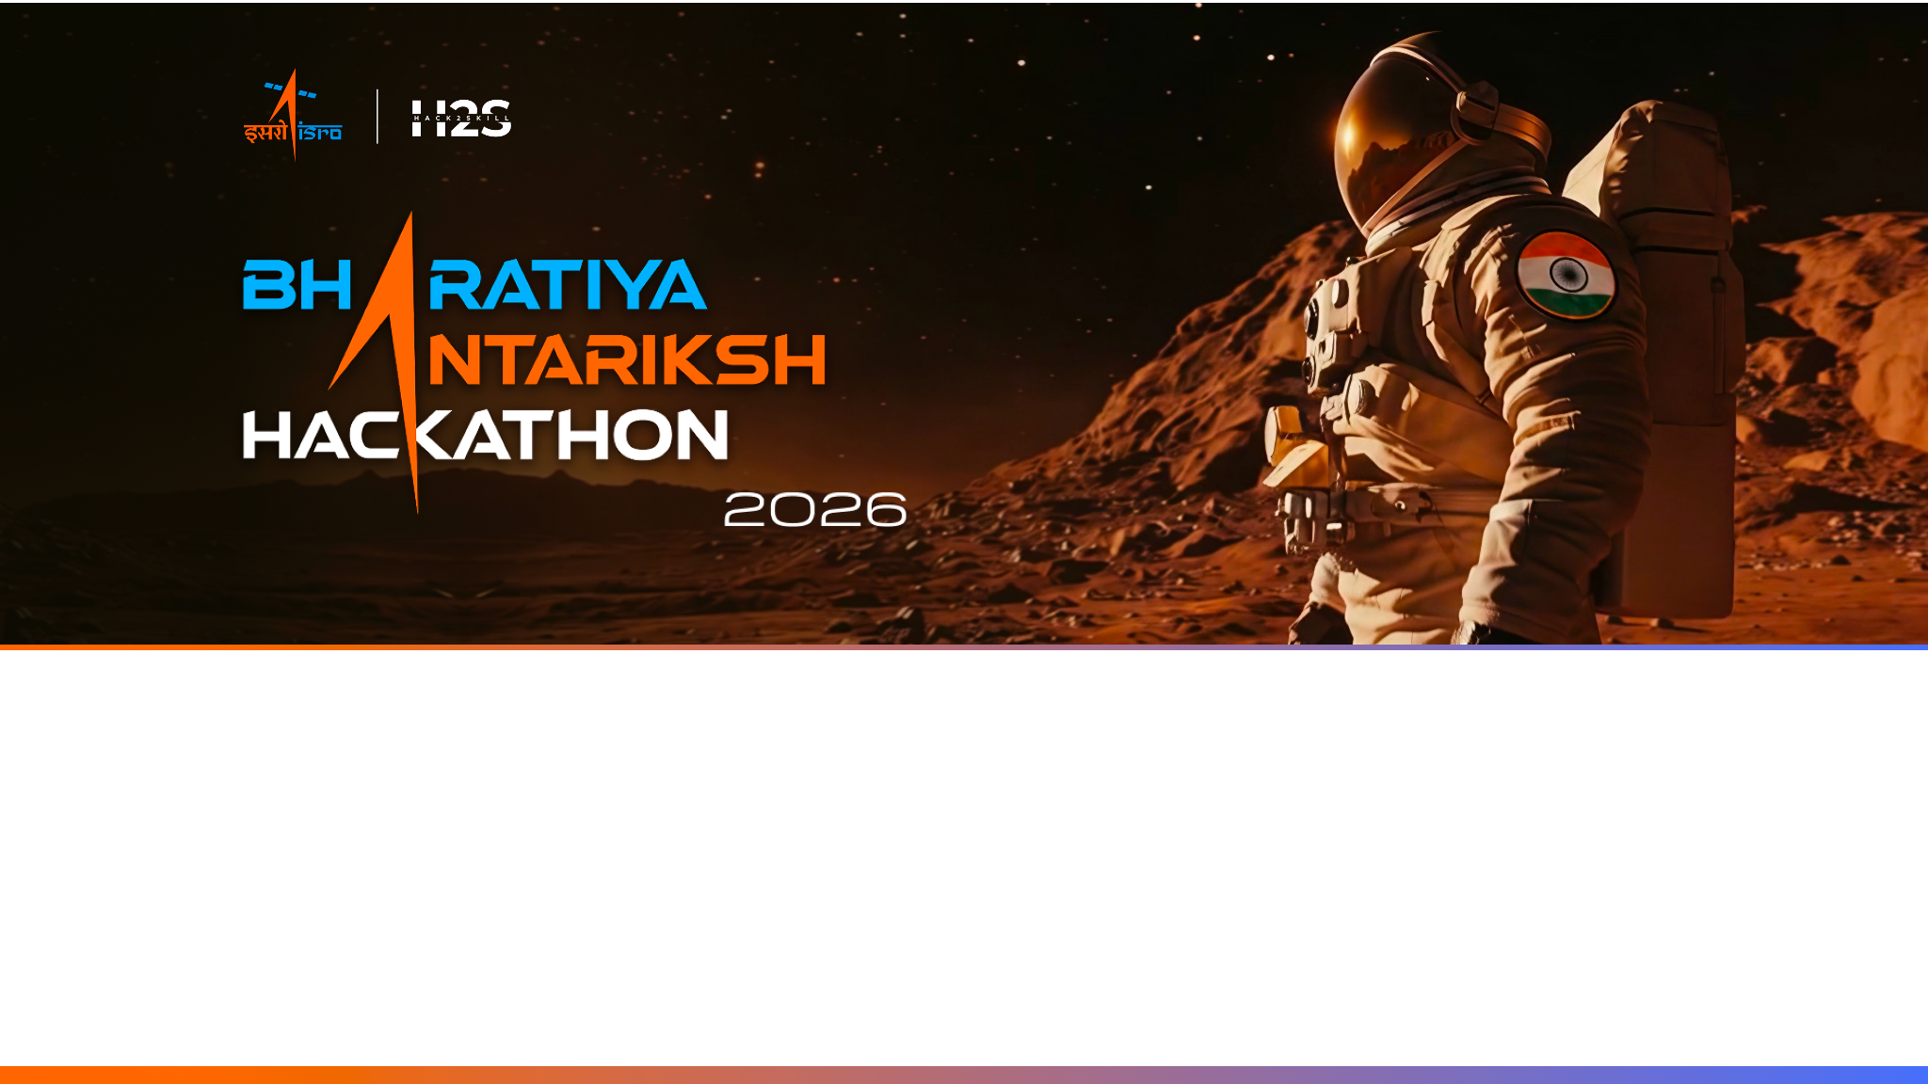
Team Name : [Team Name]
Team Leader Name : [Leader Name]
Problem Statement : PS-07 - AI-enabled Detection of Exoplanets from Noisy Astronomical Light Curves

Slide 2

Team Members
Team Leader: Name: [Leader Name] College: [College] | Team Member-1: Name: [Member 1] College: [College]
Team Member-2: Name: [Member 2] College: [College] | Team Member-3: Name: [Member 3] College: [College]

Slide 3
Opportunity
How is this different from other existing ideas?
Most pipelines apply a fixed preprocessing recipe to every star and stop at the dip. We do two things differently: an adaptive preprocessing stage tunes parameters per star -- preserving real transit signals while removing noise -- and our stellar-fusion stage then tests every surviving candidate against the host star’s own physics blueprint.
How will it solve the problem?
Adaptive detrending removes long-term stellar trends and handles gaps intelligently -- spacecraft downtime is preserved for astrophysical integrity while isolated noise is removed. The stellar-fusion physics test then filters every surviving candidate: could this shadow only come from a planet? Real planets pass. Impostors fail.
USP of the proposed solution
Our USP: an Adaptive Astrophysical Signal Enhancement Pipeline -- per-star preprocessing that maximises transit signal integrity, combined with physics-verified candidate confirmation and Mandel-Agol parameter refinement. Every planet we flag is verified by the universe’s own rules, built for ISRO’s ExoWorlds mission.

Slide 4
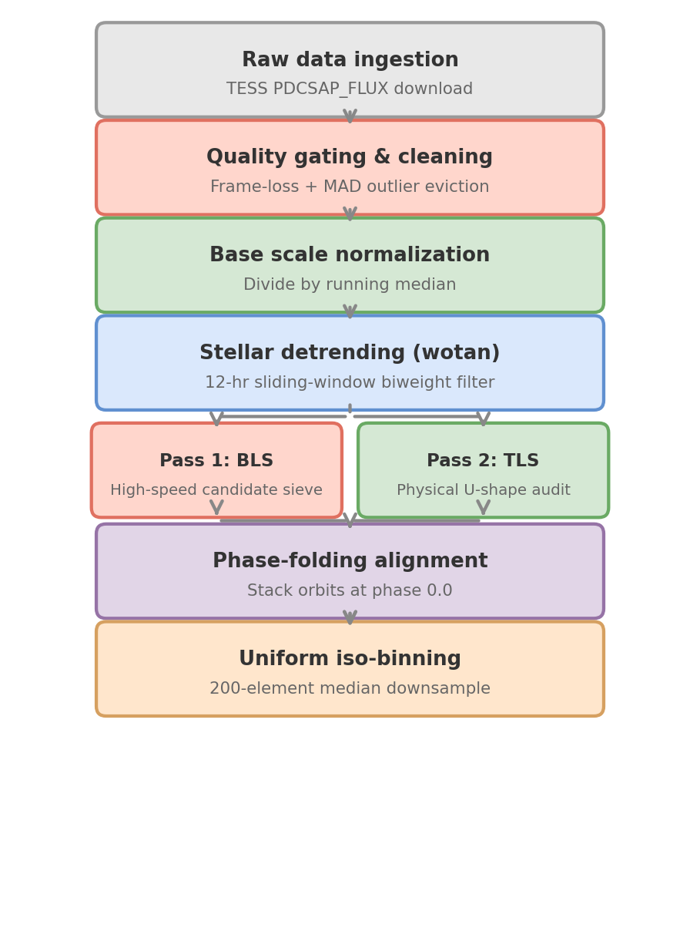
Step 2 Deep Dive: Adaptive Preprocessing Pipeline
[1] Hippke et al. 2019 -- Wotan: Comprehensive Time-series Detrending in Python. AJ 158, 143.

Slide 5
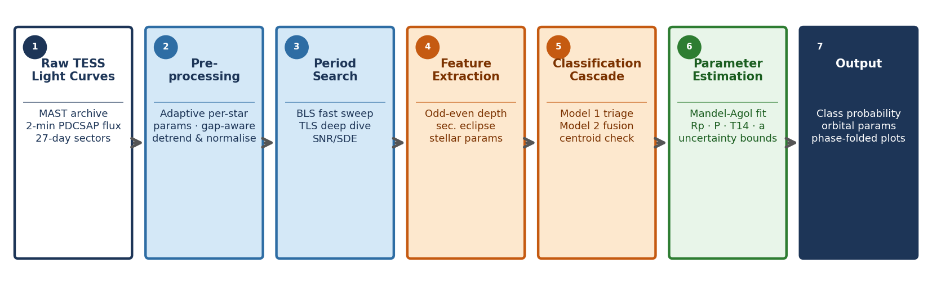
Detection Pipeline
End-to-end pipeline, from raw TESS light curves to a vetted, parameter-refined candidate.
[2] Hippke & Heller 2019 -- Optimized transit detection algorithm: TLS template matching. A&A 623, A39.

Slide 6
Why This Pipeline Finds Exoplanets Others Miss
Two-stage cascade: light-curve triage finds the shadow; the stellar-fusion stage cross-checks it against the host star's own physics. Every stage returns a calibrated probability -- evidence, never a guess.
Dual period search: BLS sweeps thousands of periods in seconds; TLS then hunts faint signatures using realistic stellar limb-darkening U-shape templates -- catching sub-stellar dips that BLS's rigid square-box approximation misses.
Physical plausibility checks via TESS Input Catalog (TIC): planet radius, transit duration and stellar density must agree with the star's own properties -- impostors fail here.
Independent centroid and difference-imaging check traces the dimming to its source star -- ruling out blended impostors hiding in the same patch of sky.
Mandel-Agol transit model fit (batman library): once a candidate clears classification, the pipeline phase-folds its light curve and fits a physics model to extract science-grade period, planet radius (Rp in Earth radii), transit duration and semi-major axis -- uncertainty bounds included.
Calibrated confidence reporting: class probability, SNR/SDE, injection-recovery completeness curve, raw and phase-folded light-curve plots -- every verdict, fully proven.

Slide 7
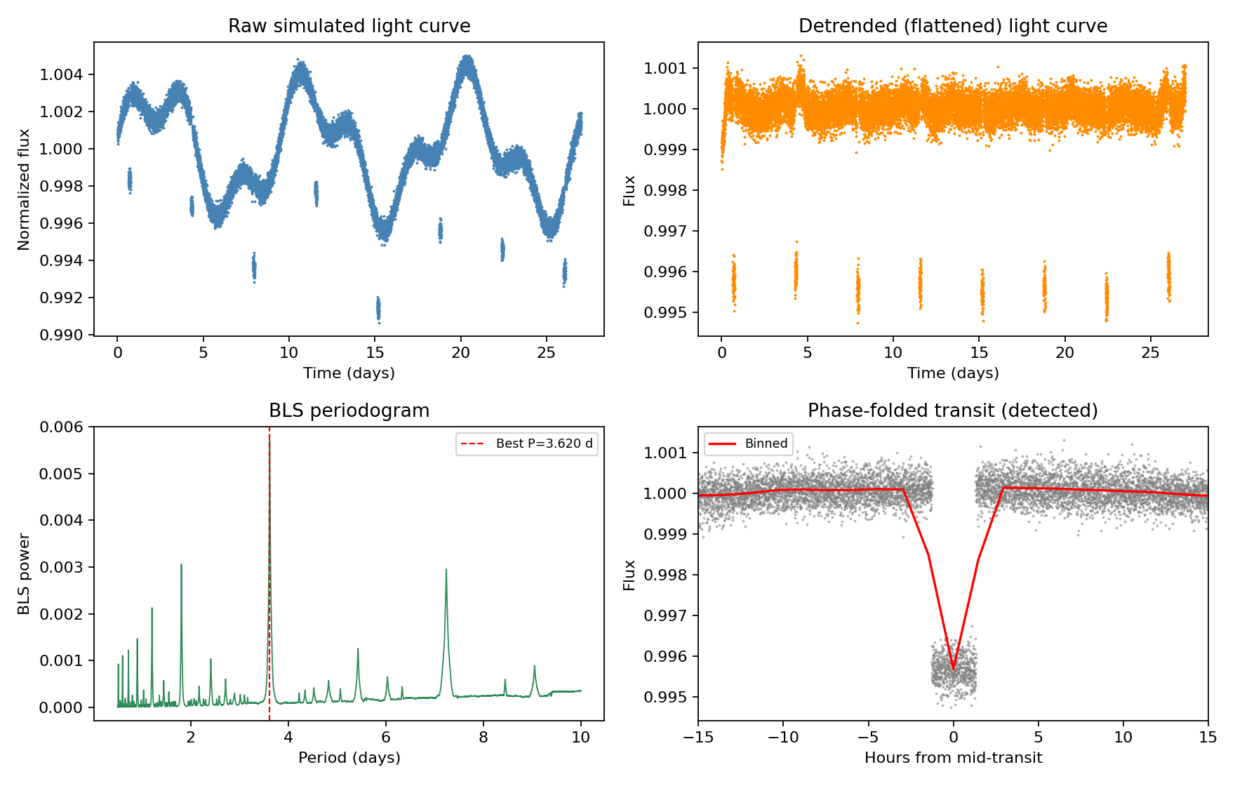
Wireframes/Mock diagrams of the proposed solution (optional)
Proof of concept: a synthetic transit recovered end-to-end through our detrending + BLS pipeline.

Slide 8
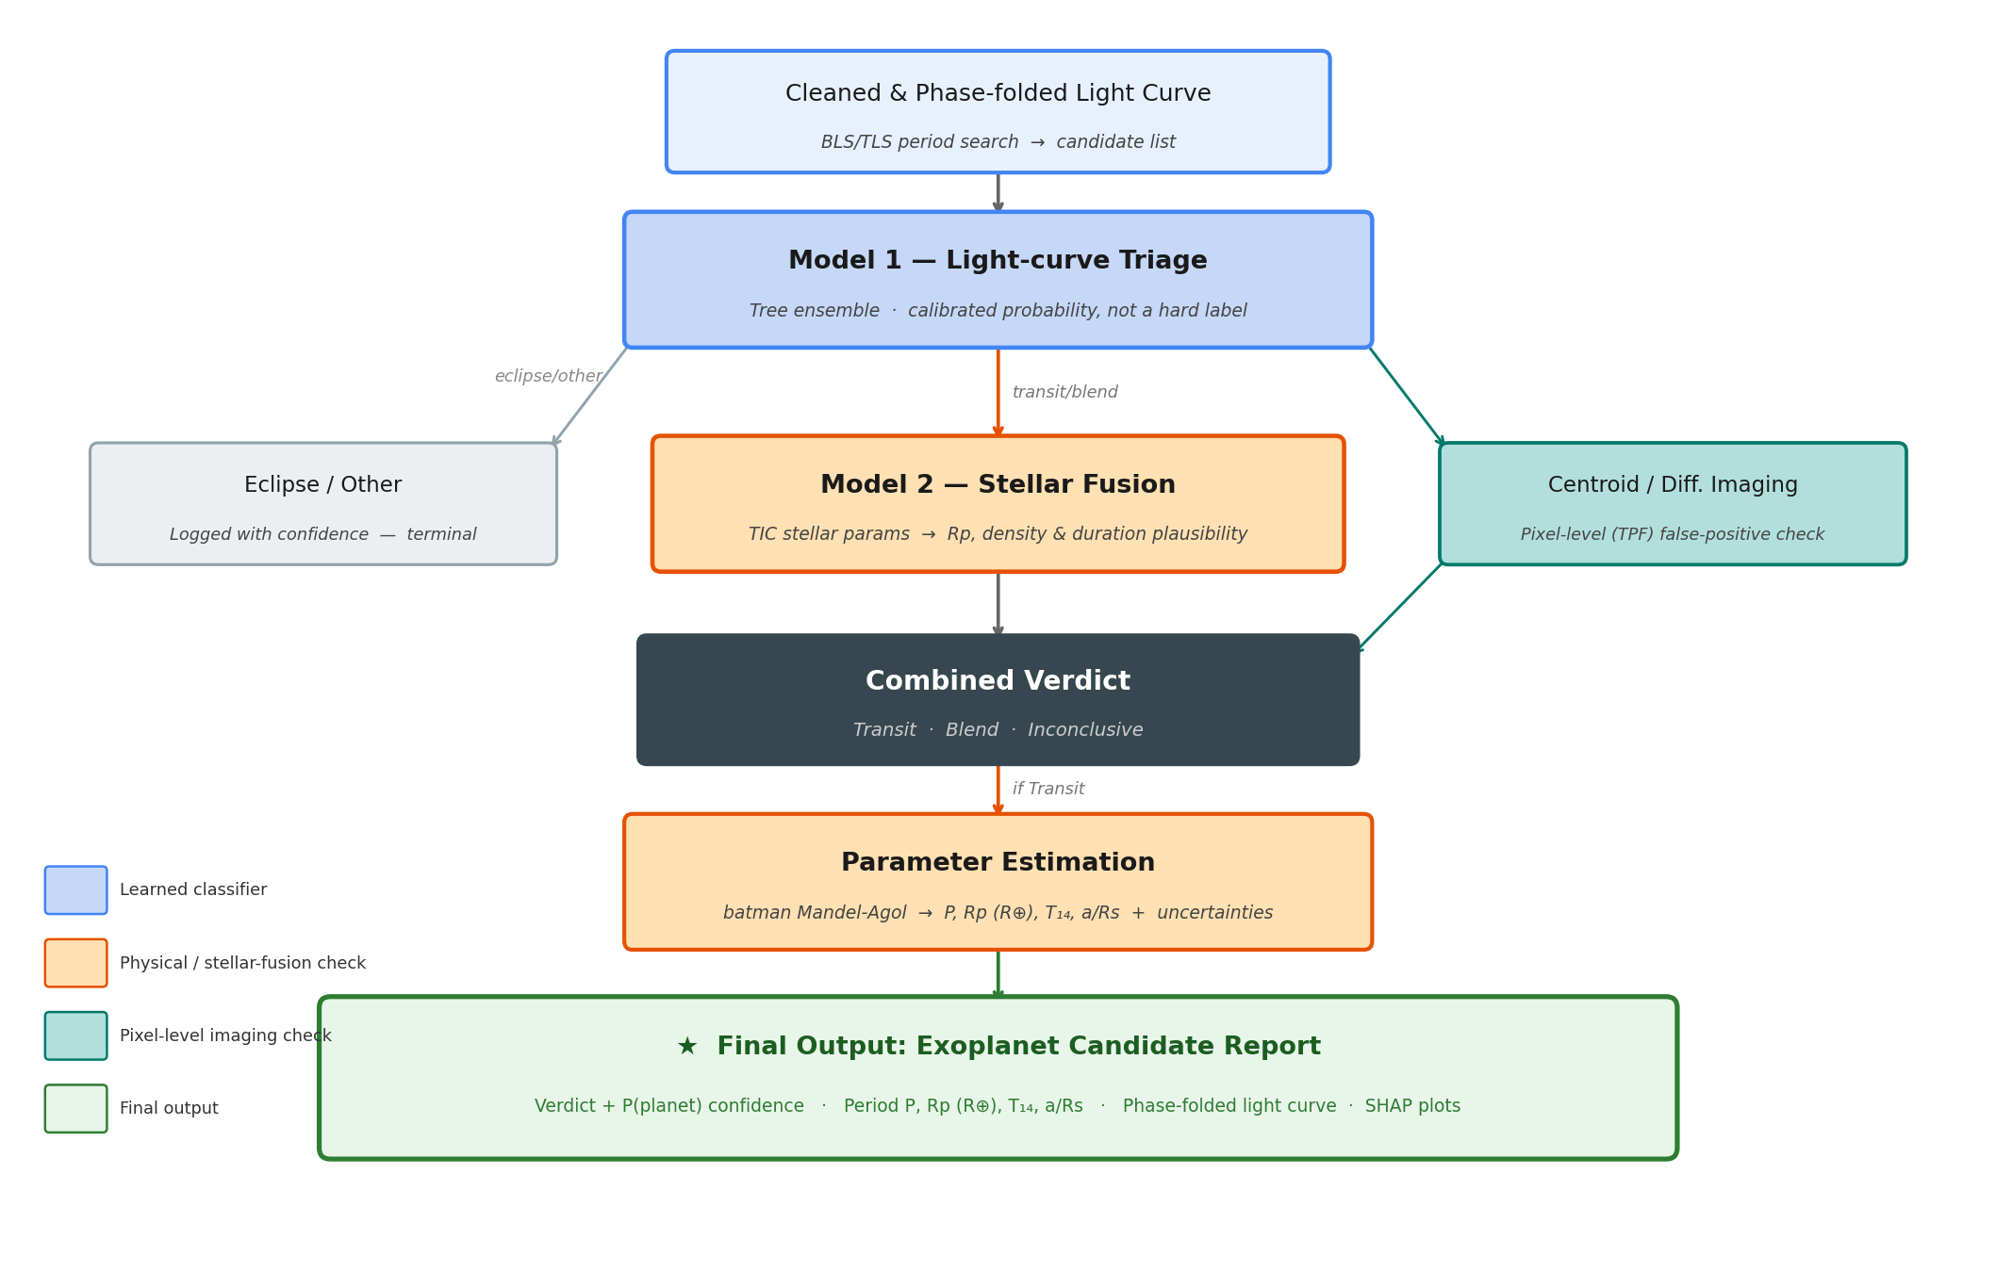
Architecture diagram of the proposed solution
[3] Seager & Mallen-Ornelas 2003 -- Planet and Star Parameters from an Extrasolar Planet Transit. ApJ 585, 1038.

Slide 9
Training & Model Selection
Step 1: Train 3 Candidate Models Per Stage
For each stage we independently train Random Forest, XGBoost, and CatBoost on the labelled candidate set -- Model 1 uses BLS/TLS light-curve features; Model 2 adds TIC stellar parameters for physical vetting.
Step 2: Evaluate Each with Star-Grouped 5-Fold CV
Stars are grouped by TIC ID so no star appears in both train and test -- preventing data leakage. Each fold yields a confusion matrix; we record cross-validated precision, recall and F2 score for all three models.
Step 3: Pick the Best -- Optimising for F2 (beta=2)
A false negative at Stage 1 drops a real planet before Stage 2 ever sees it -- unrecoverable. A false positive just costs one extra review. We therefore score all three models by F2 and the highest scorer per stage enters the final cascade.

Slide 10
Tech Stack
Data & Compute
lightkurve + astropy -- TESS PDCSAP flux from NASA MAST
Google Colab (free tier) -- sufficient for full dataset
Signal Processing
wotan -- biweight sliding-window stellar detrending
PyWavelets -- wavelet denoising; scipy MAD -- outlier rejection
Period Search
astropy-bls -- BLS fast candidate sieve
transitleastsquares -- TLS U-shape template matching
ML / Classification
scikit-learn (Random Forest), XGBoost, CatBoost
SHAP -- feature importance and model interpretability
Parameter Estimation
batman -- Mandel-Agol transit model fitting
scipy.optimize -- least-squares fit for Rp, P, T14, a/Rs
Datasets
NASA TESS TOI Catalog + TESS Input Catalog (TIC) -- labelled candidates and stellar parameters

Slide 11
References
[1] Adaptive Detrending
Hippke, M. et al. (2019). Wotan: Comprehensive Time-series Detrending in Python. The Astronomical Journal, 158, 143.
Biweight sliding-window detrending recovers 99% of shallow Kepler transits -- best performance of all tested methods.
[2] Transit Period Search (TLS vs BLS)
Hippke, M. & Heller, R. (2019). Optimized transit detection algorithm: Template matching for periodic transits of small planets. A&A, 623, A39.
TLS achieves 17% better detection efficiency for small planets over BLS; recovers known planets at higher significance for >99.9% of cases.
[3] Stellar Parameter Vetting (Model 2 Physical Check)
Seager, S. & Mallen-Ornelas, G. (2003). A Unique Solution of Planet and Star Parameters from an Extrasolar Planet Transit Light Curve. ApJ, 585, 1038.
Transit photometry uniquely constrains mean stellar density; inconsistency with TIC catalog values is a definitive false-positive discriminator.

Slide 12


