Slide 1
AI GURU
George Georgiev Amit Dutta Mahendra Kumar Jing Xu
Borathon November 2014

Slide 2

Bug Triage
When a bug comes in
Which developer should work on it
Is this a duplicate?
Is attached log information enough?
How much time we spend on this?

Slide 3
Labor
By a human
Every team, one developer is dedicated as team guru
Learning curve, delays, wrong decisions
By a machine
With machine learning, powerful processing ability
Assign bugs to the right developer automatically
$4,000,000
every year
Out of 5000 developers, 500 developers are not able to do any real developing work !!!
(assuming average a team of 10 developers)
Make those 500 developers free

Slide 4
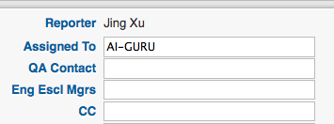
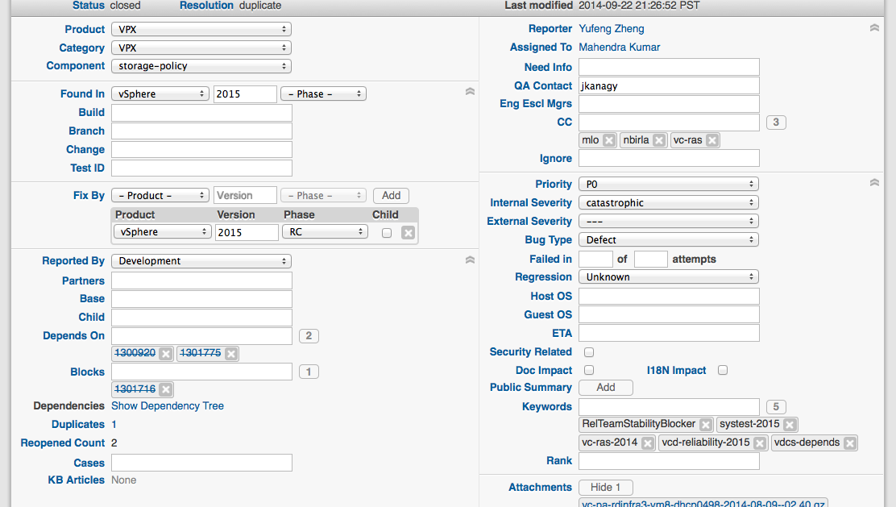
AI-GURU
All you need to do is to assign a bug to AI-GURU.
The system pools bugzilla and automatically analyzes and assigns the bugs to the developer who has resolved similar bugs

Slide 5
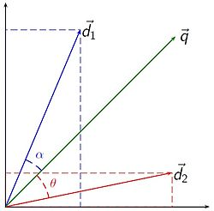
Machine Learning approach
Bug analyze and prediction
Machine-learning based approaches
Feature selection, classification, searching
Bug triage
Extract bug log
Parse Java Exception, C++ backtraces…
Index bug log
Vector space model
Query bug log
Query most relevant bugs

Slide 6






Is Elephant Bigger than a Bug?
map
Parse with Antlr4
reduce
Modeling
query
YOUR
Bug id → developer

Slide 7
Questions?

