Slide 1

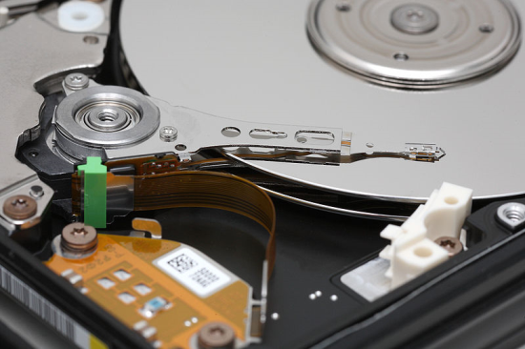
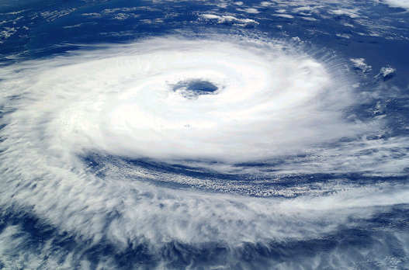
Security and Privacy in Cloud Computing
Presenter: Amit Dutta
Instructor: Ragib Hasan
University of Alabama at Birmingham CS 491/691/791 Fall 2012

Slide 2
Verifying Data Location and Storage Properties
Objective: Verifying if the cloud provider is storing the files with the agreed level of redundancy in multiple geographic locations.
Research Paper:
Karyn Benson, Rafael Dowsley and Hovav Shacham. Do You Know Where Your Cloud Files Are? In Proceedings of CCSW 2011. ACM Press, Oct. 2011.

Slide 3
Inspiration
PdP (Proof of data possession)
PDP proves the file is present in the server.
PoR (Proofs of Retrievability)
The stored file is intact and can be retrieved.
Proof Data was Replicated across Disks
A protocol that allows a user to verify that his data is replicated on multiple disks.
Single geolocation.

Slide 4
Idea
Use the concept of PoR and Proof of Data replication in multiple disks in multiple geolocation context.
PoR: To check if the provider is keeping the whole file in one location and a fraction is other.
Data replication scheme: Imposing a time constraints and some assumption of cloud provider.

Slide 5
Geolocation
Determining the estimated geolocation of a host.
Several well known methods:
GeoPing : Delay is proportional to distance.
Constraint Based Geolocation: uses triangulation technique.
Shortest Ping: Ping target from all the landmarks and pick the closes.
Speed of Internet: 4/9 * c; c is the speed of light
Topology based: Uses traceroute, topology and per-hop distance

Slide 6
A Theoretical Solution
C (Cloud Provider), n datacenters denoted by s_{i} for 1 ≤ i ≤ n
Assumptions:
All the datacenters location is well known and all the data is stored in these places.
No exclusive internet connection between the datacenters.
Have access to a machine t_{i} in every datacenter s_{i}. t_{i} should be close to s_{i}, used for distance and latency calculation.

Slide 7
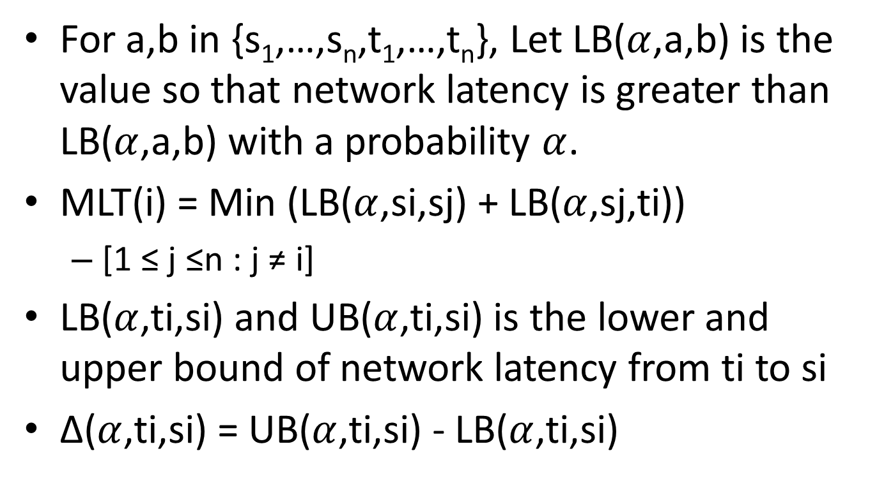
A Theoretical Solution
For a,b in {s₁,…,s_{n},t₁,…,t_{n}}, Let LB($α$,a,b) is the value so that network latency is greater than LB($α$,a,b) with a probability $α$.
MLT(i) = Min (LB($α$,si,sj) + LB($α$,sj,ti))
[1 ≤ j ≤n : j ≠ i]
LB($α$,ti,si) and UB($α$,ti,si) is the lower and upper bound of network latency from ti to si
∆($α$,ti,si) = UB($α$,ti,si) - LB($α$,ti,si)

Slide 8
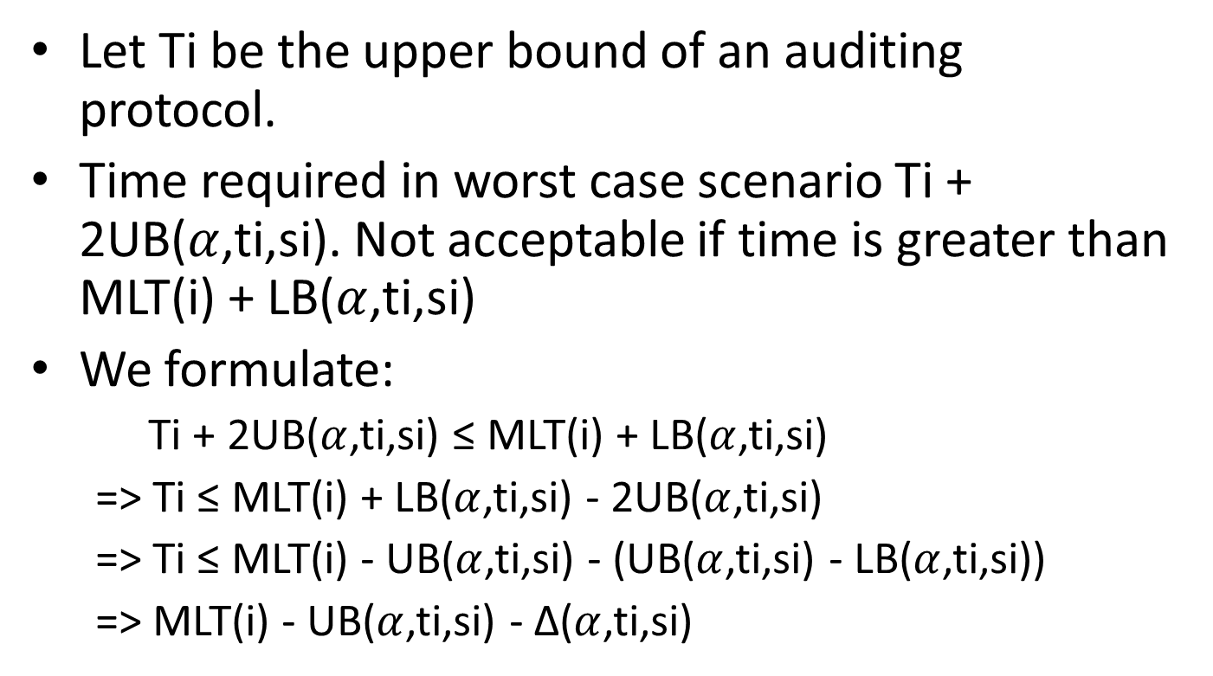
A Theoretical Solution
Let Ti be the upper bound of an auditing protocol.
Time required in worst case scenario Ti + 2UB($α$,ti,si). Not acceptable if time is greater than MLT(i) + LB($α$,ti,si)
We formulate:
Ti + 2UB($α$,ti,si) ≤ MLT(i) + LB($α$,ti,si)
=> Ti ≤ MLT(i) + LB($α$,ti,si) - 2UB($α$,ti,si)
=> Ti ≤ MLT(i) - UB($α$,ti,si) - (UB($α$,ti,si) - LB($α$,ti,si))
=> MLT(i) - UB($α$,ti,si) - ∆($α$,ti,si)

Slide 9
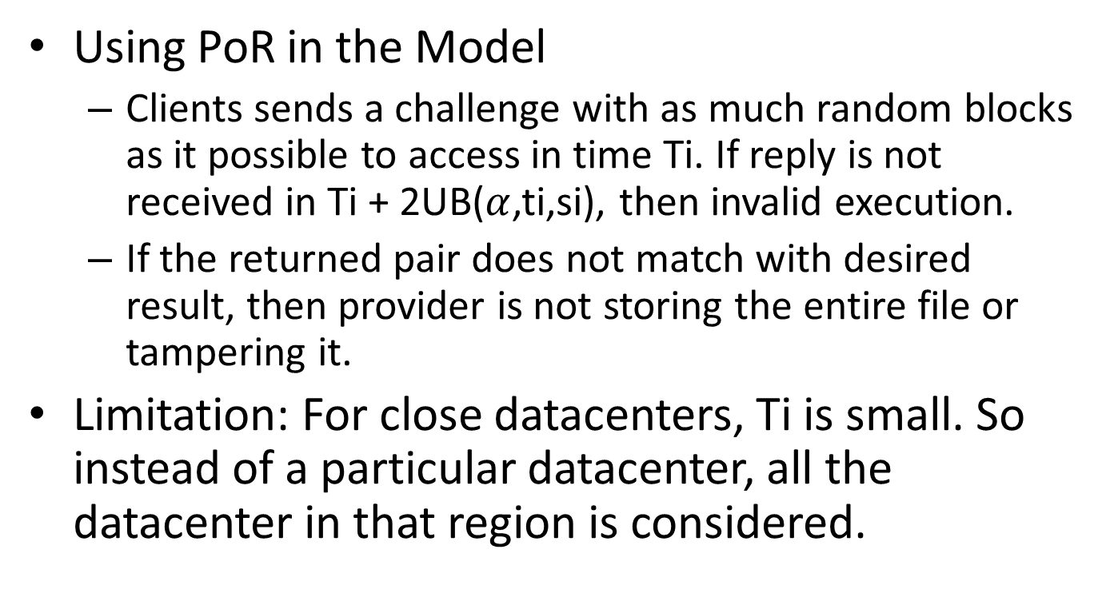
A Theoretical Solution
Using PoR in the Model
Clients sends a challenge with as much random blocks as it possible to access in time Ti. If reply is not received in Ti + 2UB($α$,ti,si), then invalid execution.
If the returned pair does not match with desired result, then provider is not storing the entire file or tampering it.
Limitation: For close datacenters, Ti is small. So instead of a particular datacenter, all the datacenter in that region is considered.

Slide 10
Building a practical verification system
Test node needs to know if the desired response came from the target datacenter or from some other datacenter.
Determine the origin of data from latency:
Haversine distance
Consider the world as a sphere and find distance between two points of a sphere
Driving distance
Compare Fiber optic topology with interstate Road topology
Topology based distance:
Can not be used because it is based on probing. So, cloud provider may know about the audit in advance.

Slide 11
Building a practical verification system (Tools)
PlanetLab (a group of computers available as a testbed for computer networking and distributed systems research)
Latency = TCP Handshaking time / 2
Geolocation predictive models
(4/5)*(speed of light) upper bound for latency
Best fit: Fits a liner regression model to a collection of (distance, latency) and then predict from the model.
Site expected model: Take data from a particular host and fit a linear regression model.

Slide 12
Best Distance and Predictive models
Compare between the models.
Using planetlab nodes, downloaded an image from Amazon’s S3 from both Seattle, WA and Ashburn, VA 75 times.
Feature cleansing: Kept removing the unusual data until a stable model is developed.

Slide 13
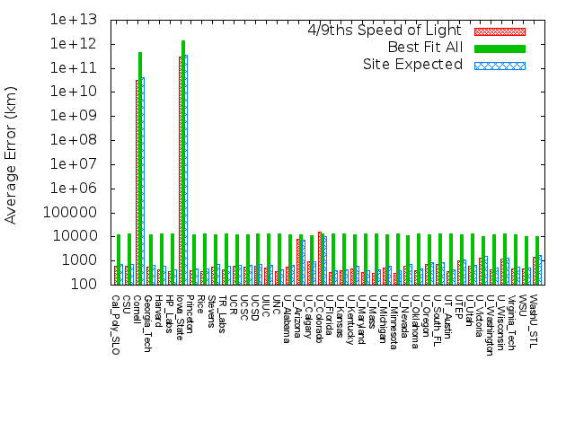
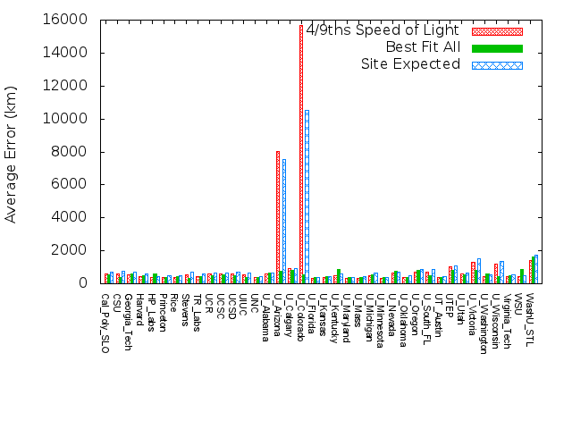
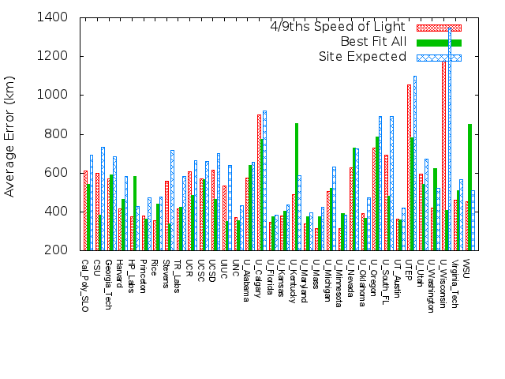
Method | Model | Avg.Error | Std. Dev.
Harversine | 4/9 | 1526.92 | 1012.672
Harversine | Best Fit | 441.637 | 459.592
Harversine | Site Exp. | 531.792 | 526.440
Driving | Best Fit | 514.217 | 542.741
Driving | Site Exp. | 629.340 | 608.167

Slide 14
Best Distance and Predictive models
Best fit model outperformed the Site Expected at 29 of the 34 cities.
Means that local routing information does not improve the predictive capability of a model.
Errors within one stand deviation, which is approximately 900 Km, seem reasonable to tell the distance between many cities.

Slide 15
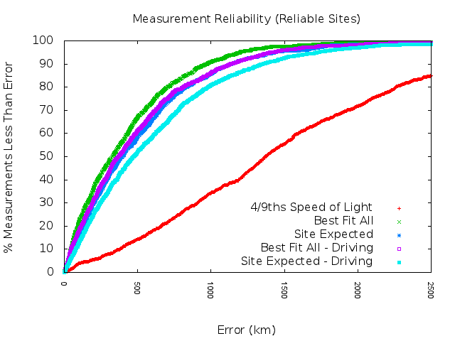
Best Distance and Predictive models
For Best Fit model, we can get 90% confidence at approximately 975 km and 95% confidence at approximately 1200km

Slide 16
Verifying storage locations
Finding datacenters.
A hierarchical clustering algorithm was used.
Several parameters were tested: counting the highest ranked guesses of geolocation, using only measurements that put the datacenter close to the planetlab node, and a combination of these parameters.

Slide 17
Verifying storage locations
Precision = tp/(tp + fp)
Recall = tp/(tp + fn)
F1 = 2 x (Precision.Recall)/(Precision + Recall)
F1 score 1 is the best and 0 is the worst
 | Actual class
Predicted class | tp | fp
 | fn | tn

Slide 18
Verifying storage locations
F-1 score versus various parameters
Test | Ash. | Dall. | Jax | Lax | Mia. | NYC | Pal. | STL | Sea.
Top | 0.88 | 0.87 | 0.27 | 1.0 | 0.0 | 1.0 | 0.91 | 0.65 | 0.92
Top 2 | 0.4 | 0.87 | 0.22 | 0.69 | 0.73 | 0.73 | 0.29 | 0.48 | 0.92
<250 | 0.31 | 0.0 | 0.0 | 0.57 | 0.0 | 0.84 | 1.0 | 0.33 | 0.31
<500 | 0.81 | 0.7 | 0.0 | 0.74 | 0.71 | 0.92 | 0.71 | 0.7 | 0.84
…

Slide 19
Verifying storage locations
Finding locations without knowing where the dataceters are located (without assumption 1)
Did not find actual solution
Reasonable because the cloud customers are more concerned about the diversity in the diversity of the location than the exact one.

Slide 20
Verifying storage locations
Detecting changes in location
Should be able to detect even a single packet from unexpected server.
Large amount of data from expected location is already in hand.
Did a test with Planetlab nodes if they can find out the difference between data downloaded from two source
Prediction methods can tell origin of the data when distance is over 3000 km; with few exceptions, it’s also correct when distance s over 1500km
The datacenters machines are homogenous and thus more predictable.

Slide 21
Discussion
Uses previous schemes.
Simple approach.
Can detect location approximately without assumption 1.
Can detect change of location after certain distance (e.g. 3000 km).
Does not provide good solution when assumption 1 is not known.
Latency based on small files over internet. In order to build a functional end-to-end system several modifications needed.
Packet loss is not addressed. Service provider would purposefully drop audit packets.
Who is going to provide this verification service?
Works on stable data.
Advanced clustering algorithms may yield better results.

Slide 22
Thanks

