Slide 1
Hackathon risc-v & ai Ofek ben atar amit zohar

Slide 2
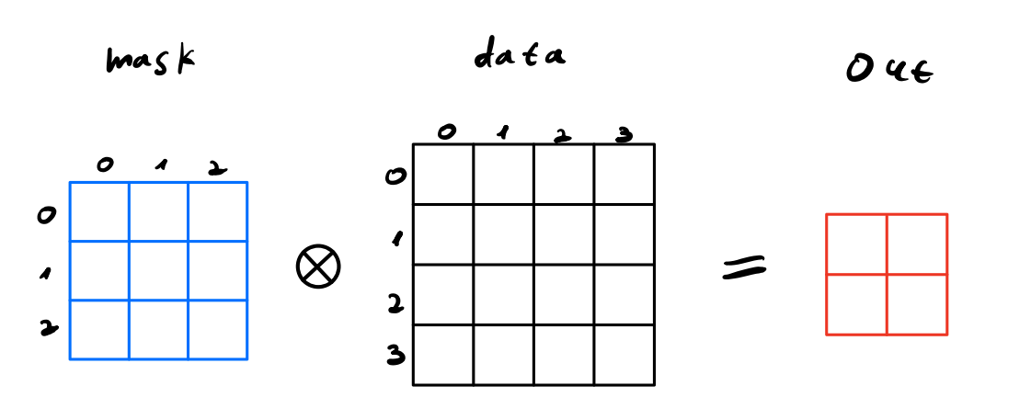
Hackathon mission
AI Accelerator that performs matrix convolution for image processing
Kernel matrix : 3X3
Data matrix : 4X4
Memory management using C language

Slide 3
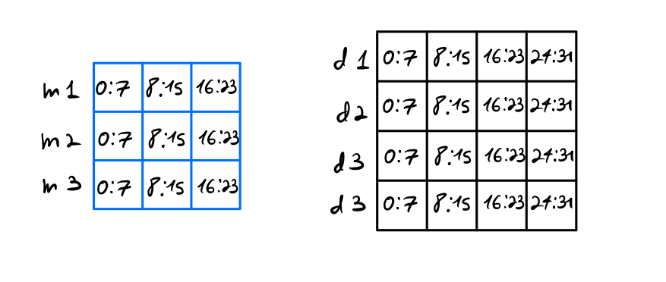
MEMORY MANAGMENT
Memory Structure : 7 registers
Kernel Registers : m1-m3
Data Registers : d1 – d4
Kernel
Data

Slide 4

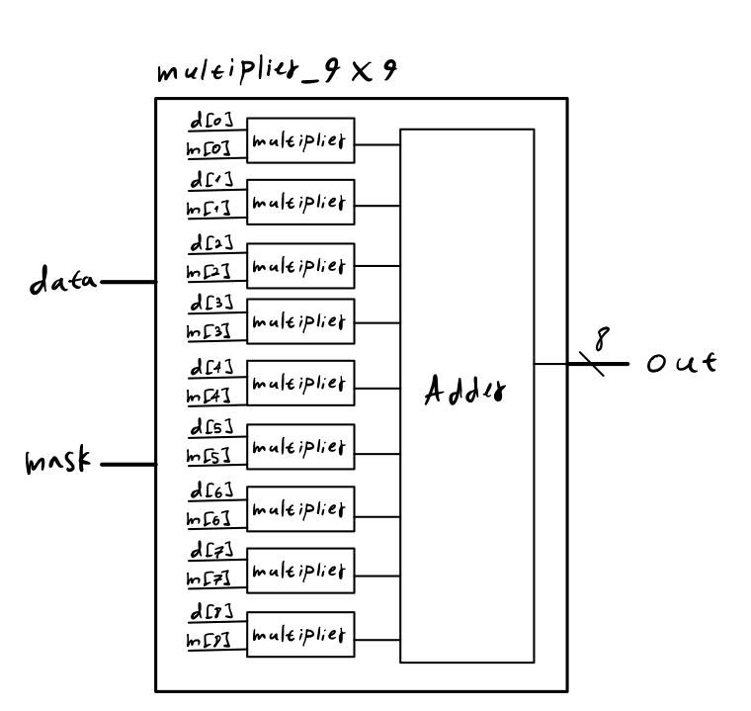
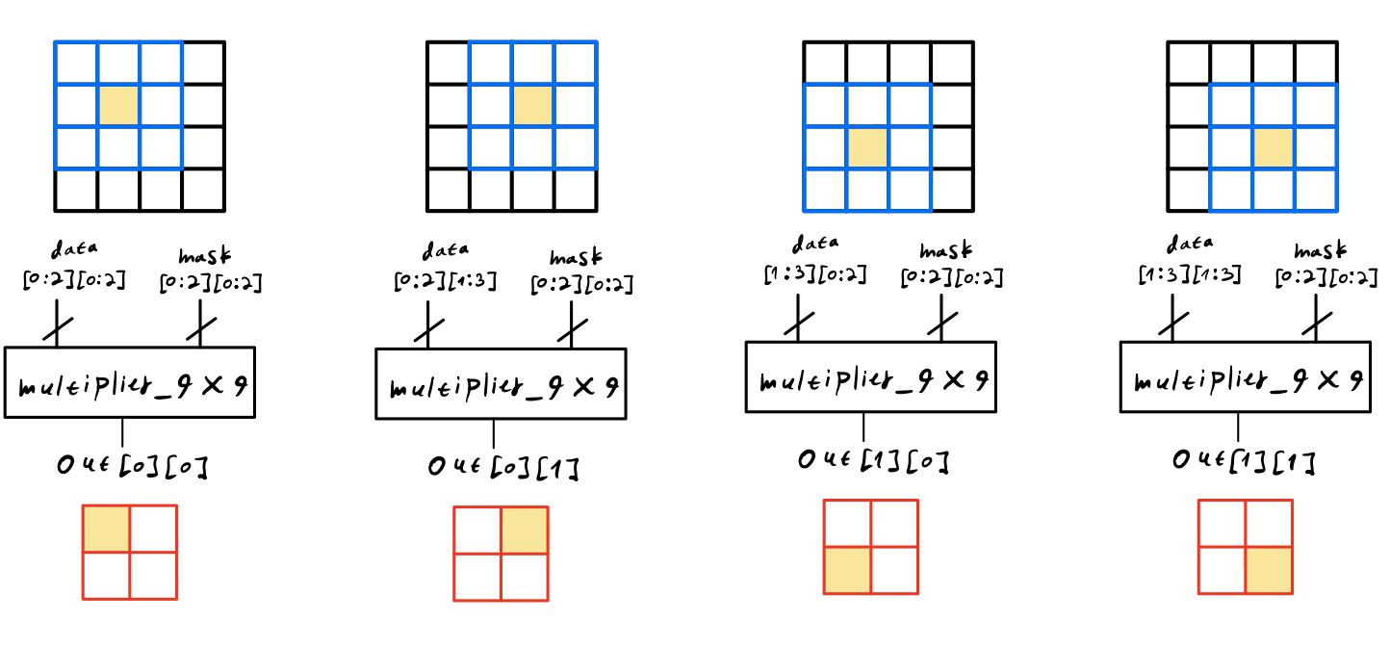
Solution
For maximum efficiency we created a module named “multiplier9by9” which performs the vector dot product parallelly
This module calculates one iteration of the convolution
Maximum use of hardware for minimum time

Slide 5
Average & variance calculation
AVERAGE
Module that receives the convolution matrix and returns it’s average
Firstly, we have added all the matrix cells into 16’ bits wire
In order to divide the sum by 4 we used shift right by 2
We used this module in order to normalize the data
VARIANCE
Module that receives the convolution matrix and returns its variance
Representing the result as 16’ bits, implementing cutoff method

Slide 6
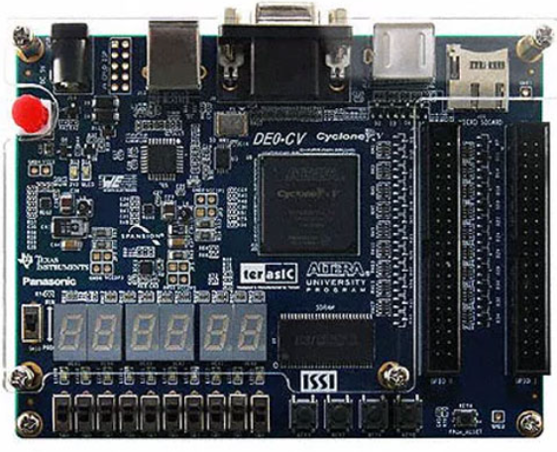
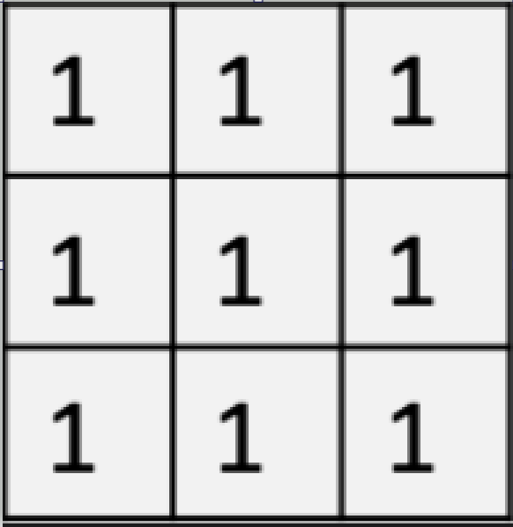
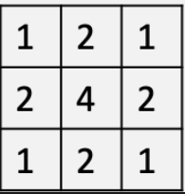
Our additional features
In order to show all the data we added switch functionality to control the 7Segment output
We added extra kernel of type “Box Blur” in addition to the default “Gaussian Blur” Kernel (That we set with C program)
OUTPUT | SW[8] | SW[9]
Convolution | 0 | 0
Normalized Convolution | 1 | 0
Average | 0 | 1
Variance | 1 | 1
BLUR | S7[7]
Gaussian | 0
Box | 1
Box Blur
Gaussian Blur

