Slide 1


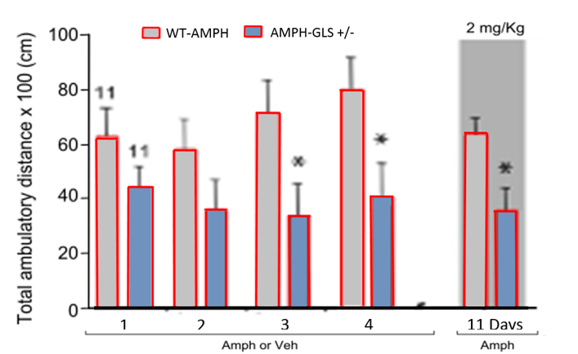
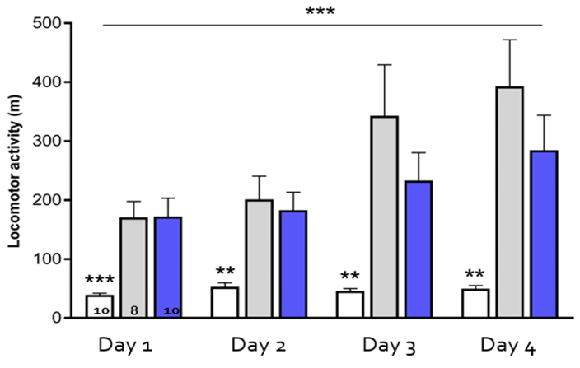
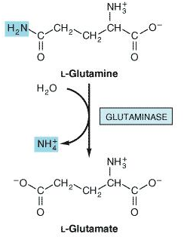
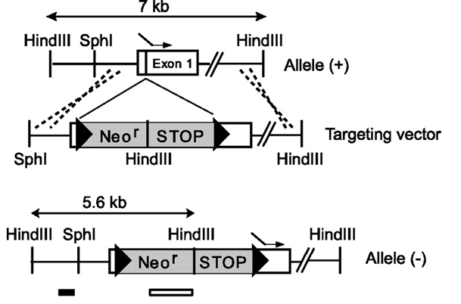

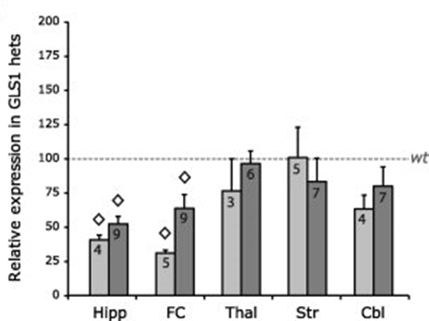
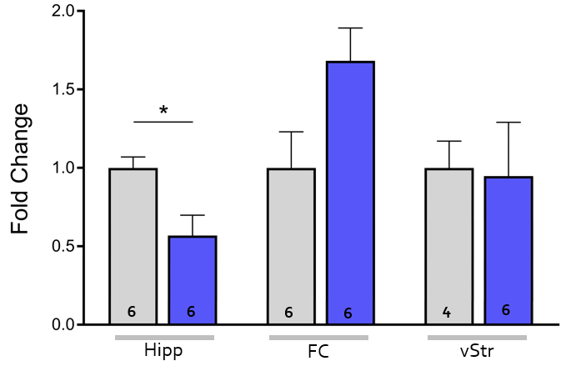

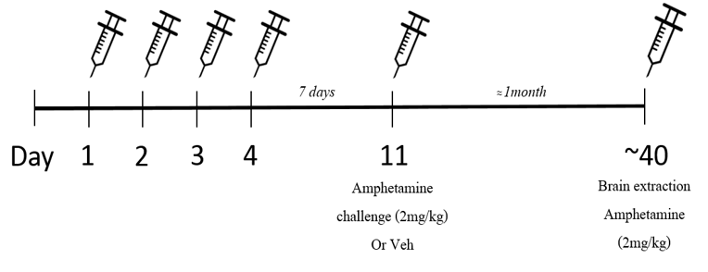
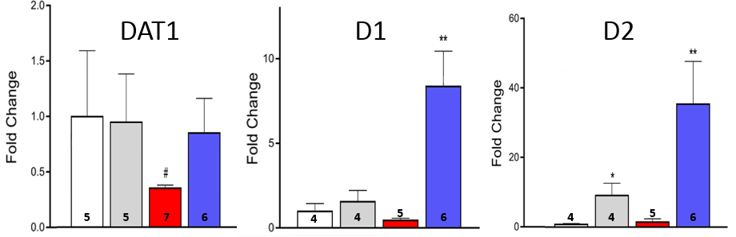
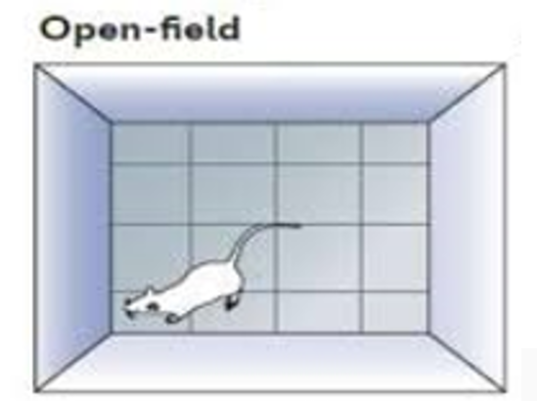
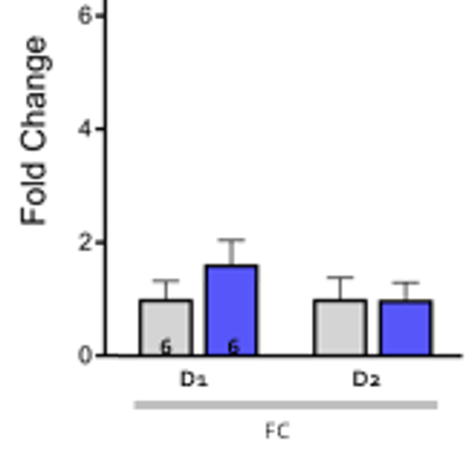


Background
The effects of the glutaminase 1 inhibitor Ebselen on dopamine
markers and locomotion of amphetamine-sensitized mice
Gross A., Cohen R., Heffetz-Giterman L., Lander S.S., and Gaisler-Salomon I.
Results
Dysregulated glutamate and dopamine neurotransmission has been strongly implicated in the pathophysiology of schizophrenia.
Glutaminase 1 (GLS1) plays a critical role in glutamate-glutamine cycle and can be targeted with genetic and pharmacological approaches, in attempt to balance glutamate abnormalities.
Previous studies have shown that GLS1-deficient
(Gls1+/-) mice, with a reduction in hippocampal
and medial prefrontal cortex (mPFC) glutamate,
exhibit a schizophrenia-resilient profile. For
example, they display attenuated sensitization to
the psychotomimetic dopamine releaser D-amphetamine.
Ebselen is a synthetic organo-selenium drug molecule with anti-inflammatory, anti-oxidant and cytoprotective activity and has been recently recognized as a potent GLS1 inhibitor.
In this study, we asked whether Ebselen (EBS; 10mg/kg) would attenuate behavioral sensitization to amphetamine (AMPH; 4mg/kg) and would it effect dopaminergic markers (D1R,D2R,DAT1) expression levels similarly to Gls1+/- mice.
Similarly to Gls1+/- mice, Ebselen-treated mice show reduced behavioral sensitization to Amphetamine
Adapted from Mingote et al. Front. Syst. Neurosci 2016
Similarly to Gls1+/- mice, Ebselen-treated mice show reduced GLS1 expression in the hippocampus
Experimental design
Gaisler-Salomon et al. Hippocampus 2012
Genetic and pharmacological inhibition of GLS1 leads to dopaminergic changes in the ventral striatum
R
R
Open field
Ebselen treatment had no effect on the Expression of Dopamine receptors (D1R,D2R) in the frontal cortex
Conclusions
Ebselen-treated mice show a trend towards attenuated behavioral response to amphetamine sensitization, similarly to Gls1+/- mice, but dissociated in their mRNA expression of dopaminergic markers (D1R,D2R,DAT1) In the ventral striatum.
Subchronic Ebselen treatment in adult mice has long-term effects on the expression of mRNA. After a long wash out period, Ebselen-treated, amphetamine-sensitized mice expressed low GLS1 levels in the hippocampus and high D1R,D2R levels in the ventral striatum.
Gls1+/- mice tendency of low dopaminergic (D1R,D2R,DAT1) mRNA expression may indicate a special mechanism of response to dopamine-related challenges, or point to low baseline levels of dopamine markers in the ventral striatum .
The attenuated behavioral response among Gls1+/- and Ebselen-treated mice, possibly stem from low hippocampal glutamate drive to the striatum, leading to alteration of dopaminergic gene expression and moderate response to amphetamine sensitization.

