Slide 1
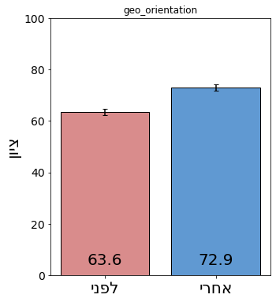
אוריינות לפני אחרי
There is a significant difference (Wilcoxon signed-rank test, W= 2775, p-value<0.001)
N=170
Before: Mean: 63.5612, Std Dev: 16.0103,Median: 64.8649
After: Mean: 72.9244, Std Dev: 15.5694,Median: 77.1429

Slide 2
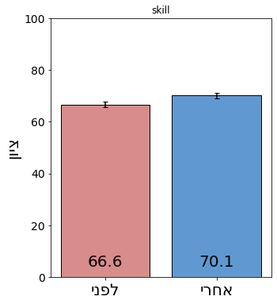
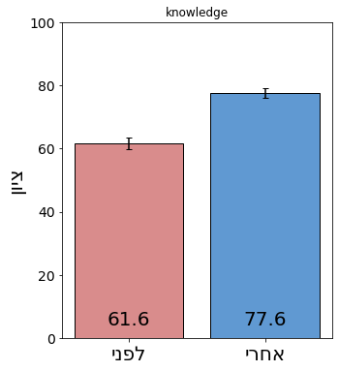
ומיומנות
ידע
There is a significant difference (Wilcoxon signed-rank test, W= 5356, p-value<0.005)
N=170
Before: Mean: 66.6, Std Dev: 14.3 ,Median:68
After: Mean: 70, Std Dev: 15.8 ,Median: 75
There is a significant difference (Wilcoxon signed-rank test, W= 1777, p-value<0.001)
N=170
Before: Mean: 61.61, Std Dev: 23.2,Median: 66.6
After: Mean: 77.63, Std Dev: 19.1,Median: 80
Notes:
skill

Slide 3
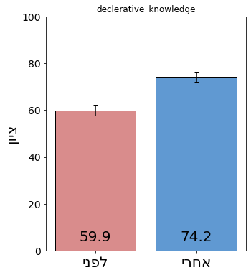
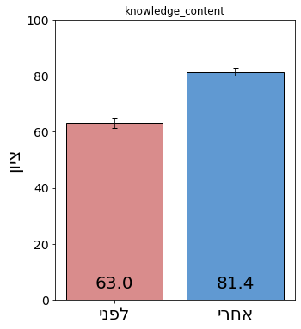
ודיע תוכן לפני ואחרי
ידע הצהרתי
There is a significant difference (Wilcoxon signed-rank test, W= 1875.5, p-value<0.001)
N=170
Before: Mean: 63, Std Dev: 23.7 ,Median:71.4
After: Mean: 81.3, Std Dev: 16.8 ,Median: 85.7
There is a significant difference (Wilcoxon signed-rank test, W= 1875.5, p-value<0.001)
N=170
Before: Mean: 59.9, Std Dev: 30 ,Median:62.5
After: Mean: 74.2, Std Dev: 26.4 ,Median: 87.5
Notes:
declerative_knowledge

Slide 4
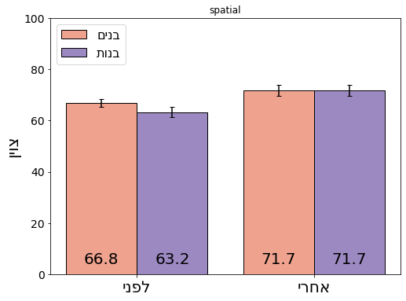
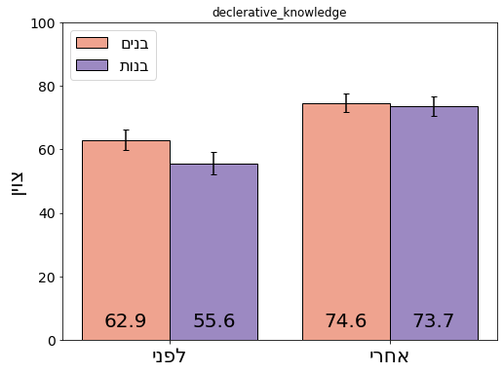
וחשיבה מרחבית
ידע הצהרתי
אחרי
Mann-Whitney U test:
Statistic: U=3565, p-value: 0.5870
There is no significant difference
Male: Length: 103 , 71.7, Std Dev: 21, Median: 77.7
Female: Length: 66,mean: 71.7, Std Dev: 17.4, Median: 77.7
אחרי
Mann-Whitney U test:
Statistic: U= 3243, p-value: 0.58
There is no significant difference
Male: Length: 95 Mean: 74.6, Std Dev: 27.9, Median: 87.5
Female: Length: 65,mean: 73.6, Std Dev: 24.3, Median: 87.5
לפני
Mann-Whitney U test:
Statistic: U= 3959, p-value: 0.033
There is a significant difference
Male: Length: 103 Mean: 66.8, Std Dev: 16, Median: 70
Female: Length: 66,mean: 63. 1, Std Dev: 16.19, Median: 60
לפני
Mann-Whitney U test:
Statistic: U= 3557, p-value: 0.047
There is a significant difference
Male: Length: 95 Mean: 62.89, Std Dev:31.3 , Median: 75
Female: Length: 65,mean: 55.5, Std Dev: 29.3, Median: 62.5

Slide 5
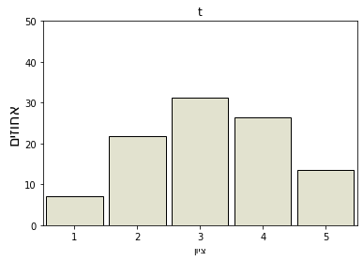
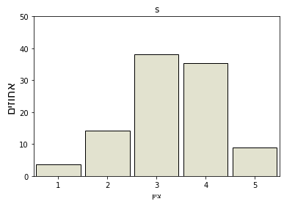
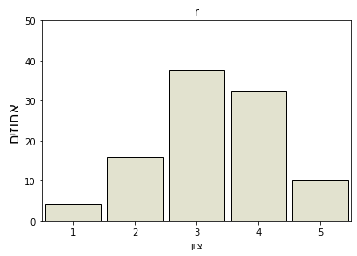
, מוכנות להמליץץץ
תרומת התכנית
שביעות רצון מהשתתפ]ות,
T
S
R

Slide 6
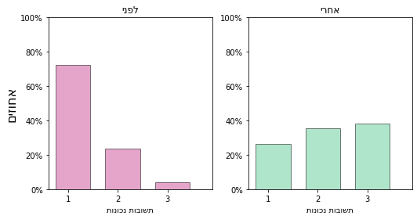
חשיבה כמדען, כגאוגרף - בהקשר לתכנון אזור מונגש
"A chi-square test was performed to compare the 'before' and 'after' values of the 'variable' column. The test revealed a statistically significant difference between the two sets of values (χ2 = 86.94, p < 0.001, df = 2). Therefore, we reject the null hypothesis that the two sets of values are independent and conclude that there is a significant association between them."

