Slide 1
Capstone Project: Sentiment analysis, Text classification using ML algorithm & visualisation. Final Submission report
To model the impact of sellers engagement with customers on twitter and consequently on rating score and polarity of review on amazon.
Amit Kumar Pandey
M.Sc. Data Science
4th semester Projects(MUIT,NOI-DA)

Slide 2
Business objective
To create a model based on seller review on amazon and seller engagement on twitter &test the hypothesis as impact of engagement with customers on twitter helps sellers overall review on amazon and consequently on polarity of amazon review.
The objective is thus classified into following sub goals
Analyse interaction between KPI of scraped amazon and twitter data through visualisation and other such means.
To test the hypothesis as impact of engagement with customers on twitter helps sellers overall review on amazon and consequently on polarity of amazon review
To create a machine learning model classifying tweets (marketing, conversation)
To summarise the business
Outcome and recommen-dations to the sellers.

Slide 3
Problem Solving methodology
The various stages of the framework are represented below in a sequential flow :
Understanding the business objective and map out a structure to scrape the required data from twitter and amazon
Data pre-processing, wrangling to make it suitable for further exploration
Exploratory data analysis&
Visualization
Model evaluation and selection
Preparing classification models for prediction & determining matrices.
Hypothesis testing

Slide 4
Scrapping data from amazon and twitter
Following data were available after scraping for further analysis
Amazon scrapped data table having these columns:-Sellers Url, Rating, Date, Text Review
Twitter scrapped data table having these columns:-Twitter handle and their tweets.

Slide 5
Data pre-processing and clean-up
Cleaning of raw tweets to make it suitable for
Analysis by removing digits, alphanumeric word, some unwanted words, and sign, removal of links and has tags ,retweet notations etc. from scrapped twitter table.
Cleaning of raw reviews and ratings to makeit suitable for further analysis by removing unwanted words,digit,alpha numeric and other notation from scraped amazon table

Slide 6
Basic feature engineering:Creation of new KPI
Creating cleaned tweet column after cleaning the scrapped tweet column by using regex library ,
Created new column “Polarity”, by using textblob library which quantify tweets sentiment into digits. Created another categorical column based on polarity into “+ive”,”-ve”, and neutral
Created another column subjectivity by using textblob library from cleaned column and categories into subjective and objective tweet
Created new column abs_rating ,Positive score from rating column .
Created new column Rating score column from positive score column which depict the average positive score of all the review of each sellers
Created another categorical column
Based on abs_rating into positive, neutral and negative categories

Slide 7
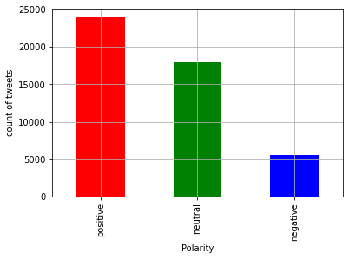
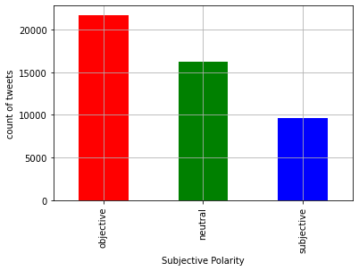
Visualisation: Insight into the data
Most of the tweets are having positive and neutral polarity
Most of the tweet are objective in nature. There are considerable nu of subjective tweets too!

Slide 8
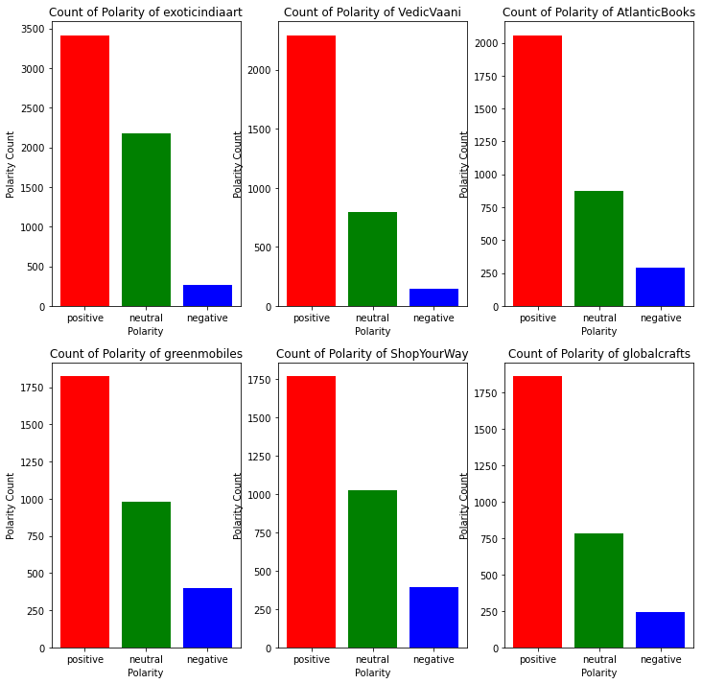
Top 6 handlers with respect to nu of tweets and their visualization of polarity of tweets
These sellers 'exoticindiaart',‘ VedicVaani', 'AtlanticBooks', 'greenmobiles ','ShopYourWay','globalcrafts are top 6 with respect to nu of tweets consecutively.

Slide 9
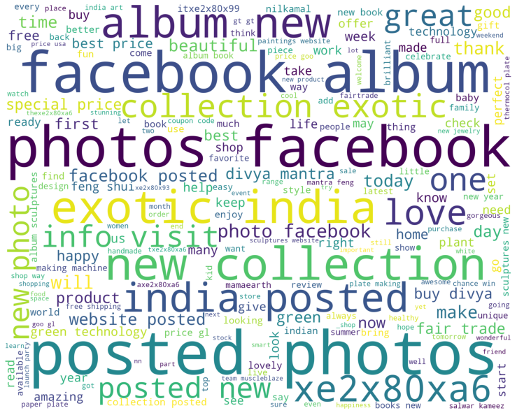
Word cloud graph based on polarity
Positive sentiment wordscloud

Slide 10
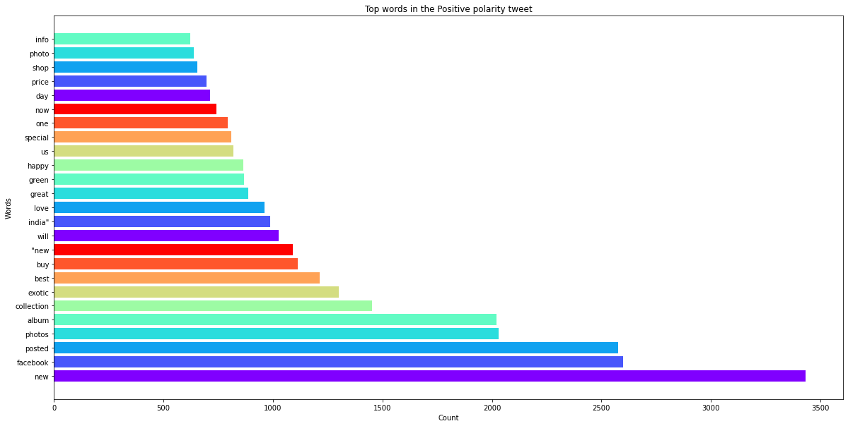
Visualisation contd.
Top 25 most frequent positive polarity word :['new', 'facebook', 'posted', 'photos', 'album', 'collection', 'exotic', 'best', 'buy', '"new', 'will', 'india"', 'love', 'great', 'green', 'happy', 'us', 'special', 'one', 'now', 'day', 'price', 'shop', 'photo', 'info']

Slide 11
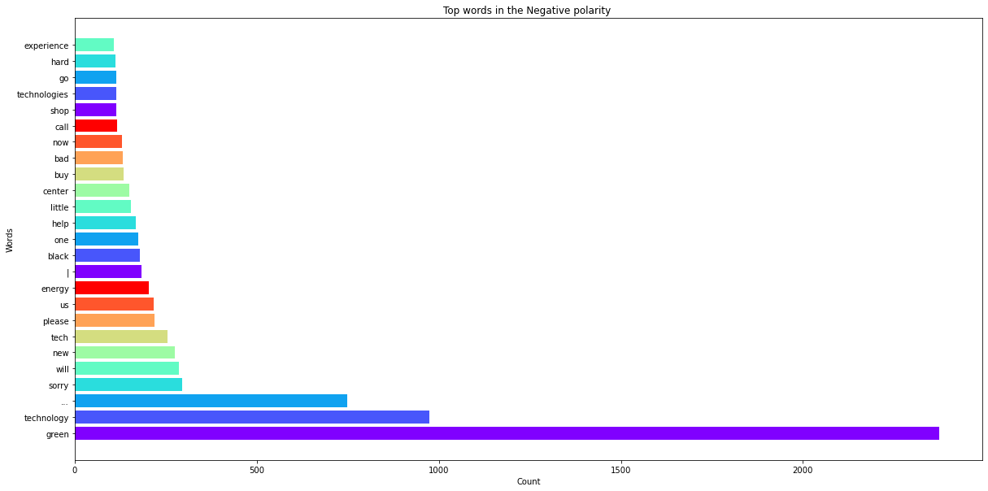
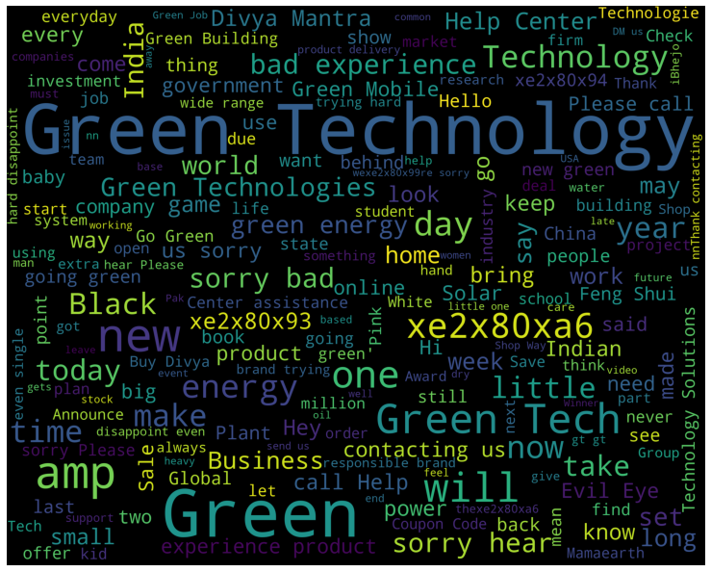
Amazon data visualization
Top 25 Negative sentiment key ['green', 'technology', '...', 'sorry', 'will', 'new', 'tech', 'please', 'us', 'energy', '|', 'black', 'one', 'help', 'little', 'center', 'buy', 'bad', 'now', 'call', 'shop', 'technologies', 'go', 'hard', 'experience'] word
After removing the Stop words

Slide 12
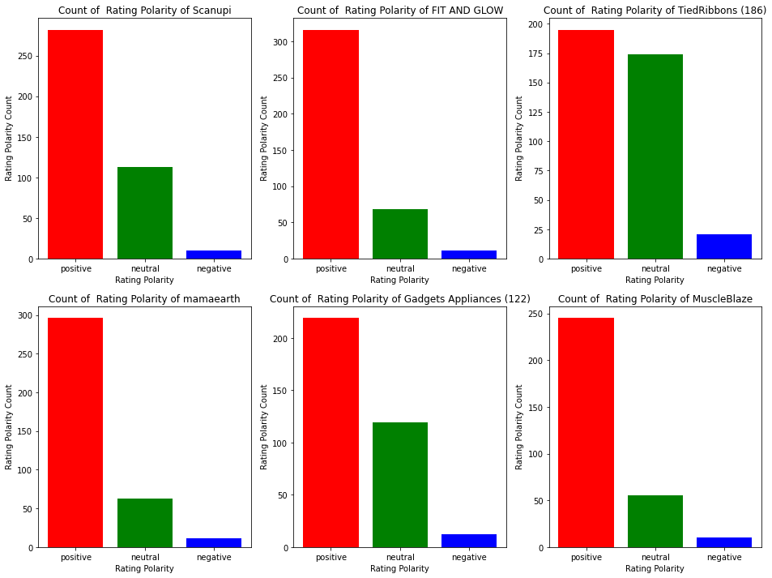
count of rating score polarity based on top 6 sellers w.r.t. nu of review
Top 6 Sellers:-"Scanupi" , "FIT AND GLOW", "TiedRibbons (186)","mamaearth", "Gadgets Appliances (122)" , "MuscleBlaze"

Slide 13
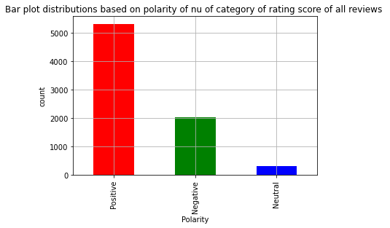
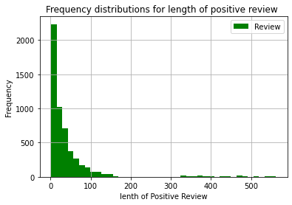
Visualization continued
Most of the positive reviews are said in less words

Slide 14
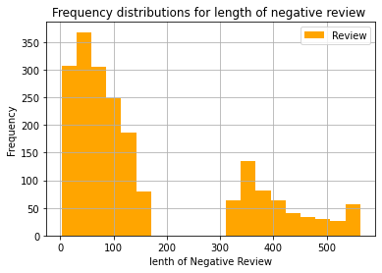
Visualization cont.
Top 10 sellers with respect to rating score
Glamfort 99.367089
Marshland Technology 98.741419
ShopyStore 98.507463
DTHIndia 97.759674
MARKET YARD 97.697368
seven_rays 96.052632
Exotic India (322) 95.473251
Yogabar 94.714882
Ada Chikan 94.214876
Collectible India 93.796526
Negative reviews are having mix of mid to large length of review

Slide 15
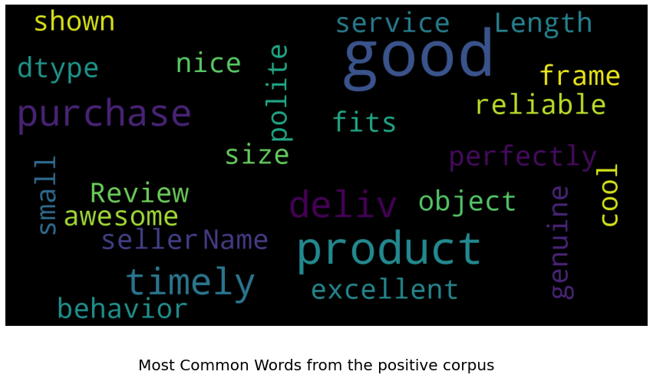
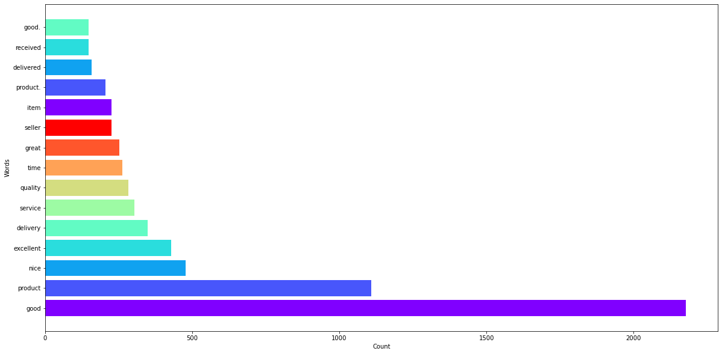
Visualization:Wordcloud
Top most common positive word:-'good', 'product', 'nice', 'excellent', 'delivery', 'service', 'quality', 'great', 'time', 'item', 'seller', 'product.', 'delivered', 'received', 'good.', 'one', 'well', 'happy', 'thanks', 'best']

Slide 16
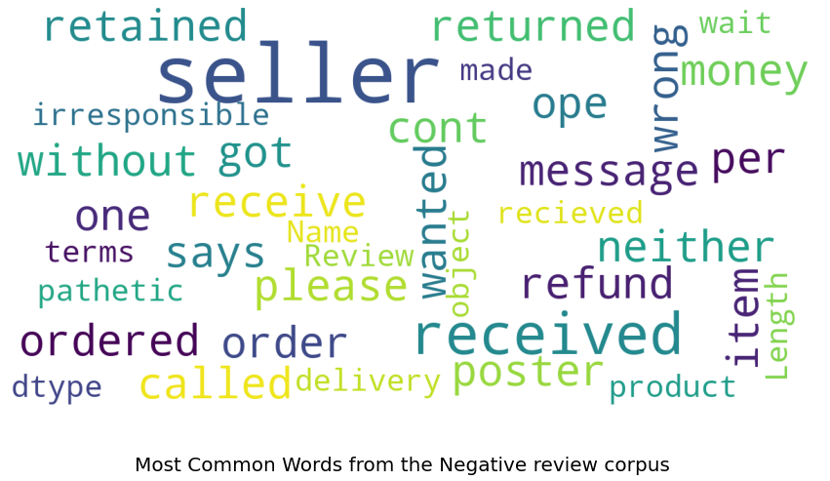
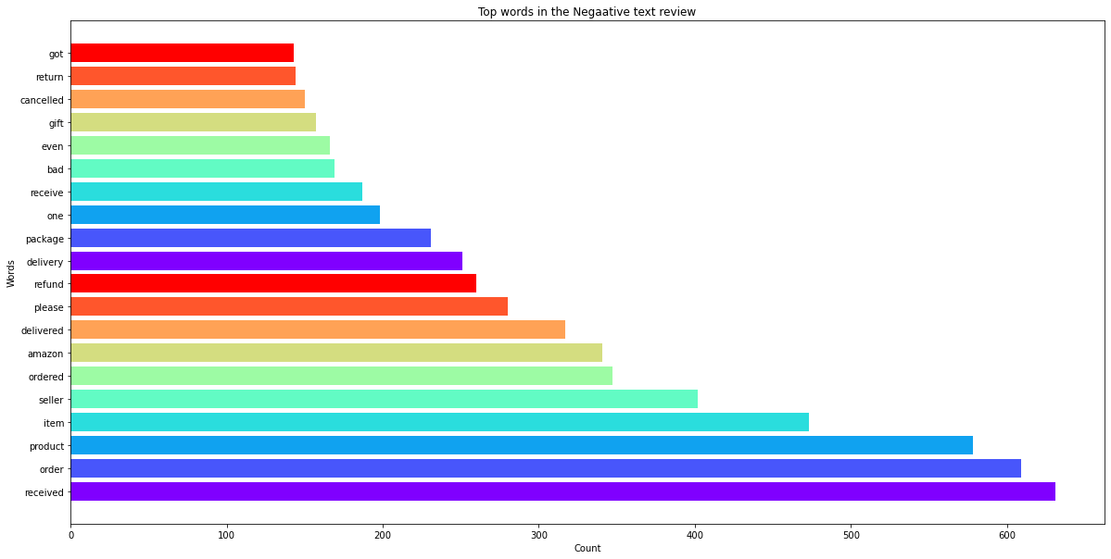
Visualization:Wordcloud
Top 20 common words from Negative corpus:-'received', 'order', 'product', 'item', 'seller', 'ordered', 'amazon', 'delivered', 'please', 'refund', 'delivery', 'package', 'one', 'receive', 'bad', 'even', 'gift', 'cancelled', 'got', 'return']

Slide 17
One Sample t-test
H_0= Mean of rating score of sellers where conversations tweets are less than 10 is equal to mean of rating score of all sellers with all tweets
H_1=Mean of rating score of sellers where conversations tweets are less than 10 is not equal to mean of rating score of all sellers with all tweets
tstat,p_val=stats.ttest_1samp(a=sample['Rating score'] , # Sample data
popmean= am['Rating score'].mean()) # Pop mean
print("p_value", p_val)
print("t_stat",tstat)
p_value 0.6953666533934537
t_stat -0.39524797366895204
if p_val<0.05:
print('we are able to reject null hypothesis as ,there is no impact on overall rating score due to engagement with \n customers on twitter')
else:
print("we are failed to reject null hypothesis as ,there is no impact on overall rating score due to engagement \n with customers on twitter")
we are failed to reject null hypothesis as ,there is no impact on overall rating score on amazon due to engagement with customers on twitter.

Slide 18
Upper tail 1 sample t-test
H_0= Mean of rating score of sellers where conversations tweets( are grater than 10) is less than or equal to mean of rating score of all sellers with all tweets
H_1=Mean of rating score of sellers where conversations tweets (are greater than 10) is greater than mean of rating score of all sellers with all tweets
tstat,p_val=stats.ttest_1samp(a=sample['Rating score'] , # Sample data
popmean= am['Rating score'].mean()) # Pop mean
print("p_value", p_val)
print("t_stat",tstat)
p_value 0.6953666533934537
t_stat -0.39524797366895204
Upper_tail_p_val=1-p_val/2
print(Upper_tail_p_val)
0.6523166733032731
if Upper_tail_p_val<0.05:
print("we are able to reject H_0")
else:
print("we are accepting H_0")
we are fail to reject H_0

Slide 19
A brief description of matrices of output of ML models
Precision
what proportion of predicted each class is truly the same
Recall
what proportion of actual one class is correctly classified
F1-score = 2 × (precision × recall)/(precision + recall)
macro-averaged F1-score, or the macro-F1 for short, and is computed as a simple arithmetic mean of our per-class F1-scores:
weighted-average F1-score, or weighted-F1, we weight the F1-score of each class by the number of samples from that class.
https://towardsdatascience.com/multi-class-metrics-made-simple-part-ii-the-f1-score-ebe8b2c2ca1
Link for detailed explanations

Slide 20
A brief descriptions of Voting classifier(Ensemble learning)
used for better outcome for final model
Voting is one of the way of combining the predictions from multiple machine learning algorithms. Voting classifier is a wrapper for set of different ones that are trained and valuated in parallel in order to exploit the different peculiarities of each algorithm.
Hard voting / Majority voting : In this case, the class that received the highest number of votes , will be chosen.
Soft voting : In this case, the probability vector for each predicted class (for all classifiers) are summed up &averaged. The winning class is the one corresponding to the highest value
ML model used while classifying:-Logistic regression(),SVM(),Multinomial Naïve Bayes, Voting classifier for the final model selection

Slide 21
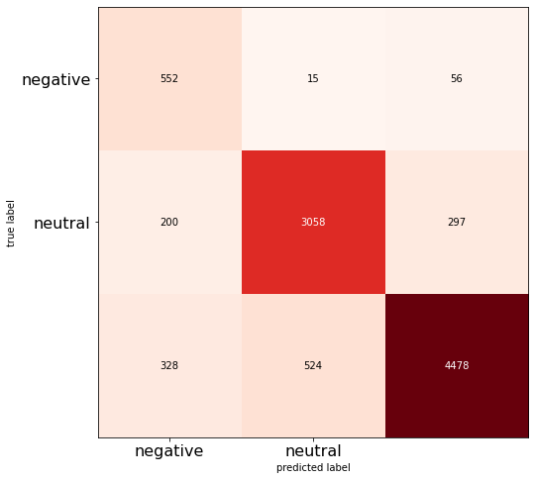
Classification Model report for the categorical polarity of tweets
precision recall f1-score support
-1 0.51 0.89 0.65 623
0 0.85 0.86 0.86 3555
1 0.93 0.84 0.88 5330
accuracy 0.85 9508
macro avg 0.76 0.86 0.79 9508
weighted avg 0.87 0.85 0.86 9508
0.8506520824568784
[[ 552 15 56]
[ 200 3058 297]
[ 328 524 4478]]

Slide 22
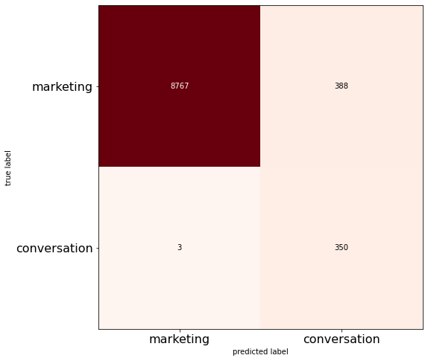
Classification ML model report for marketing and
Conversation tweets
precision recall f1-score support
0 1.00 0.96 0.98 9155
1 0.47 0.99 0.64 353
accuracy 0.96 9508
macro avg 0.74 0.97 0.81 9508
weighted avg 0.98 0.96 0.97 9508
0.958876735380732
[[8767 388]
[ 3 350]]

Slide 23
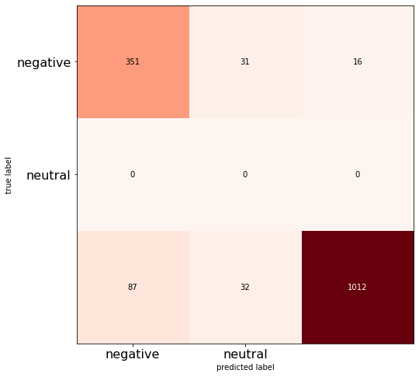
Classification Model report for the categorical polarity of review
precision recall f1-score support
-1 0.80 0.88 0.84 398
0 0.00 0.00 0.00 0
1 0.98 0.89 0.94 1131
accuracy 0.89 1529
macro avg 0.60 0.59 0.59 1529
weighted avg 0.94 0.89 0.91 1529
0.8914323086984958
[[ 351 31 16]
[ 0 0 0]
[ 87 32 1012]]

Slide 24
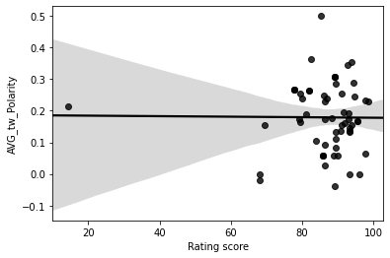
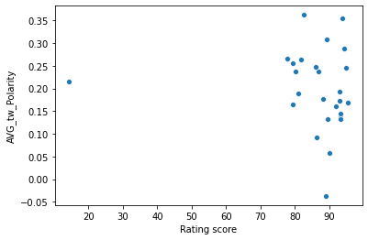
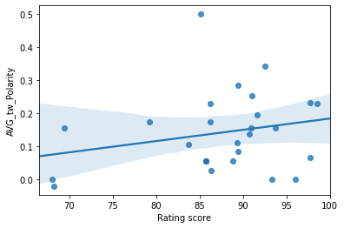
Visualization based on blend data
Regression plot between average tweet polarity and Rating score
Scatter plot between average tweet polarity and rating score for sellers which has got more than 10 tweet conversation
Scatter plot between average tweet polarity and rating score for sellers which has got less than 10 tweet conversation

Slide 25
Recommendations to the sellers and business outcomes
Most of the tweets are marketing in nature. Engaging customers with tweets using contest, correlating product with current hot topic scenario would make an impact on customers.
While going through the word cloud of tweets, we can infer that facebook link is being tweeted more as compare to other social page for the marketing purpose.
Album ,photo,posted word are also poping out from wordcloud shows ,sellers are actively posting
pic of products.

Slide 26
Recommendations to the sellers and business outcomes
Those sellers which are having more nu of reviews by consumers may lead to less negative reviews. It could be possible that ,if their grievances is resolved at amazon review section only, could impact over all rating score for sellers.
Word clouds of negative review revealed more frequency of these word as ordered, refund, delivery, package ,bad, cancel, return sums up major customer grievances related to refund issue, delivery issue, packaging issue, cancelling issue, return issue. If sellers could focus on these issue might lead to improve in their over all rating score.
Using 1 sample t-test we are failed to reject null hypothesis as ,there is no impact on overall rating score due to engagement with customers on twitter

Slide 27
Recommendations to the sellers and business outcomes
Using upper tail 1 sample t-test we have to reject our alternate hypothesis(H_1), H_1=Mean of rating score of sellers where conversations tweets (are greater than 10 ) is greater than mean of rating score of all sellers with all tweets
There seems to be slightly positive correlation between average tweet polarity and rating score for sellers which has got less than 10 tweet conversation(majority of marketing tweets), implies marketing on twitter may lead to overall positive sentiment and positive review score on amazon.

