Slide 1

Problem Set 5 CIS508
By:
Amit Kheterpal

Slide 2
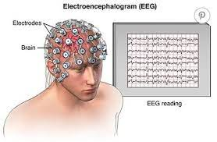
Business Problem and Motivation:
Problem In question:
Using patient EEG images, we are attempting to determine whether there is a possibility of epileptic seizures. This will help the medical field identify people who are at risk for seizures simply by observing their brain activity, allowing doctors to plan a course of action in accordance with these people's medical histories.
Stakeholders:
Medical industry professionals will undoubtedly be our stakeholders. They will be able to identify particular people who have a risk of epileptic seizures thanks to this model.
Given that any EEG reading requires close attention and that there is a high likelihood of human error, applying machine learning will decrease that error and help hospitals avoid potentially facing legal action.

Slide 3
Workflow
Each of the 500 observations in the input data lasts for 23 seconds.We have 11500 observations as a result of stacking each observation for a separate second. Furthermore, every second is divided into 179 values or features.
Since there are more rows in our data that indicate no elliptical seizures than its opposite, our data is unbalanced. So that our model training is not biased towards any particular value, we will use stratified shuffling split for test/train data.
Our initial model is now available. To enhance our classification metrics, we must decide on the ideal combination of elements. We used feature variance to identify the elbow using various PCA models and graphical representation. No obvious elbow was present.
The following step is to combine our model with clustering. Hierarchical clustering and K means will be used in this. We will use k=5 from our business problem since no distinct clusters were found when we plotted cluster vs. inertia. By incorporating clustering into our base model, we were able to raise the F1 score to 100%.
All outliers are eliminated from the data during cleaning. Finding the elliptical seizures is the goal. Therefore, our target variable has been binarized. The data is normalized using a min-max scalar
Observations:
No anomalies were found.
For further analysis, we must now choose a baseline classifier model. We trained a variety of models and assessed them using a variety of metrics.
Conclusion:
We will use Random Forest because it has the highest F1 score (96%), which will be used for future calculations.
Then, by combining PCA and RF using a pipeline, we were able to achieve a very high F1 score using just 40 components.

Slide 4

Conclusion:
With a high f1 score of 96%, random forest is our top pick among its competitors for our classifier model.
Our dataset's dimensionality has been significantly reduced through the use of PCA, which will eventually enhance performance when working with large datasets.
The performance of the Random Forest model has significantly improved by clustering the data and using it as a feature.

Slide 5
Sklearn Pipeline

Slide 6
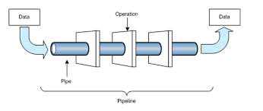
What exactly is a pipeline in the context of data engineering?
It is essentially a method in which raw data from various sources is ingested, processed, and then stored in a data store such as a data warehouse or data lake for analysis.
This is also known as ETL
Pipelining is a technique for increasing the throughput of a computer system. It keeps all of the processors busy and improves system efficiency.

Slide 7
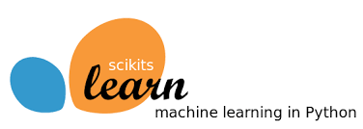
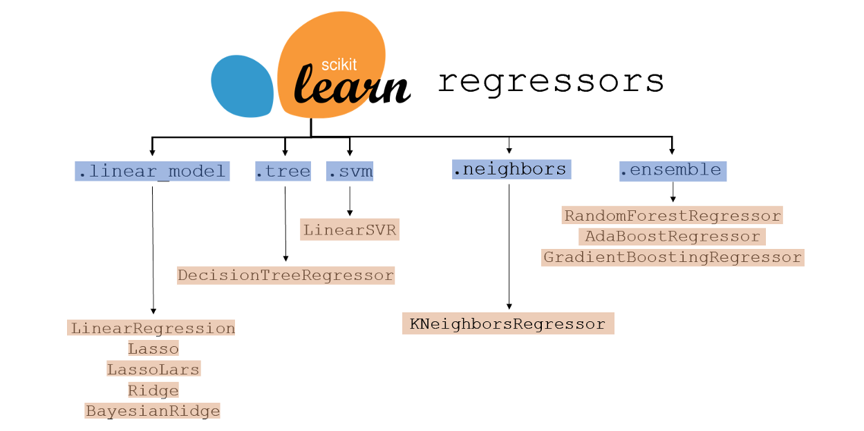
What is Sklearn?
Sklearn, also known as Scikit-Learn, is one of Python's most useful Machine Learning libraries. It offers a comprehensive set of machine learning tools and statistical modelling, including classification, regression, clustering, and dimensionality reduction.
It is relatively simple to learn, and anyone can do it.

Slide 8
What is Sklearn Pipeline?
For the purpose of streamlining the procedure, it is a single interface that encapsulates transformers and predictors. A series of transformations are sequentially applied to the input data by the Sklearn pipeline, followed by a final estimator.
Transformers:
transforming the input data by extracting features or creating new features.
It covers every action we take prior to executing the final model.
It can also add custom functions for transformers. Like,We can also include n-degree polynomials as our transformers.
Estimators:
Learn patterns form the data i.e apply a regressor or a classifier depending on the target.
Using a pipeline, we can combine multiple estimators into one composite estimator.

Slide 9
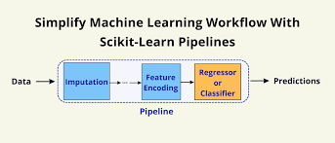
How does a Scikit –Learn Pipeline looks like?
Final Predictions from the Estimator
Input data aggregated from various sources
Final Estimator is applied after all the transformations
Sequence of various transformations on the input data

Slide 10
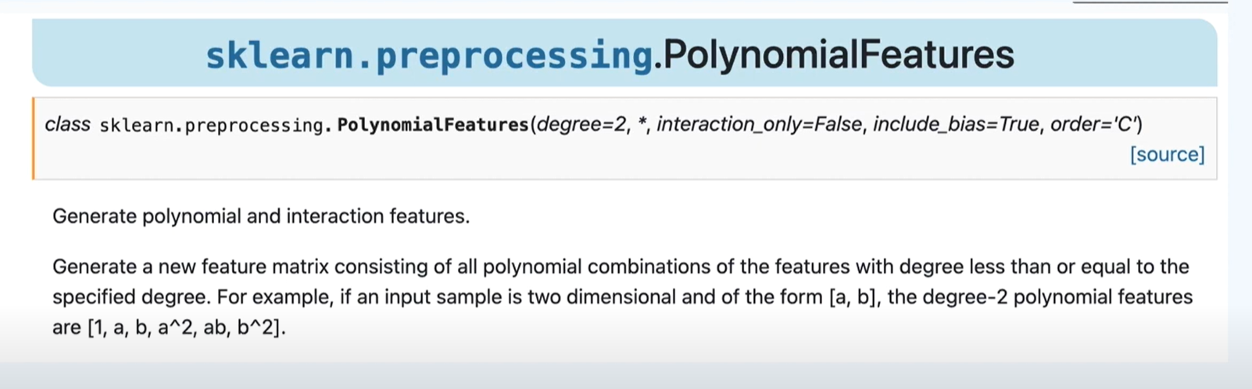
Example of a Transformer:
Source: https://scikit-learn.org/stable/modules/generated/sklearn.preprocessing.PolynomialFeatures.html

Slide 11
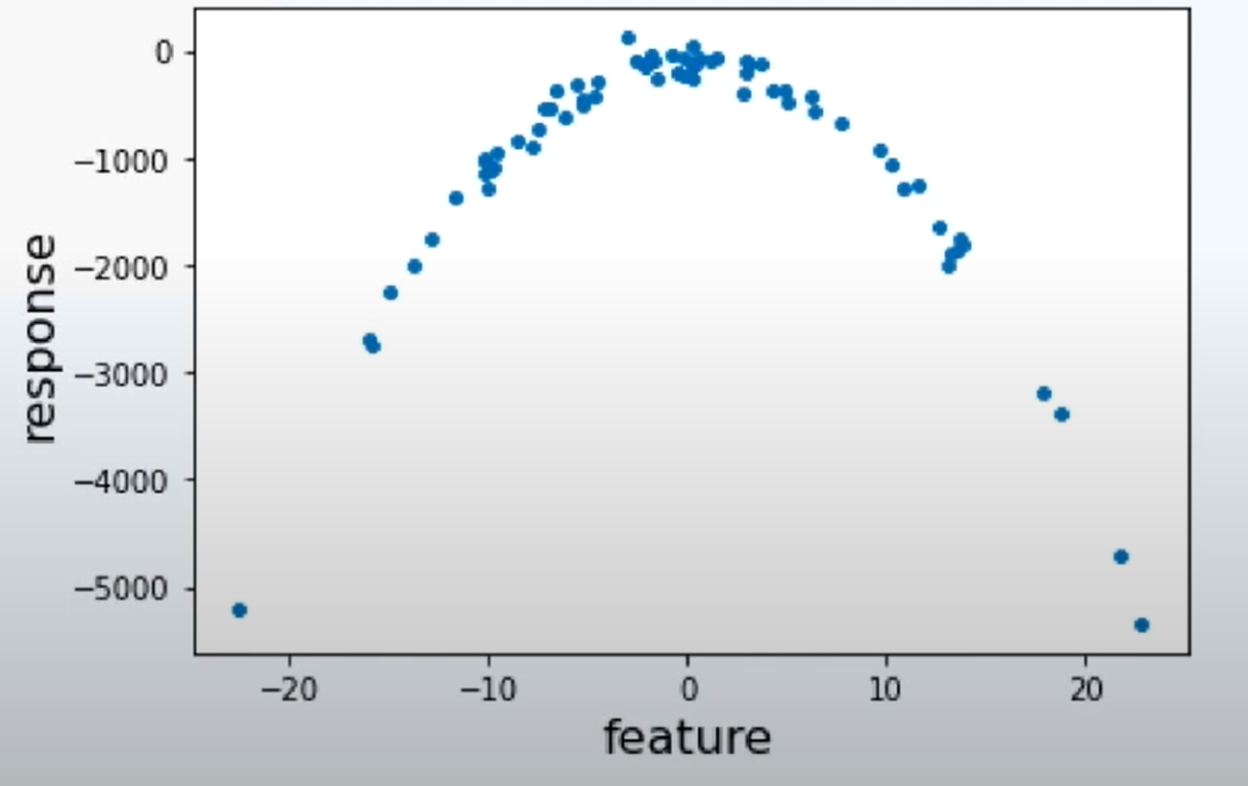
Suppose we have a dataset that looks like this.
On the X axis we have a feature and on the Y axis we have our target variable which is the response.
What will happen if we decided to fit a linear model for this dataset?

Slide 12
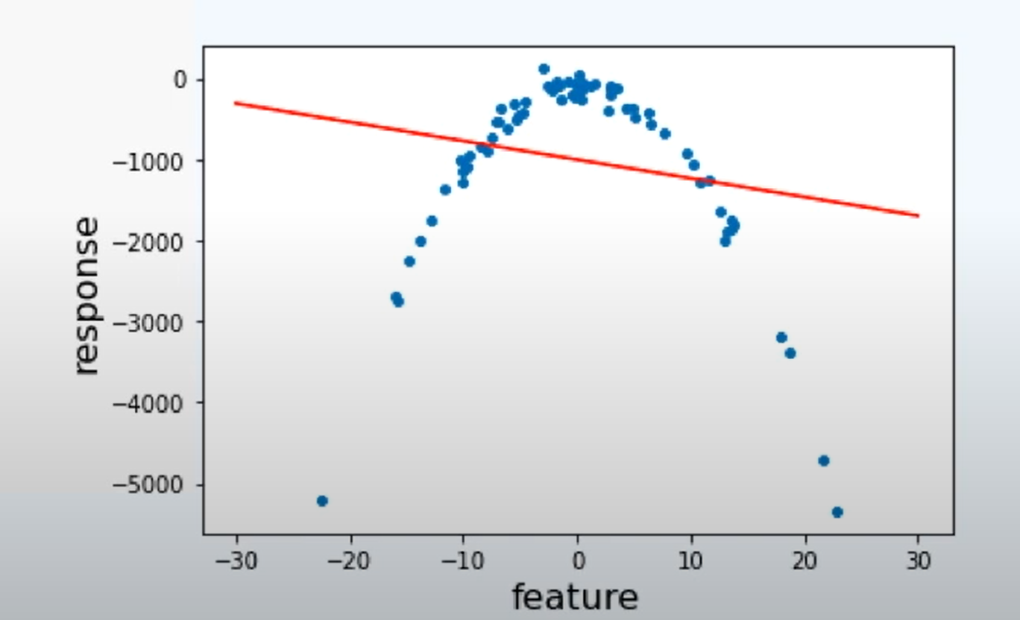
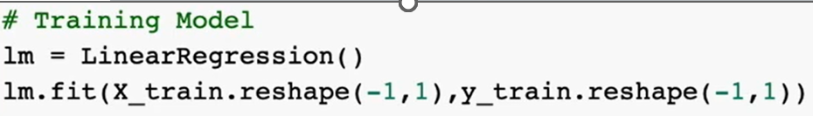
We get a linear line with a negative slope
Y = AX + B
How does this line fits our data?
A simple linear model does not fits our data well. Either we can create a new feature with polynomial properties or we can use the Sklearn pipeline to do it for us

Slide 13
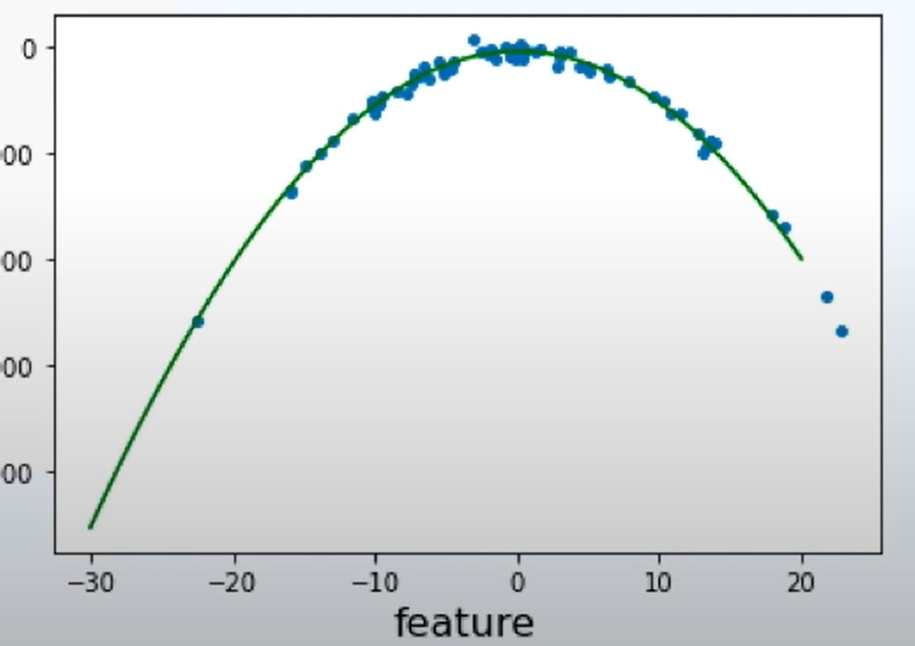
We can add the polynomial Transformation using Sklearn Pipeline with Polynomial Features as a pre-processing function.
Now how do this data looks?
This curve definitely fits our data.
See how we have added a new second degree polynomial feature for our model.
Y = A + BX +CX^2

Slide 14
Advantages of SKLearn Pipeline
Convenience:
you only have to call fit and predict once on your data to fit a whole sequence of estimators.
Machine learning functions like Grid search and cross-validation over all parameters of the pipeline's estimators can be carried out simultaneously.
Safety:
By ensuring that the same samples are used to train the transformers and predictors, pipelines prevent statistics from your test data from leaking into the trained model during cross validation.

Slide 15
Thank You!

