Slide 1

INTERNSHIP
REPORT
By Amit Kumar
IILM University,
Knowledge Park II,
Greater Noida,
Uttar Pradesh 201306

Slide 2

ABOUT
Student:
Name : Amit Kumar
Roll no: 25SCS1003005264
Section: 2CSE37
Semester: 3rd
Program: B.Tech. CSE
Organization
Name:

Slide 3
INTRODUCTION
My internship was based at Sakshem IT Solution PVT. LTD. , Janakpuri, New Delhi – 110058. It was remote internship.
I completed my required 2 months by serving as a Frontend Development Intern from 1st June 2026 to 31st July 2026, which included many hours of learning the frontend languages like HTML, CSS, Javascript and also applying it on live webpages.

Slide 4
OBJECTIVES
To work cooperatively with my supervisor, and to complete the required development.
To develop my skill set and interest in Front-end development.
To get practical experience in real life projects.

Slide 5
ACTIVITIES
Made changes in the design of pages of a new software project.
Updates on the user authentication and login/signup page.
Live server running the frontend and backend.

Slide 6
CHALLENGES
These are some of the challenges faced
during my internship:
Difficulty in learning how to user web development
application and new programming languages.
Cooperating with the team to increase the efficiency.
Not able to understand some of the new concepts.

Slide 7
EXAMPLES OF WORK
Worked on the new social media app project
(still in work).
Making chat with friend interface.
Uploading videos and posts.

Slide 8
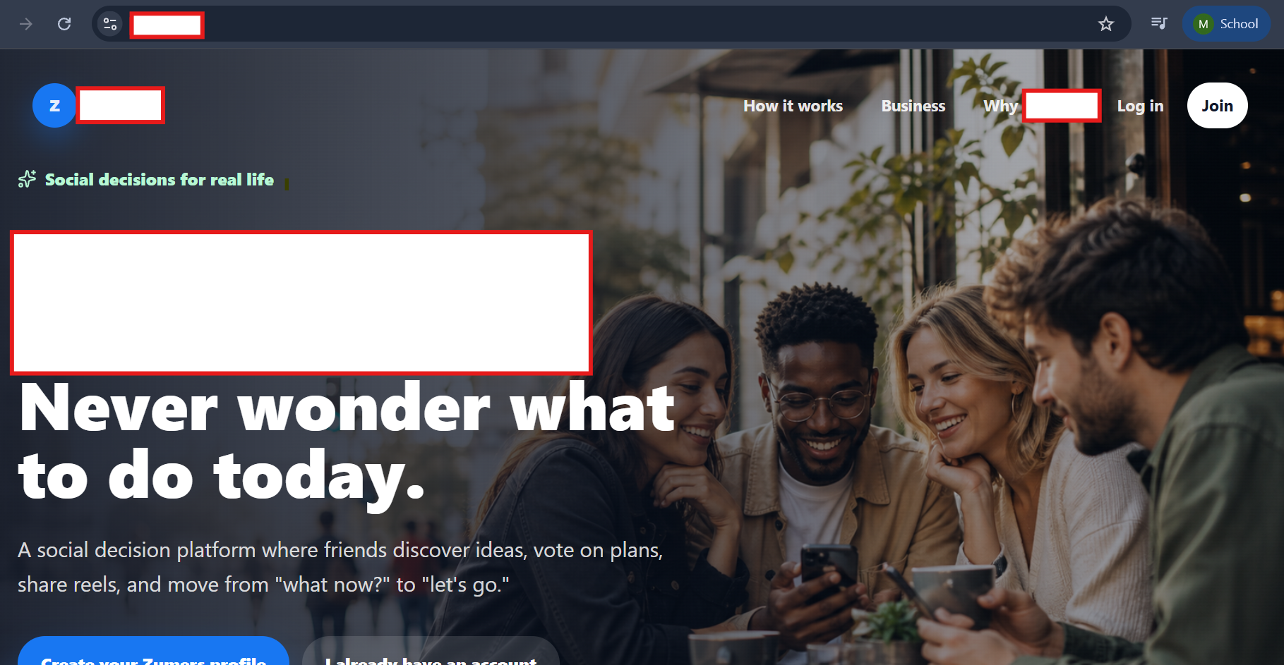
PICTURES

Slide 9
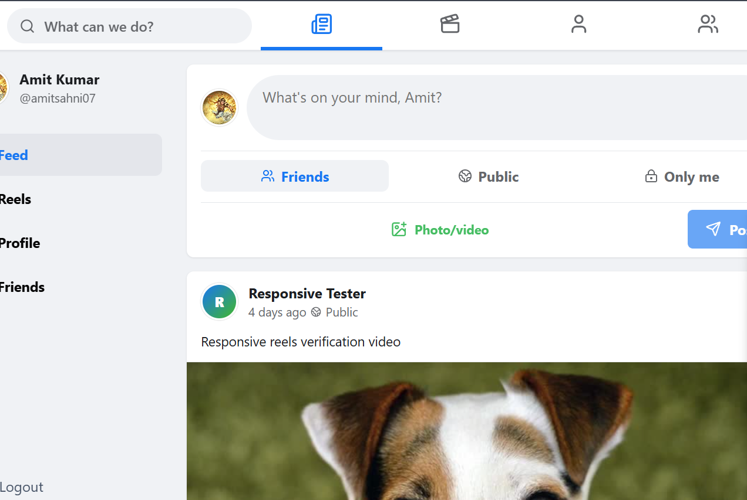
PICTURES

Slide 10
PERSONAL BENEFITS
I have become quite skillful using VS Code for actual project building. I will be able to use this application for personal project building.
I have developed habit of working in a team and to work continuously to meet the requirement and building a single project with a team.
I have been able to know more about the requirements to build a scalable software not just the frontend but also what goes in the backend And also, databases and clouds.

