Slide 1

Seasonal Agriculture Performance Analysis
Student Name: Amit Kumar Gupta
College Name: Amity University Jharkhand
AICTE STU ID: STU6a2a7bd06be6f1781169104

Slide 2

PROBLEM STATEMENT
Agricultural performance varies with seasonal environmental conditions, farming practices, resource availability and market conditions. This project analyzes the given agricultural dataset to identify seasonal differences, trends, relationships and unusual patterns.

Slide 3
This project analyzes 4,000 farm-level records across 3 seasons, 8 crops and 8 states. The workflow covers data exploration, missing-value treatment, descriptive statistics, seasonal comparisons, crop and irrigation analysis, correlation analysis, visualization and evidence-based recommendations.

Slide 4

WHO ARE THE END USERS?
Farmers and farm managers
Agricultural planners and extension teams
Agribusiness and supply-chain stakeholders
Researchers and students analyzing seasonal performance
Decision-makers interested in resource and crop planning

Slide 5

Technology Used
Python
Jupyter Notebook
Pandas — data manipulation and aggregation
NumPy — numerical processing
Matplotlib / Seaborn — visualization
Statistical analysis — descriptive statistics and correlation

Slide 6
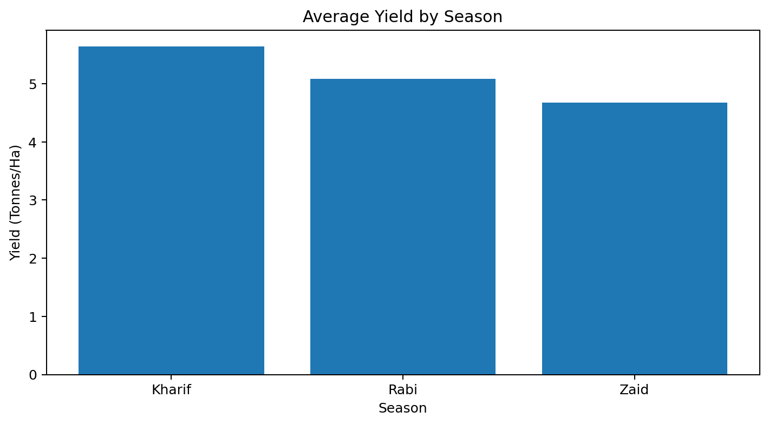
RESULTS
Dataset: 4,000 records × 28 columns
Total production: 172,985 tonnes
Total revenue: ₹2.55 billion
Total profit: ₹446.23 million
Missing values before cleaning: 120
Missing values after cleaning: 0

Slide 7
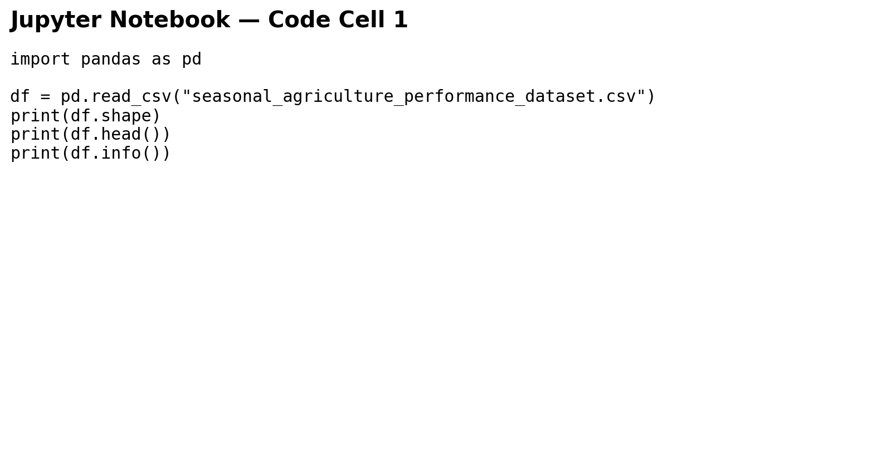
RESULTS
[Add screen shots of your code ]
Data preparation: 4,000 rows and 28 columns. 120 missing cells were identified and numeric gaps were filled using median imputation.

Slide 8
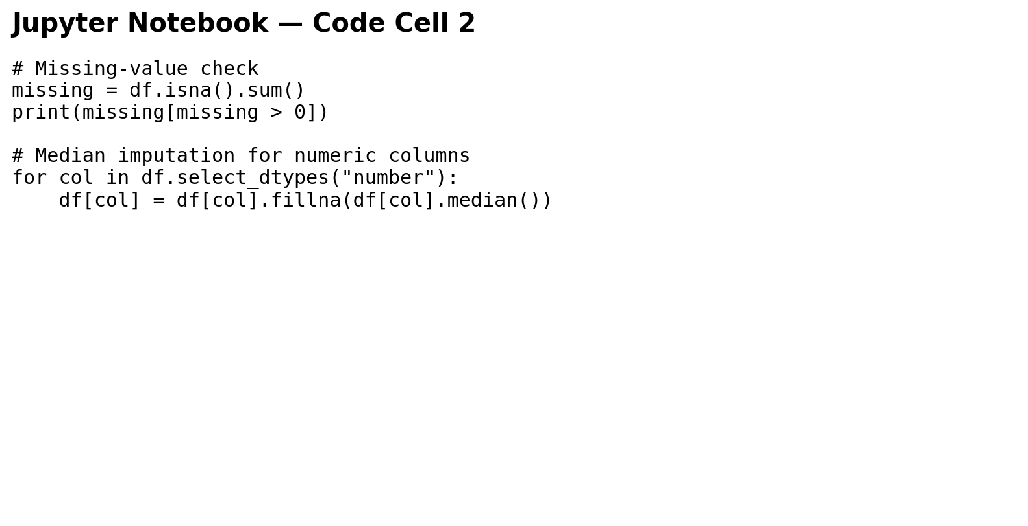
RESULTS
[Add screen shots of your code ]
Seasonal aggregation was used to compare yield, profit and water efficiency across Kharif, Rabi and Zaid.

Slide 9
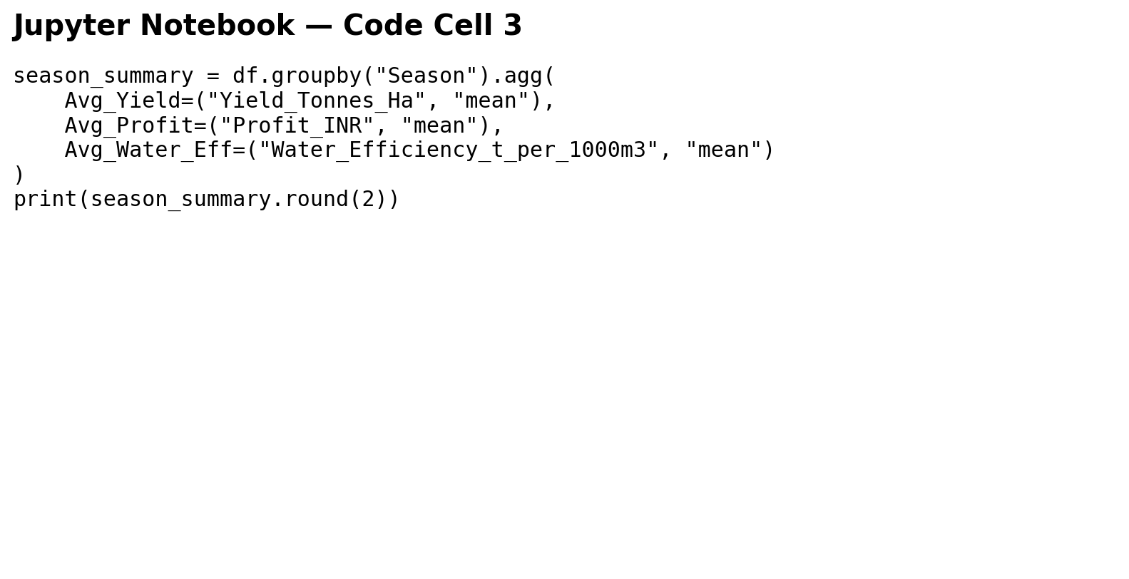
RESULTS
[Add screen shots of your code ]
Kharif had the highest average yield (5.64 t/ha) and highest average profit (₹178,915). Zaid showed the lowest average profit (₹-24,805).

Slide 10
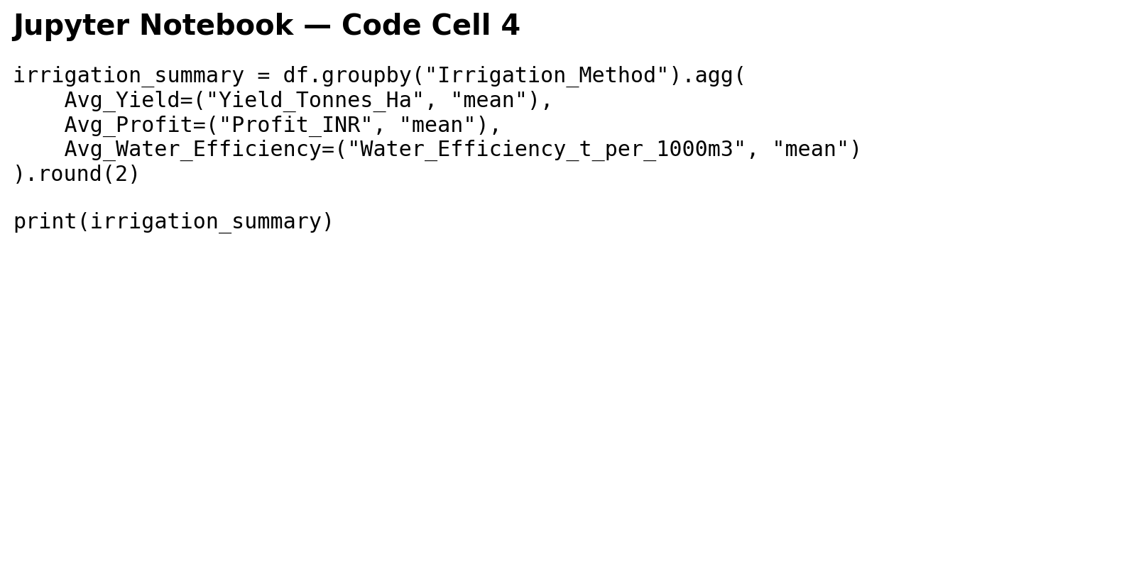
RESULTS
[Add screen shots of your code ]
Drip irrigation recorded the highest average yield (6.62 t/ha) among irrigation methods, while Rainfed had the highest water efficiency (7.56 t/1,000 m³).

Slide 11
Future scope
Build predictive models for yield and profit forecasting.
Add time-series weather and market-price data for stronger seasonal analysis.
Develop an interactive dashboard for region, crop and season filtering.
Use optimization methods to recommend crop and irrigation choices.
Integrate real-time weather and soil data for decision support.

Slide 12
GitHub Link
https://github.com/AmitKumarGupta15/Seasonal-Agriculture-Performance-Analysis
Project notebook and analysis files can be maintained in the repository.

Slide 13

VOIS Course Completion Certificate
Course name: Getting Started with Linux File System

Slide 14
Thank you
.
.

