Slide 1
CP
CampaignPulse
Marketing Campaign ROI Analytics
Data-Driven Insights for Marketing Optimization
Amit Kumar Jha · Data Analyst
September 2026 · github.com/AmitKumarJha-ds/marketing-campaign-roi-analytics
Python
SQL
Tableau
9,995 Campaigns

Slide 2
Agenda
02
What this deck covers
01
Executive Summary
Portfolio performance in five numbers
02
Project Overview
Objectives, methodology and tooling
03
Business Problems Addressed
The 15 questions this project answers
04
Dataset Overview
9,995 campaigns, 41 features, 2022–2024
05
Campaign Type Performance
Retention 204% vs Brand Awareness −51%
06
Channel Performance
SEO, Email and Affiliate lead the ROI table
07
Budget Analysis
Diminishing returns to scale
08
Geographic & Audience Analysis
Where and who to invest in
09
Seasonal Trends & Top Campaigns
Timing and what winners look like
10
Key Findings & Recommendations
10 findings, 8 actions
11
Dashboard Preview
The four Tableau dashboards
CampaignPulse | Marketing Campaign ROI Analytics
2

Slide 3
Executive Summary
03
Portfolio performance across 9,995 campaigns
TOTAL REVENUE
TOTAL SPEND
OVERALL ROI
TOTAL PROFIT
AVG CAC
$388.9M
$198.4M
96.0%
$190.5M
$266
▪ The portfolio generated $388.9M of revenue from $198.4M of spend — a blended ROI of 96.0% and $190.5M of profit across 9,995 campaigns.
▪ Retention campaigns are the standout performer at 203.9% average ROI; Brand Awareness is the only value-destroying type at −50.8% — only 10.8% of its campaigns are profitable.
▪ SEO (191.7%), Email (185.8%) and Affiliate (185.4%) are the most efficient channels; Instagram Ads (23.1%) and Social Media (24.1%) the least.
▪ 46.6% of campaigns lose money — 4,660 campaigns consuming $86.2M of spend with no return.
▪ Budget elasticity of revenue is ≈ 0.70 — clear diminishing returns; bigger budgets do not buy bigger returns.
▪ Efficiency has been flat for three years (98.8% → 92.1% → 97.1%) while CAC climbed from $261 to $270 — a productivity problem, not a volume problem.
CampaignPulse | Marketing Campaign ROI Analytics
3

Slide 4
Project Overview
04
Objectives, methodology and tooling
OBJECTIVES
METHODOLOGY
TOOLS & TECH
▪ Quantify ROI by campaign type, channel, region and audience
▪ Identify the loss-making cohort and its root causes
▪ Establish whether scale creates or destroys returns
▪ Deliver an auditable, reproducible analytics pipeline
▪ Produce dashboards and reports for executive decisions
▪ Ingest the raw extract and profile every column
▪ Repair missing values, duplicates, negatives and broken dates
▪ Recompute all derived KPIs from cleaned base metrics
▪ Winsorise outliers, then engineer 14 analytical features
▪ Validate with 12 automated data-quality gates
▪ Analyse in Python, verify in SQL, visualise in Tableau
▪ Python — pandas, NumPy, matplotlib, seaborn
▪ Jupyter — 2 executed notebooks, 49 + 47 cells
▪ MySQL 8 — 73 validated statements across 3 scripts
▪ Tableau — 4 interactive dashboards
▪ PowerPoint / PDF — executive deliverables
CampaignPulse | Marketing Campaign ROI Analytics
4

Slide 5
Business Problems Addressed
05
The questions this project answers
1
Which marketing campaigns deliver the highest ROI?
9
Which campaigns should be scaled up, paused or discontinued?
2
How do different channels compare in cost-efficiency?
10
What is the customer acquisition cost trend across channels?
3
What is the optimal budget allocation across campaign types?
11
How has marketing efficiency evolved over three years?
4
Which geographic regions respond best to marketing efforts?
12
Which channel + audience + type combination yields the highest returns?
5
What is the ideal campaign duration for maximum ROI?
13
Are there diminishing returns as campaign budgets increase?
6
Which target audience segments are most profitable?
14
What distinguishes top performers from underperformers?
7
How do seasonal patterns affect campaign performance?
15
How can the company optimise spend to maximise ROI?
8
What is the relationship between budget size and success?
CampaignPulse | Marketing Campaign ROI Analytics
5

Slide 6
Dataset Overview
06
Dimensions, time period, features and quality
CAMPAIGNS
FEATURES
CHANNELS
REGIONS
PERIOD
9,995
41
10
6
2022–2024
STRUCTURE
DATA QUALITY AFTER CLEANING
▪ 27 source columns + 14 engineered features
▪ 5 campaign types, 10 channels, 6 audiences, 6 geographies
▪ Full funnel: impressions → clicks → leads → conversions
▪ Financials, KPIs, engagement scores and status
▪ Grain: one row = one campaign (campaign_id is the primary key)
CHECK
RAW
CLEANED
Missing values
2,510 cells (0.93%)
0
Duplicate rows / IDs
6 / 22
0 / 0
Impossible negatives
66
0
Broken dates
25
0
Mis-computed ROI
~300 rows
0
Non-standard labels
~300 rows
0
Outliers
6,974 observations
winsorised
CampaignPulse | Marketing Campaign ROI Analytics
6

Slide 7
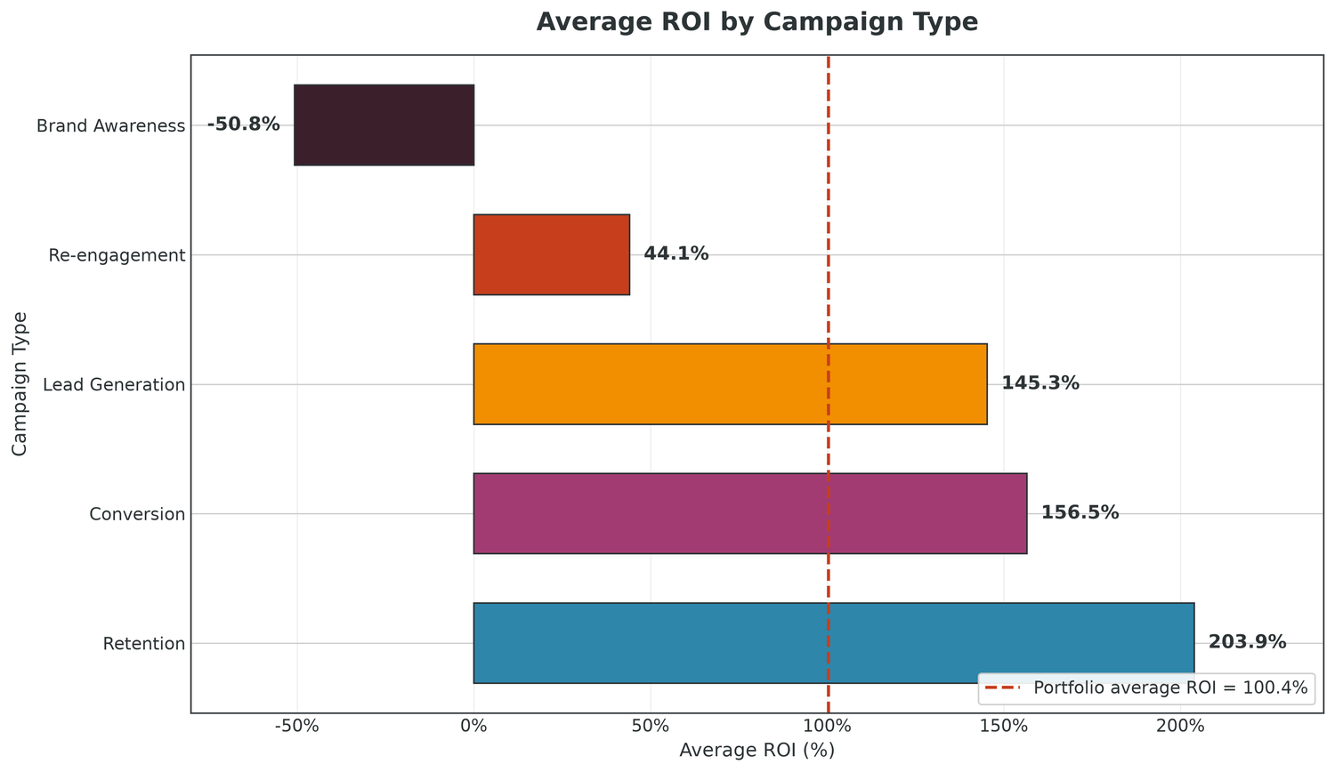
Campaign Type Performance
07
Average ROI by campaign type
KEY INSIGHTS
▪ Retention leads at 203.9% average ROI — double the portfolio average of 100.4%.
▪ Conversion (156.5%) and Lead Generation (145.3%) follow closely.
▪ Re-engagement returns only 44.1% — below break-even territory.
▪ Brand Awareness destroys value at −50.8%: $39.9M spent, $21.2M returned — a $18.7M loss.
▪ The blended ROI is dragged down almost entirely by the two weakest types.
CampaignPulse | Marketing Campaign ROI Analytics
7

Slide 8
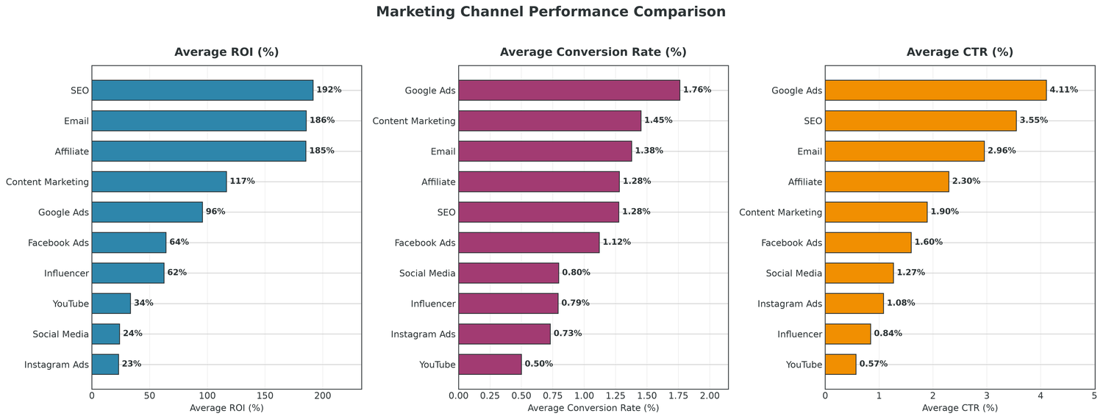
Channel Performance Analysis
08
ROI, conversion rate and CTR by channel
KEY INSIGHTS
▪ SEO (191.7%), Email (185.8%) and Affiliate (185.4%) dominate on ROI.
▪ Instagram Ads (23.1%), Social Media (24.1%) and YouTube (33.6%) trail badly.
▪ Google Ads (1.76%) and Content Marketing (1.45%) lead on conversion rate.
▪ Google Ads wins on CTR (4.11%) yet ranks only 5th on ROI — clicks ≠ value.
▪ Instagram carries the highest CAC ($406) despite a mid-range CPC of $1.31.
CampaignPulse | Marketing Campaign ROI Analytics
8

Slide 9
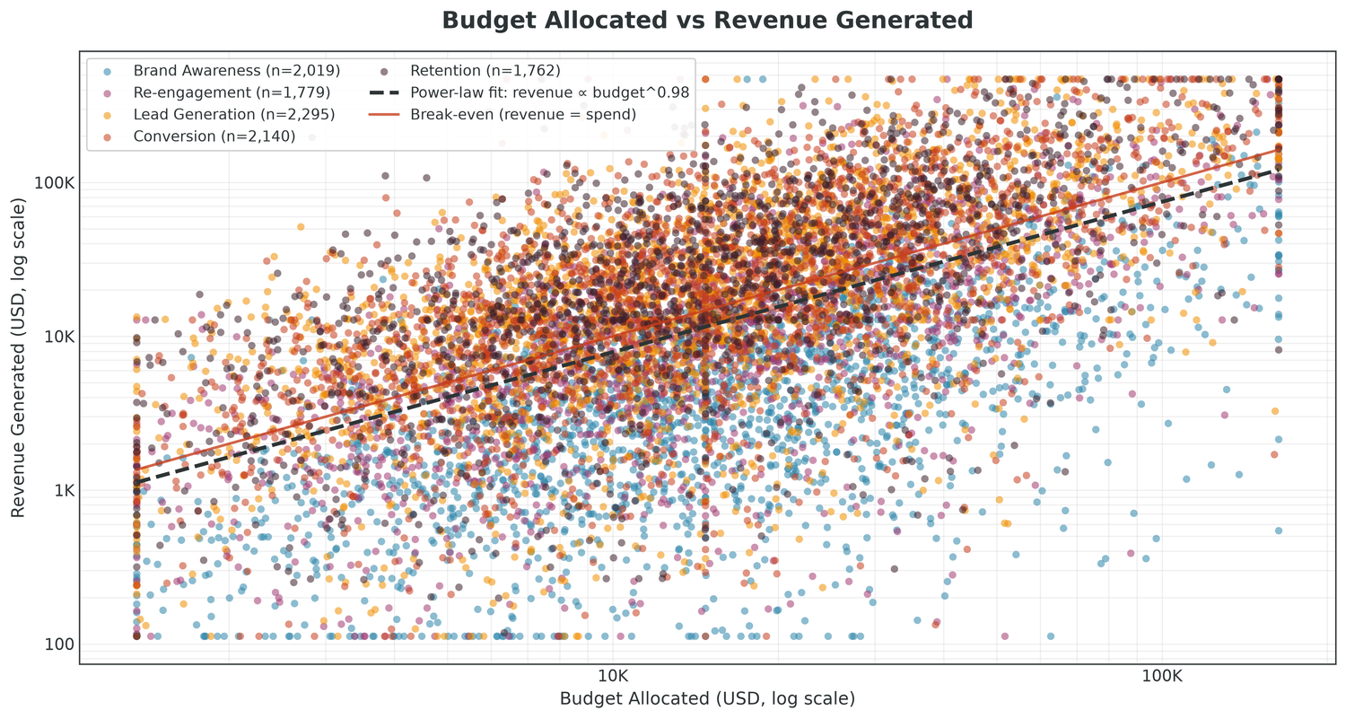
Budget Analysis
09
Budget allocated vs revenue generated
KEY INSIGHTS
▪ Budget and revenue correlate only moderately (r = 0.55).
▪ Power-law fit gives a budget elasticity of ≈ 0.70 — diminishing returns.
▪ Micro and Small campaigns cluster above the break-even line.
▪ Several Large campaigns sit well below it — scale is not a success factor.
▪ Budget tier ROI falls from 115.9% (Micro) to 66.8% (Large).
CampaignPulse | Marketing Campaign ROI Analytics
9

Slide 10
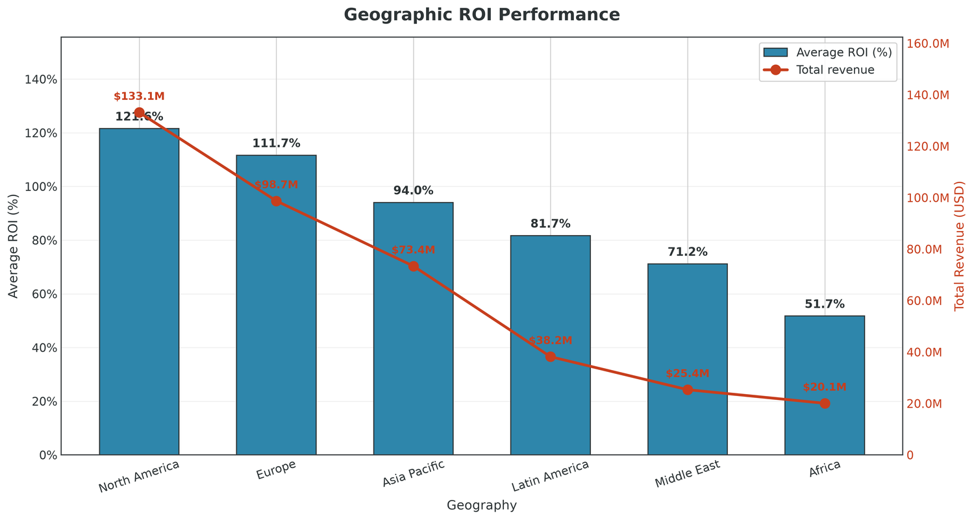
Geographic Performance
10
Average ROI and total revenue by region
KEY INSIGHTS
▪ North America (121.6%) and Europe (111.7%) are the strongest regions.
▪ Together they generate $232M of the $389M total revenue.
▪ Africa (51.8%) and the Middle East (71.2%) are weakest, with the lowest profitability.
▪ CAC is flat across regions ($258–$279) — the gap is revenue per acquisition.
▪ Latin America is a credible third market: 81.7% ROI at below-average CAC.
CampaignPulse | Marketing Campaign ROI Analytics
10

Slide 11
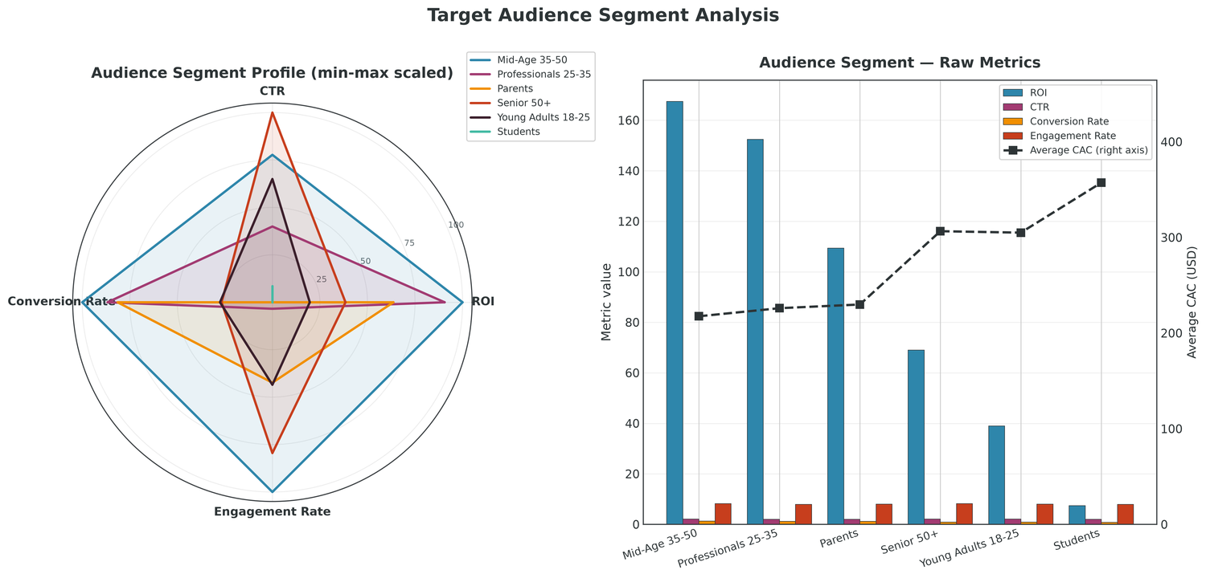
Audience Segment Analysis
11
ROI, CTR, conversion rate and engagement by segment
KEY INSIGHTS
▪ Mid-Age 35-50 (167.5%) and Professionals 25-35 (152.5%) are the sweet spot.
▪ They also carry the lowest CAC — $218 and $226 respectively.
▪ Students (7.5%) and Young Adults (38.9%) are weakest, with the highest CAC.
▪ Parents (109.3%) sit above the portfolio average — a strong third segment.
▪ CTR is flat across all segments (~2.0%): audiences differ after the click.
CampaignPulse | Marketing Campaign ROI Analytics
11

Slide 12
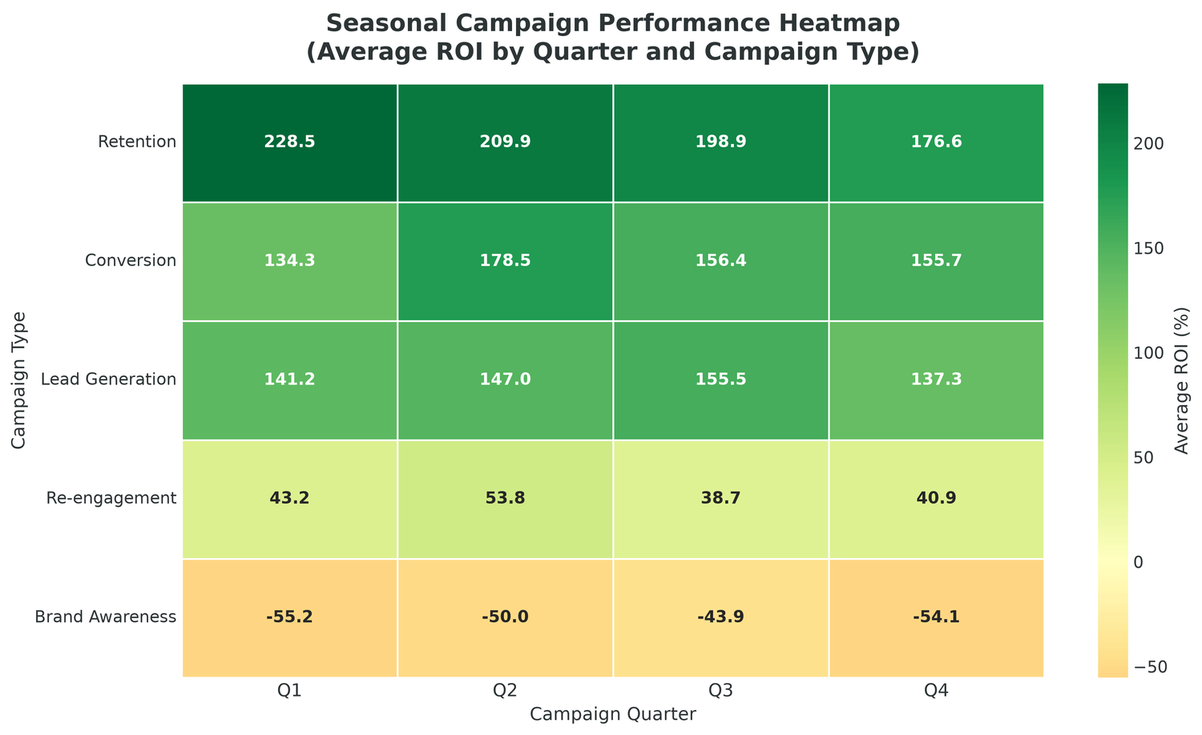
Seasonal Trends
12
Average ROI by quarter and campaign type
KEY INSIGHTS
▪ Q2 (106.3%) is the best quarter, marginally ahead of Q3 (103.7%).
▪ Q1 (94.7%) and Q4 (96.4%) are the weakest quarters.
▪ Retention is the best type in every quarter — its advantage is structural.
▪ Brand Awareness is negative in all four quarters and worst in Q1.
▪ Quarter effects are ±10 points; campaign type effects are 10× larger.
CampaignPulse | Marketing Campaign ROI Analytics
12

Slide 13
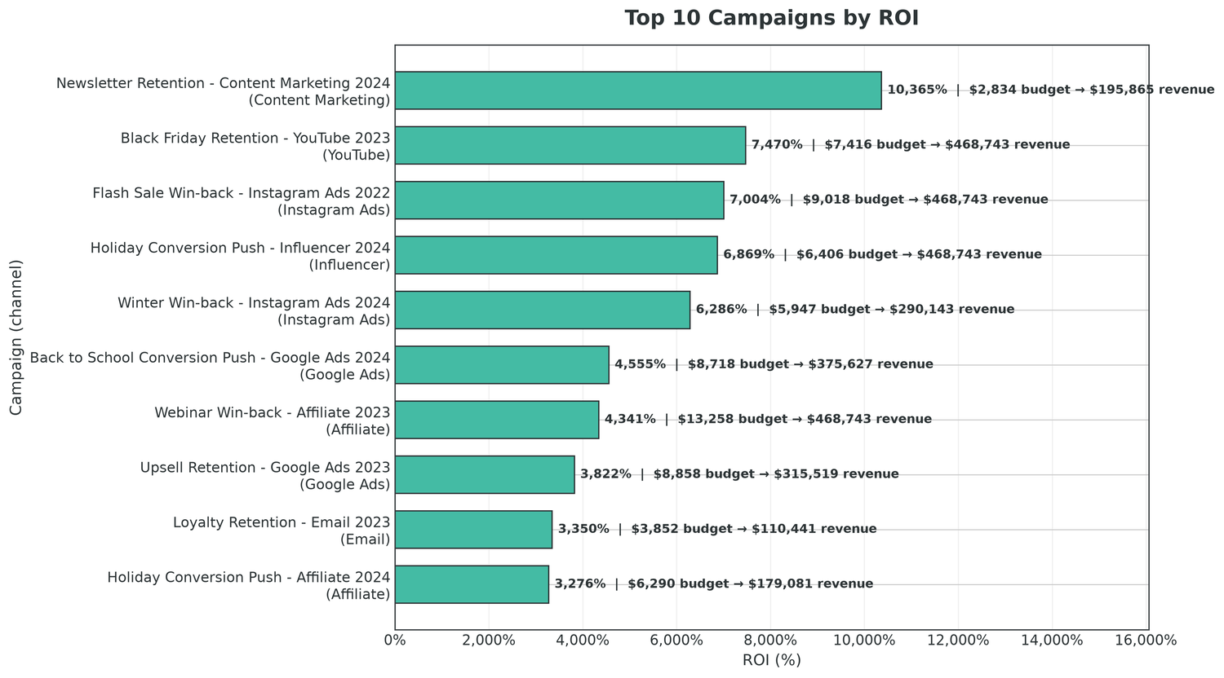
Top Performing Campaigns
13
The ten highest-ROI campaigns
KEY INSIGHTS
▪ Every top-10 campaign is a Retention or Conversion campaign.
▪ All are small-to-mid budget: $2.8K to $13.3K.
▪ Several returned 3,000–10,000% ROI on a few thousand dollars.
▪ Winners span 7 different channels — fit, not channel, drives success.
▪ These are the obvious scaling candidates: replicate the mechanic, not the budget.
CampaignPulse | Marketing Campaign ROI Analytics
13

Slide 14
Underperforming Campaigns
14
Root-cause analysis of the loss-making cohort
LOSS-MAKING CAMPAIGNS
SHARE OF PORTFOLIO
SPEND WITH NO RETURN
MEDIAN ROI
4,660
46.6%
$86M
11.5%
WORST 8 CAMPAIGNS
ROOT CAUSES
CAMPAIGN
CHANNEL
TYPE
ROI
▪ Awareness and re-engagement objectives with no revenue mechanism
▪ Paid-social channels with high CAC and poor post-click conversion
▪ Students / Young Adults audiences that click but do not buy
▪ Spend continued on Cancelled and Paused campaigns (23% / 58% utilisation)
▪ No CAC guardrail — campaigns ran despite negative unit economics
Flash Sale Brand Awareness - Insta
Instagram Ads
Brand
-99.2%
Webinar Win-back - YouTube 2022
YouTube
Re-engagement
-99.2%
Webinar Brand Awareness - Social M
Social Media
Brand
-99.0%
Black Friday Brand Awareness - Fac
Facebook Ads
Brand
-98.9%
New Year Brand Awareness - Faceboo
Facebook Ads
Brand
-98.8%
Evergreen Brand Awareness - Instag
Instagram Ads
Brand
-98.8%
Spring Brand Awareness - Email 202
Email
Brand
-98.8%
Newsletter Brand Awareness - YouTu
Email
Brand
-98.7%
CampaignPulse | Marketing Campaign ROI Analytics
14

Slide 15
Key Findings Summary
15
Ten evidence-backed conclusions
1. Retention is the best campaign type
6. Diminishing returns to budget are real
203.9% average ROI, best in all four quarters
Elasticity ≈ 0.70; budget vs ROI r ≈ 0
2. Brand Awareness destroys value
7. Top performers are small and precise
−50.8% ROI; $39.9M spend returns $21.2M
Top 10 are all $2.8K–$13.3K Retention/Conversion
3. Owned and earned media win
8. Mid-Age and Professionals are the sweet spot
SEO 191.7%, Email 185.8%, Affiliate 185.4%
167.5% / 152.5% ROI with the lowest CAC
4. CAC is the master variable
9. Duration is not a performance lever
Strongest negative correlate of ROI (r = −0.30)
r ≈ 0.00 across every duration bucket
5. Nearly half of all campaigns lose money
10. Efficiency has been flat for three years
46.6% negative ROI; median ROI only 11.5%
ROI 98.8% → 92.1% → 97.1%; CAC $261 → $270
CampaignPulse | Marketing Campaign ROI Analytics
15

Slide 16
Recommendations
16
Eight actions, prioritised by impact
1
Rebalance the campaign-type mix
Shift ~15% of Brand Awareness budget into Retention and Conversion — several million dollars of incremental profit with no extra spend.
2
Cap or re-purpose Brand Awareness
Hold it to reach and recall KPIs, or cap it as a fixed brand-building line. It currently loses ~$22.6M.
3
Move paid-social budget to SEO, Email and Affiliate
These combine the highest ROI with the lowest CAC; reduce Instagram and Influencer to test-level budgets.
4
Manage to CAC, not CPC or CTR
CAC predicts return; CPC and CTR do not. Make CAC the primary optimisation target in every channel review.
5
Concentrate spend on the two leading audiences
Reallocate Students and Young Adults budget, or rebuild their post-click experience before spending more.
6
Release incremental budget only to winners
With elasticity ≈ 0.70, scale campaigns already above break-even in small increments.
7
Triage the 4,660 loss-making campaigns
Diagnose targeting, creative, offer or channel, then pause, fix or reallocate — the largest single profit pool.
8
Report medians, not means
Median ROI is 11.5% against a mean of 100.4%. Average-based dashboards flatter performance and hide the losers.
CampaignPulse | Marketing Campaign ROI Analytics
16

Slide 17
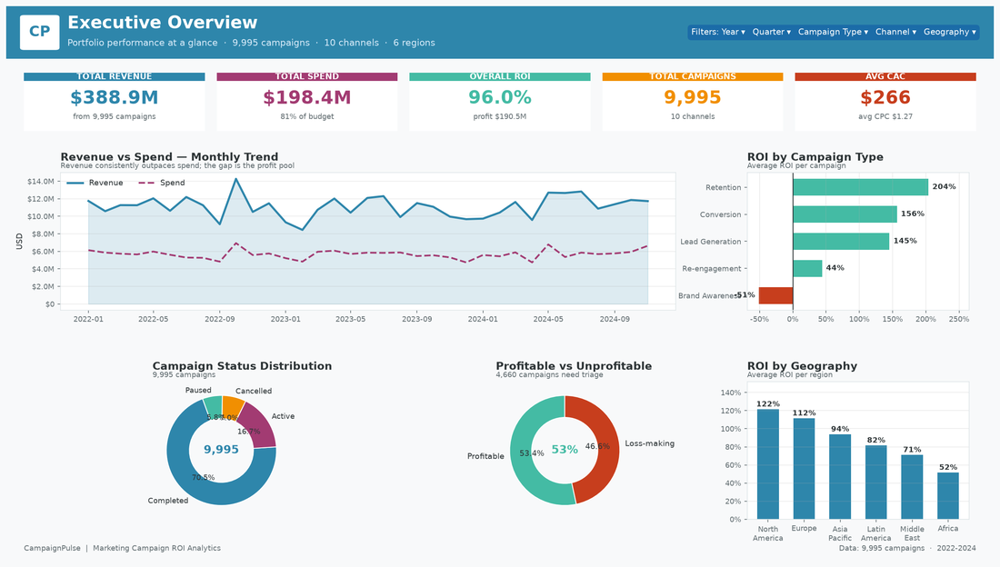
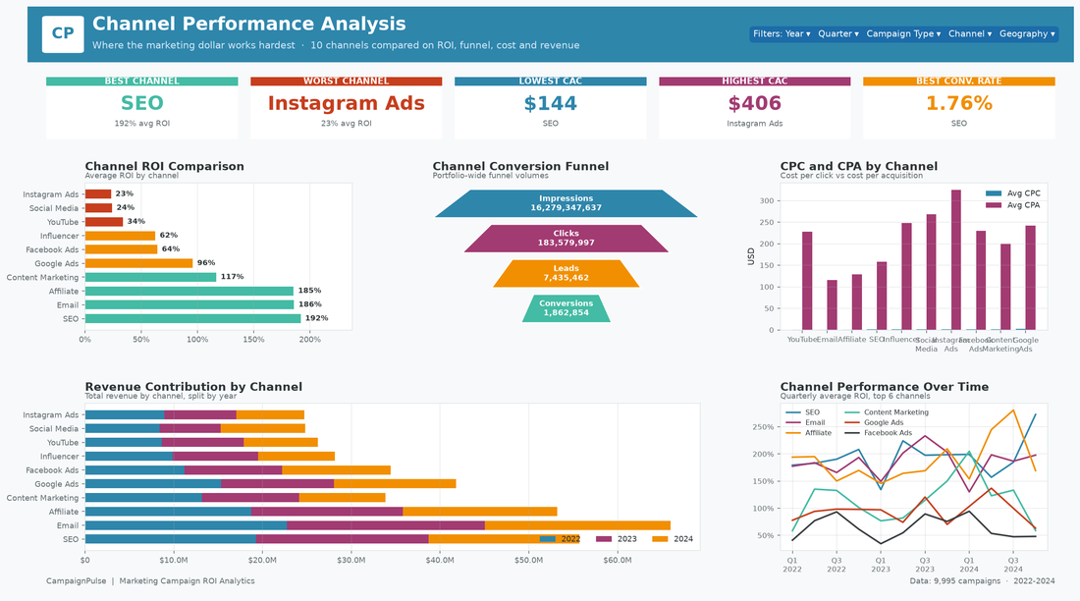
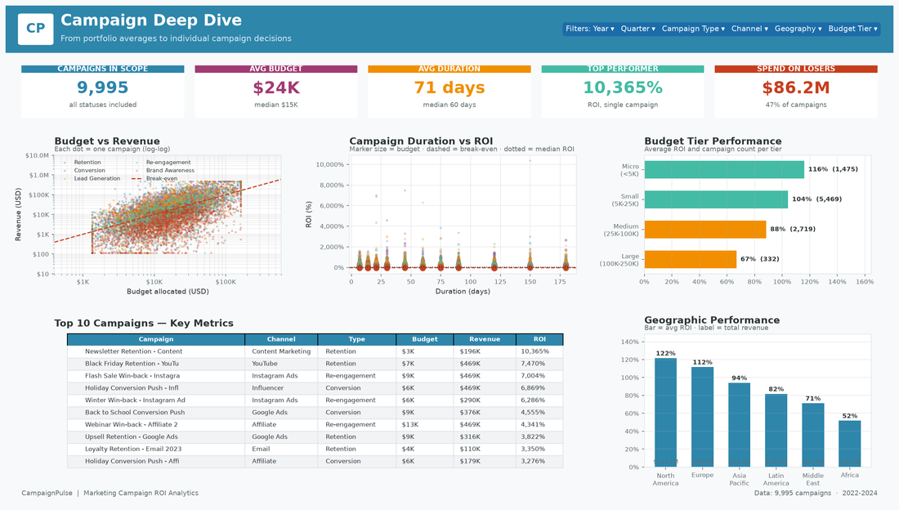
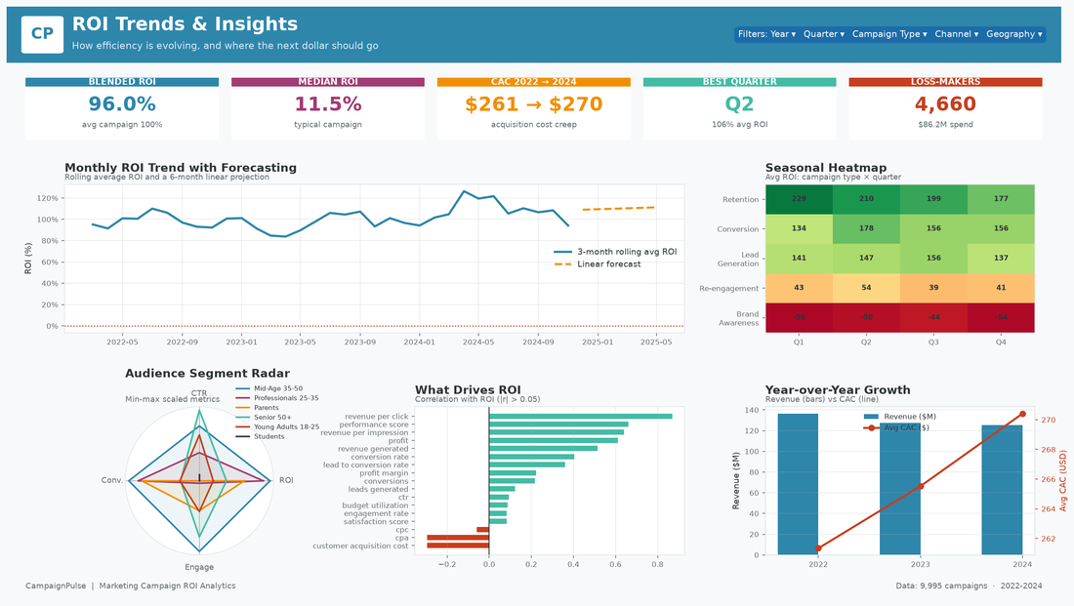
Dashboard Preview
17
The four CampaignPulse Tableau dashboards
01 Executive Overview
02 Channel Performance
03 Campaign Deep Dive
04 ROI Trends & Insights
CampaignPulse | Marketing Campaign ROI Analytics
17

Slide 18
Thank You
Questions & Discussion
Amit Kumar Jha · Data Analyst
GitHub: github.com/AmitKumarJha-ds/marketing-campaign-roi-analytics
Appendix: reports/reports/CampaignPulse_Marketing_Campaign_ROI_Report.pdf
Data dictionary: docs/data_dictionary.md · SQL: sql/03_business_queries.sql
⭐ If you found this project helpful, please star the repository.

