Slide 1

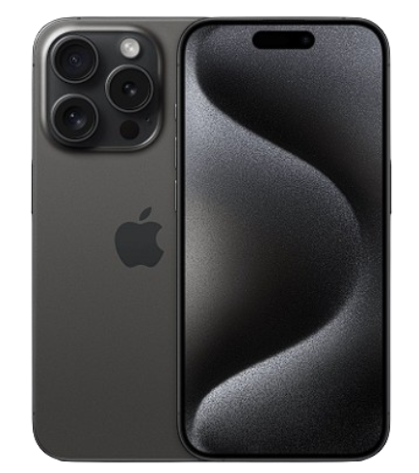
iPhone Product Page
Presented by
Guided by
Aryan Singh Tomar (1RVU23CSE085)
Amit C Narendra (1RVU23CSE042)
Names of the guides:-
1) Professor Evlin Vidyu Latha P
2) Professor S Parameshwari
Submitted for the partial fulfillment
of
Name of degree- B.Tech Honours
in
Name of branch- Computer Science and Engineering
Name of the department- School of Computer Science and Engineering
December- 2023

Slide 2
Content
Abstract
Introduction
Tools and technologies
Findings and results
Conclusion
References
iPhone Product Page
December- 2023
2

Slide 3
1. Abstract
This report details a web design project focused on creating an engaging iPhone product page, addressing the evolving demands of online product representation. The project emphasizes the fusion of aesthetics with functionality, navigating challenges such as diverse user expectations and incorporating current design trends without compromising usability. The chosen implementation involves the creation of three web pages: 'Main.html' for showcasing the product, 'login.html' for user authentication, and 'Select.html' for model and color selection. Each page employs HTML and CSS elements, utilizing various selectors, properties, and techniques to enhance visual appeal and user experience. Noteworthy implementations include responsive design principles, comprehensive user research, and the integration of JavaScript functions for dynamic interactions.
iPhone Product Page
December - 2023
3

Slide 4
1. Abstract
The report highlights the rationale for project selection, encountered problems, suggested solutions, and the meticulous implementation process, providing insights valuable to web designers, developers, and stakeholders aiming to optimize digital product interfaces.
iPhone Product Page
December - 2023
4

Slide 5
2. Introduction
Background Information:
1)Project focuses on creating a web design for an iPhone product page.
2)Emphasis on blending aesthetics with functionality for an engaging user experience.
Basic Information:
1)iPhone product page design project.
2)Integrating user preferences into design decisions.
3)Striking a balance between creativity and usability.
Encountered Problems:
1)Ensuring responsiveness across devices.
iPhone Product Page
DECEMBER - 2023
5

Slide 6
2.Introduction
2) Navigating the challenge of diverse user expectations.
3)Incorporating current design trends without compromising usability.
Suggested Solutions:
1)Implemented responsive design principles.
2)Conducted comprehensive user research to inform design choices.
3)Regular updates and optimizations to stay aligned with evolving trends.
Project Selection Rationale:
1)Addressing the increasing significance of online presence for products.
2)Meeting the demand for visually appealing and user-friendly interfaces
3) Aligning with the goal of enhancing overall user engagement and conversion rates.
iPhone Product Page
DECEMBER - 2023
6

Slide 7
2.Introduction
In essence, this project is a response to the evolving landscape of online product representation, focusing on creating a visually appealing and user-centric iPhone product page. The encountered challenges prompted strategic solutions, and the project's selection aligns with the broader industry trend of prioritizing user experience and aesthetics in digital interfaces.
iPhone Product Page
DECEMBER - 2023
7

Slide 8
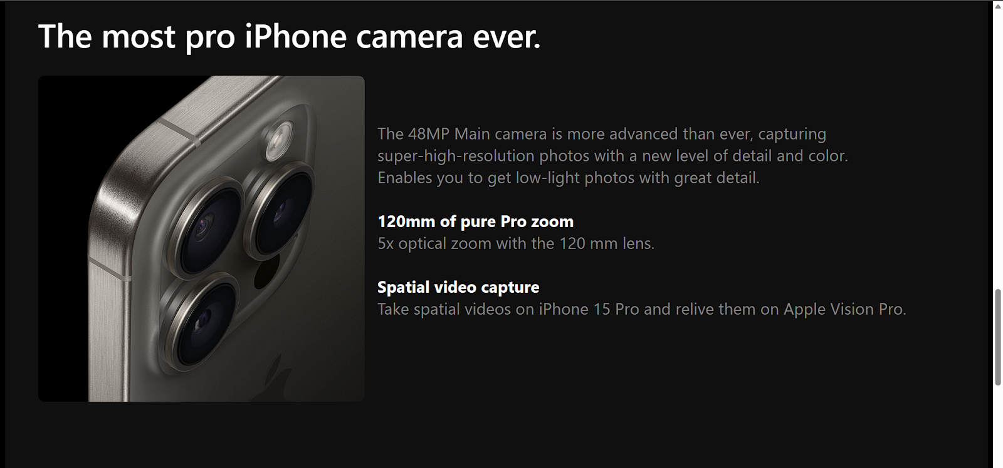
3.Implementation
Main.html:
Created a webpage to showcase the product iPhone 15 Pro along with information about it features
Used <div> tag to separate elements and style them
Used <img> tag relevant images
Used element ,class, and id selectors to appropriately style different elements of the web page
Used <style> tag within <head> to implement css for the web page elements
Implemented css using internal and inline methods
Used css properties like font family, color, text align, font size, and font weight to style the text
Used background color property to change background color of different elements
Used css properties like float, height, width, and border radius to style images
iPhone Product Page
DECEMBER - 2023
8

Slide 9
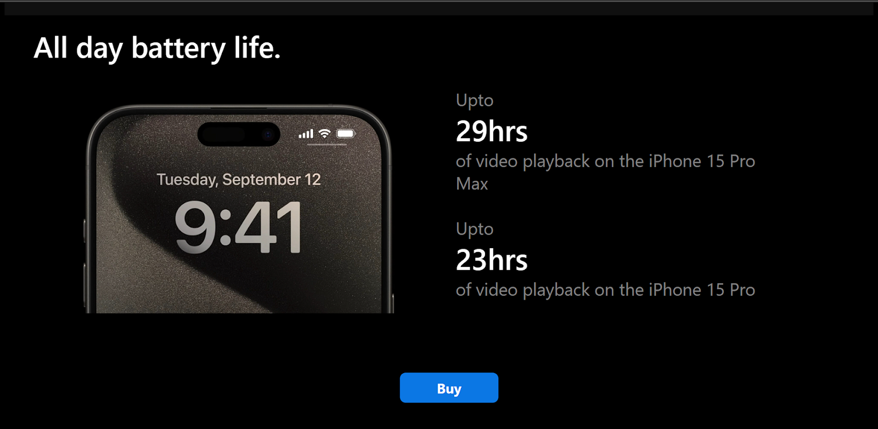
3.Implementation
Used the property transform along with the pseudo selector hover to increase the size of images when cursor hovers over it
Implemented appropriate spacing of elements using properties like padding and margin
Used <a> tag to link to the next webpage
login.html:
Created a webpage to login using ID and password
Used <style> tag within <head> to implement css for the web page elements
Used <div> tag to separate elements and style them
Used <header> tag to add a header and <img> tag to add logo
Used input type email to take ID as input
Used input type password to take password as input
iPhone Product Page
DECEMBER - 2023
9

Slide 10
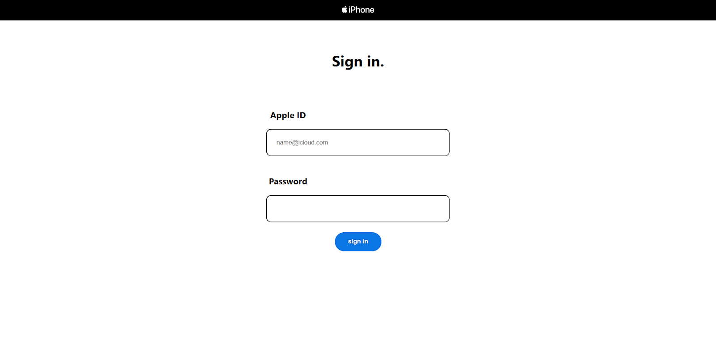
3.Implementation
Used element ,and id selectors to appropriately style different elements of the web page
Used hover pseudo class along with input element to change border color on hover
Used css properties like font family, color, text align, font size, and font weight to style the text
Used css properties like float, height, width, border radius, padding, margin to change position, spacing, and shape of elements
Used the property transform along with the pseudo selector active to increase the size of the submit button when it is held down
Used submit button to redirect to next page
iPhone Product Page
DECEMBER - 2023
10

Slide 11
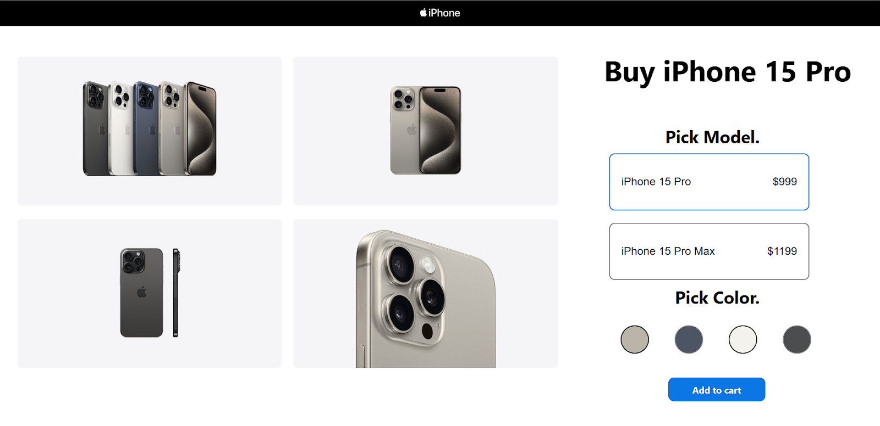
3.Implementation
Select.html
Created a web page to select the model and color of iPhone
Used <header> tag to add a header and <img> tag to add logo
Used <div> tag to separate elements and style them
Used <style> tag within <head> to implement css for the web page elements
Implemented css using internal and inline methods
Used element ,class, and id selectors to appropriately style different elements of the web page
Used <img> to add images of the product and css height property to change its size
Used css properties float, padding, margin to position elements appropriately
Used <button> element to implement the button to select model and color
Used css properties like font family, color, text align, font size, and font weight to style the text
iPhone Product Page
DECMBER - 2023
11

Slide 12
3.Implementation
Used background color property to change background color of different elements
Used css properties like float, height, width, border radius, padding, margin to change position, spacing, and shape of elements
Used onclick event along with button change border color using internal javascript function added using <script> tag
Used ondblclickevent event to remove the border color change using internal javascript function added using <script> tag
Linked external javascript file to the page using src attribute of <script> to implement a function to save model and color based on the latest button click and print it in the console
iPhone Product Page
DECEMBER-2023
12

Slide 13
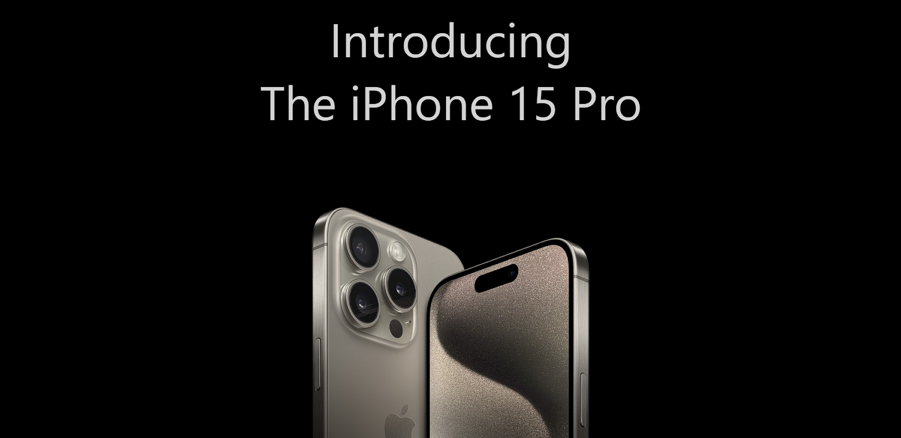
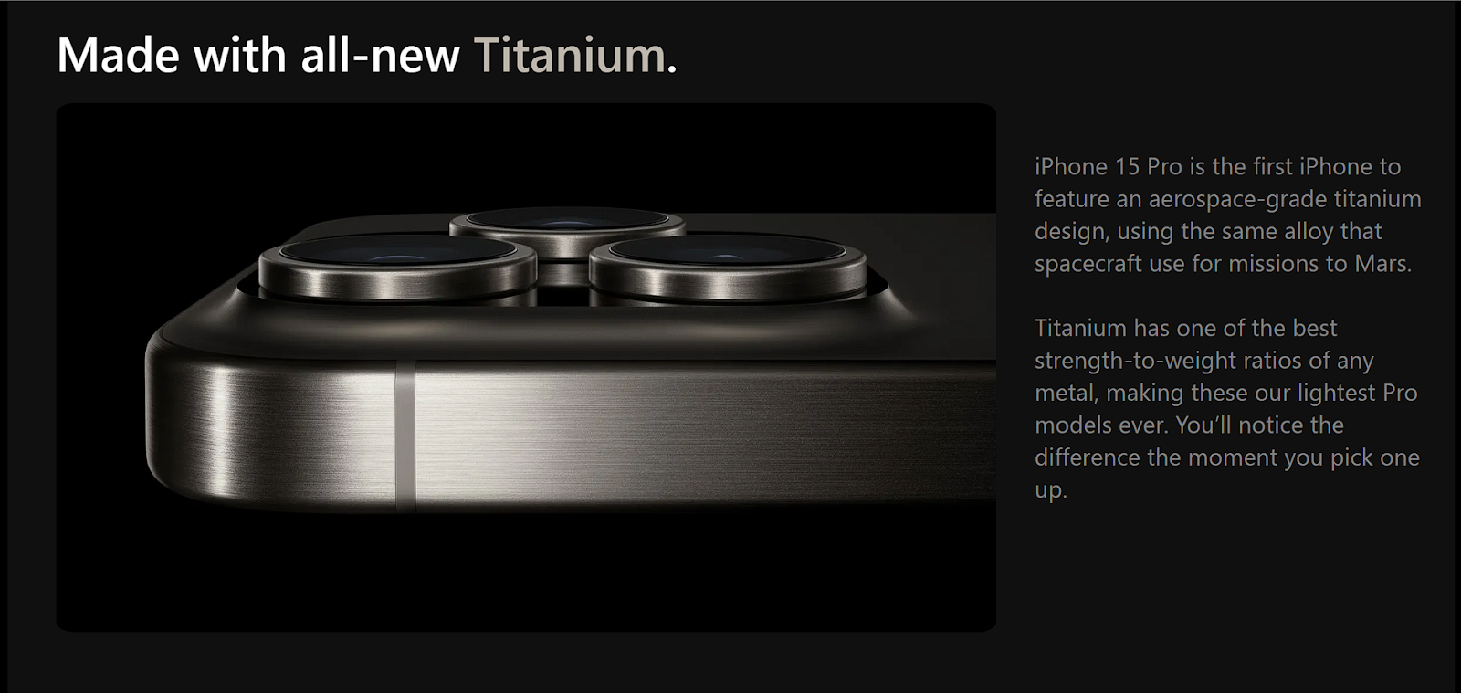
4. Result
iPhone Product Page
DECEMBER-2023
13

Slide 14
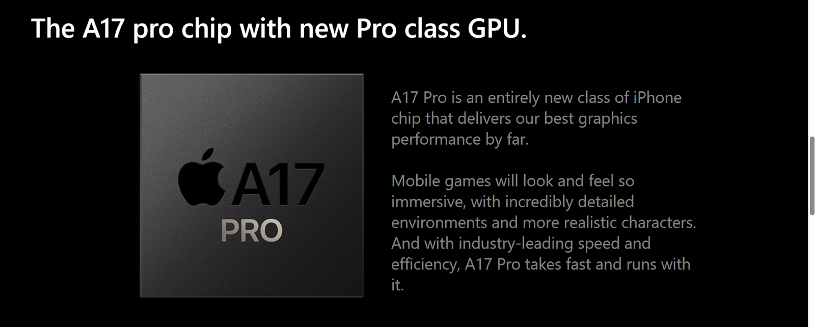
4. Result
iPhone Product Page
DECEMBER-2023
14

Slide 15
4. Result
iPhone Product Page
DECEMBER-2023
15

Slide 16
4. Result
iPhone Product Page
DECEMBER-2023
16

Slide 17
5. Conclusion
In conclusion, this web design project has successfully addressed the challenges associated with creating an aesthetically pleasing and user-centric iPhone product page. By incorporating user preferences into the design decisions, we have strived to strike a delicate balance between creativity and usability, enhancing the overall user engagement.
The three web pages, 'Main.html,' 'login.html,' and 'Select.html,' each serve a distinct purpose in delivering a cohesive and interactive user journey. From showcasing product features to implementing user authentication and facilitating
.
iPhone Product Page
DECMBER-2023
17

Slide 18
5. Conclusion
model and color selection, the project encapsulates the essential elements of a comprehensive digital experience.
Notable features of the implementation include the use of HTML and CSS elements, thoughtful styling choices, and the integration of JavaScript functions for dynamic user interactions. The project aligns with the industry trend of prioritizing user experience, acknowledging the increasing importance of online presence for products.
As technology and user expectations continue to
iPhone Product Page
DECEMBER - 2023
18

Slide 19
5. Conclusion
evolve, the insights gained from this project provide valuable lessons and recommendations for future web design endeavors. By maintaining a focus on user-centric design principles, continuous improvement, and staying abreast of emerging trends, digital interfaces can be optimized to meet the ever-changing demands of the online landscape. This project serves as a testament to the significance of blending creativity and functionality to create compelling and user-friendly web designs
iPhone Product Page
DECEMBER - 2023
19

Slide 20
3. References
Images used sourced from www.apple.com
iPhone Product Page
DECEMBER-2023
20

Slide 21


