Slide 1
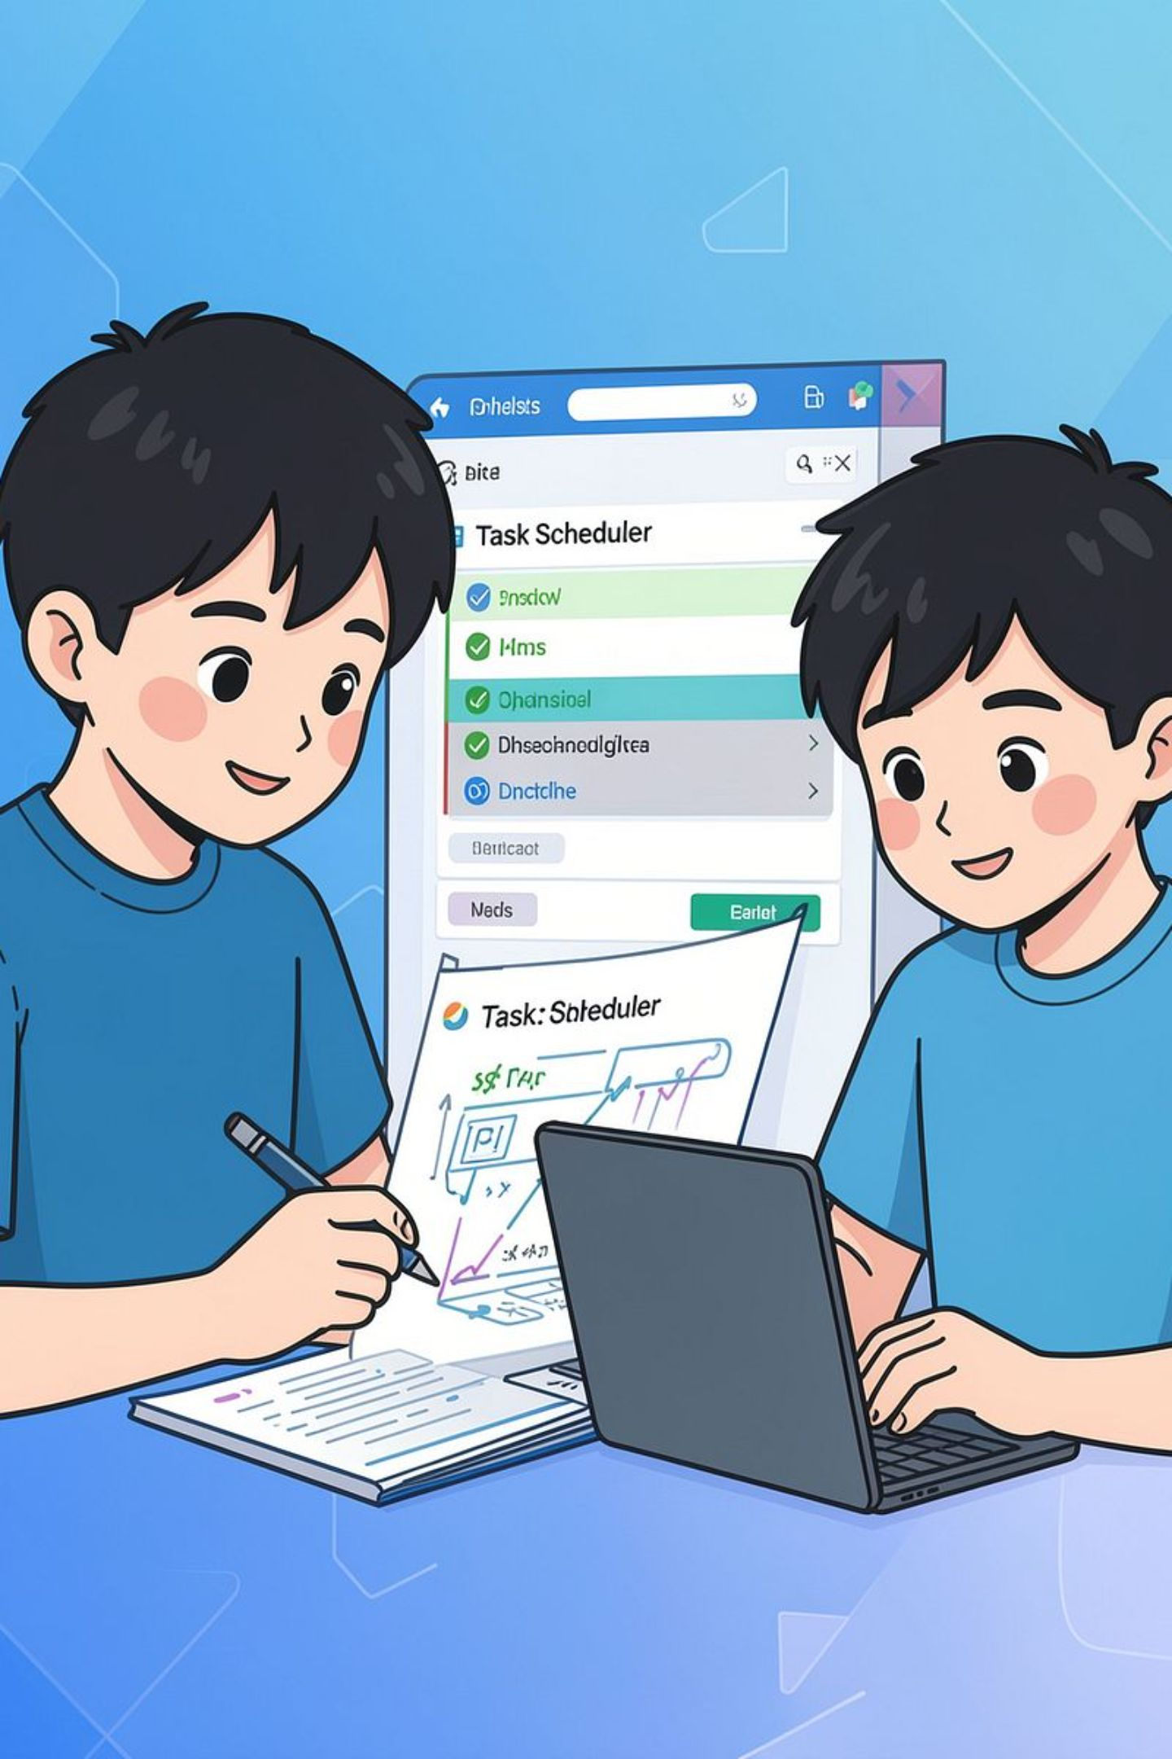

MedRoute AI: Smart Medicine Redistribution
Student: [Your Name] • College: [Your College] • Dept: CSE
HEALTHCARE LOGISTICS PLATFORM

Slide 2

Introduction & Problem Statement
Need: Hospitals face critical medicine shortages while excess stocks expire unused in nearby facilities.
Severe stockouts in emergency & ICU wards put patient lives at risk
Surplus medicines expire in donor warehouses without redistribution
Manual inter-hospital coordination is slow, fragmented, and error-prone
Purpose: Build an intelligent web platform that automates demand forecasting, AI donor matching, and medicine transfer tracking.

Slide 3
Objectives
Inventory Intelligence
Demand Forecasting
Smart Donor Matching
Real-time batch tracking with automated FIFO rules and expiry alerts.
Deterministic risk engine to preempt critical medicine shortages.
Rank nearest donors within 50 km by stock, distance, and reliability.
Transfer Lifecycle
Geospatial Operations
End-to-end 7-stage workflow from dispatch to verified delivery.
Interactive Leaflet map for regional healthcare logistics command.

Slide 4





Key Features
Role-Based Access
Batch Inventory & FIFO
Command Dashboard
Smart Donor Engine
Live telemetry counters, inventory health, and critical risk alerts.
BCrypt auth for Admin, Hospital, Pharmacy, and Logistics roles.
Batch tracking with cold-chain, controlled flags, and audit logs.
Multi-factor scoring: distance penalty, stock surplus, and reliability.
Transfer Manifests
Full lifecycle tracking: Requested, Accepted, In-Transit, and Received.

Slide 5








Technology Stack
System Layers
Frontend: JSP, JSTL, Bootstrap 5, Vanilla JS, Leaflet.js, Chart.js
Backend: Java 17, Spring MVC 5.3.31, classic javax.servlet
Database: MySQL 8.x via Spring JDBC / JdbcTemplate
Connection Pool: HikariCP (high-performance connection pooling)
AI & APIs: Hugging Face AI, Open-Meteo, OpenStreetMap
Server & Build: Apache Tomcat 9, Apache Maven
HTML5 / JSP
Bootstrap 5
JavaScript
Java 17
Spring MVC
MySQL 8
Tomcat 9
Maven / APIs

Slide 6
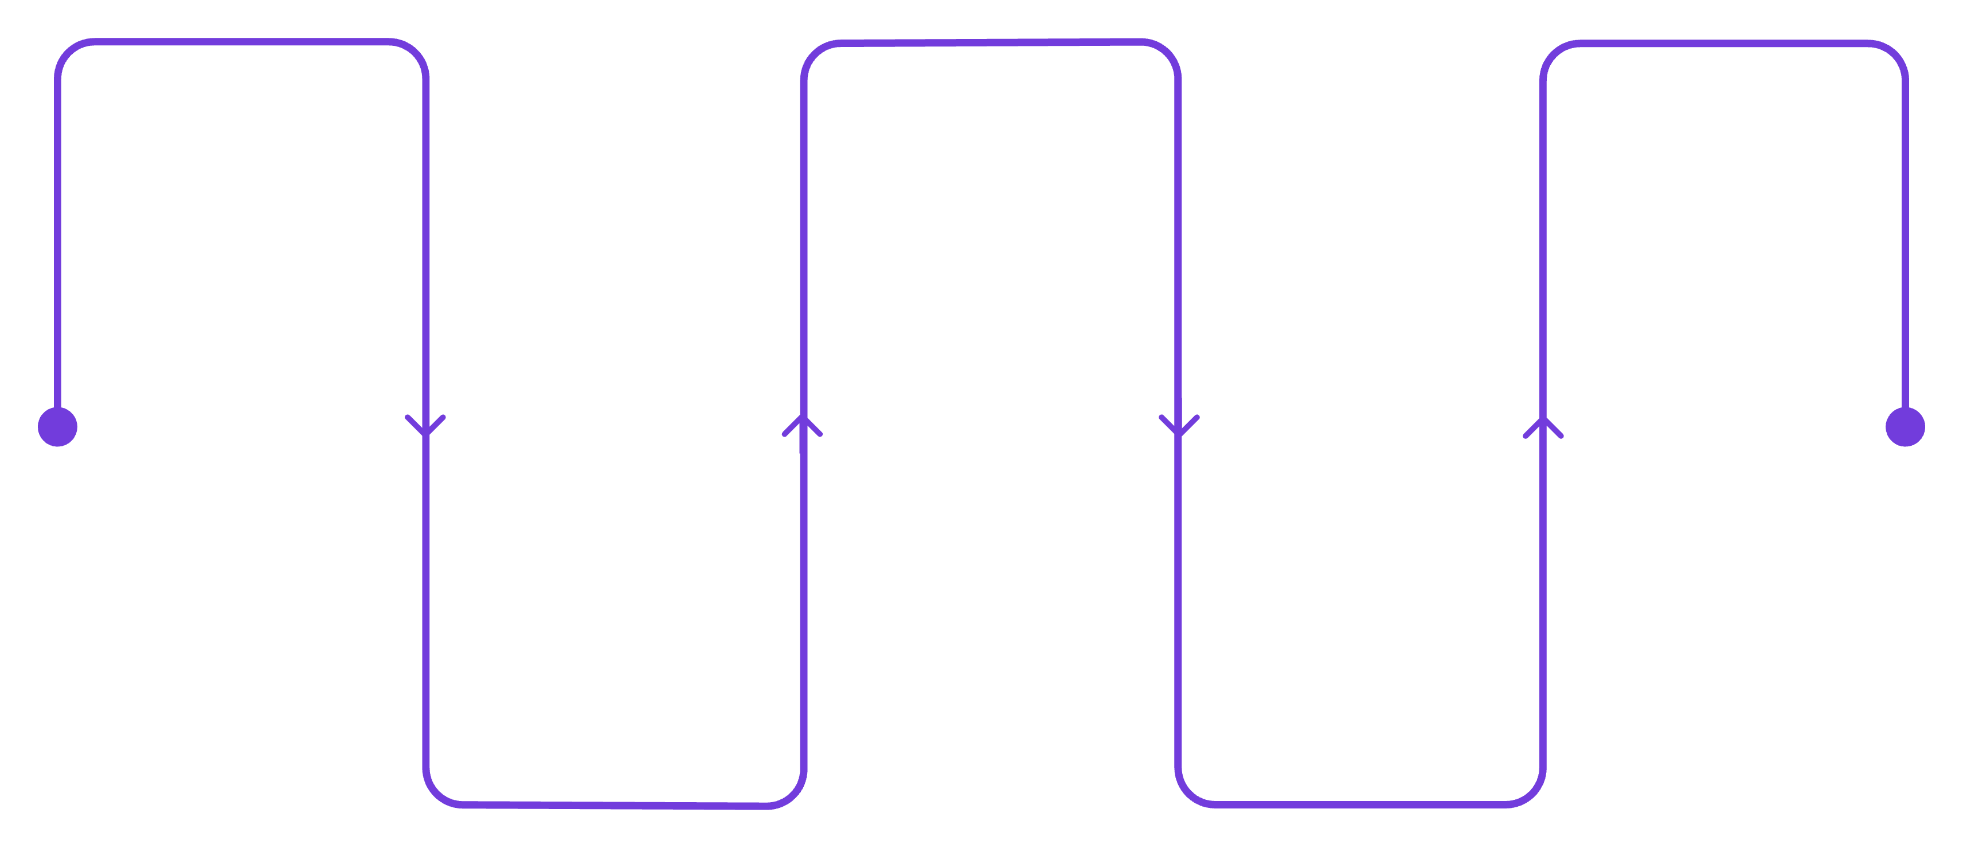
System Architecture
JSP / Leaflet View
Service Layer
MySQL Database
User interacts with tactical UI & maps
Matching, Demand, & Transfer logic
Persists inventory, batches, & manifests
Spring Controller
Spring JDBC DAO
Routes requests & checks session auth
Executes fast parameterized queries
Architecture summary: Classic MVC — View (JSP/Leaflet) → Controllers → Services → DAOs (JDBC) → MySQL 8. Deployed on Tomcat 9.

Slide 7
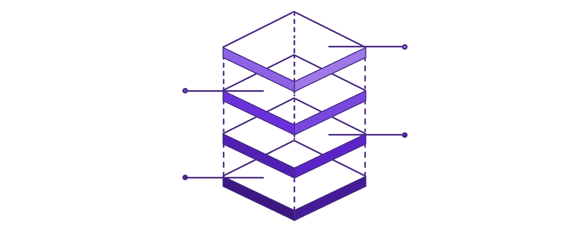
Database Design (ER Model)
Entities: Facilities, Batches, Requests, Transfers
Relationships
Facilities & Users (facility_id PK, coords, reliability; user_id, role)
Catalog & Batches (medicine_id PK, cold_chain; batch_id PK, qty, expiry)
Transactions & Demand (trans_id PK, type, qty; 60-day consumption)
Emergency & Transfers (request_id PK, urgency; transfer_id PK, status)
Facilities 1→* Batches; Requests 1→* Transfers
Emergency Requests
request_id PK, urgency, ai_score, status
Inventory Batches
batch_id PK, facility_id FK, qty, expiry
Facilities & Users
facility_id PK, lat/lon; user_id PK, role
Relational Schema: 14 interconnected tables with foreign key constraints, audit logging, and transactional integrity.

Slide 8
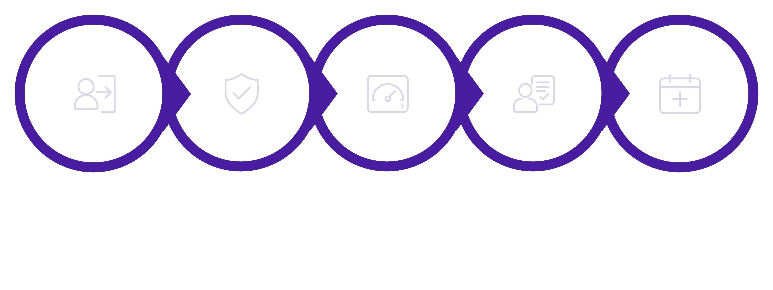
Implementation & Operational Workflow
4. AI Smart Match
2. Stock Risk Alert
3. Emergency Need
5. Transfer Manifest
1. Auth & Access
01
02
Demand & Risk Engine
Smart Donor Matching
Calculates 30-day consumption trends, stock coverage, and priority scores.
Ranks donor facilities within 50 km based on surplus, distance, and reliability.
03
04
Transfer Manifest Lifecycle
Verification & Testing
Full 7-stage workflow: Requested → Accepted → In-Transit → Completed.
120 automated unit tests passing; packaged WAR deployed on Apache Tomcat 9.

Slide 9
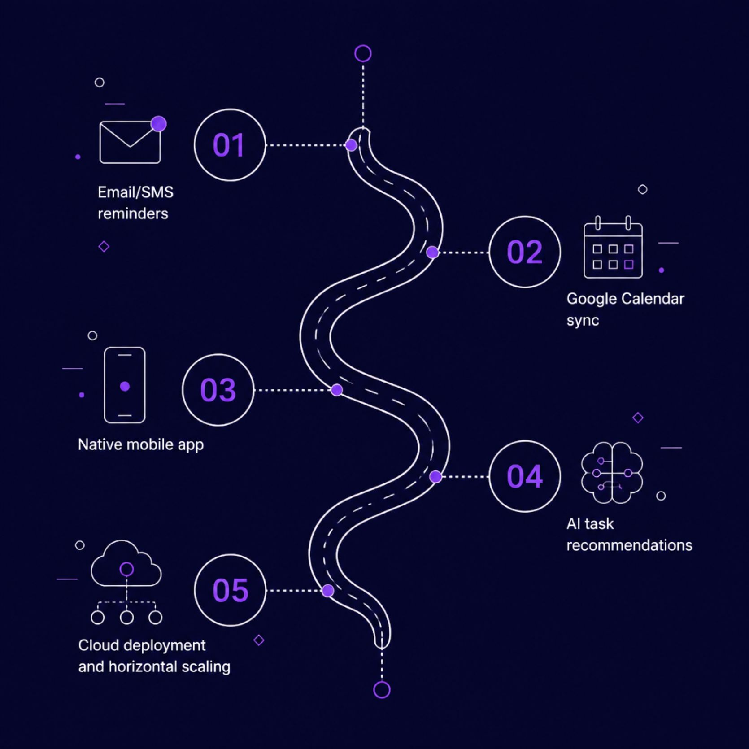
Advantages & Future Scope
Life-Saving Speed
Automated donor matching cuts emergency coordination from hours to seconds.
Zero Waste & Expiry Prevention
Proactive FIFO redistribution routes near-expiry medicines to high-demand hubs.
Deterministic Intelligence
Mathematical scoring combined with Hugging Face AI insights preempts shortages.
Future Roadmap
IoT cold-chain telemetry, automated drone dispatch, and multi-region federation.

Slide 10


Conclusion & Thank You
Summary: MedRoute AI bridges critical healthcare supply gaps using Java 17, Spring MVC, Spring JDBC, and MySQL. It delivers automated demand risk scoring, intelligent 50 km donor matching, and complete transfer manifest management.
Key Highlights: 120/120 tests passing, 14 relational tables, live Leaflet tactical map, and production deployment on Apache Tomcat 9.
Questions welcome — Live system demonstration ready.
Thank you

