Slide 1
LANE LINE DETECTION BY AI
AMIT R NAGARI

Slide 2
INTRODUCTION:
Lane line means a solid or broken paint line or other marker line separating lanes of traffic moving in the same direction .Lane Line detection is a critical component for self driving cars and also for computer vision in general. This concept is used to describe the path for self-driving cars and to avoid the risk of getting in another lane. In this article, we will build a machine learning project to detect lane lines in real-time. Lane detection is a hot topic in the field of machine learning and computer vision and has been applied in intelligent vehicle systems . The lane detection system comes from lane markers in a complex environment and is used to estimate the vehicle's position and trajectory relative to the lane reliably . Lane detection. To detect lane markings, the horizontal straight line is created, it intersects with the extended segment at red points, these points are in the red circles. Based on the distances among these points, the points are close which are clustered a group.

Slide 3
PROBLEM STATEMENT:
Regular cars are pretty much the everyday cars that are mainly monitored by humans sitting behind the steering wheel. The standard automotive platform of the regular cars we drive everyday has not changed significantly since its introduction nearly 100 years ago. In regular cars, the human driver does all the tasks from navigating to operating the vehicle.
Most of the vehicle accidents occur due to distraction or changing the lanes in busy highways ,our proposed system will helps to overcome this problem. The problem of Road Lane Detection a is to find out the lane automatically for self driving cars. Essentially, lane detection is a multi feature detection problem that has become a real challenge for computer vision and machine learning techniques. Although many machine learning methods are used for lane detection, they are mainly used for classification rather than feature design.

Slide 4
LITREATURE SURVEY:
Now a day's vision based lane detection is an area where researchers are performing research. The motive behind it is that every year there are so many road accident cases in India as vehicles collide on each other. According to a survey in year 2016 there are 17 deaths on Indian roads per hour. In 2014 there was 1, 39,671 people were killed in the road accidents . These road accidents were avoidable, if the vehicles had the lane detection system. On Mumbai Pune express highway maximum road accidents were happened due to the speed of the vehicle, careless driving and while departing the lane. It is important to have a lane departure system tracking the leading vehicle, finding the curves of the road . But while developing this system the main problem is detecting the street and path recognition and identifying obstruction, for example, vehicles and person on footpath. Advanced driver assistance systems, which alarm the driver in risky circumstances or take a dynamic part in the driving, are bit by bit being consolidated into vehicles. Such frameworks are relied upon to develop increasingly complex towards full self-rule amid the following decade. The principle bottleneck in the improvement of such frameworks is the discernment issue , which has two components: street and path/lane recognition and obstruction (i.e. vehicles and passerby) detection.

Slide 5
COMPONENTS REQUIREMENTS:
Software Requirements:
Operating System :windows 7 or above
Programming language: python
Others: OpenCV, Command Prompt , Editor Note++,all python packages
Hardware Requirements:
Processor:Intel I3 or above
RAM:4GB or above
HDD:100GB
Graphic Card:2GB or above

Slide 6
INPUTS & OUTPUTS:
The lane detection pipeline follows these steps: Pre-process image using grayscale and gaussian blur. ... Apply Hough transform to the image. Extrapolate the lines found in the hough transform to construct the left and right lane lines.
INPUT:
A video of highway lanes running forward with curves and bumps with solid white strips , solid yellow left strips.
Command input : python lane_lines.py –I challege.mp4 –o result.mp4
OUTPUT:
A video of highway with detected lane lines with red markings on lanes, of both yellow solid left or white solid strips on road.

Slide 7
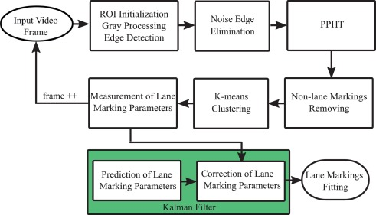
ER DIAGRAM OR DFD:

Slide 8
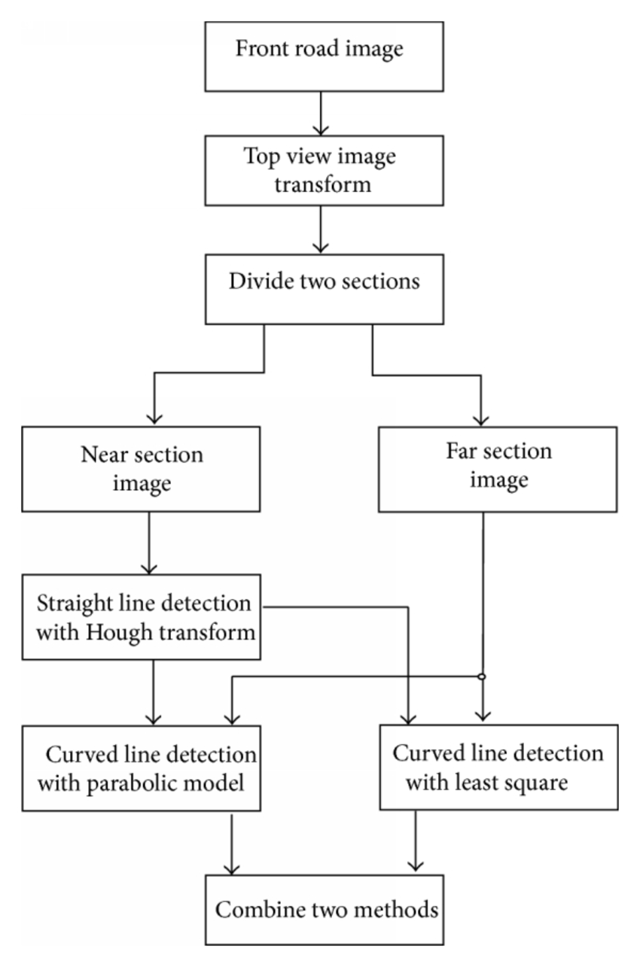
CASE DIAGRAM:

Slide 9
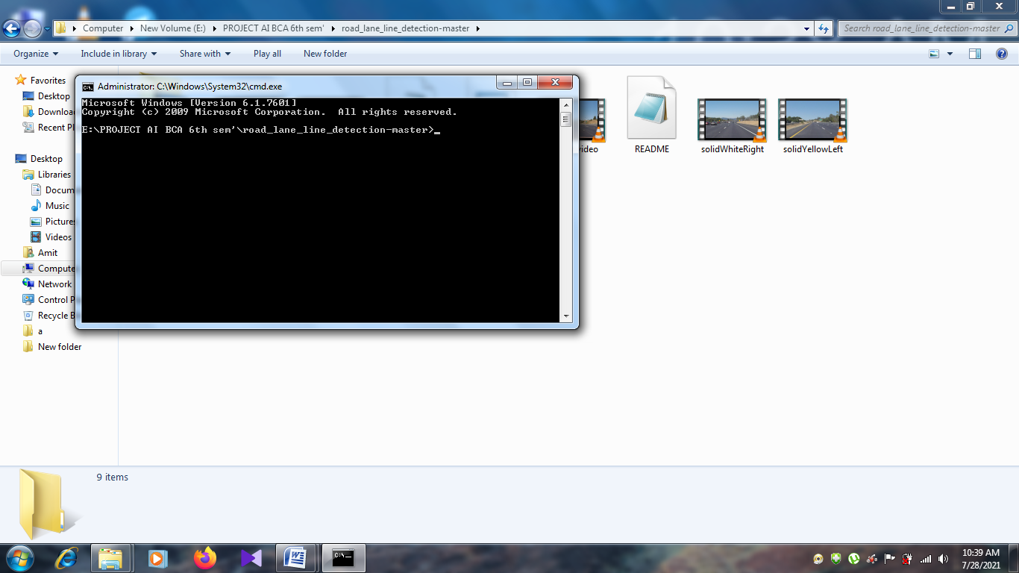
SCREEN SHOTS:

Slide 10
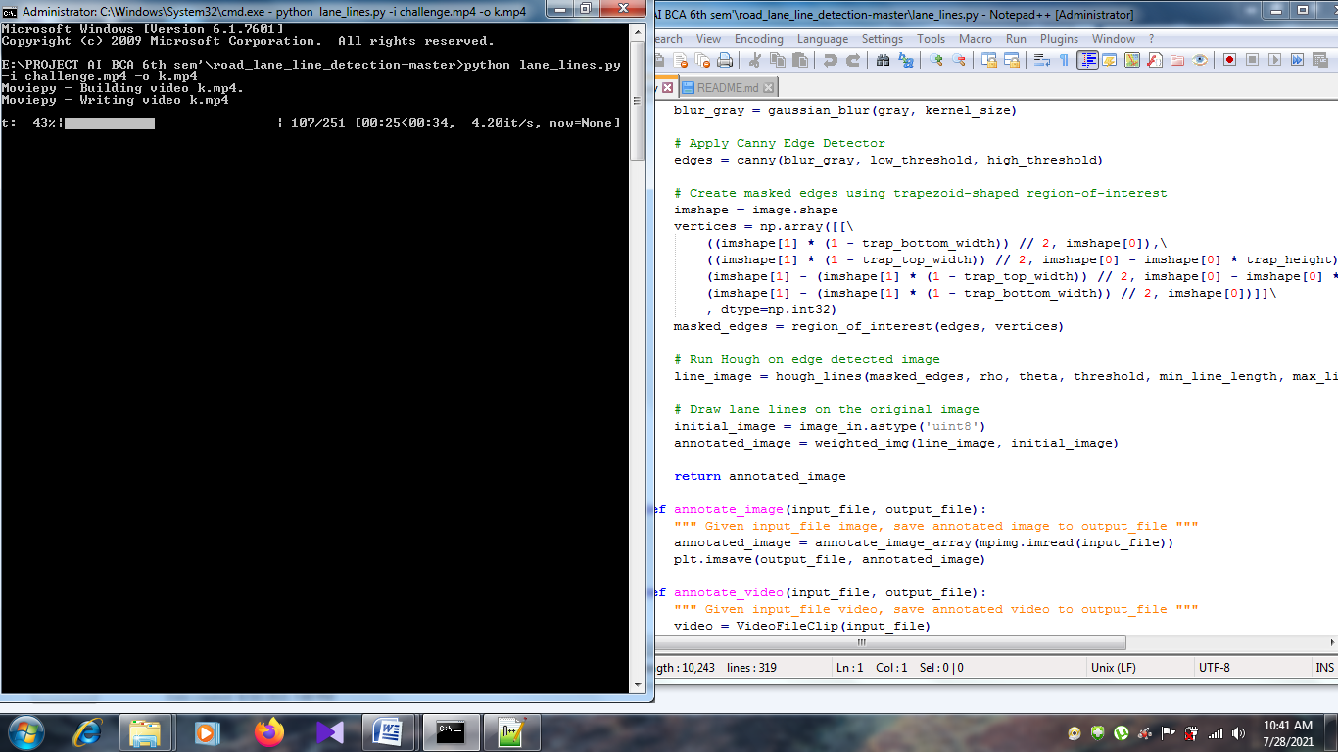

Slide 11
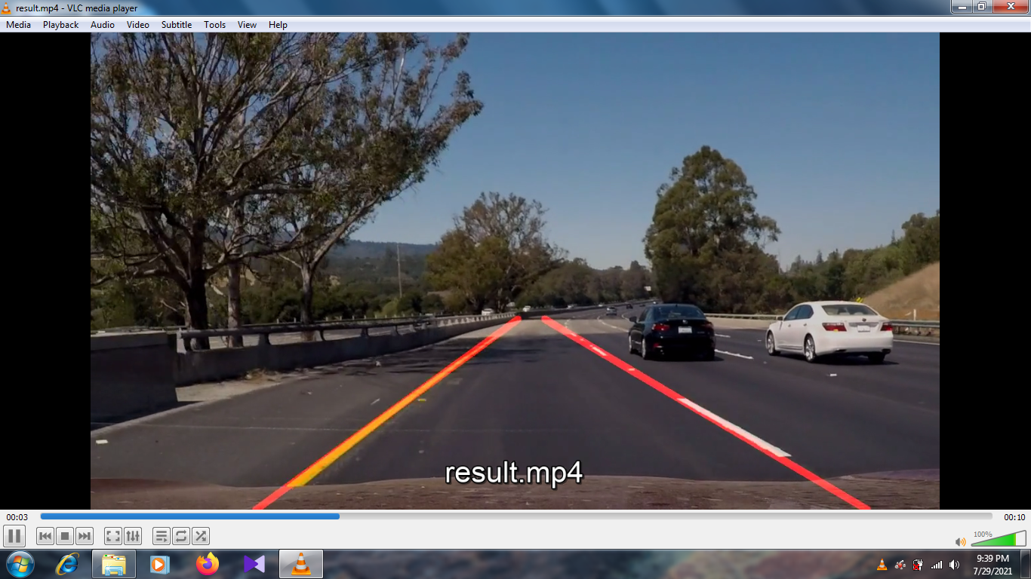

Slide 12
ADVANTAGES:
Lower the accident rates
Gives assistance and details to pedestrians and drivers
Uniformity of the markings is an important factor in minimizing confusion and uncertainty about their meaning
Allows vehicular drivers to drive safely
Perfection in lane stability

Slide 13
DISADVANTAGES:
faulty detection in curvy roads
wrong detection due to shadows
Limited to only lanes highway
Poor accuracy in rainy whether
Highly expensive
Fault in camera or sensor can lead to accident

Slide 14
FUTURE SCOPE:
One thing that could potentially improve the performance of the vehicles ability to keep within the lane in higher speeds is to change the camera to one that distorts the image to a lesser amount.
we can install this lane detection for all auto and manual vehicles to set up warning system for changing lanes on highway.

Slide 15
CONCLUSION:
we proposed a new lane detection preprocessing and ROI selection methods to design a lane detection system. The main idea is to add white extraction before the conventional basic preprocessing. Edge extraction has also been added during the preprocessing stage to improve lane detection accuracy. We also placed the ROI selection after the proposed preprocessing. Compared with selecting the ROI in the original image, it reduced the non lane parameters and improved the accuracy of lane detection. Currently, we only use the Hough transform to detect straight lane and EKF to track lane and do not develop advanced lane detection methods. In the future, we will exploit a more advanced lane detection approach to improve the performance.

Slide 16
REFERENCES:
D. Pomerleau, “RALPH: rapidly adapting lateral position handler,” in Proceedings of the Intelligent Vehicles '95. Symposium, pp. 506–511, Detroit, MI, USA, 2003. View at: Publisher Site | Google Scholar
J. Navarro, J. Deniel, E. Yousfi, C. Jallais, M. Bueno, and A. Fort, “Influence of lane departure warnings onset and reliability on car drivers' behaviors,” Applied Ergonomics, vol. 59, pp. 123–131, 2017. View at: Publisher Site | Google Scholar
https://jivp-eurasipjournals.springeropen.com/articles/10.1186/s13640-018-0326-2#Fig1
https://www.hindawi.com/journals/am/2018/8320207/
https://www.google.com/search?q=methodology+for+lane+line+detection&client=firefox-b-d&sxsrf=ALeKk01GXqXP6_1gFVXzhpVGWMJlfYG2Dg:1626766435899&source=lnms&tbm=isch&sa=X&ved=2ahUKEwjw4qyckfHxAhUH7XMBHaJKC9sQ_AUoAXoECAEQAw&biw=1366&bih=643#imgrc=OnvIckBQXRzuRM

