Slide 1
SOCIAL COMPLAINTS
IET Project Group Number 11
Group Members:
Pooja Dole -0073
Pankaj Patil-0068
Amit Pisal-0013
Nikhil Chandramore-0062
Kartik Gujar-0052

Slide 2
INTRODUCTION:
Social Complaints is a Web based Platform which aims to create a single window platform wherein the citizens can easily register their complaints and connect with local Government Officials to resolve any kind of issues.
The platform allows citizens to upload the images and exact location of the problematic area , whereas the worker can upload the image when the work is completed . System provides current location of the citizen to help the worker to find out where is the exact problem location. System supports roles mainly as citizen, government officials, actual workers and administration who performs their respective roles. Also status will be shared among citizens, workers and the officials.
System manages the complete end to end complaint management or complaint flow starting from citizen to the worker end, which helps in making the whole process transparent and flexible for the citizens and eliminates the delay in getting problem resolved.

Slide 3
Features:
Visual Proof:
Capturing and uploading the snap of the problematic zone as a visual proof.
Complaint Management:
Department Wise Sorting
Schedule Complaint
Update Status
Status
User can see status regarding complaints
Worker Allocation
Officials will assign task to the workers
Analytics Chart of
All Complaints/Resolved Complaints/Pending Complaints

Slide 4
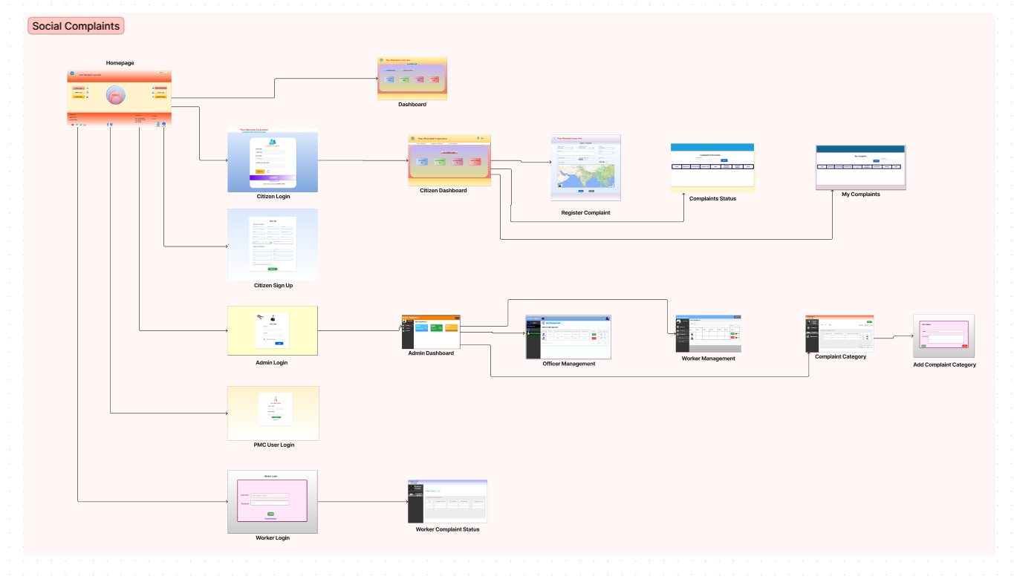
FLOW DIAGRAM:

