Slide 1
SARVALINK
Unified Dashboard, Smart Device: Streamlining Campus Management with Secure, Cost-Effective Solutions

Slide 2
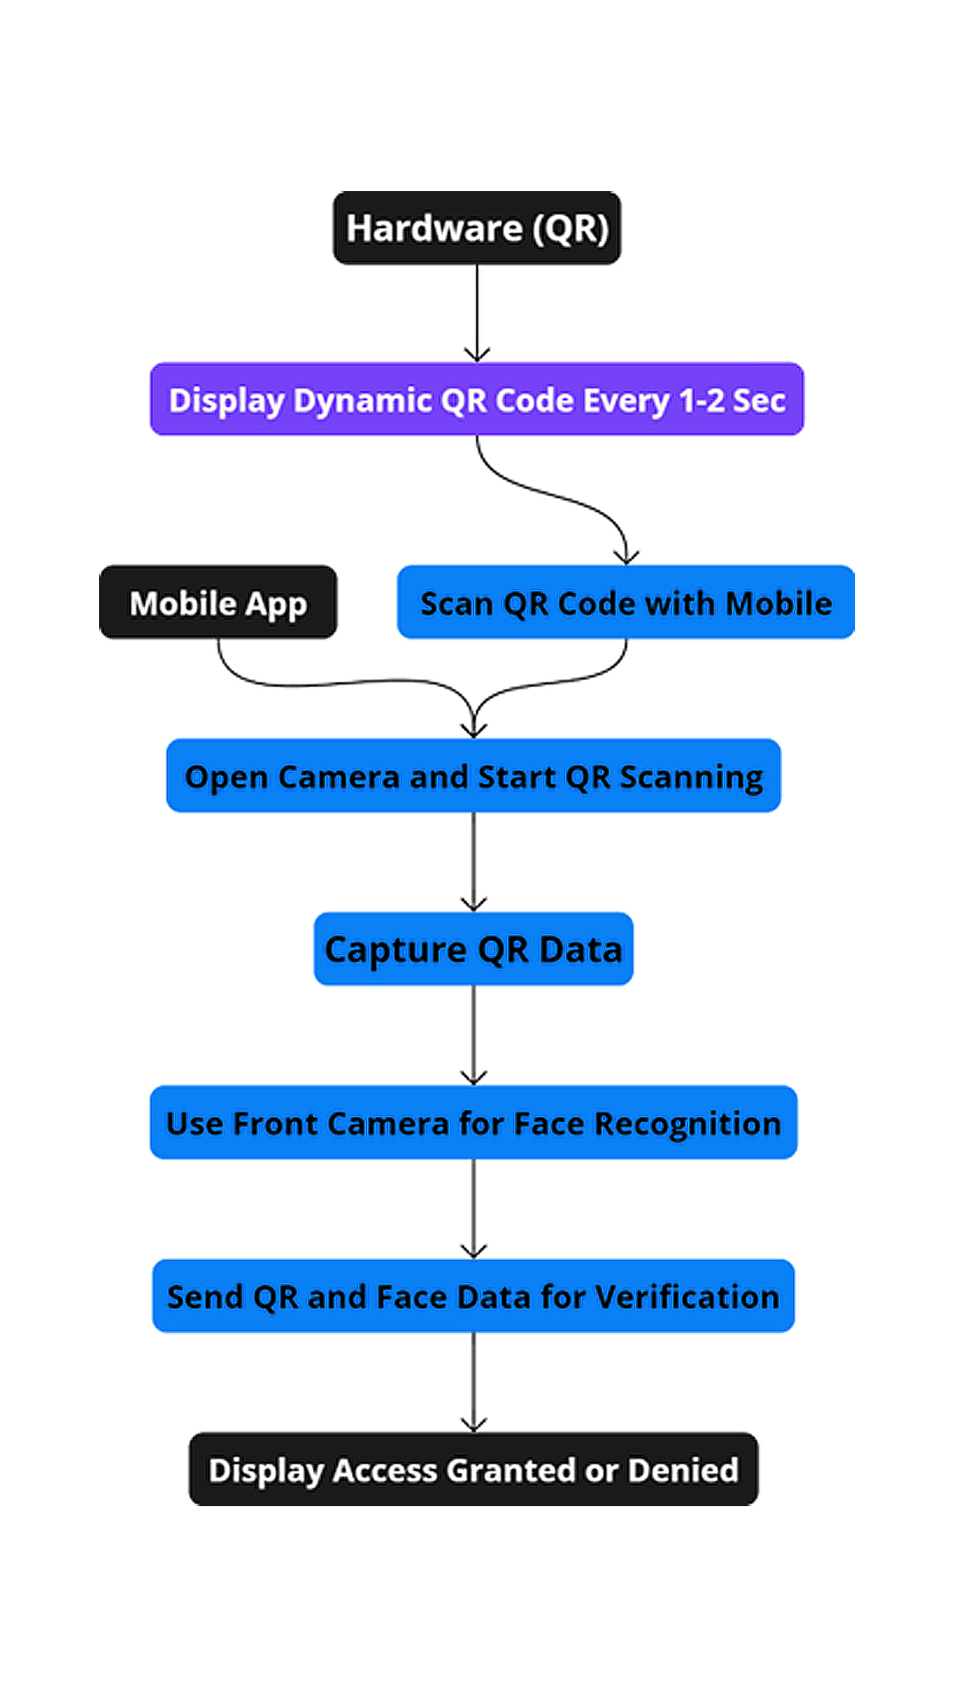

SARVALINK
Problem Statement:
Educational institutions struggle with inefficient manual systems for attendance, data access, and secure authentication. The lack of a unified platform integrating Aadhar and ABC complicates identity verification and academic record management. Proposed Solution: A unified college management system integrating QR code scanning, biometric face recognition, Aadhar, and the Academic Bank of Credits (ABC). With dual authentication, it automates attendance, manages departments, and enhances security and efficiency in academic institutions.
How It Addresses The Problem:
Streamlines department workflows (library, accounts, exams, hostel) with real-time data syncing.
Enhances security via dual authentication using Aadhar and biometric verification.
Integrates ABC for seamless academic credit management.
Reduces fraud in identity verification during exams.
Automates attendance tracking through QR scanning and face recognition, eliminating manual errors.
For Referance Watch this: https://youtu.be/JNJ41hFCE5Q
Fig.1) How Will QR System Work

Slide 3
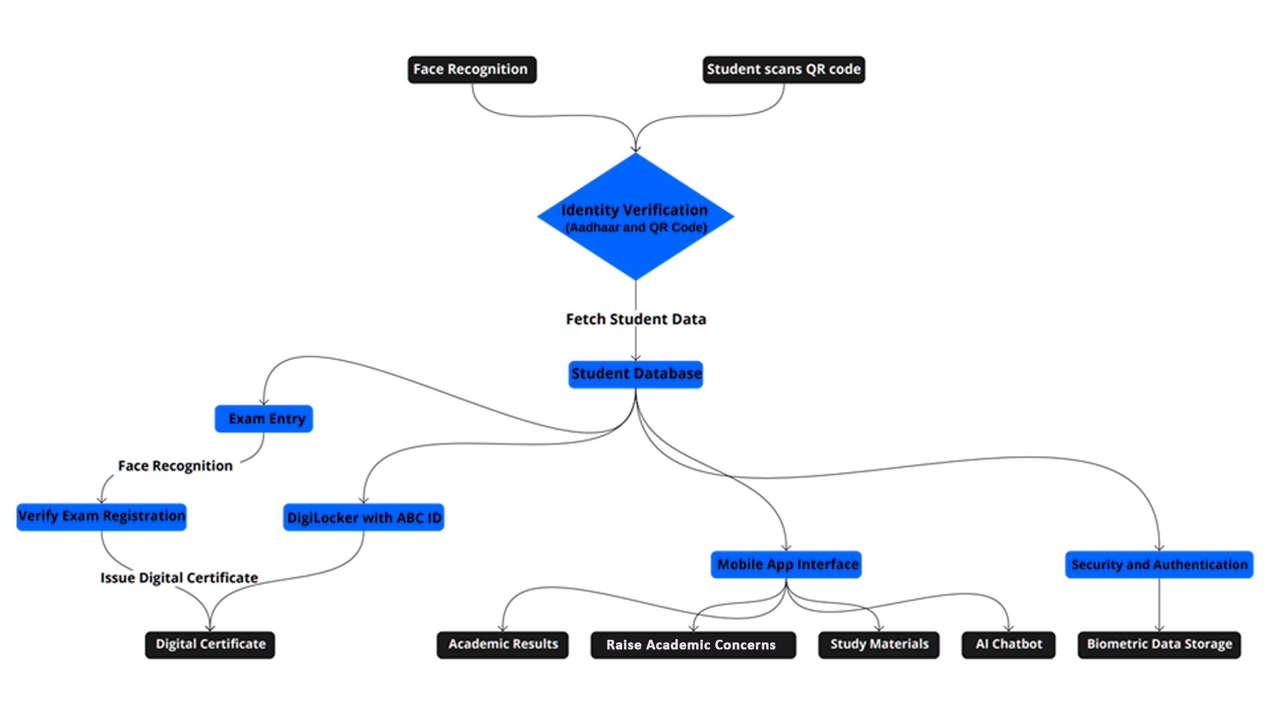
TECHNICAL APPROACH
Dynamic QR code and Face Recognition
Hardware Used & Costing:
ESP32
LCD Screen
Battery & it’s Module
Total costing :- ₹899
Frontend:
APP(for students)
WEB APP (for admin)
Backend:
Directus
Python
Database
Fig.2) How Will Overall System Work
3

Slide 4
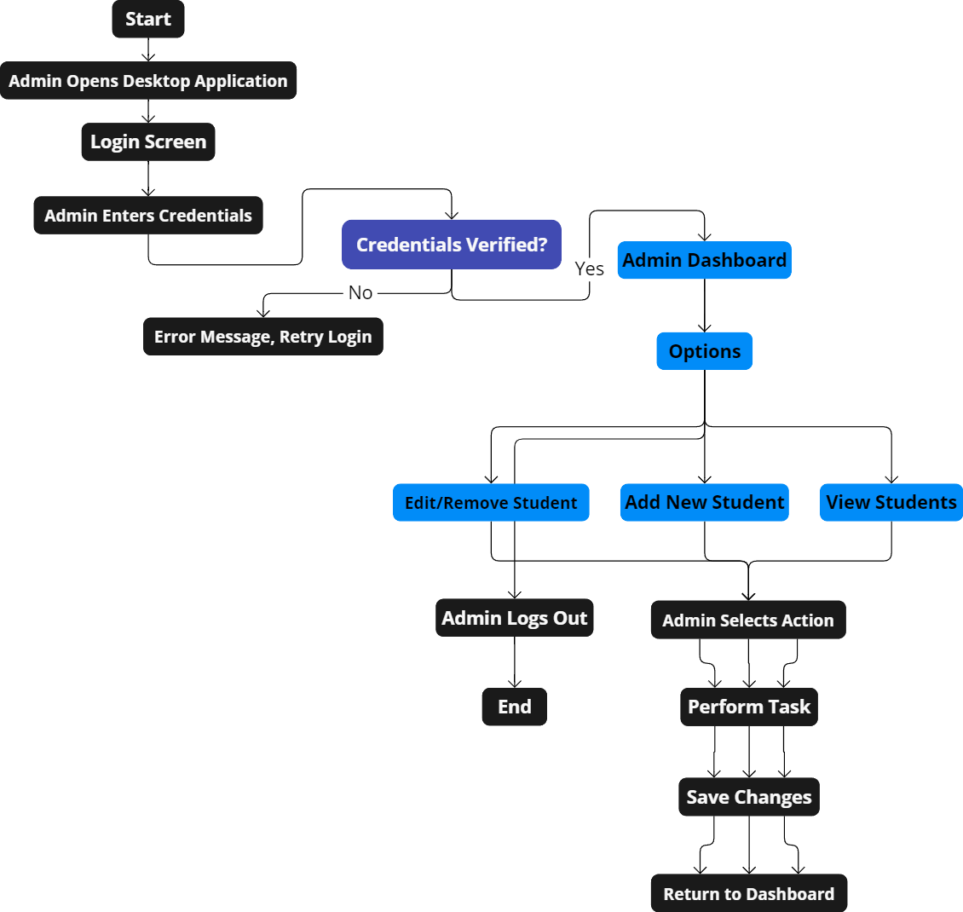
FEASIBILITY AND VIABILITY
Feasibility:
Technical: QR code, face recognition, Aadhar, ABC integration are feasible with existing technology and cloud infrastructure.
Operational: Intuitive system with minimal training required; easily adopted across departments.
Legal/Security: Follows data protection and Aadhar compliance regulations.
Viability:
Cost: Initial investment offset by long-term savings in administrative costs and efficiency gains.
Sustainability: Reduces paperwork, scalable across departments, and future-proof with ABC integration.
Satisfaction: Streamlined processes improve student/staff experience, supporting institutional modernization.
Fig.3) How Will Admin Dashboard Work

Slide 5
FUTURE SCOPE & IMPACT , BENEFITS
Future Scope
AI & Mobile Integration: Add face recognition and develop mobile apps for better accessibility.
Aadhar & ABC Integration : Ensures secure identity verification with Aadhar and seamless academic credit management via ABC.
Eco-Friendly: Further reduce paper usage and adopt energy-efficient hardware.
LMS Integration: Connect with platforms like Google Classroom.
IoT Expansion: Include biometric systems and more IoT devices for tracking.
Market Research with Financial Insights
Target Market:
Schools, colleges, universities, and corporate training centers looking to improve administrative efficiency and monitoring through smart solutions.
Trends:
Increasing demand for smart campus solutions driven by the shift towards digital infrastructure and remote monitoring post-pandemic.
Market Size:
The global smart campus market is projected to grow significantly, with estimates suggesting a value of over USD 20 billion by 2030, driven by investments in IoT, AI, and cloud-based campus management systems​
The Market Reports
​Valuates Reports
Competition:
Competing with platforms like Classter, Alma, and PowerSchool, SarvaLink's solution offers enhanced hardware-software integration with features like RFID and face recognition for better attendance management.
Opportunities:
Collaboration with government initiatives (e.g., Smart India Hackathon), subscription-based revenue models, and partnerships with EdTech companies to expand into new markets.

