Slide 1
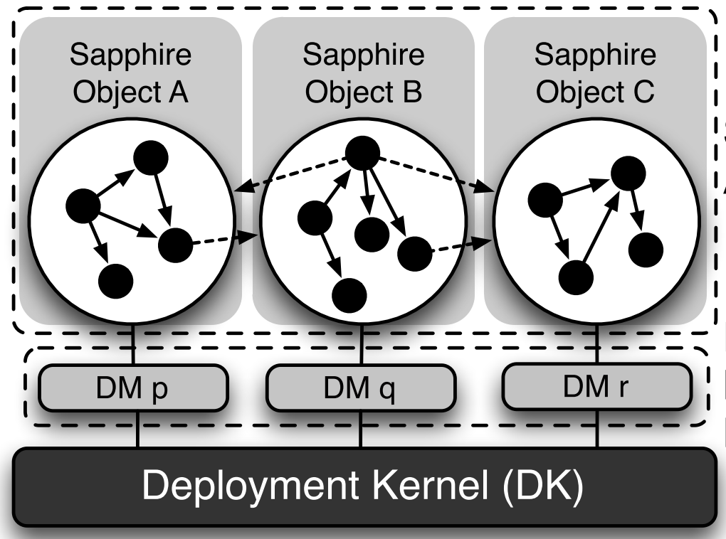
O.S.
O.S.
Host
Host
OMS
O.S.
Host

