Slide 1
Cloud Computing Issues and Challenges

Slide 2
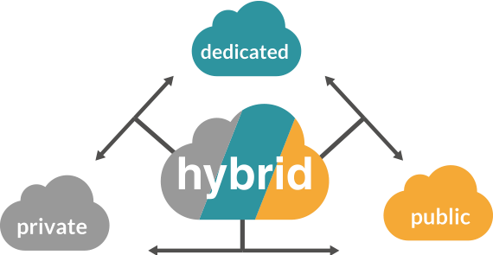
Cloud with right decision
Cloud Computing is a new name for
an old concept. The delivery of
computing services from a remote location.
Cloud Computing is Internet-based
computing, where shared resources,
software, and information are
provided to computers and other devices on demand.

Slide 3
Data Security concern
When we talk about the security concern of cloud technology, then a lot of questions remain unanswered.
Multiple serious threats like virus attacks and client site hacking are the biggest cloud computing data security issues.
Entrepreneurs have to think about these issues before adopting cloud computing technology for their business.
Since you are transferring your company’s important details to a third party so it is important to ensure yourself about the manageability and security system of the cloud.

Slide 4
Selecting the perfect cloud set-up
Choosing the appropriate cloud mechanism per your business’s needs is very necessary.
There are three types of clouds configuration such as public, private, and hybrid.
The main secret behind successful cloud implementation is picking up the right one.
If you are not selecting the right cloud then maybe you have to face some serious hazards.
Some companies have vast data, and prefer private clouds, while small organizations usually use public clouds.
A few companies like to go for a balanced approach with hybrid clouds.
Choose a cloud computing consulting service which is aware of and clearly discloses the terms and conditions regarding cloud implementation and data security.

Slide 5

Real time monitoring requirements
In some agencies, it is required to monitor their system in real-time.
It is a compulsory term for their business that they continuously monitor and maintain their inventory system.
Banks and some government agencies need to update their system in real-time but cloud service providers are unable to match this requirement.
This is really a big challenge for cloud service providers.

Slide 6
Resolving the stress
Every organization wants to have proper control and access to the data.
It is not easy to hand over your precious data to a third party.
The main tension between enterprises and executives is their desire to control the new modes of operations while using technology.
These tensions are not unsolvable, but they suggest that providers and clients alike must deliberately address a suite of cloud challenges in planning, contracting and managing the services.

Slide 7
Reliability on new technology
It is human nature that we trust the things in front of our eyes.
Normally entrepreneurs hesitate to give organizational information to any unknown service provider.
They think that information stored in their office premises is more secure and easily accessible.
By using cloud computing they have a fear of losing control over the data.
They think that data is taken from them and handover to an unknown third party.
Security threads are increased as they do not know where is the information stored and processed.
These frights of the unknown service providers must very amicably be dealt with and eliminated from their minds.

Slide 8
Dependency on service providers
For uninterrupted services and proper working it is necessary that you acquire vendor services with proper infrastructural and technical expertise.
An authorized vendor who can meet the security standards set by your company’s
internal policies and government agencies.
While selecting the service provider you must carefully read the service level agreement and understand their policies and terms and provision of compensation in case of any outage or lock-in clauses.

Slide 9
Cultural obstacles
High authority of the company and organizational culture has also become a big obstacle in the proper implementation of cloud computing.
Top authority never wants to store the important data of the company somewhere else where they are not able to control and access the data.
They have misconceptions in their minds that it puts the organization at the risk by seeping out important details.
Their mindset is such that the organization is on risk-averse footing, which makes it more reluctant to migrate to a cloud solution.

Slide 10
Cost barrier
For efficient working of this you have to bear the high charges of the bandwidth.
Businesses can cut down the cost of hardware but they have to spend a huge amount on the bandwidth.
For smaller applications cost is not a big issue but for large and complex applications it is a major concern.
For transferring complex and intensive data over the network it is very necessary that you have sufficient bandwidth.
This is (COST) a major obstacle in front of small organizations, which restricts them from implementing cloud technology in their business.

Slide 11
Lack of knowledge and expertise
Every organization does not have sufficient knowledge about the implementation of cloud solutions.
They do have not the expertise staff and tools for the proper use of cloud technology.
Delivering the information and selecting the right cloud is quite difficult without the right direction.
Teaching your staff about the process and tools of cloud computing is a very big challenge in itself.
Requiring an organization to shift their business to cloud-based technology without having any proper knowledge is like asking for disaster.
They would never use this technology for their business functions.

Slide 12
Consumption basis services charges
Cloud computing services are on-demand services so it is difficult to define the specific cost for a particular quantity of services.
These types of fluctuations and price differences make the implementation of cloud computing very difficult and complicated.
It is not easy for a normal business owner to study consistent demand and fluctuations with the seasons and various events.
So it is hard to budget for a service that could consume several months of budget in a few days of heavy use.

Slide 13
Alleviate the threats risk
It is very complicated to certify that the cloud service provider meets the
standards for security and threat risk.
Every organization may not have enough mechanisms to mitigate these types of threats.
Organizations should observe and examine the threats very seriously.
There are mainly two types of threats such as internal threats, within the organizations and external threats from professional hackers who seek out important information about your business.
These threats and security risks put a check on implementing cloud solutions.

Slide 14
Unauthorized service providers
It is a new concept for most of the business organizations.
A normal businessman is not able to verify the genuineness of the service provider agency.
It’s very difficult for them to check whether the vendors meet the security standards or not.
They do have not an ICT consultant to evaluate the vendors against the worldwide criteria.
It is necessary to verify that the vendor must be operating this business for a sufficient time without having any negative record in past.
Vendor continuing business without any data loss complaints and having a number of satisfied clients. The market reputation of the vendor should be unblemished.

Slide 15
Hacking of brand
It carries some major risk factors like hacking.
Some professional hackers are able to hack the application by breaking the
efficient firewalls and stealing the sensitive information of the organizations.
A cloud provider hosts numerous clients; each can be affected by actions taken against any one of them.
When any threat came into the main server it affects all the other clients also.
As in distributed denial of service attacks server requests that inundate a provider from widely distributed computers.

Slide 16
Recovery of lost data
Cloud services face the issue of data loss.
A proper backup policy for the recovery of data must be placed to deal with the loss.
Vendors must set proper infrastructures to efficiently handle server breakdowns and outages.
All the cloud computing service providers must set up their servers at economically stable locations where they should have proper arrangements for the backup of all the data in at least two different locations.
Ideally they should manage a hot backup and a cold backup site.

Slide 17
Data portability
Every person wants to leverage migrating in and out of the cloud. Ensuring
data portability is very necessary.
Usually, clients complain about being locked in the cloud technology from where they cannot switch without restraints.
There should be no lock-in period for switching the cloud.
Cloud technology must have the capability to integrate efficiently with the on- premises.
The clients must have a proper contract of data portability with the provider and must have an updated copy of the data to be able to switch service providers, should there be any urgent requirement.

Slide 18
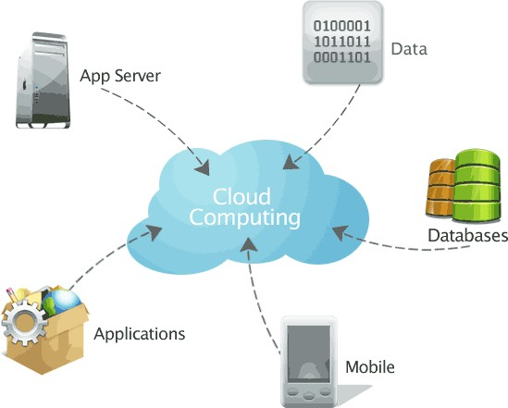
Cloud management
Managing a cloud is not an easy task.
It consists of a lot of technical challenges.
A lot of dramatic predictions are famous about the impact of cloud computing. People think that traditional IT departments will be outdated and research supports the conclusion that cloud impacts are likely to be more gradual and less linear.
Cloud services can easily change and update by business users. It does not involve any direct involvement of the IT department.
It is the service provider’s responsibility to manage the information and spread it across the organization.
So it is difficult to manage all the complex functionality of cloud computing

Slide 19
Dealing with lock-ins
Cloud providers have an important additional incentive to attempt to
exploit lock-ins.
A prefixed switching cost is always there for any company receiving external services.
Exit strategies and lock-in risks are primary concerns for companies looking to exploit cloud computing.

Slide 20
Transparency of service provider
There is no transparency in the service provider’s infrastructure and service area.
You are not able to see the exact location where your data is stored or
being processed.
It is a big challenge for an organization to transfer its business information to such an unknown vendor.

Slide 21
Transforming the data into virtual set-up
Transition of business data from a premise set up to a virtual set-up is a major issue for various organizations.
Data migration and network configuration are the serious problems behind avoiding cloud computing technology.

Slide 22
Popularization
The idea of the cloud has been famous that there is a rush of implementing virtualization among CIOs (chief information officers).
This has led to more complexities than solutions.

Slide 23
Conclusion
These are some common problems regarding cloud computing execution in real life.
But the benefits of cloud computing are more vast in comparison to these hazards.
So you should find the perfect solutions and avail the huge benefits of cloud technology in your business.
It can take your business to new heights!!

