Slide 1


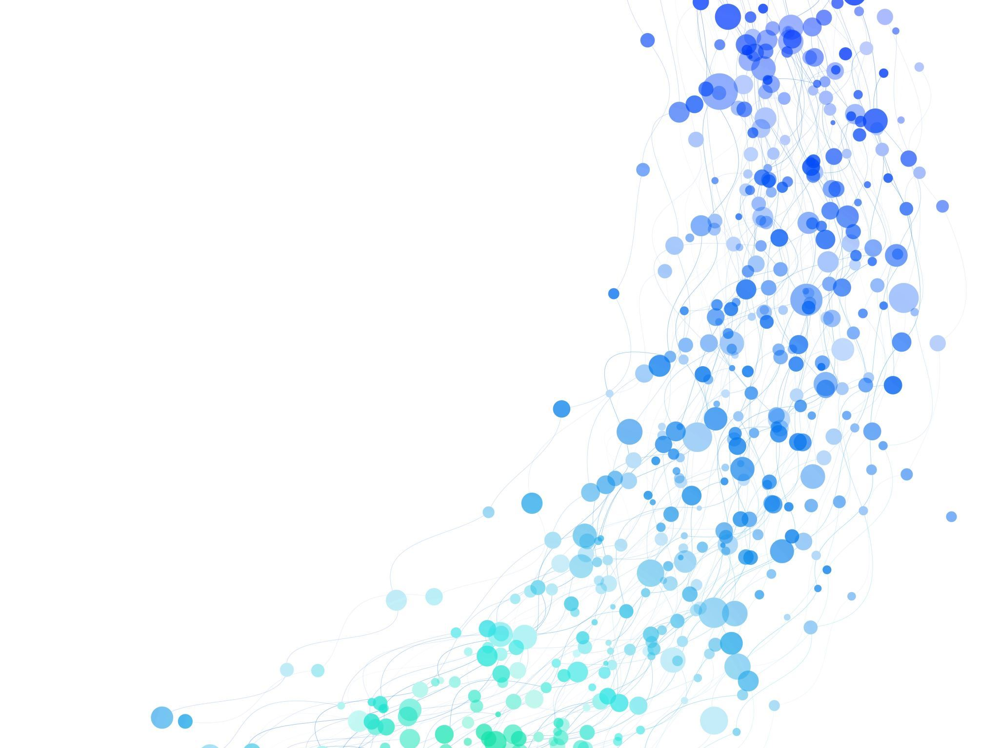
Predictive Modelling Spaceship Titanic Presented by Amit Sarohi
This Photo by Unknown author is licensed under CC BY-NC-ND.

Slide 2

Objective
Create a predictive model to predict whether a passenger was transported to an alternate dimension during the Spaceship Titanic's collision with the spacetime anomaly
To make these predictions, we are given a set of personal records recovered from the ship's damaged computer system.
Type of machine learning will be classification supervised learning as we are trying to predict whether the Transported flag will be True or False.
This Photo by Unknown author is licensed under CC BY-SA.

Slide 3

Introduction
What is Machine Learning and it's types ?
Data Wrangling :How to clean data with outliers, impute missing values, encode categorical features ,engineer new features and split it into training, validation, and test sets?
How to establish baseline accuracy and build a model with a transformer and a tree-based predictor?
How to calculate training and validation accuracy?
How to perform Randomized and Grid Search Cross-validations for hyperparameter tuning?
How to calculate precision and recall from a confusion matrix with plotting?
This Photo by Unknown author is licensed under CC BY.

Slide 4
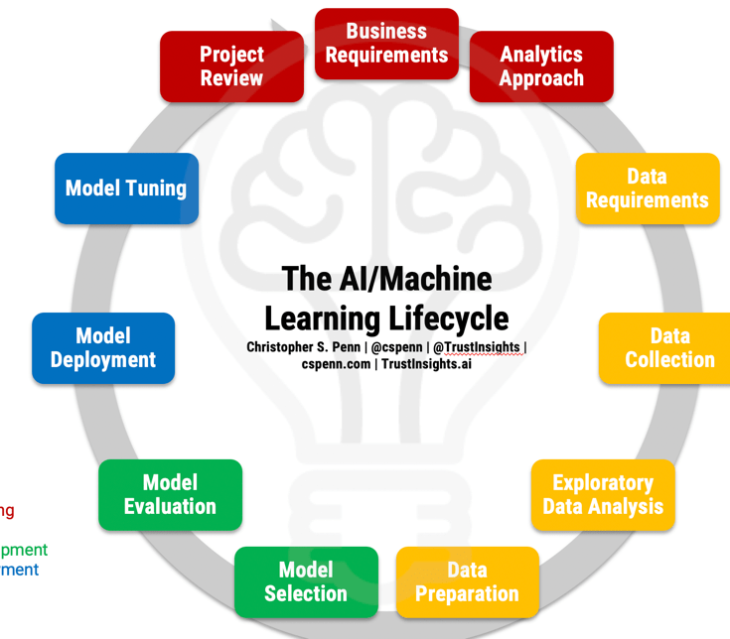
Machine Learning Life cycle
Planning
Data Preparation
Model Engineering
Model Evaluation
Model Deployment
Monitoring and Maintenance
This Photo by Unknown author is licensed under CC BY-NC-ND.

Slide 5
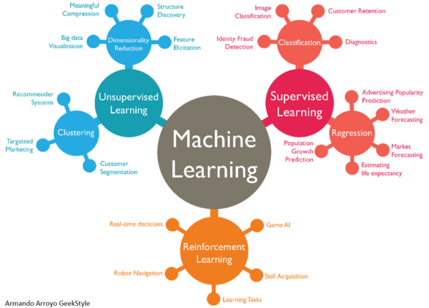
Types of Machine Learning
Supervised
Regression
Classification
Unsupervised
Clustering
Association
Semi-Supervised
Reinforcement
Positive
Negative

Slide 6
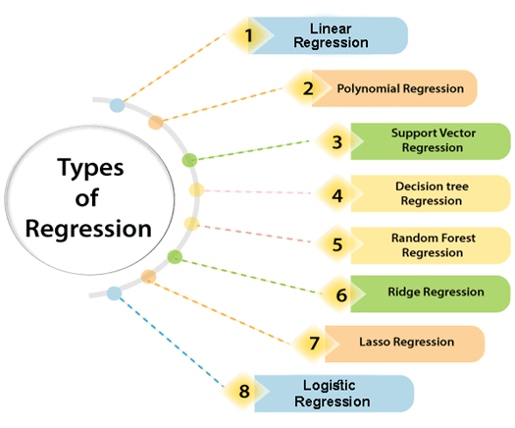
Regression Learning Regression is a supervised learning technique which helps in finding the correlation between variables and enables us to predict the continuous output variable based on the one or more predictor variables. It is mainly used for prediction, forecasting, time series modeling, and determining the causal-effect relationship between variables.

Slide 7
Classification The Classification algorithm is a Supervised Learning technique that is used to identify the category of new observations on the basis of training data. In Classification, a program learns from the given dataset or observations and then classifies new observation into a number of classes or groups. Such as, Yes or No, 0 or 1, Spam or Not Spam, cat or dog, etc.
Linear Models
Logistic Regression
Support Vector Machines
Non-linear Models
K-Nearest Neighbours
Kernel SVM
Naïve Bayes
Decision Tree Classification
Random Forest Classification

Slide 8
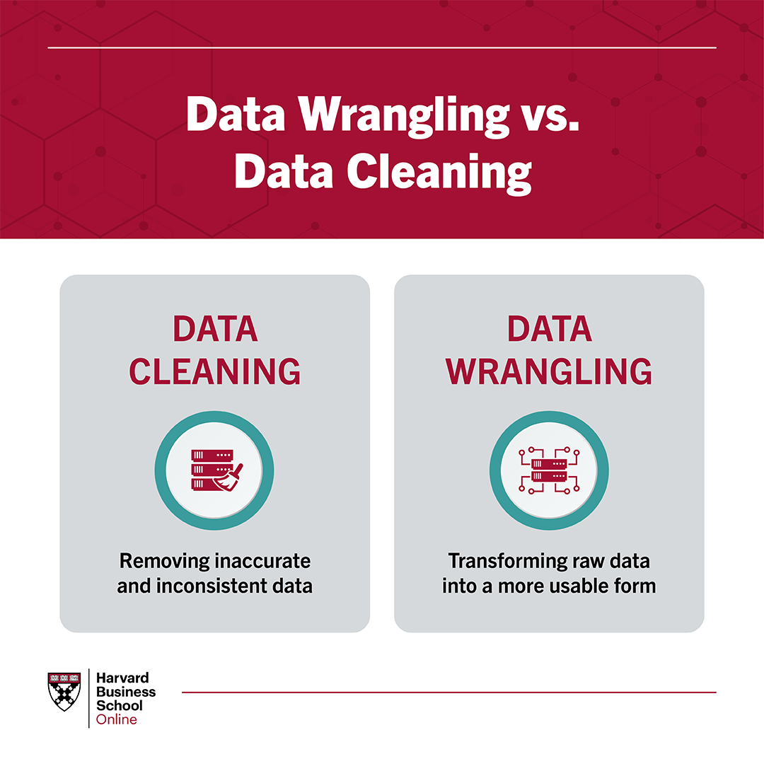
Data Wrangling and Exploratory Data Analysis (EDA)
Data wrangling involves cleaning and organizing data for analysis.
EDA involves exploring and summarizing data to gain insights

Slide 9
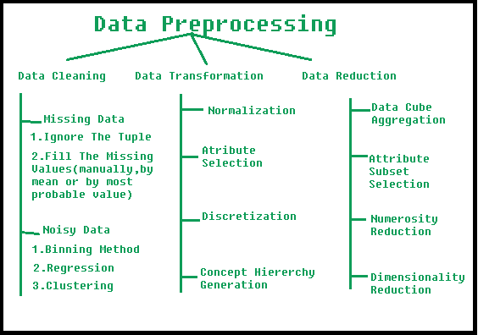
Data Cleaning and Wrangling
Loading Data
import pandas as pd
test_path = '/content/drive/MyDrive/Colab Notebooks/PixelTestTraining/Kaggle/SpaceshipTitanic/test.csv'
train_path = '/content/drive/MyDrive/Colab Notebooks/PixelTestTraining/Kaggle/SpaceshipTitanic/train.csv'
df = pd.read_csv(train_path)
X_test = pd.read_csv(test_path)
Shape and Missing Values
df.shape #(8693, 14)
df.isnull().sum().sum() #2324

Slide 10
Data Cleaning and Wrangling
df['HomePlanet'].fillna('""', inplace=True) df['CryoSleep'].fillna(False, inplace=True) df['Age'].fillna(df['Age'].mean(), inplace=True) df['VIP'].fillna(False, inplace=True) df['RoomService'].fillna(df['RoomService'].mean(), inplace=True) df['FoodCourt'].fillna(df['FoodCourt'].mean(), inplace=True) df['ShoppingMall'].fillna(df['ShoppingMall'].mean(), inplace=True) df['Spa'].fillna(df['Spa'].mean(), inplace=True) df['VRDeck'].fillna(df['VRDeck'].mean(), inplace=True)
Handling Missing Values
Drop NaN Values
One approach to handling Nan values is to drop all rows containing NaN values. You can use the dropna() function to remove all rows containing NaN values.
Fill NaN Values
Another approach to handling NaN values is to fill them with a value. You can use the fillna() function to replace all NaN values with a specified value.
We have filled NAN values for current dataframe.

Slide 11
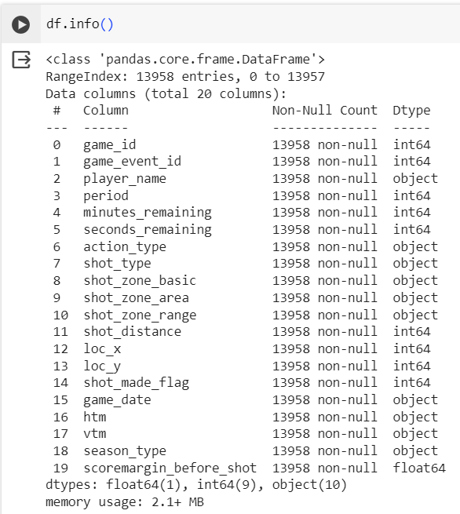
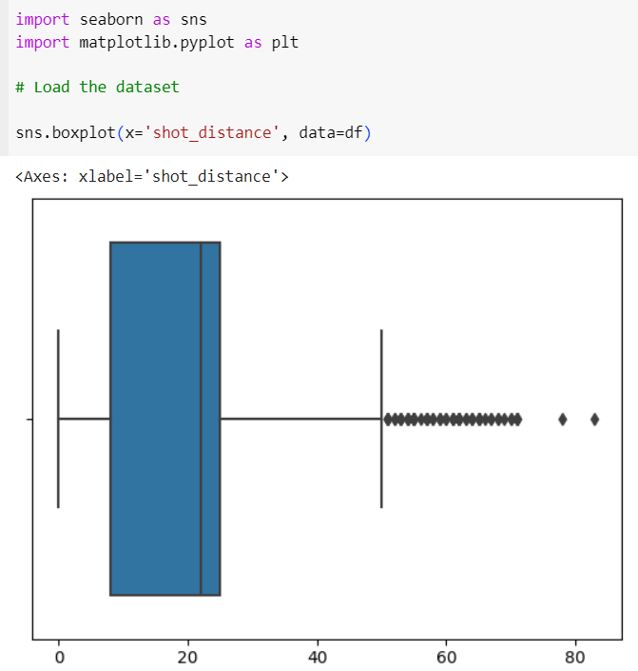
Exploratory data analysis(EDA)
Univariate Analysis
Bivariate Analysis
Multivariate Analysis
Time Series Analysis
Missing Data Analysis
Outlier Analysis
Data Visualization

Slide 12
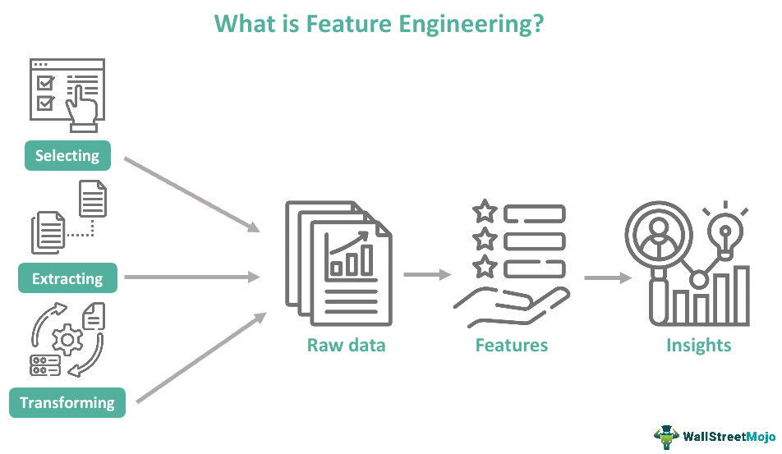
Feature Engineering
Feature Creation
Creating features involves identifying the variables that will be most useful in the predictive model. It can be Domain-Specific, Data-Driven or Synthetic
HomePlanet - The planet the passenger departed from, typically their planet of permanent residence.
CryoSleep - Indicates whether the passenger elected to be put into suspended animation for the duration of the voyage. Passengers in cryosleep are confined to their cabins.
Age - The age of the passenger.
Transported - Whether the passenger was transported to another dimension. This is the target, the column you are trying to predict.

Slide 13
Feature Engineering
Transformations
Transformation involves manipulating the predictor variables to improve model performance; e.g. ensuring the model is flexible in the variety of data it can ingest; ensuring variables are on the same scale, making the model easier to understand; improving accuracy; and avoiding computational errors by ensuring all features are within an acceptable range for the model.
Normalization: Rescaling the features to have a similar range, such as between 0 and 1, to prevent some features from dominating others.
Scaling: Scaling is a technique used to transform numerical variables to have a similar scale, so that they can be compared more easily. Rescaling the features to have a similar scale, such as having a standard deviation of 1, to make sure the model considers all features equally.
Encoding: Transforming categorical features into a numerical representation. Examples are one-hot encoding and label encoding.
Transformation: Transforming the features using mathematical operations to change the distribution or scale of the features. Examples are logarithmic, square root, and reciprocal transformations.

Slide 14
Feature Engineering
Feature Extraction
Feature Extraction is the process of creating new features from existing ones to provide more relevant information to the machine learning model. This is done by transforming, combining, or aggregating existing features.
Dimensionality Reduction: Reducing the number of features by transforming the data into a lower-dimensional space while retaining important information. Examples are PCA and t-SNE.
Feature Combination: Combining two or more existing features to create a new one. For example, the interaction between two features.
Feature Aggregation: Aggregating features to create a new one. For example, calculating the mean, sum, or count of a set of features.

Slide 15
Feature Engineering
df['previous_shot_successful'] = df['shot_made_flag'].shift(1)
df['previous_shot_successful'].fillna(0,inplace=True)
Feature Selection
Feature selection algorithms essentially analyze, judge, and rank various features to determine which features are irrelevant and should be removed, which features are redundant and should be removed, and which features are most useful for the model and should be prioritized.
Transported - Whether the passenger was transported to another dimension. This is the target, the column we are trying to predict.

Slide 16
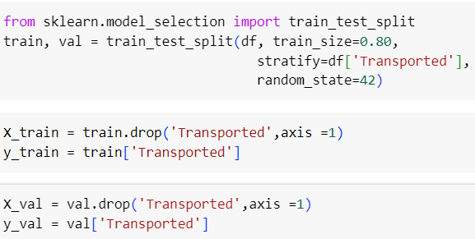

Data Splitting
Data splitting comes into the picture when the given data is divided into two or more subsets so that a model can get trained, tested and evaluated.
Training set: A subset of the main dataset will feed into the model so that that model can learn the data patterns.
Validation Set: This set is used to understand the performance of the model in comparison to different models and hyperparameter choices.
Test set: This set checks the final model’s accuracy
.

Slide 17
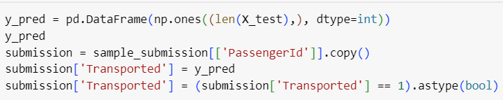
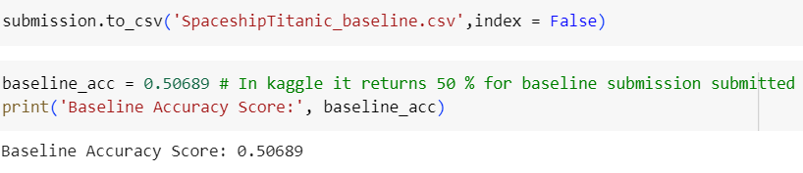
Baseline Accuracy
A baseline serves as a point of reference against which the performance of more advanced models is measured. It provides a clear indication of the minimum level of performance that needs to be exceeded to warrant the implementation of more complex and resource-intensive algorithms. This strategic approach prevents the pursuit of unnecessarily intricate models that might not yield proportionate benefits.
Random Baseline
A random baseline generates predictions purely by chance. It is used when there’s no prior information available and serves as a minimal performance expectation. For instance, in spam email classification, a random baseline predicts spam or not-spam with equal probability. Models should outperform this baseline for any credibility.
Majority Class Baseline
This baseline always predicts the majority class. It’s helpful for imbalanced datasets, where one class dominates. For instance, in medical diagnosis, if a rare disease occurs in only a fraction of cases, a majority class baseline that predicts “not the rare disease” might seem accurate due to the dataset’s imbalance.
Simple Heuristic Baseline
Here, a simple rule or heuristic is used for predictions. In sentiment analysis, a heuristic baseline could assume positive sentiment for reviews with more positive words than negative ones.

Slide 18
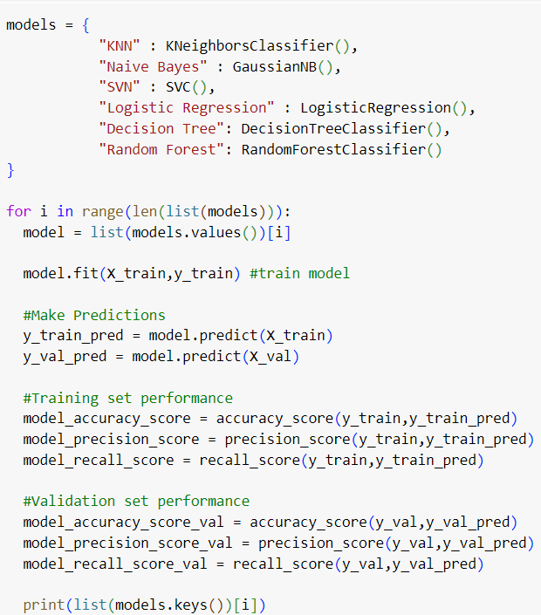
Pipeline Model Build
A machine learning pipeline is a way to codify and automate the workflow it takes to produce a machine learning model. Machine learning pipelines consist of multiple sequential steps that do everything from data extraction and preprocessing to model training and deployment.
It includes raw data input, features, outputs, the machine learning model and model parameters, and prediction outputs.

Slide 19
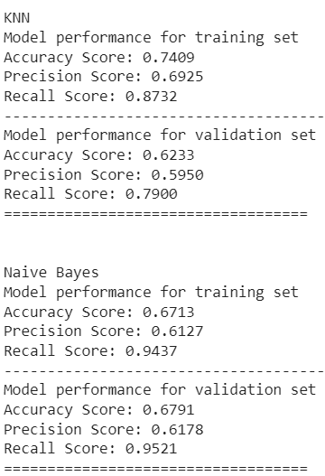
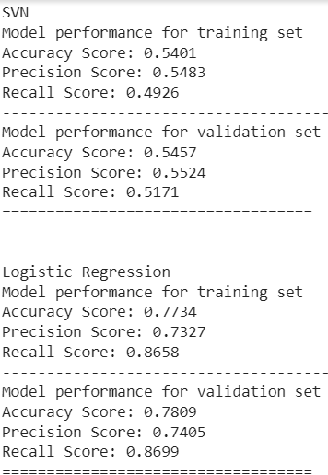
Category Encoders
A set of scikit-learn-style transformers for encoding categorical variables into numeric by means of different techniques. Nominal data is classified without a natural order or rank, whereas ordinal data has a predetermined or natural order.
It includes raw data input, features, outputs, the machine learning model and model parameters, and prediction outputs.
Two common ways to encode categorical features:
OneHotEncoder for unordered (nominal) data
OrdinalEncoder for ordered (ordinal) data
In some cases (especially when modeling with tree-based algorithms), nominal data can be encoded with an ordinal encoder
Note
OneHotEncoder and OrdinalEncoder encodes target values according to their alphabetic order.
When using one hot encoder in a pipeline, it may need to be used with a column transformer.

Slide 20
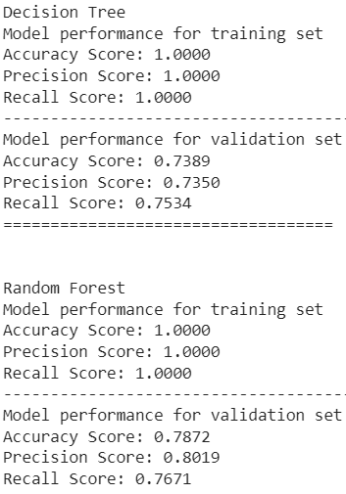
Simple Imputter & Standard Scaler
The SimpleImputer class provides basic strategies for imputing missing values. Missing values can be imputed with a provided constant value, or using the statistics (mean, median or most frequent) of each column in which the missing values are located. This class also allows for different missing values encodings
The StandardScaler class provided by Scikit Learn applies the standardization on the input (features) variable, making sure they have a mean of approximately 0 and a standard deviation of approximately 1.
StandardScaler adjusts the data to have a standardized distribution, making it suitable for modeling and ensuring that no single feature disproportionately influences the algorithm due to differences in scale.

Slide 21
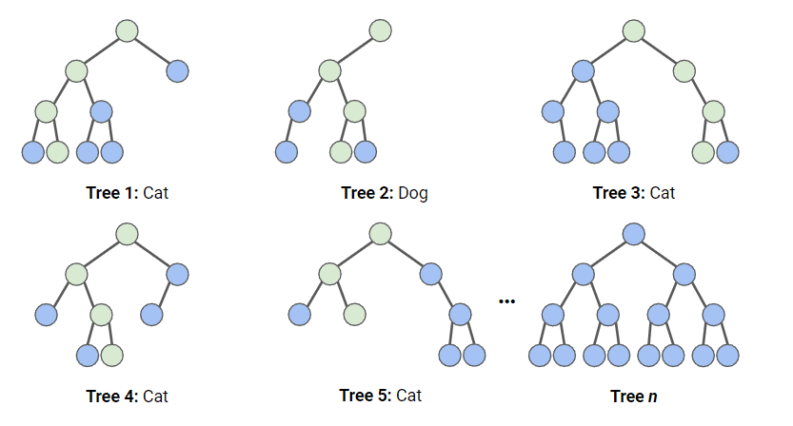
Random Forest Classifier
In a random forest classification, multiple decision trees are created using different random subsets of the data and features. Each decision tree is like an expert, providing its opinion on how to classify the data. Predictions are made by calculating the prediction for each decision tree, then taking the most popular result.
In the diagram below, we have a random forest with n decision trees, and we’ve shown the first 5, along with their predictions (either “Dog” or “Cat”). Each tree is exposed to a different number of features and a different sample of the original dataset, and as such, every tree can be different. Each tree makes a prediction. Looking at the first 5 trees, we can see that 4/5 predicted the sample was a Cat. The green circles indicate a hypothetical path the tree took to reach its decision. The random forest would count the number of predictions from decision trees for Cat and for Dog, and choose the most popular prediction.
We first create an instance of the Random Forest model, with the default parameters. We then fit this to our training data. We pass both the features and the target variable, so the model can learn.
At this point, we have a trained Random Forest model, but we need to find out whether it is making accurate.

Slide 22
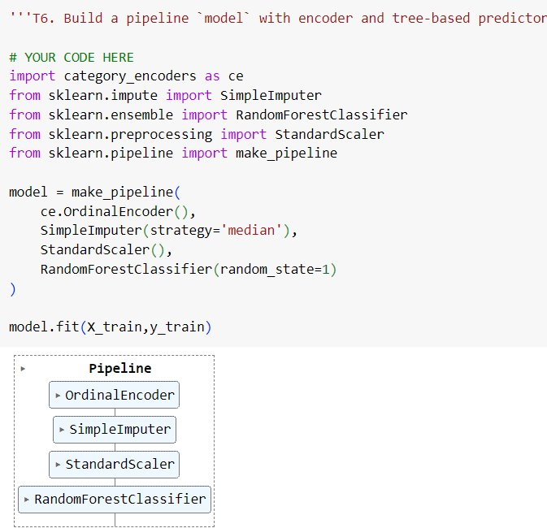
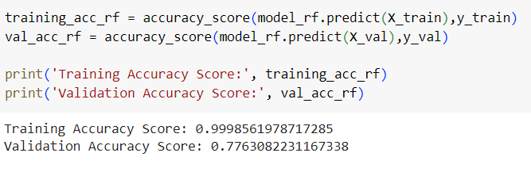
Check Metrics
The simplest way to evaluate this model is using accuracy; we check the predictions against the actual values in the set and count up how many the model got right.

Slide 23
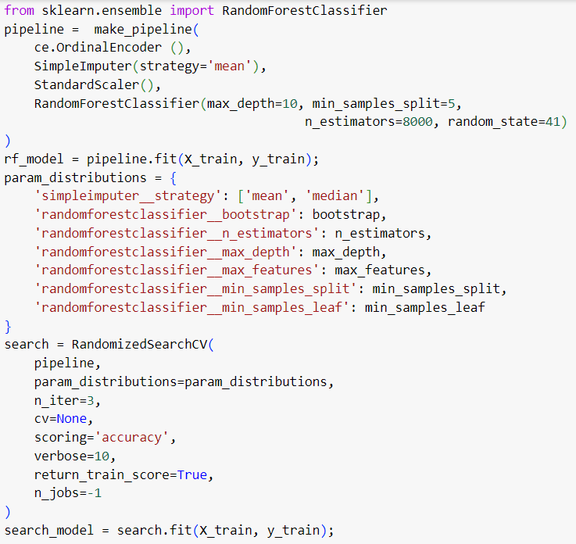
Hyperparameter Tuning
Important hyperparameters for all tree-based models: max_depth.
Important hyperparameters for random forest models: n_estimators, max_samples.
Important hyperparametes for gradient boosting tree models: n_estimators, learning_rate.
RandomizedSearchCV, which will randomly search parameters within a range per hyperparameter.
RandomizedSearchCV will train many models (defined by n_iter_ and save each one as variables, the code below creates a variable for the best model and prints the hyperparameters.
n_estimators: the number of decision trees in the forest. Increasing this hyperparameter generally improves the performance of the model but also increases the computational cost of training and predicting.
max_depth: the maximum depth of each decision tree in the forest. Setting a higher value for max_depth can lead to overfitting while setting it too low can lead to underfitting.

Slide 24
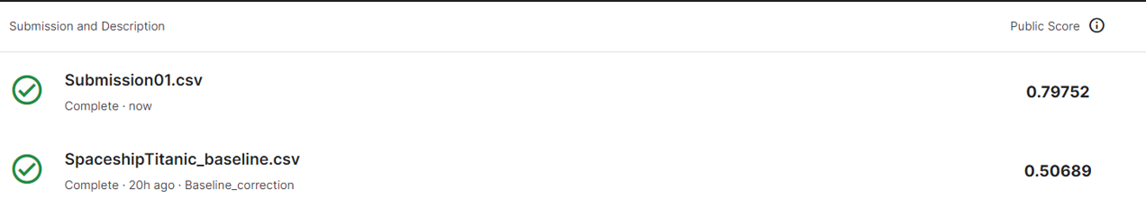
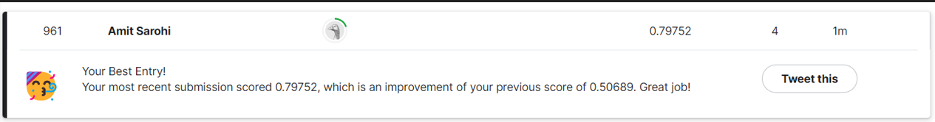
Kaggle Score

Slide 25
Thank you
Jayanth Rasamsetti and Team PixelTests
By :
Amit Sarohi
amitsarohi@gmail.com

