Slide 1

Developer To Architect
Moving from Application Design/Architecture to System Architecture

Slide 2
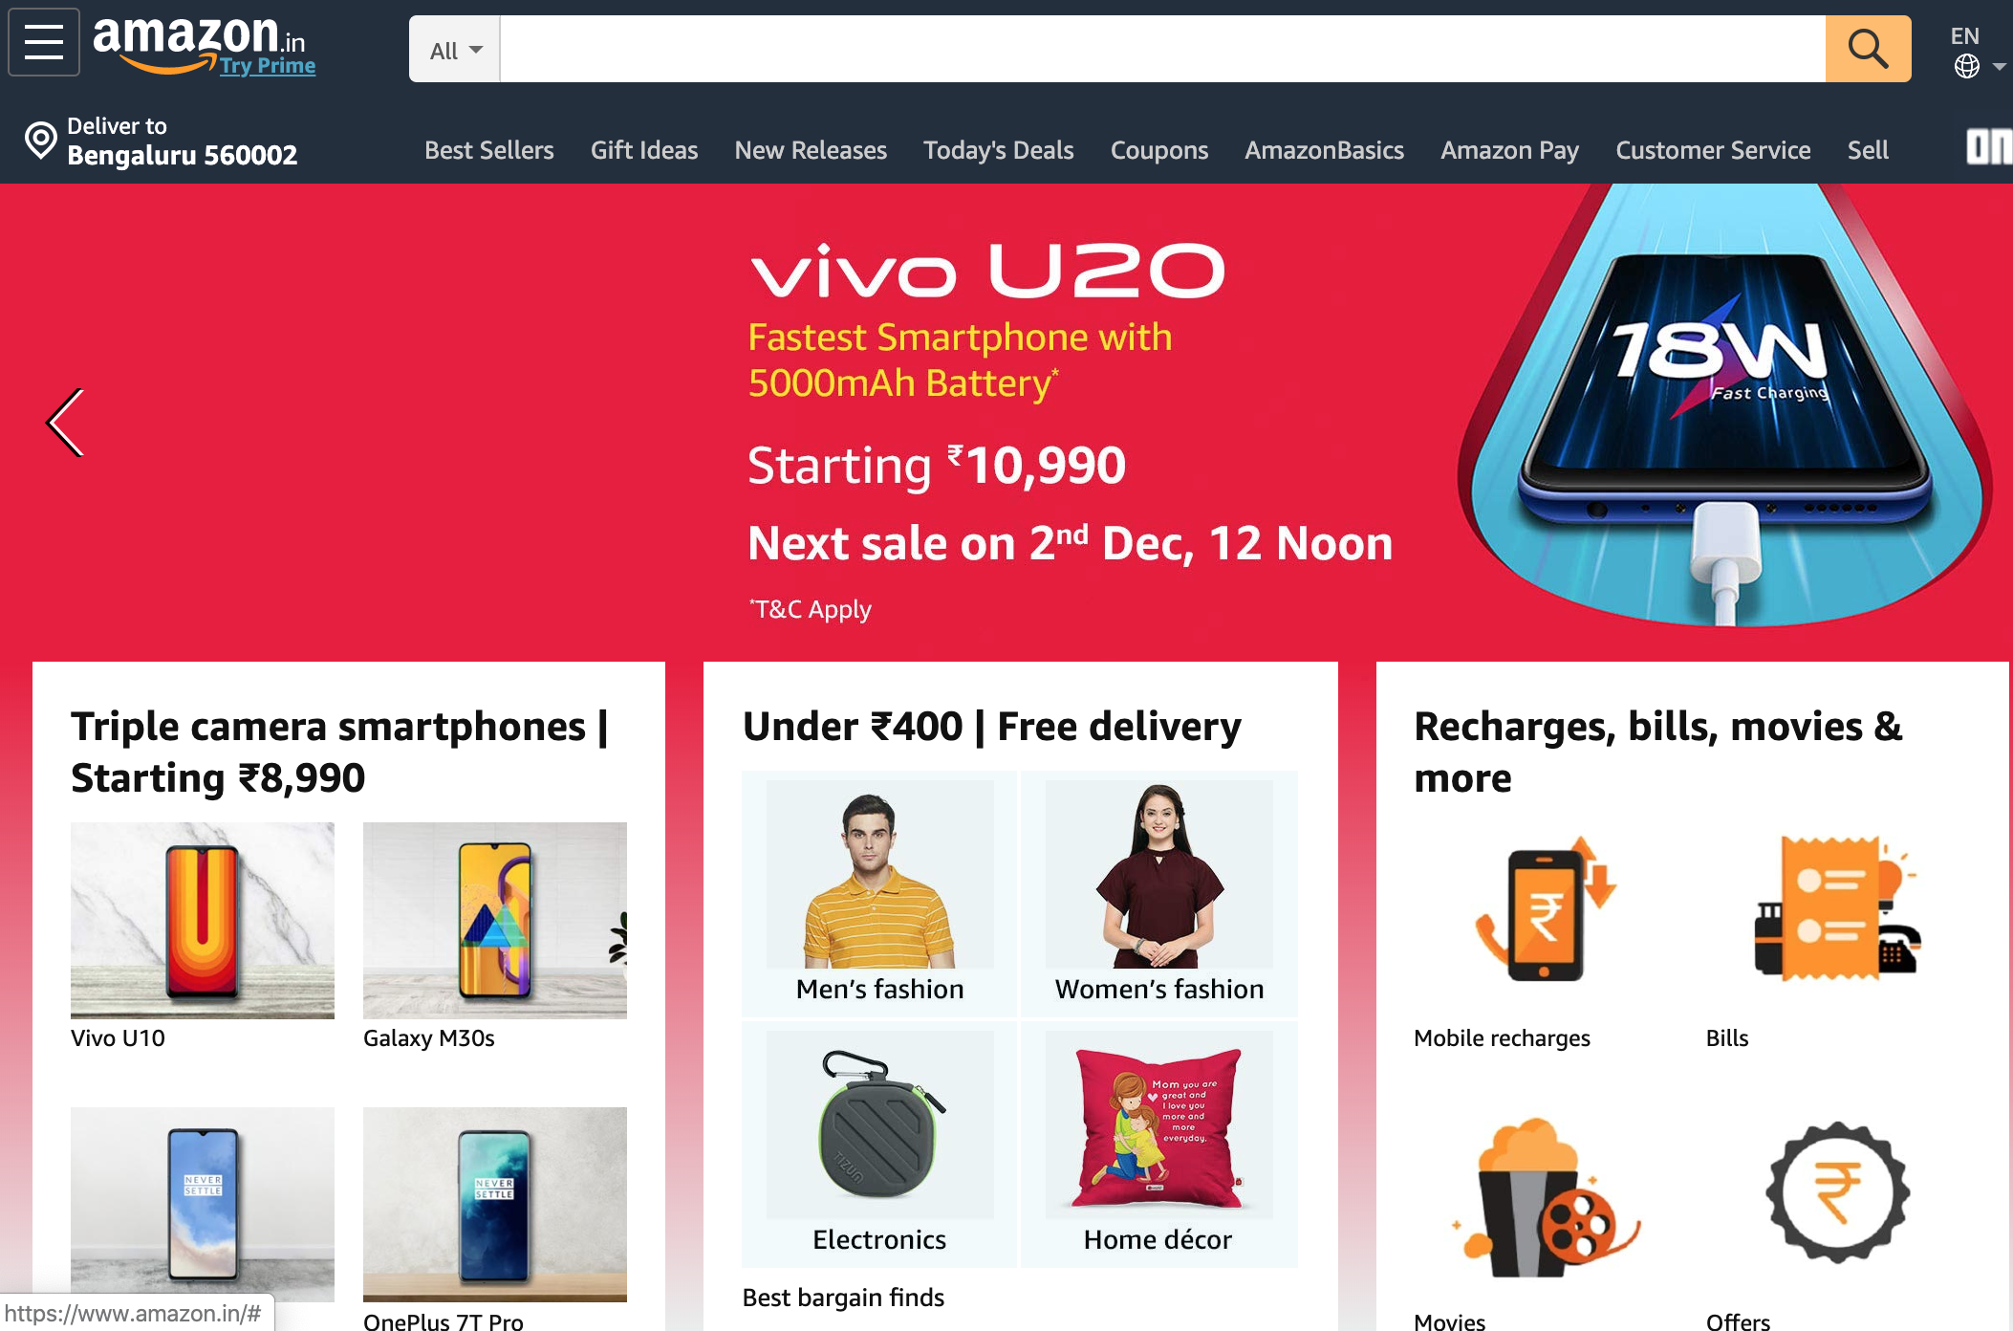
Our Objective
Assume ‘Architecting’ a big e-commerce system as our objective

Slide 3
Application Architecture

Slide 4
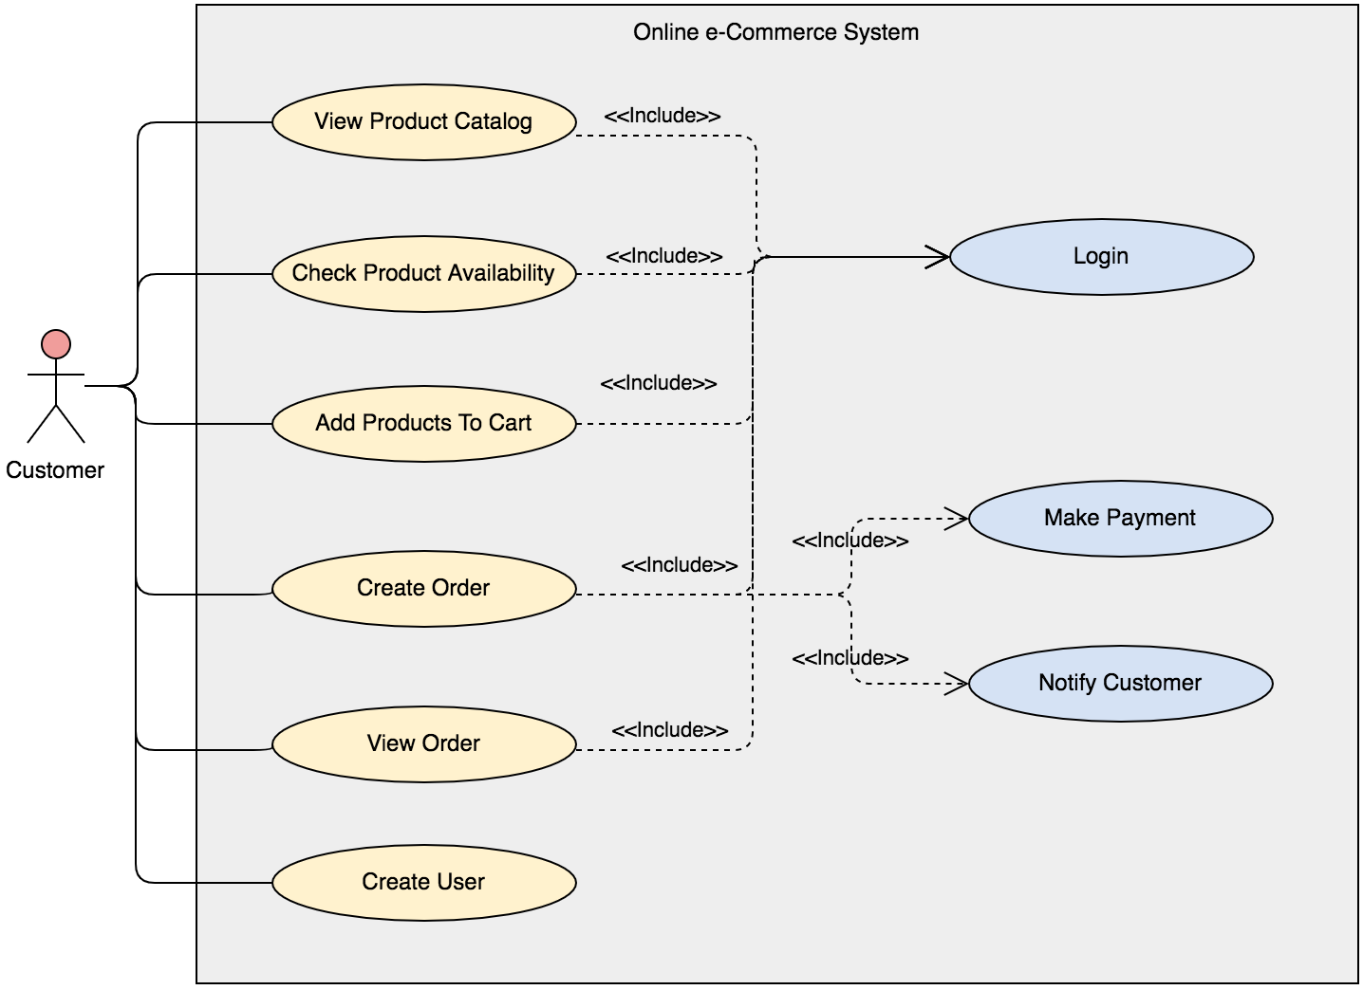
Use Case Model
NewTechWays

Slide 5
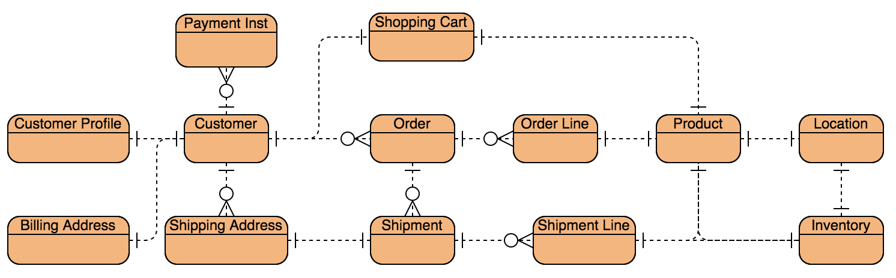
Domain Model
NewTechWays
NewTechWays

Slide 6
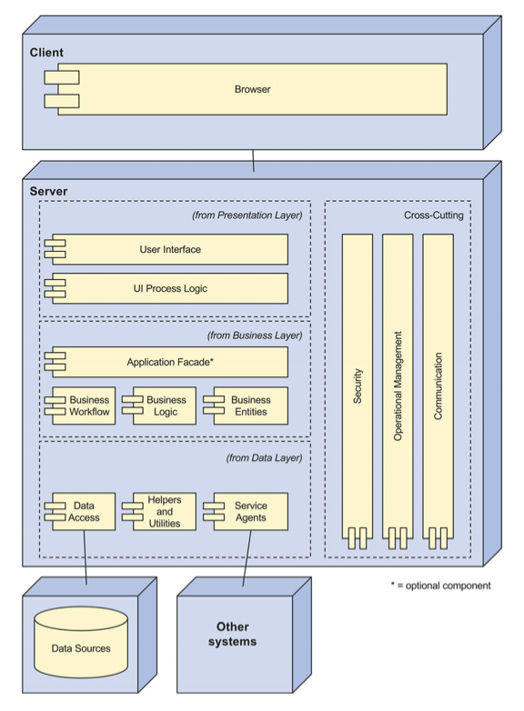

Component Model
Client
Web
Tier
Business Logic
Tier
Database

Slide 7
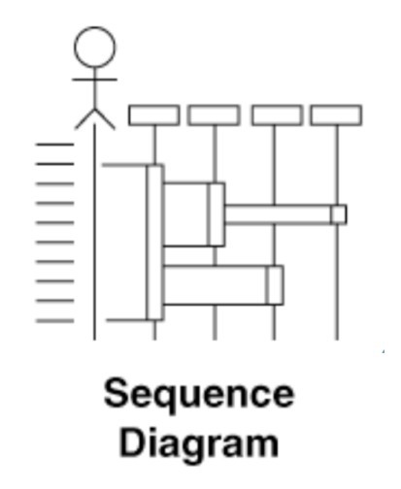
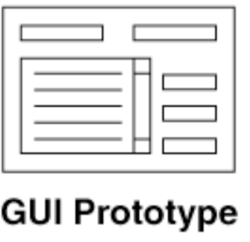
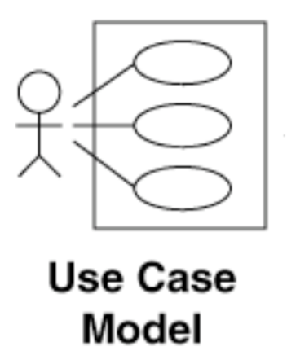
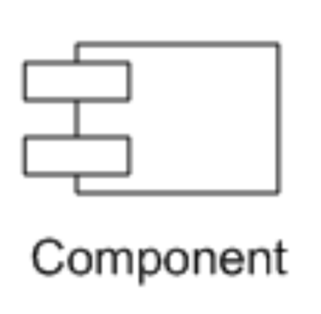
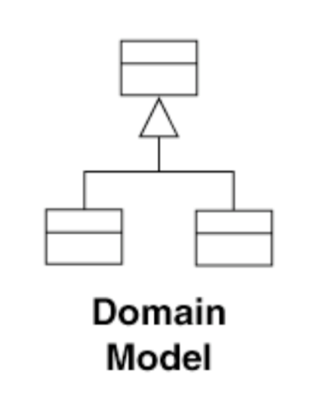
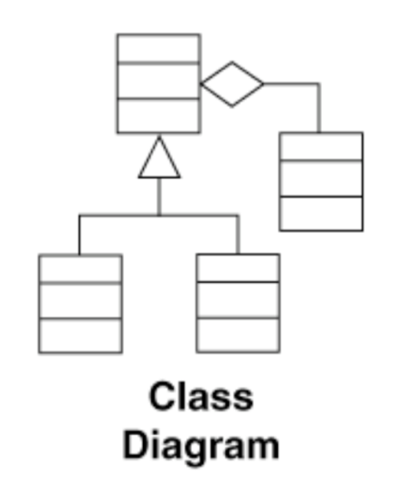
Low Level Design
Behavior
State
Code
Static + Transactional

Slide 8
What About?
High
Availability
Response
Latency
Global
Customers
System &
Data Security
File storage for
Catalog Images
Mobile
Support
Unstructured Data
Storage & Analytics
Cloud
Deployment

Slide 9

Going Beyond
Application Architecture To System Architecture

Slide 10
Application Architecture Vs System Architecture
System level challenges
surface up in large scale systems
Scale, Reliability, Security, Deployment are biggest concerns for a large-scale system

Slide 11
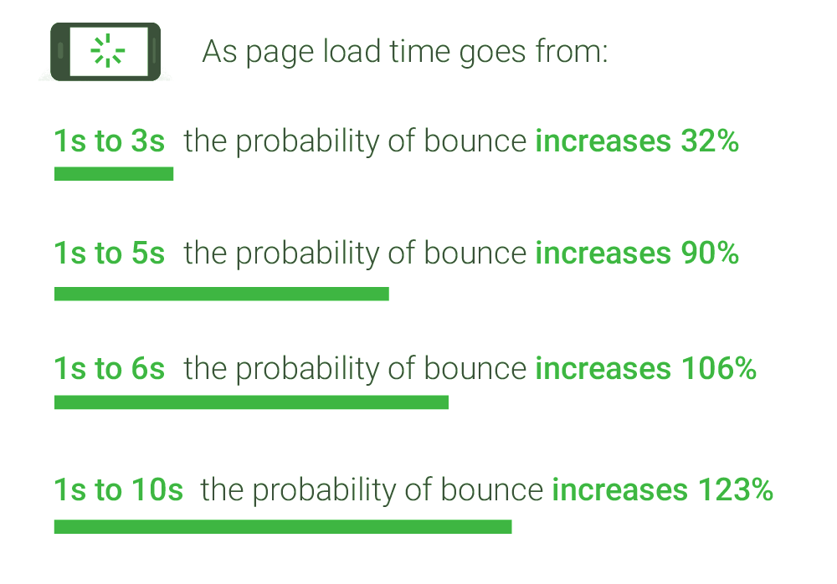
Latency Requirements
UI page load in < 250ms
across the globe
Customer transactions < 3 sec
Latency is not an option
10 years ago, Amazon found that every 100ms of latency cost them 1% in sales
Now Akamai study shows that every 100-millisecond delay in website load time can hurt sales by 6%
Google found an extra .5 seconds in search page generation time dropped traffic by 20%
A stockbroker can lose millions if their trading platform is 5ms behind its competition
Notes:
https://www.thinkwithgoogle.com/marketing-resources/data-measurement/mobile-page-speed-new-industry-benchmarks/
https://www.gigaspaces.com/blog/amazon-found-every-100ms-of-latency-cost-them-1-in-sales/

Slide 12
Scalability Requirements
10 million requests/day
1K to 100K simultaneous users
Global customer base
100 million products
Transaction data for last 5 years
Petabytes of log data
For 10 M requests with average response size of 10KB
Data Outflow = 10M x 10KB = 100 GB
For 100 M orders/year with average order size of 10 KB, five years data
Data storage = 5 x 100M x 10KB = 5 TB
For 100 M products with average product description/image size of 1 MB
Data Storage = 100M x 1MB = 100 TB
Logs generated and archived
Data Storage => in Petabytes
Buying customers in 100 countries

Slide 13

Availability & Reliability Requirements
Unavailability results in
Business loss
Reputation loss
99.95% Availability
Maximum cumulative disruption of 4 hours 22 minutes in a year
99.999999999% Durability for storage systems
Data once stored is practically never lost
Disaster Recovery
Operations to continue even if a region goes down due to a natural calamity

Slide 14
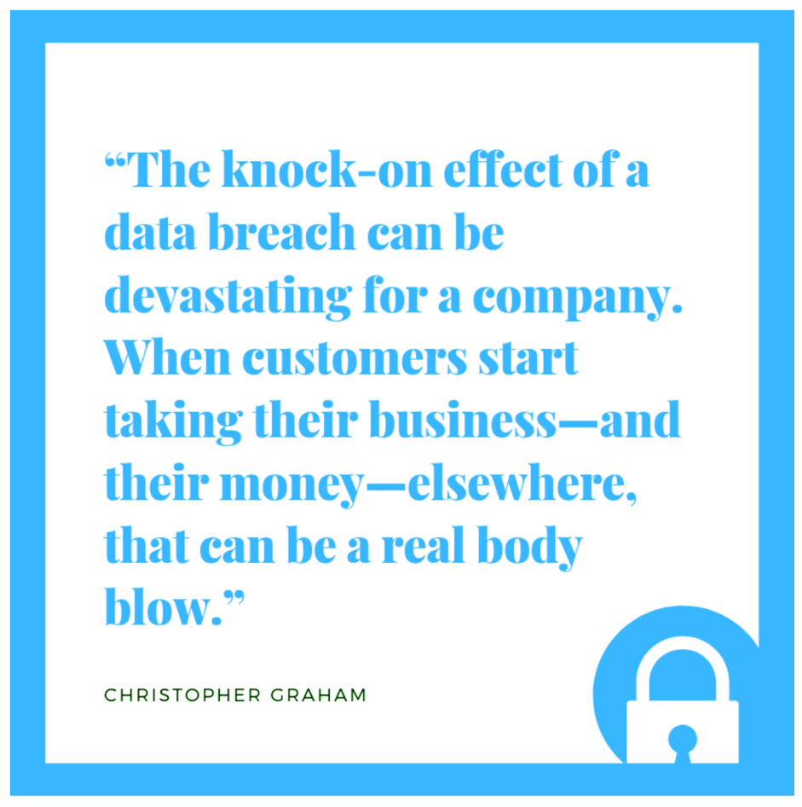
Security Requirements
Infrastructure protection
Network access
System access
Service access
Data Protection
Data sensitivity classification
Protect data at rest
Protect data on wire
Data backup & replication
Identity & Access Management
Authentication, Authorization
Role based access

Slide 15
Designing System Architecture
Copyright © 2019 newtechways.com All Rights Reserved

Slide 16

Scalability Principle
Monolith is an anti-pattern for Scalability
Scalability goes up with
Decentralization
More specialized workers – Services
More workers – Instances, Processors, Threads
Independence
Multiple workers are as good as a single worker if they can’t work independently
They must work concurrently to maximum extent
Independence is impeded by
Shared resources
Shared mutable data

Slide 17
Modularity
Scalable architecture starts with modularity
Provides the foundation for breaking a system function/service into more specialized functions/services
Web Browser
Web Application
Business Application
DBMS
View
API Protocol Layer
Controller
Service Modules:
User
Catalog
Order
Inventory
Model
Data Access Layer

Slide 18
Specialized Services – WebServices
Services can be scaled differently e.g., Number of instances
Notification Service
Inventory Service
Order Service
Web Application
Catalog Service
User Service

Slide 19
Aggregator Service & RESTful API – Mobile Support
REST for external interface interoperability & Mobile Support
RPC for internal communication performance
Notification Service
Inventory Service
Order Service
Web Application
Thrift
REST
Catalog Service
RESTful
Aggregator/
Gateway
Service
User Service

Slide 20
Independent Services – MicroServices
Micro-Services can be scaled differently and deployed independently
Notification Service
Inventory Service
Order Service
Web Application
Catalog Service
Aggregator/
Gateway
Service
User Service

Slide 21
Asynchronous Services
Updates can be done asynchronously to buffer peak loads and to reduce response latency
Notification
Inventory
View Order
Create/Update Order
Web Application
Order
Queue
Order
Order
Processing
Catalog
Aggregator/
Gateway
Service
User

Slide 22
Stateless Replication
Replication provides more computation power
Notification
Inventory
Web Application
Order
Queue
Order
Order Processing
Catalog
Aggregator/
Gateway
Service
User

Slide 23
Load Balancing & Discovery
Load Balancers for routing and load balancing
Discovery services for naming and tracking healthy services
Notification
Inventory
Discovery Service
Web Application
Order
Queue
Order
Processing
Order
Catalog
Aggregator/
Gateway
Service
User

Slide 24
Caching & Compression
Caching and compression for reducing response latency
Caching can also reduce the backend load
Notification
Inventory
Discovery Service
HTTP Cache
Web Application
HTTP Cache
Order
Order
Queue
Order
Processing
Catalog
Compressed Response
Variable Width Encoding
Aggregator/
Gateway
Service
Object Cache
Session Cache
User

Slide 25
Serving Static Data
High throughput Cloud Object Stores for serving static content
Notification
Inventory
Discovery
Static
HTTP Cache
Order
Order
Queue
Order
Processing
Dynamic
Catalog
HTTP Cache
Aggregator
Service
Object Cache
Session Cache
User

Slide 26
CDN & Edge Proxy
CDN for global distribution of static content
Edge Proxies for reducing latency through Early Termination, SSL Termination
Notification
Inventory
Discovery
Static
HTTP Cache
Order
Order
Queue
Order
Processing
Dynamic
Catalog
HTTP Cache
Aggregator
Service
Object Cache
CDN
Session Cache
User

Slide 27
Think About It!
User Session Management
Load Balancer
Routing & Sessions
Types – Software/Hardware, External/Internal
Policies
Balancing Latency & Throughput
RDBMS Scaling Limitations
NoSQL Vs RDBMS
Transaction Concurrency
Eventual Consistency
Routing for Global Scalability

Slide 28
Reliability Principle
Reliability
Normal functioning even in the presence of faults
Availability
Always available even in the presence of faults
Reliability and Availability are achieved mainly through Fault Tolerance
Fault Tolerance requires
Provisioning Redundancy
Stateless & Stateful
Active, Passive, Cold
Fault Detection Mechanisms
Health-checks, heart-beats
Recovery or Failover
Stateless & Stateful

Slide 29
Single Point Of Failures
Identify all SPOF
Any component that does not have a redundant replica is a SPOF
Power Supply
Notification
Inventory
Discovery
Static
HTTP Cache
Order
Order
Queue
Order
Processing
Dynamic
Catalog
HTTP Cache
Aggregator
Service
Object Cache
CDN
Session Cache
User

Slide 30
Redundancy
Components that are SPOF requires redundancy
Power Supply
Notification
Inventory
Discovery
Static
HTTP Cache
Order
Order
Queue
Order
Processing
Network
Dynamic
Catalog
HTTP Cache
Aggregator
Service
Object Cache
CDN
Session Cache
User

Slide 31
Monitoring For Fault Detection
Hierarchical Monitoring -> Health Checks
Peer to Peer Monitoring -> Heart Beats
Power Supply
Notification
Inventory
Discovery
Static
HTTP Cache
Order
Order
Queue
Order
Processing
Network
Dynamic
Catalog
HTTP Cache
Aggregator
Service
Object Cache
CDN
Session Cache
User

Slide 32
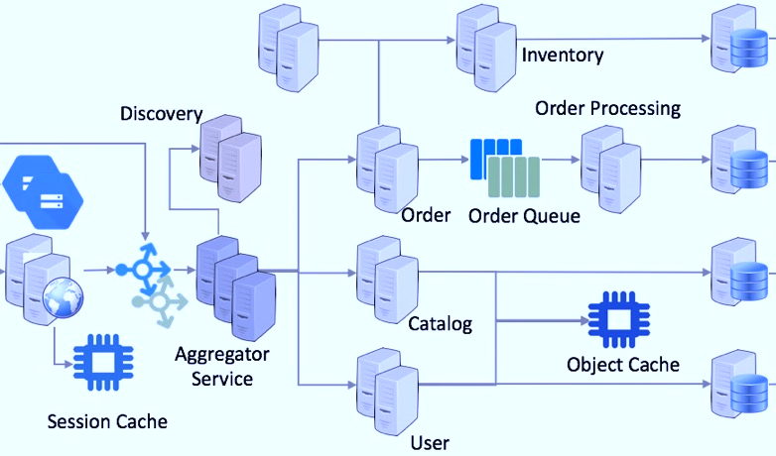


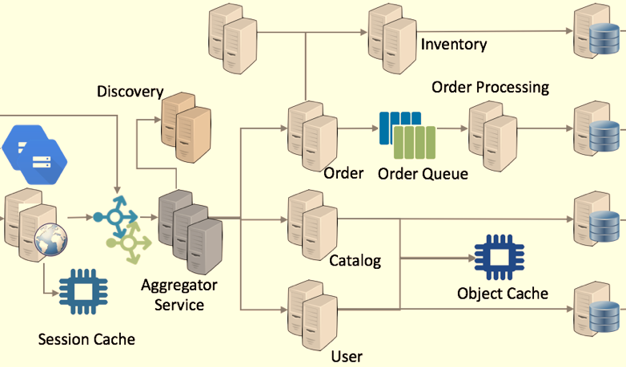

Zonal Redundancy
Zonal redundancy for fault isolation
Power Supply
HTTP Cache
Zone 1
NewTechWays
Backend Replication
Zone 2
HTTP
Cache
Power Supply
CDN
User

Slide 33
Think About It!
Zonal Redundancy & Routing
Regional Redundancy & Routing
Redundancy & Recovery
Stateless Components
Stateful Components
Automated Recovery
Detecting Faults
Triggering Failover
Reliability Practices
Retries & Idempotency
Graceful handling of errors
Controlled service degradation
Load Shedding
Backpressure

Slide 34
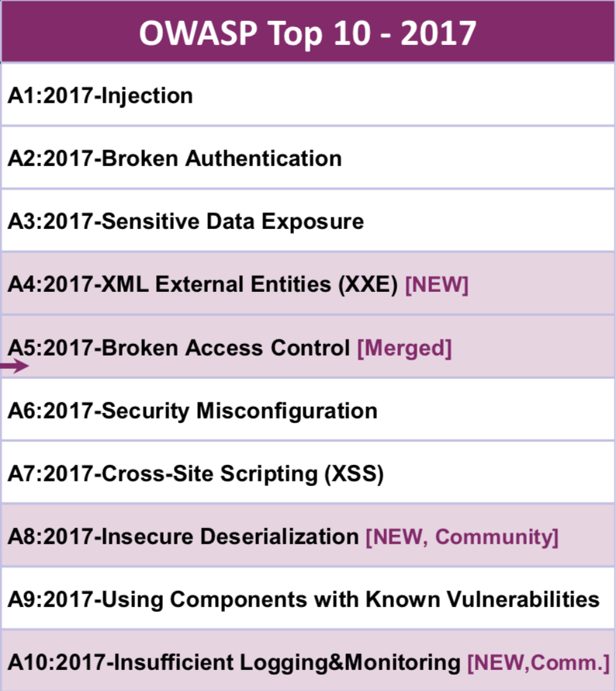
Security Principles
Least Privilege
Minimalistic user access rights just enough to perform a task
Minimize attack surface area
Reduce entry points by authorizing every API request or Activity
Allow only minimum set of roles for each API
Defense In Depth
Multiple layered resource access controls
Separation of Duties
Different entities should have different roles
Fail Secure
Failure should not expose more than required information through error messages or logs
Weakest Link
Any system is as strong as its weakest link

Slide 35
Role Based Access Control
View/Create/Update/Delete Order
View Catalog
View/Update Profile
Web
Application
Alice
Customer
Customer Role
Gateway Service
Bob
Support Role
Order Service
Support
Carol
View Inventory
Catalog Service
Inventory
Manager
Manager Role
David
Inventory Service
View/Create/Update/Delete Catalog
View/Create/Update/Delete Inventory
Web App Account
App Role
Message Queue
Eve
View/Create/Update/Delete Services
Inventory DB
Users
Service Account
Service Role
Publish/Consume MQ
View/Create/Update/Delete Services
View/Create/Update/Delete DB
Order DB
Groups
Product DB
Roles
Permissions
Resources

Slide 36
Authentication & Authorization
Token based authentication over HTTPS
Certificates & keys deployed on external load balancers
Inventory
Notification
TLS
Token
Token
Storage
Web Application
Order
Order
Queue
Order
Processing
Token
TLS
Catalog
Aggregator/
Gateway
Service
Token
Storage
(Http only Cookies)
User Auth
TLS Certificates
& Private Keys

Slide 37
Network Security
Not Allowed
Allowed
DMZ – Subnet 1
DMZ – Subnet 2
Services Subnet
DB Subnet
Inventory
Notification
Port 1522
TLS
Web Application
Port 443
Order
Order
Queue
Order
Processing
Port 443
TLS
Port 80
Catalog
Aggregator/
Gateway
Service
Port 8080
TLS Certificates
User Auth

Slide 38
Web Application Firewalls
Multiple security related attacks can be prevented by inspecting requests for common attacks and vulnerabilities by using Web Application Firewalls
Notification
TLS
XSS Attack
Injection Attack
DDoS Attack
Session Hijacking
Whitelists & Blacklists
Web Application
Order
TLS
Catalog
Aggregator/
Gateway
Service
User Auth

Slide 39
Think About It!
Security Token Storage
Stateless & Stateful Authentication
Third-Party Authorization with OAuth2
Single Sign On
TLS Termination
Common Vulnerabilities
Stored Data Encryption
Key Management

Slide 40
That’s Just The Beginning
Further challenge lies in the detail
And we have sorted it out for you
If you are an Architect or a Developer
And you want to bridge the gap between
A Great Developer and a True Architect
You should get started with
‘NewTechWays’ course
‘Developer To Architect’
And leapfrog your career

Slide 41
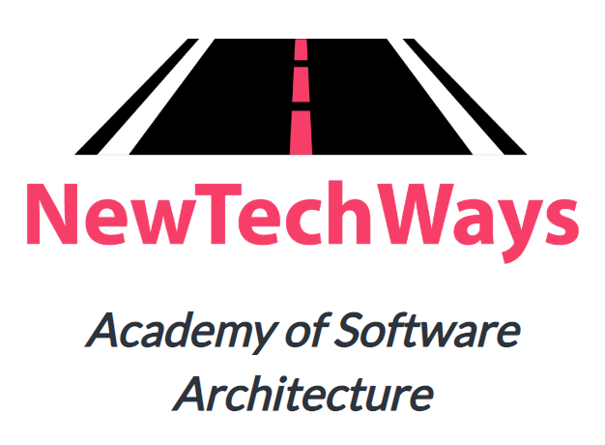
Thank You!
Visit us at
https://www.newtechways.com

