Slide 1
תכנות מונחה עצמים תרגול 02
מייל : simon.pikalov@msmail.ariel.ac.il
נכתב ע"י : סמיון פיקלוב

Slide 2
נושאים להיום
חזרה על שיעור קודם.
comparator.
iterator.
exceptions.
Java I/O.

Slide 3
חזרה
מהו ממשק?
An interface is a reference type in Java. It is similar to class. It is a collection of abstract methods. A class implements an interface, thereby inheriting the abstract methods of the interface.
Along with abstract methods, an interface may also contain constants, default methods, static methods, and nested types. Method bodies exist only for default methods and static methods.
https://www.tutorialspoint.com/java/java_interfaces.htm

Slide 4
חזרה
מה ההבדל בין ממשק לבין מחלקה אבסטרקטית?
בjava יש אפשרות לממש כמה ממשקים בניגוד להורשה מרובה.
בעוד שמחלקה אבסטרקטית יכולה להכיל את כל סוגי המשתנים ,
ממשק יכול להחיל רק משתנים מסוג . final and static
בממשק אנחנו מחזירים על השיטות ללא אפשרות מימוש בניגוד למחלקה אבסטרקטית שבה הפונקציות יכולות להכיל מימוש.

Slide 5
חזרה
הגדר את המושג super
תן דוגמא לשימוש בו.
The super keyword refers to superclass (parent) objects.
It is used to call superclass methods, and to access the superclass constructor.
The most common use of the super keyword is to eliminate the confusion between superclasses and subclasses that have methods with the same name.

Slide 6
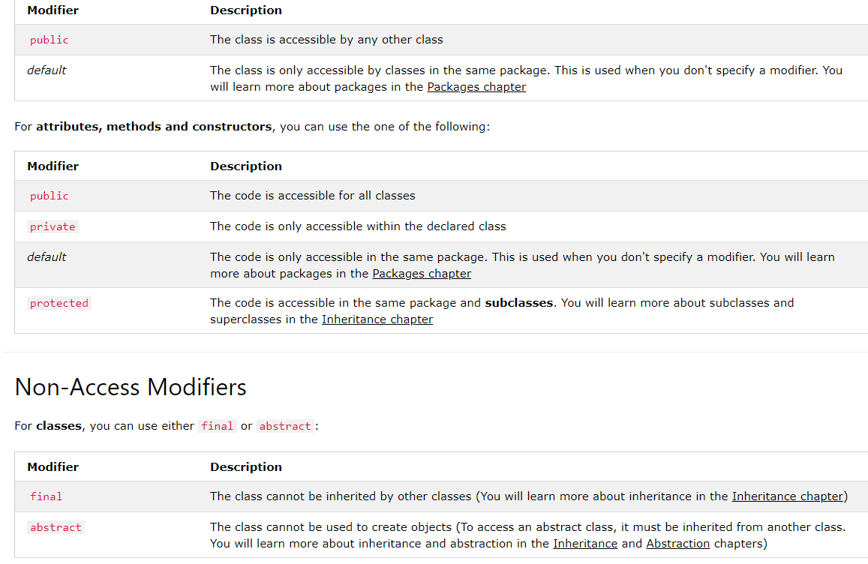
Classes Modifier

Slide 7
Upcast and Downcast
Java instanceof
The java instanceof operator is used to test whether the object is an instance of the specified type (class or subclass or interface).

Slide 8
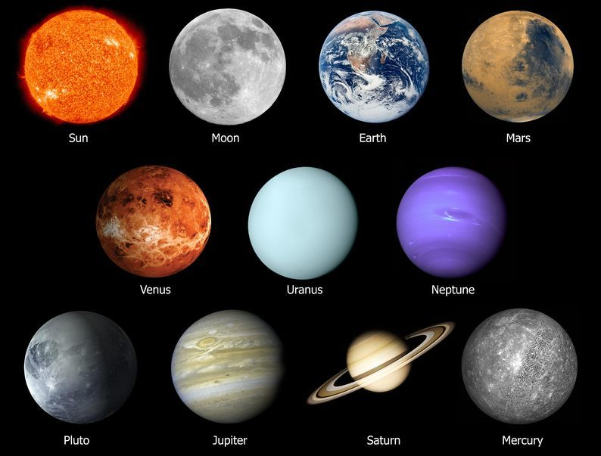
compare Objects
When working with custom types, or trying to compare objects that aren't directly comparable, we need to make use of a comparison strategy. We can build one simply, but making use of the Comparator or Comparable interfaces.

Slide 9
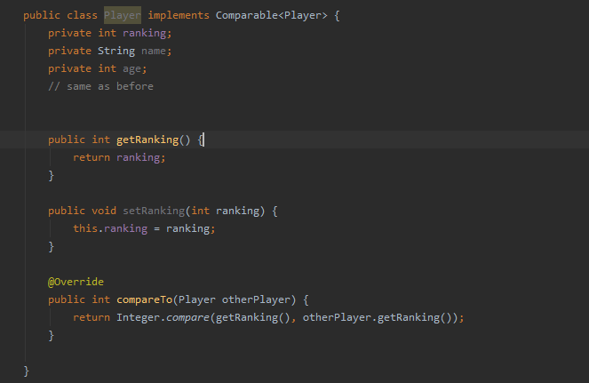
Comparable
As the name suggests, Comparable is an interface defining a strategy of comparing an object with
other objects of the same type. This is called the class's “natural ordering”.

Slide 10
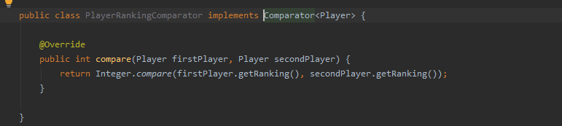
Comparator
The Comparator interface defines a compare(arg1, arg2) method with two arguments that represent compared objects and works similarly to the Comparable.compareTo() method.
create a Comparator, we have to implement the Comparator interface.
In our first example, we'll create a Comparator to use the ranking attribute of Player to sort the players:

Slide 11
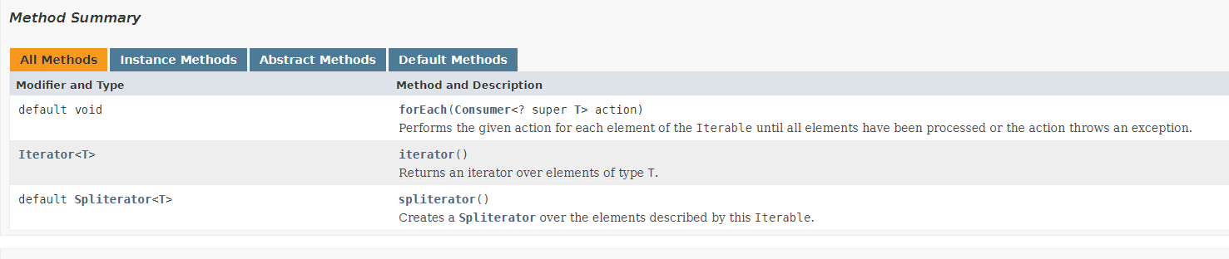
Iterable
Performs the given action for each element of the Iterable until all elements have been processed or the action throws an exception. Unless otherwise specified by the implementing class, actions are performed in the order of iteration (if an iteration order is specified). Exceptions thrown by the action are relayed to the caller.

Slide 12
Iterator
It is a universal iterator as we can apply it to any Collection object. By using Iterator, we can perform both read and remove operations. It is improved version of Enumeration with additional functionality of remove-ability of a element.
Iterator must be used whenever we want to enumerate elements in all Collection framework implemented interfaces like Set, List, Queue, Deque and also in all implemented classes of Map interface. Iterator is the only cursor available for entire collection framework.
iterator object can be created by calling iterator() method present in Collection interface.
Limitations of Iterator :
Only forward direction iterating is possible.
Replacement and addition of new element is not supported by Iterator.
Iterator interface defines three methods:
// Returns true if the iteration has more elements public boolean hasNext(); // Returns the next element in the iteration // It throws NoSuchElementException if no more // element present public Object next(); // Remove the next element in the iteration // This method can be called only once per call // to next() public void remove(); }

Slide 13
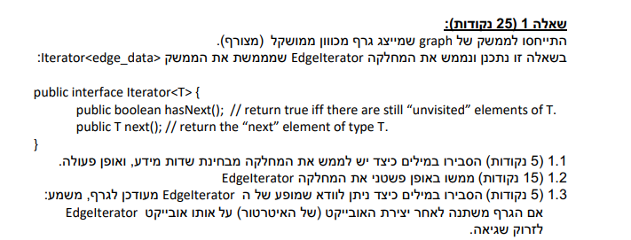
שאלה ממבחן

Slide 14
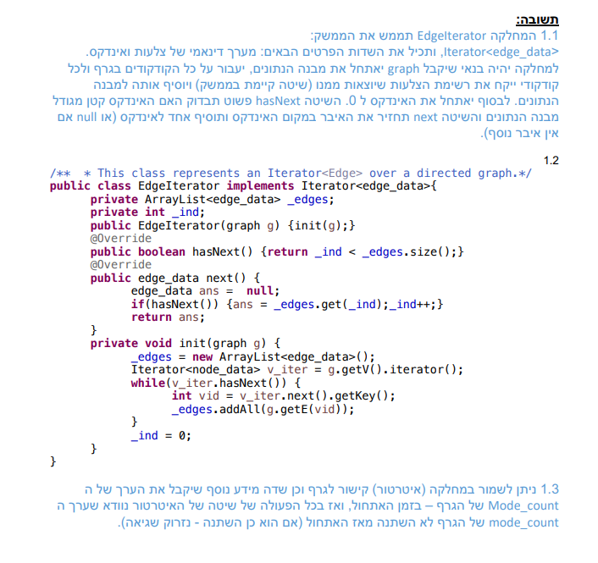
שאלה ממבחן תשובה

Slide 15
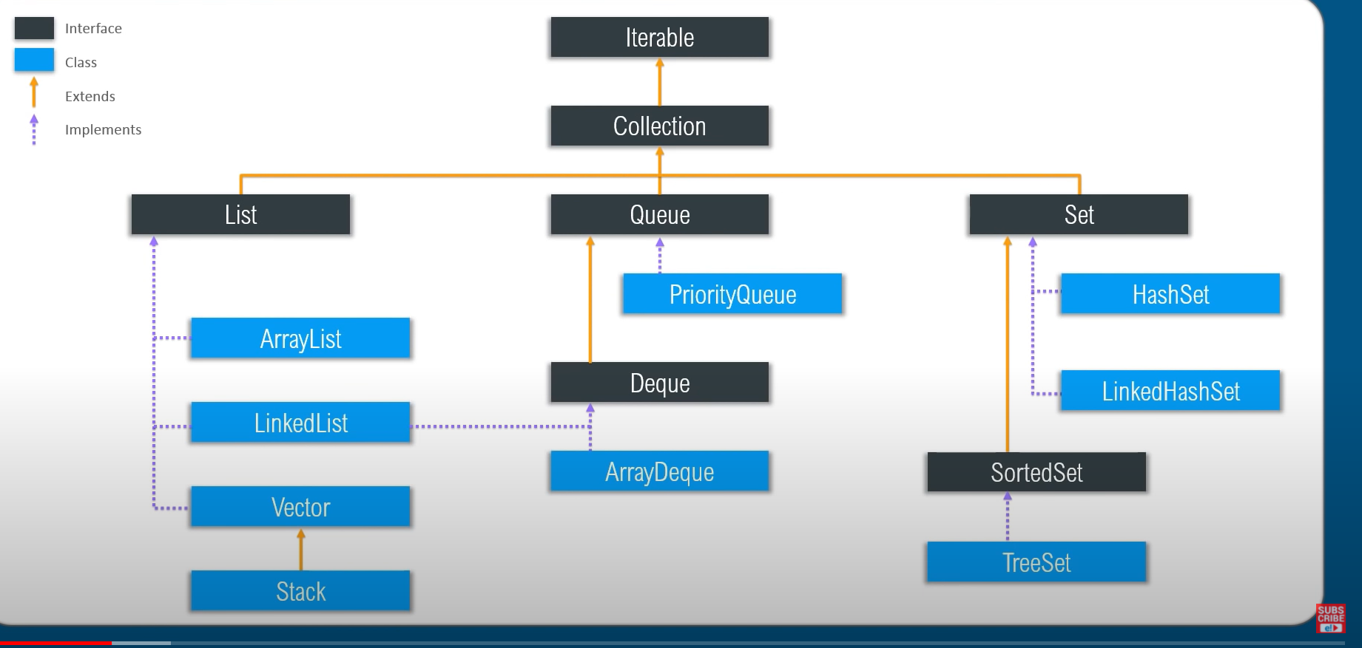
Java Collections Interface
The root interface in the collection hierarchy. A collection represents a group of objects, known as its elements. Some collections allow duplicate elements and others do not. Some are ordered and others unordered. The JDK does not provide any direct implementations of this interface: it provides implementations of more specific subinterfaces like Set and List. This interface is typically used to pass collections around and manipulate them where maximum generality is desired.

Slide 16
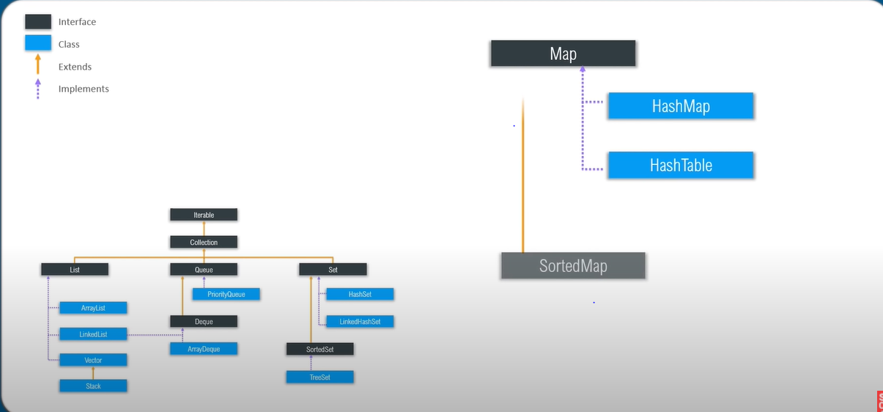
Java Collections Framework

Slide 17
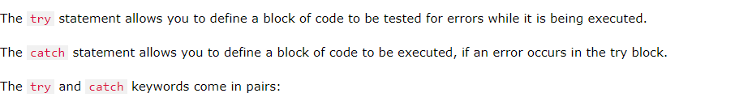

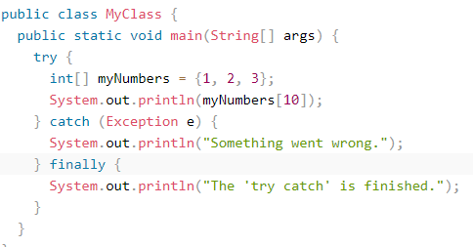
Exceptions
When executing Java code, different errors can occur: coding errors made by the programmer, errors due to wrong input, or other unforeseeable things.
When an error occurs, Java will normally stop and generate an error message. The technical term for this is: Java will throw an exception (throw an error).

Slide 18
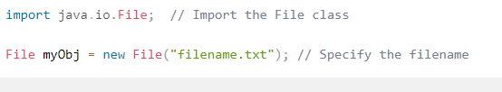
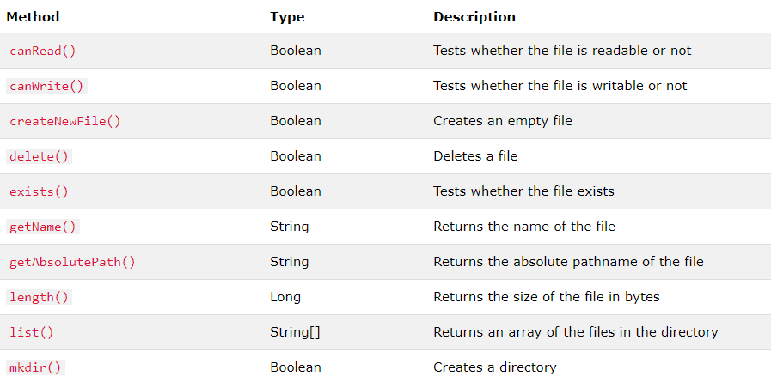
Java Files
The File class from the java.io package, allows us to work with files.
To use the File class, create an object of the class, and specify the filename or directory name:

Slide 19
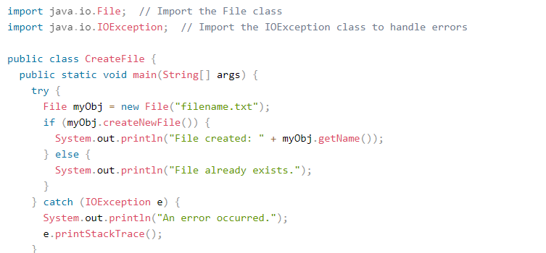

Create a File
To create a file in Java, you can use the createNewFile() method. This method returns a boolean value: true if the file was successfully created, and false if the file already exists. Note that the method is enclosed in a try...catch block. This is necessary because it throws an IOException if an error occurs (if the file cannot be created for some reason):
To create a file in a specific directory (requires permission), specify the path of the file and use double backslashes to escape the "\" character (for Windows). On Mac and Linux you can just write the path, like: /Users/name/filename.txt

Slide 20
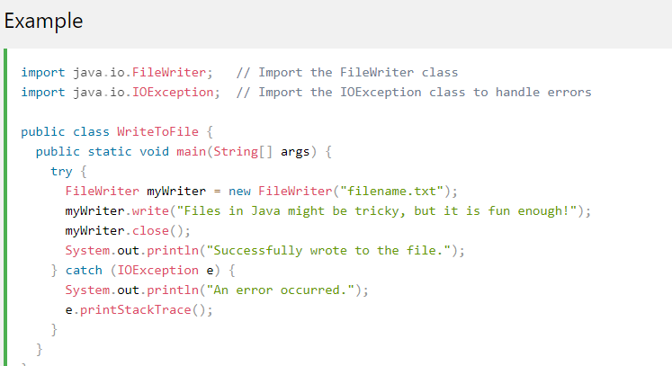
Write To a File
In the following example, we use the FileWriter class together with its write() method to write some text to the file we created in the example above. Note that when you are done writing to the file, you should close it with the close() method:

Slide 21


Slide 22
מקורות
https://www.w3schools.com/java/
Edureka

