Slide 1


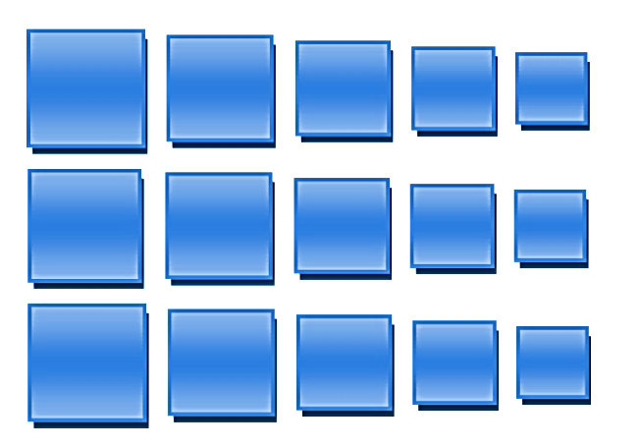
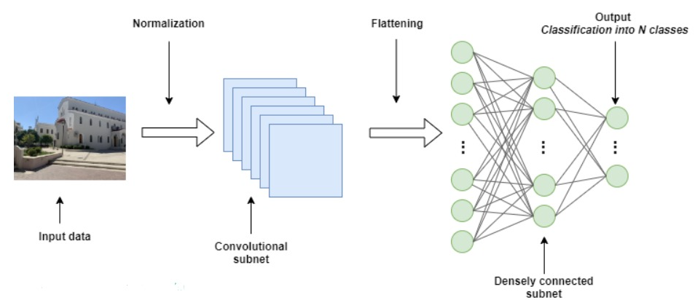
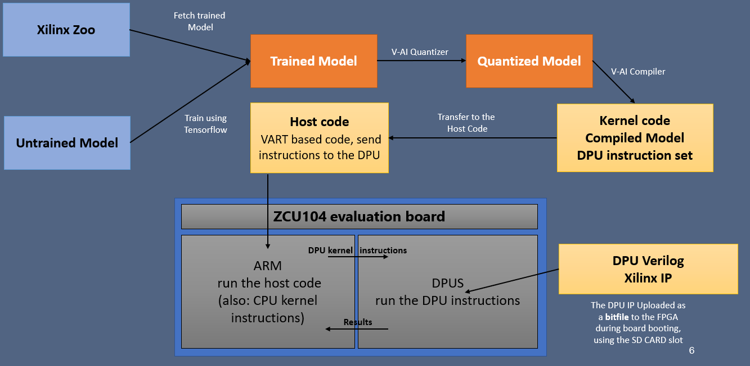
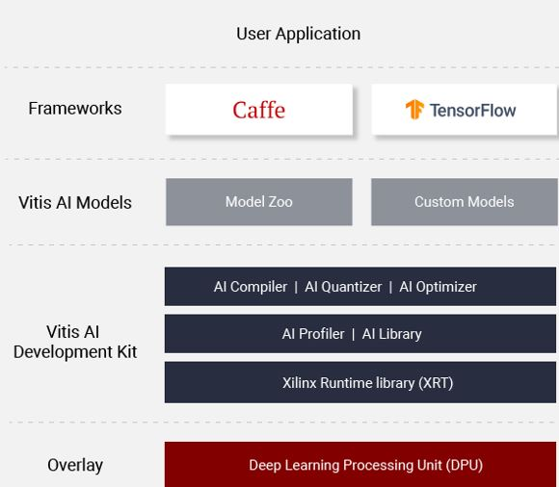
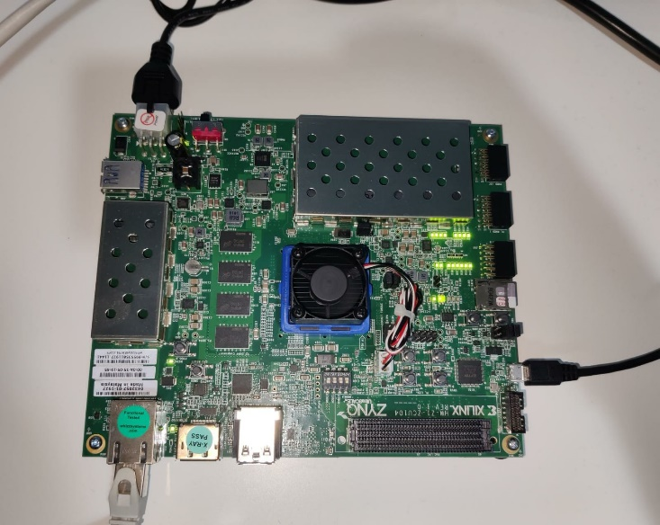
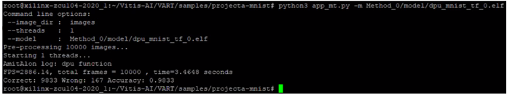


The Andrew & Erna Viterbi Faculty of
Electrical Engineering
Electronics
Computers
Communications
Deep Neural Network On FPGA
Amit Shtober and Alon Nemirovsky Supervised by:
Ina Rivkin and Oz Shmueli
Background:
Deep Neural Network
Creating the Network
Full process of creating working neural network Includes:
Creating the model
Train it using CPU/GPU
Optimize the model
Inference which can be done on various machines such as host using GPU or dedicated Hardware
Create and manufacture the dedicated hardware which will run the Inference stage
Creation of Neural Network was inspired by the human brain and the way it functions
Works according to the algorithm and can predict a solution based on experience
The system has process layers that indicates on the depth of the Neural Network
This method is very popular and highly used today
Vitis-AI Ecosystem
Xilinx offers a full ecosystem which helps deal with those problems.
It includes:
Dedicated IP which called DPU on the board ZCU-104
AI Zoo - Repository which includes optimized deep learning models. Great for quick start
Quantizer - Takes a floating-point model and performs pre-processing and then quantizes the weights/biases and activations to the given bit width
Compiler - Maps a network model into a highly optimized DPU instruction sequence
Project Goals and Challenges
Full Flow – Block Diagram
Evaluate and validate the Xilinx Vitis-AI ecosystem:
Understanding Vitis-AI ecosystem
Running full flow from TensorFlow to the FPGA
Step #1 – Using trained model from Xilinx Zoo (resnet50)
Step #2 – Using untrained model from the Zoo (MNIST), Modify it and run the flow in order to fully understand the ecosystem ability
Evaluate and modify, when possible, each step in the process of the ecosystem
Creating a tutorial for running the flows step by step and indicate problems we have encountered in the process
Evaluation and Modification
Conclusions
Accuracy can be improved in substantial rate on method 0 quantization
Running time can be improved in substantial rate on the right quantity of threads due to its parallelism
In some cases, the board can achieve better accuracy than normal computer in the inference stage due to his dedicated hardware
Xilinx gives AI ability, even to unexperienced people (although it could be limited)
Creating your own Custom model is very complex. Many adjustments have to be done in order to successfully run it on the board
There is a lack of updated information on Xilinx ecosystem. Therefore, it’s hard to solve problems that arise during the process
Performance
PC - Intel(R) Xeon(R) CPU @ 2.20GHz, 2 Cores
Accuracy 98.25%
Time: $2.221\left[Sec\right],0.02221\left[\frac{μSec}{Pic}\right]$
ZCU104 - Quad-core ARM®️ Cortex™️-A53 + DPU
Accuracy 98.33%
Time: $2.592\left[Sec\right],0.02592\left[\frac{μSec}{Pic}\right]$
Improve of 0.14%! (Accuracy)
As showed in the image above - ZCU 104 can achieve higher accuracy! However, it’s slower compared to inference on a regular PC

